Slide 1
IBM University Engagement Project Submission
“Exploring the Power of Machine Learning with IBM Cloud”

Slide 2
Project Tile – [Intelligent Classification of Rural Infrastructure Projects]
Domain of Project – [ Education ]
Student Name | Recent Passport Photo | Email ID | Mobile number [WhatsApp]
Snehal Mundhe

Slide 3
Problem Statement -
Problem statement 35 - Intelligent Classification of Rural Infrastructure Projects
The Pradhan Mantri Gram Sadak Yojana (PMGSY) is a flagship rural development
program in India, initiated to provide all-weather road connectivity to eligible
unconnected habitations. Over the years, the program has evolved through different
phases or schemes (PMGSY-I, PMGSY-II, RCPLWEA, etc.), each with potentially
distinct objectives, funding mechanisms, and project specifications.
For government bodies, infrastructure planners, and policy analysts, efficiently
categorizing thousands of ongoing and completed projects is crucial for effective
monitoring, transparent budget allocation, and assessing the long-term impact of these
schemes. Manual classification is time-consuming, prone to errors, and scales poorly.
Your specific task is to design, build, and evaluate a machine learning model that can
automatically classify a road or bridge construction project into its correct
PMGSY_SCHEME based on its physical and financial characteristics.

Slide 4
Proposed Solution -
(IBM watsonx.ai Studio – AutoAI):
We propose an AI-powered Rural Infrastructure Project Classification System using IBM watsonx.ai Studio and AutoAI.
Project information such as road length, bridge length, project cost, project duration, state, district, terrain type, funding details, construction type, and other physical and financial characteristics will be collected and uploaded into watsonx.ai.
AutoAI will automatically perform data preprocessing, feature engineering, algorithm selection, and hyperparameter optimization.
Multiple machine learning classification models will be generated and evaluated to identify the best-performing model for PMGSY scheme prediction.
The selected model will accurately classify infrastructure projects into appropriate PMGSY schemes such as PMGSY-I, PMGSY-II, PMGSY-III, RCPLWEA, and other available schemes.
The proposed system will support government departments in automating project classification, improving monitoring efficiency, ensuring transparent budget allocation, and enabling faster infrastructure planning and decision-making.

Slide 5
Technology Used
IBM Cloud – It provides the infrastructure to build, train, deploy, and scale the Rural Infrastructure Project Classification System efficiently. IBM Cloud offers a secure and reliable environment for developing machine learning solutions.
IBM watsonx.ai Studio – Used to build the machine learning model using AutoAI. It automatically performs data preprocessing, feature engineering, model selection, hyperparameter tuning, and evaluation to identify the best-performing classification model.
Programming Language: Python
Machine Learning Platform: IBM watsonx.ai AutoAI
Data Processing Libraries: Pandas, NumPy
Data Visualization: Matplotlib
ML Algorithm / Model Used: XGBoost Classifier (or replace with the best model selected by AutoAI)
Accuracy Obtained: 98.23%
Enhancements and Hyperparameter tuning: Automated data preprocessing, feature engineering, model optimization, and hyperparameter tuning using IBM watsonx.ai AutoAI.

Slide 6
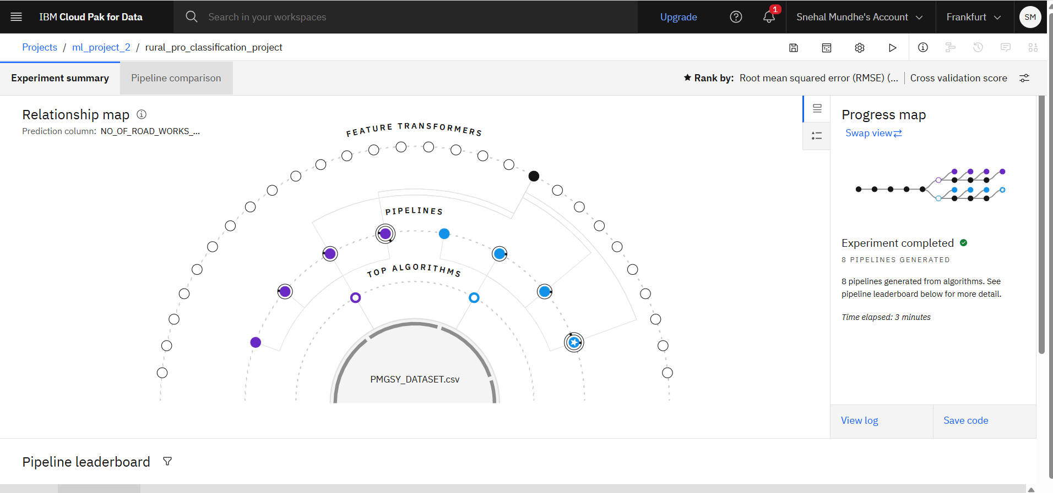
Training Screenshots-

Slide 7
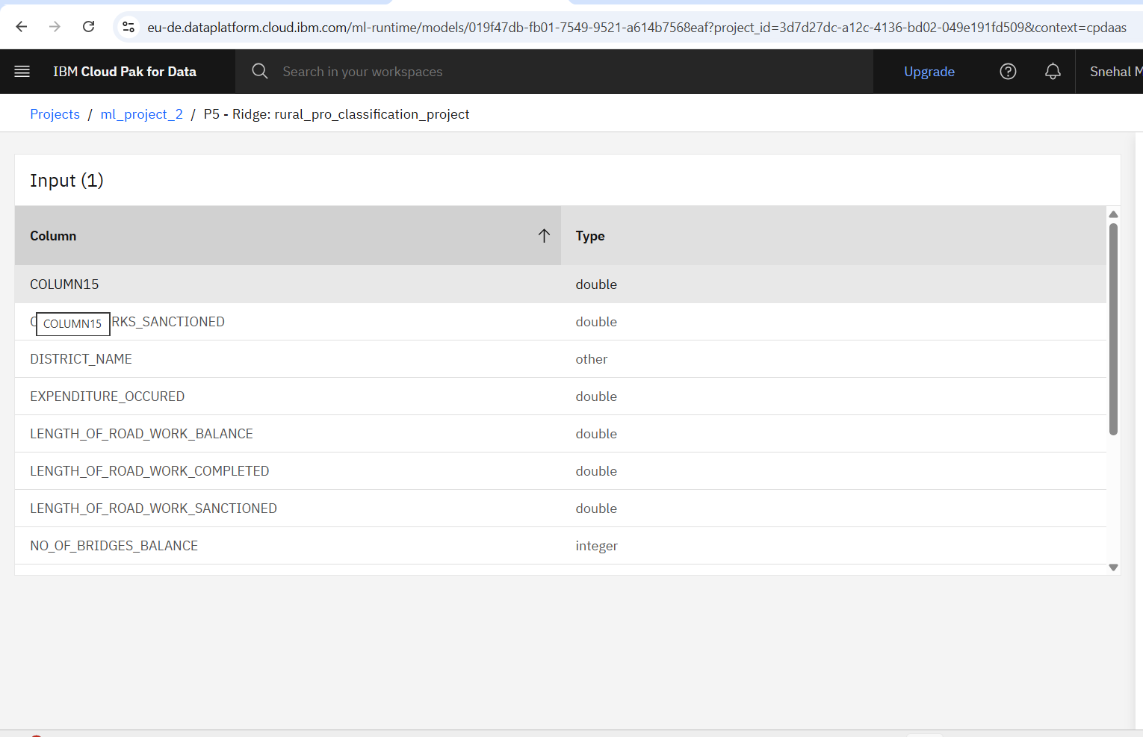
Best Model Screenshot:

Slide 8
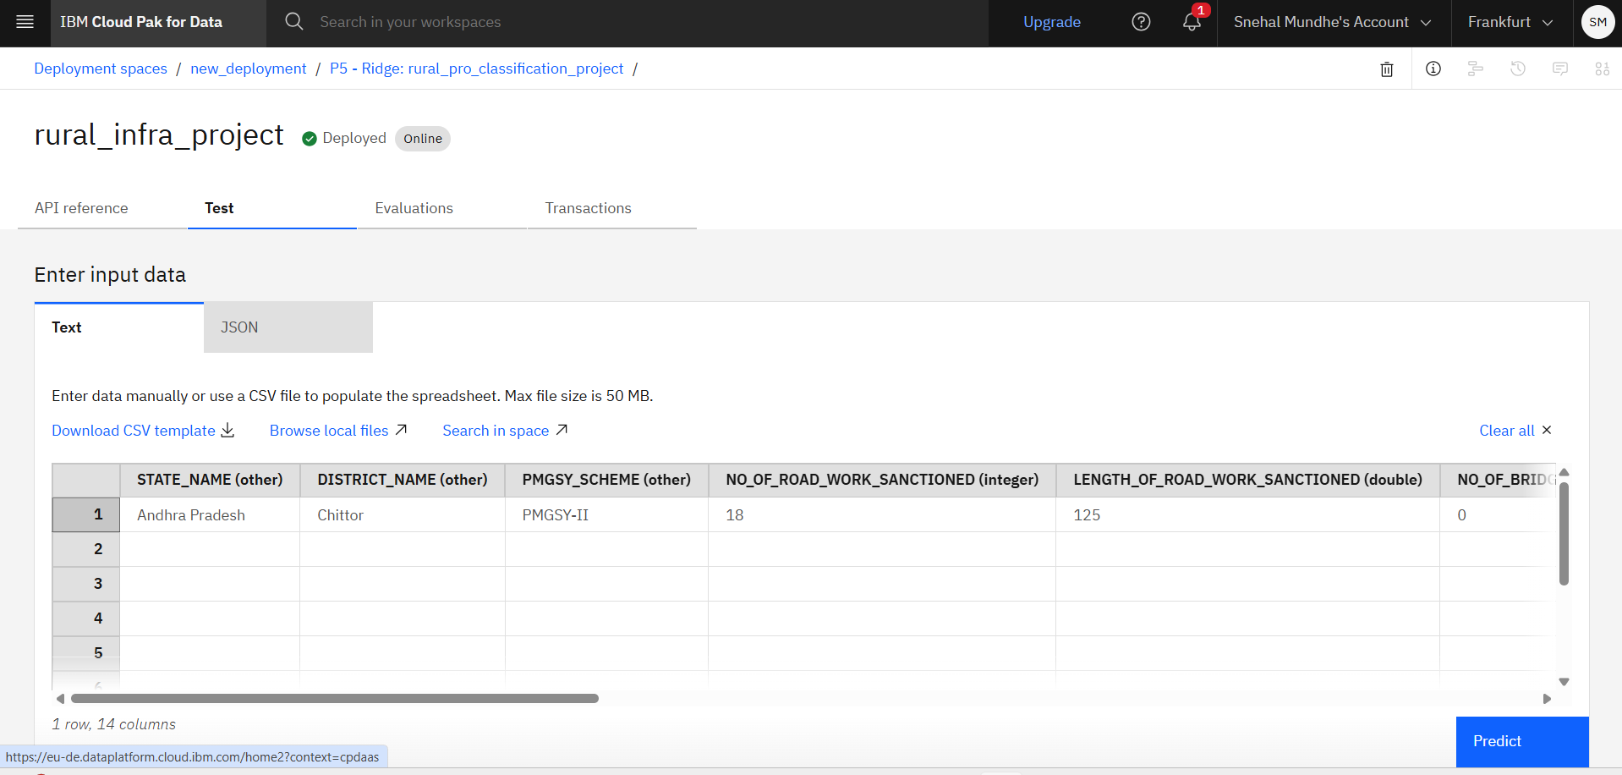
Testing Screenshot:

Slide 9
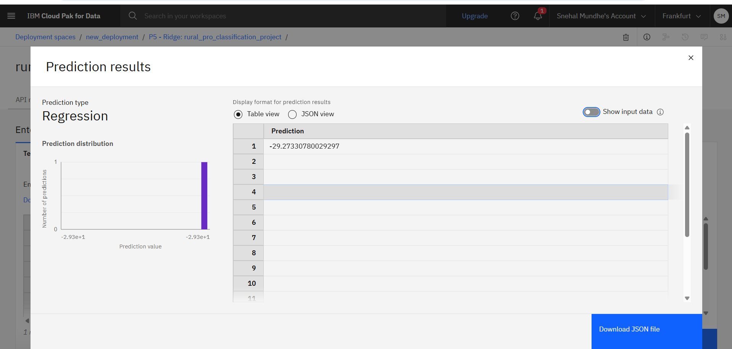
Testing Screenshot:

Slide 10
Novelty and Uniqueness
The solution automates the classification of rural road and bridge construction projects into their appropriate PMGSY schemes, significantly reducing manual effort and processing time.
It uses IBM watsonx.ai AutoAI to automatically discover the best-performing machine learning model without extensive coding or manual model selection.
The system can accurately classify thousands of infrastructure projects into multiple PMGSY schemes using a single intelligent platform.
Automated feature engineering identifies important physical and financial project characteristics that contribute to accurate classification.
The model ensures consistent, transparent, and unbiased project categorization, minimizing human errors and supporting better infrastructure planning, project monitoring, and budget allocation.

Slide 11
Git Hub Link
·
·
·

Slide 12
Future Scope
The system can be integrated with government infrastructure management portals to automate the end-to-end classification of newly sanctioned road and bridge projects.
Additional rural development schemes can be incorporated, enabling a unified AI-based infrastructure project classification platform.
Real-time integration with GIS data, satellite imagery, and government databases can improve project verification, monitoring, and fraud detection.
Advanced machine learning and deep learning models in IBM watsonx.ai can be utilized to continuously improve prediction accuracy as new infrastructure project data becomes available.
The solution can be deployed at a national scale to support faster, transparent, and data-driven decision-making for rural infrastructure planning, monitoring, and policy implementation across India.
·
·
·

Slide 13

Certificates Earned:

Slide 14
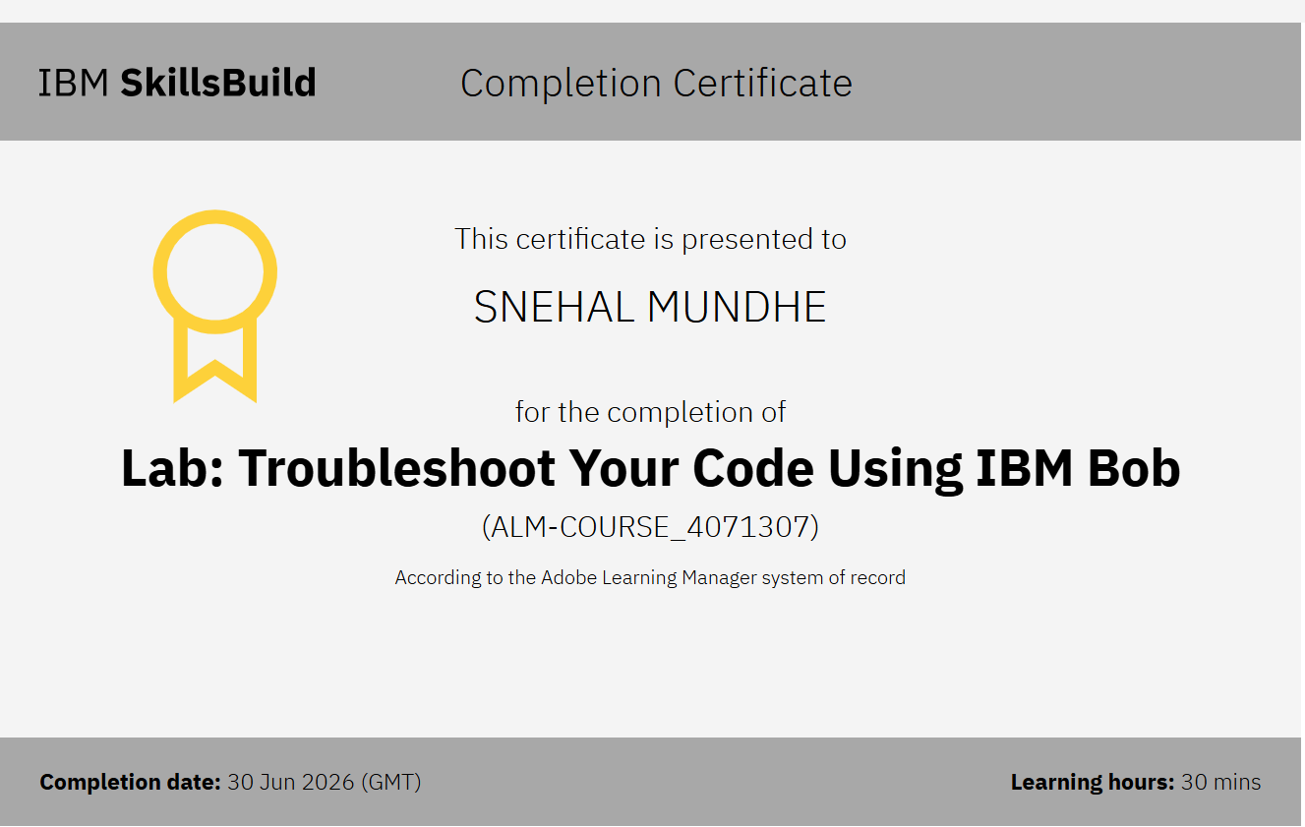
Certificates Earned:​
IBM BOB Certificate

Slide 15


Slide 16


