Slide 1



Authoring a Virtual Patient
How an author builds a VP activity in VP Studio
Literal text
Generated text
Interaction
shown as written
the LLM writes it
the agent converses
Mundorum Platform · VP Studio
Notes:
VP Studio lets educators author virtual patient activities: a scripted sequence of steps in which an LLM tutor, and optionally an LLM patient, guide a student through clinical cases. This deck walks through how an author builds one: the Activity Script, the structure of a phase, and the three kinds of elements in a phase's pipeline. The screenshots show the public example case 'Anemia: reading the MCV'.

Slide 2






From idea to student link
The author's path through VP Studio's simple-mode editor
1
2
3
New case
Shape the Activity Script
Fill each phase
Start from scratch (Welcome + Final feedback), from a script template, or import a .vp.json file.
Add, move, rename and remove steps. The editor disables options that would break the script rules.
Build the phase's pipeline of elements: Literal text, Generated text and Interaction.
4
5
6
Guide the agents
Preview and try
Publish and share
Attach hidden side information and strategies, insert {{fields}}, and tune the agent prompts.
Preview shows what the student sees. Try it plays the draft, with trace notes only the author sees.
Publish checks readiness and freezes a copy. Students play it at /vp/play/<case id>/.
Notes:
1. New case opens a gallery: start from scratch, from a script template, or import a case file. 2. Shape the script: the editor enforces Welcome first, Final feedback last, transfers and assessments after Explain case 1, single steps at most once. 3. Each step holds an ordered list of elements. 4. Side information and strategies guide the agents; {{fields}} pull in authored content and earlier answers; the Strategies panel holds the agent prompts. 5. Preview and Generate sample; Try it plays the current draft, even unsaved. 6. Publish runs the readiness checks; students always play the published copy.

Slide 3
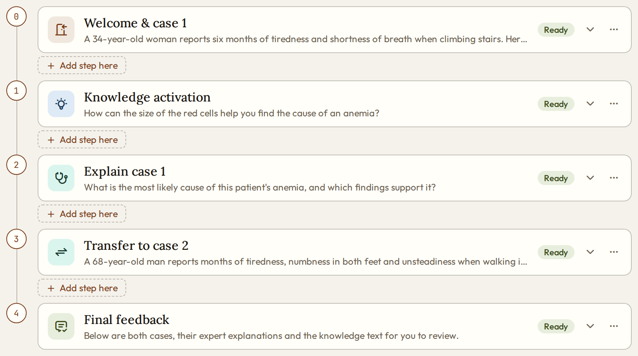
The Activity Script
In the editor, the script is the list of steps; each step after Welcome is a phase
order
Steps run top to bottom, numbered from 0
type
Sets the phase banner and the answer field
Ready
Or Needs input: what publishing still needs
title
The phase name; click it to rename the step
open
Opens the step's pipeline of elements
summary
The step's first text, shown while collapsed
step options
Move, rename or remove the step
Add step here
Offers only the steps the script rules allow
fixed ends
Welcome always first, Final feedback always last
Notes:
The anemia example uses the Recall, Explain, Transfer script: Welcome and case 1, Knowledge activation, Explain case 1, Transfer to case 2, Final feedback. Collapsed, each step shows its type icon, its phase name and a summary. Clicking a step opens its pipeline of elements. 'Add step here' only offers what the rules allow: assessments and transfers after Explain case 1, single steps at most once; disabled options show the reason.

Slide 4
Step types and their rules
Each type has a phase name, an answer field later steps can use, and a sequencing rule
Welcome & case 1
Knowledge activation
Explain case 1
Transfer to case 2
Final feedback
Fixed ends: Welcome first, Final feedback last. Middle: pick the steps, e.g. the Recall → Explain → Transfer script above.
Step type | Phase banner | Answer field | Rule
welcome | (none) | {{welcome.answer}} | Exactly one, first
know | Knowledge Activation | {{knowledge.answer}} | At most once
explain | Narrative Construction | {{case1.answer}} | At most once
assess | Assessment | {{assessment.answer}} | After explain
transfer | Reasoning Transfer | {{caseN.answer}} | After explain; N = 2, 3, …
interview | Patient Interview | {{interview.answer}} | At most once
reflect | Reflection | {{reflection.answer}} | Once
custom | Its own title | {{<key>.answer}} | Unique answer key
final | (none) | (none) | Exactly one, last
The case also holds
title
The activity's name
settings
Student level (4 / 3 / 2 hints per point), progress bar
agentPrompts
Tutor persona, patient persona, guardrails
strategyPrompts
One instruction per strategy used
Notes:
A case is one JSON document; its steps list is the Activity Script. Each step type has a default phase name shown in the banner (a step's title replaces it) and records the student's answer under a field later steps can use. Assessments and transfers need Explain case 1 before them; a transfer introduces case 2, 3, and so on. Custom steps get their own title and answer key; renaming one rewrites every reference to its answer.

Slide 5
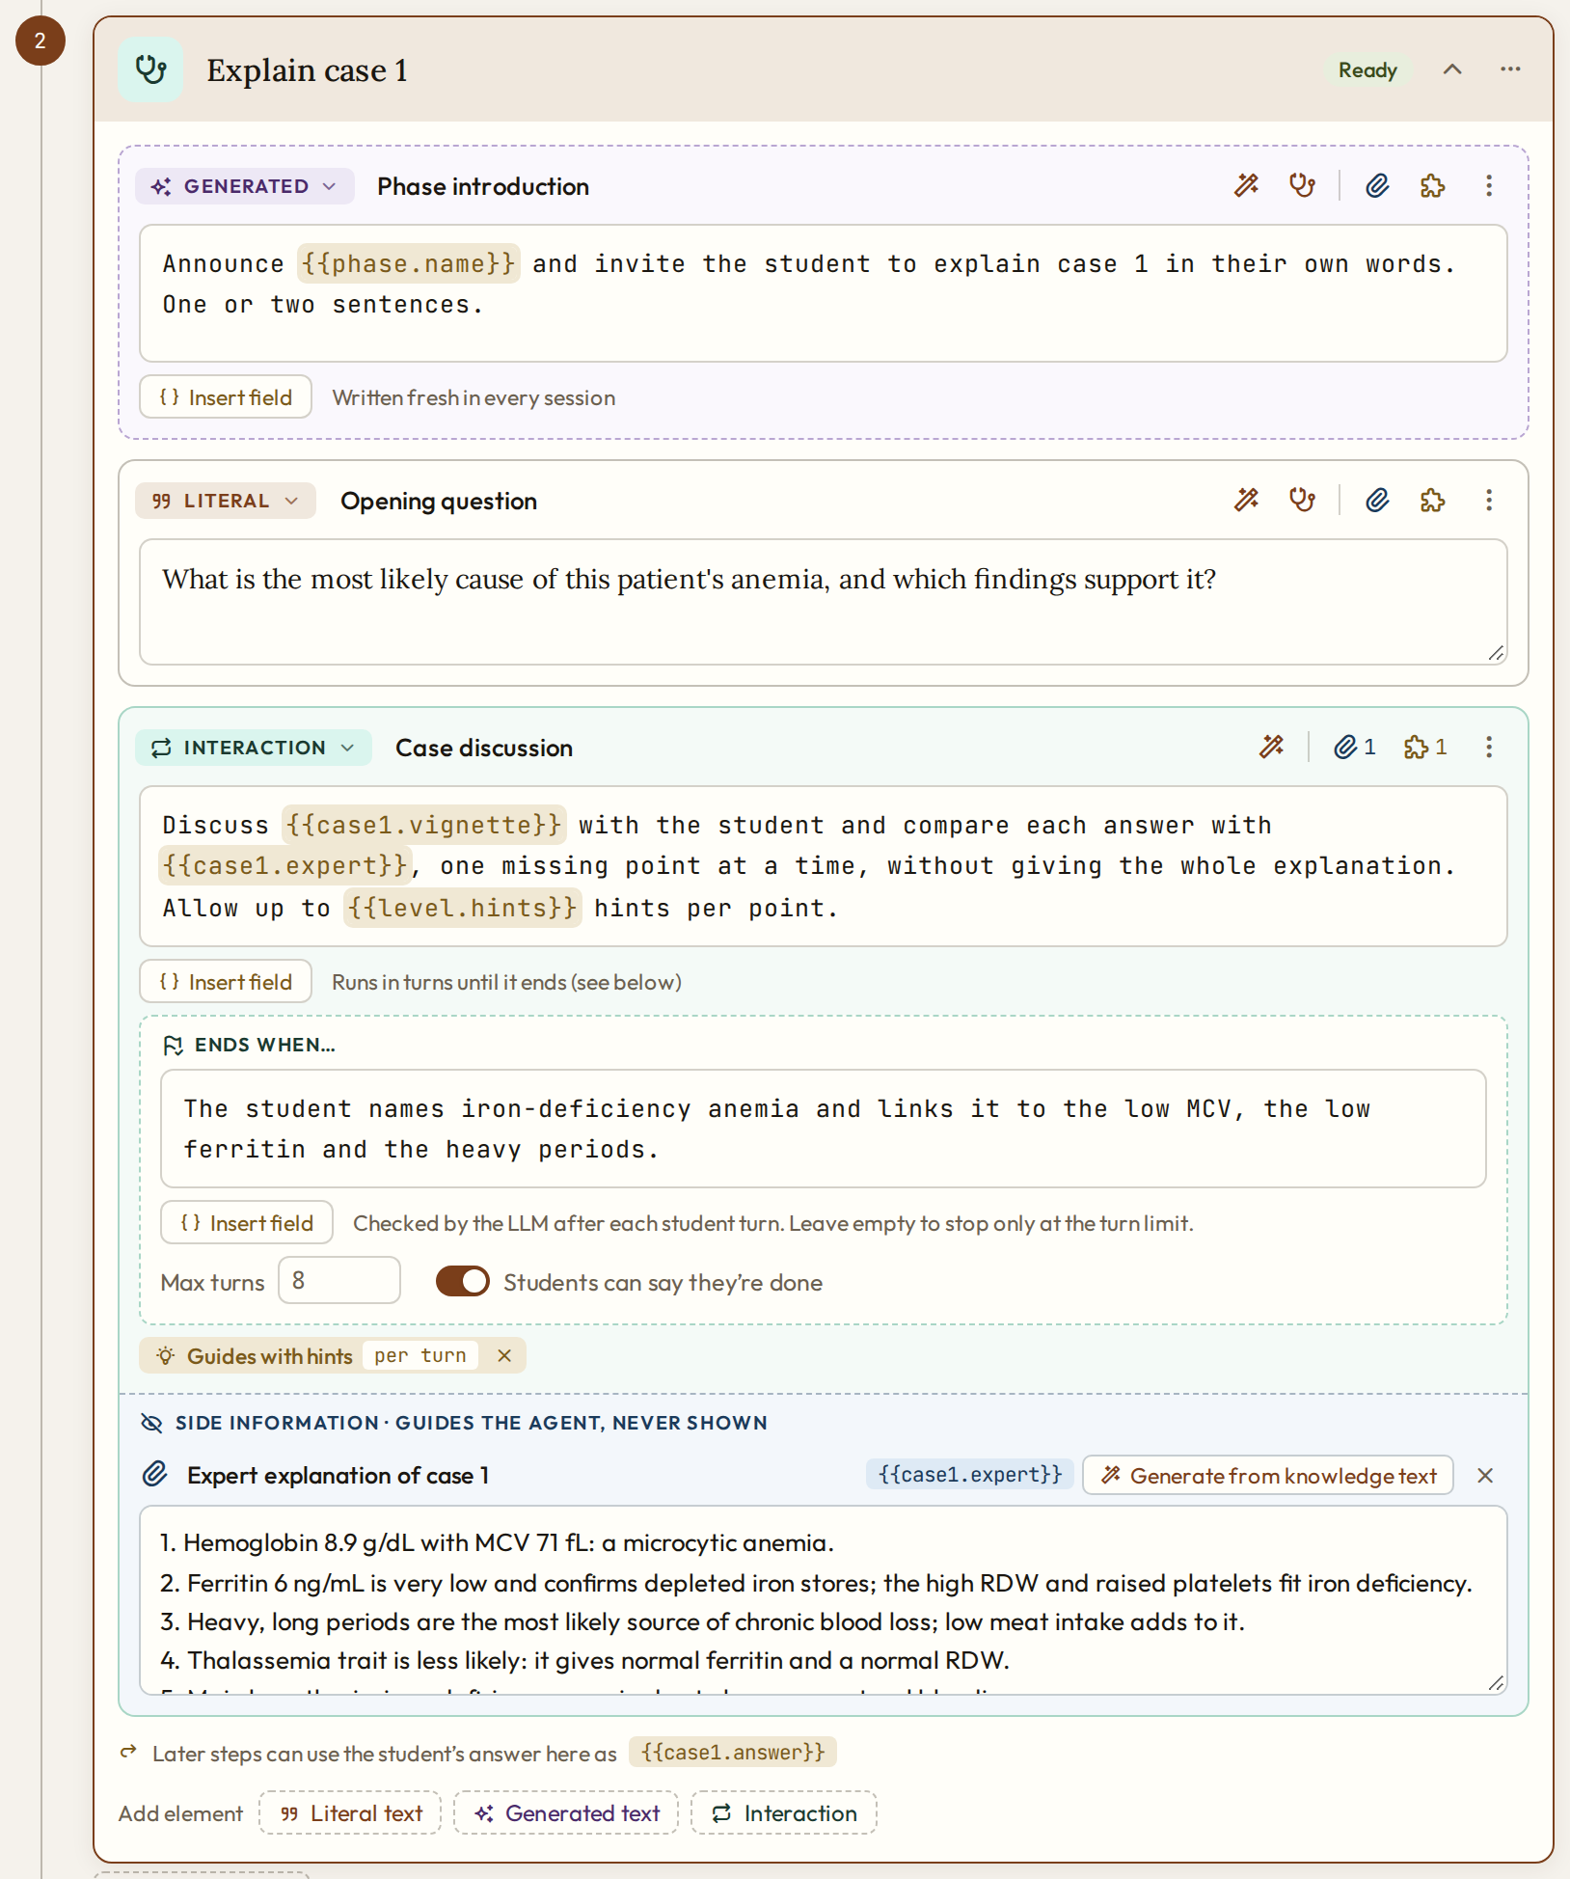
Structure of a phase
A step opens into its pipeline: elements that run top to bottom, then the answer it records
position
Phase 2 of the script
title
Phase name in the student's banner: Narrative Construction unless renamed
1 · Generated text
The tutor writes the phase introduction
2 · Literal text
The opening question; the student answers it first
3 · Interaction
The case discussion with the tutor
sideInfo
Hidden from the student: here the expert explanation the evaluator uses
answer
Recorded as {{case1.answer}}: that reply, or the last message of the interaction
Add element
Append a Literal text, Generated text or Interaction
Notes:
This is the Explain case 1 step of the anemia example. The pipeline runs top to bottom: a generated introduction, a literal opening question and an interaction that carries the expert explanation as hidden side information. A step with no interaction (except Final) waits for one student reply at its end. The answer it records becomes {{case1.answer}} for later steps.

Slide 6
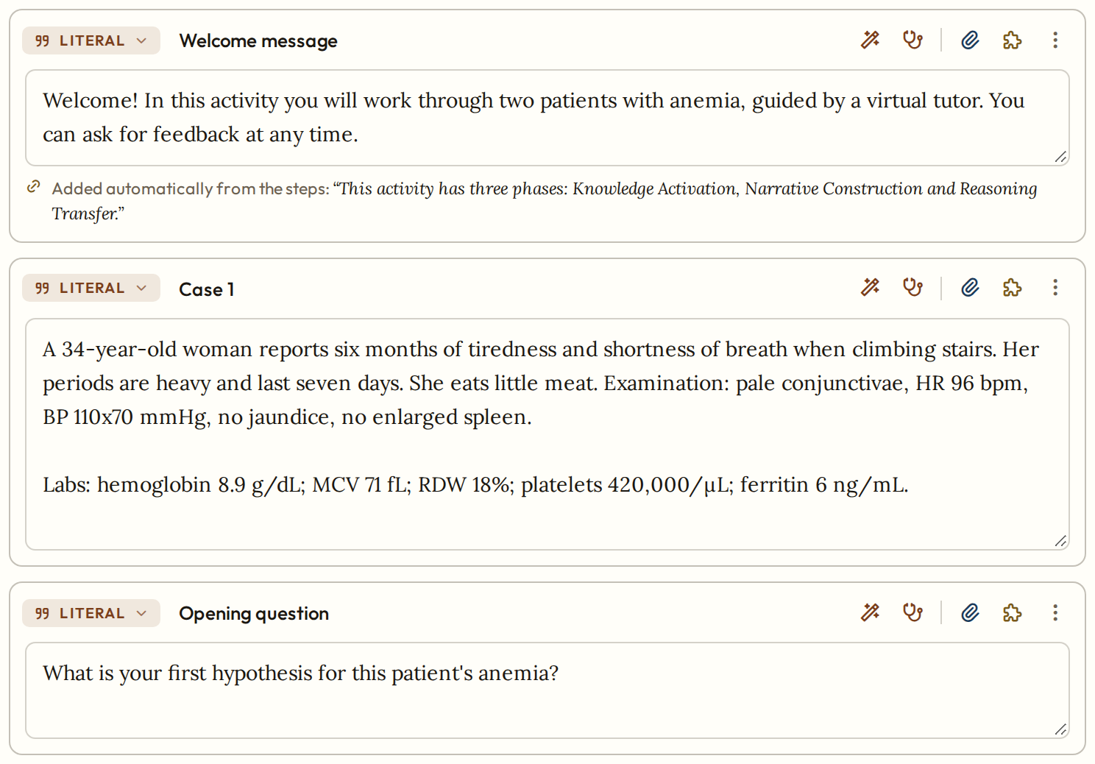
Literal text
Shown to the student exactly as the author wrote it
kind · label
The type (click to change) and the name the author sees
strategies
Gamification only
sideInfo
Attach hidden information
text
Exactly what the student reads; no {{fields}}
assistant
Writes the text, or a case vignette
autoPhaseSentence
Welcome: the list of phases is appended
card · ref
Case vignette: shown as a case card, usable as {{case1.vignette}}
opening question
No card, just before an interaction: the student answers first
Notes:
The welcome step of the example holds three literals: the welcome message (with autoPhaseSentence, the player appends the list of phases), the case 1 vignette (card 'Case 1', ref case1.vignette) and the opening question. card and ref are part of the case document; the editor doesn't show them as separate controls. reviewMaterials, on the last literal of Final, appends the vignettes, expert explanations and knowledge text.

Slide 7
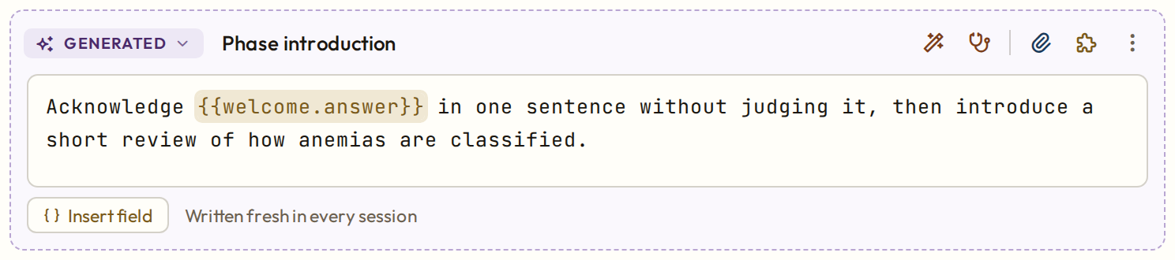
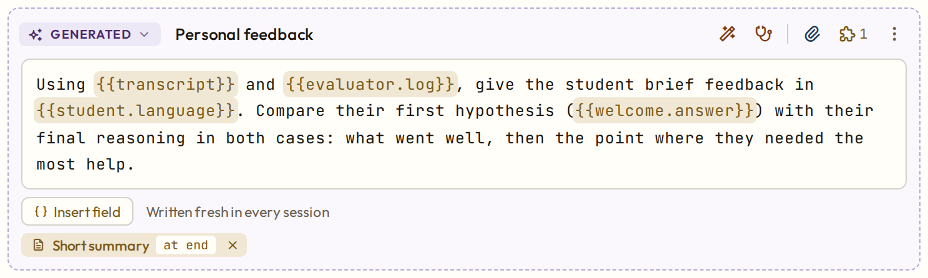
Generated text
The author writes a prompt; the tutor writes the text when the session runs
Knowledge activation · Phase introduction
kind
generated
assistant
Drafts the prompt, or one that writes a vignette
text
A prompt to the tutor, in the second person, not what the student reads
Final feedback · Personal feedback
Insert field
Lists what this step can use
strategies
One attached: 1
isFinalFeedback
Final step: feedback from {{transcript}} and {{evaluator.log}}
{{fields}}
Amber when known; red when unknown or not yet available
strategy
Final feedback or Gamification
moment
on start · per turn · at end; click to change
Also in the document: ref makes the generated text a field for later steps.
Notes:
In a generated element the text is an instruction to the LLM. The tutor writes the student's text at that point in the session, with the fields filled in and the tutor persona and guardrails applied. With an 'on start' strategy such as self-rating, the tutor first asks that question and waits for the reply. Typical uses: phase introductions that recall earlier answers, and the Final step's personal feedback.

Slide 8
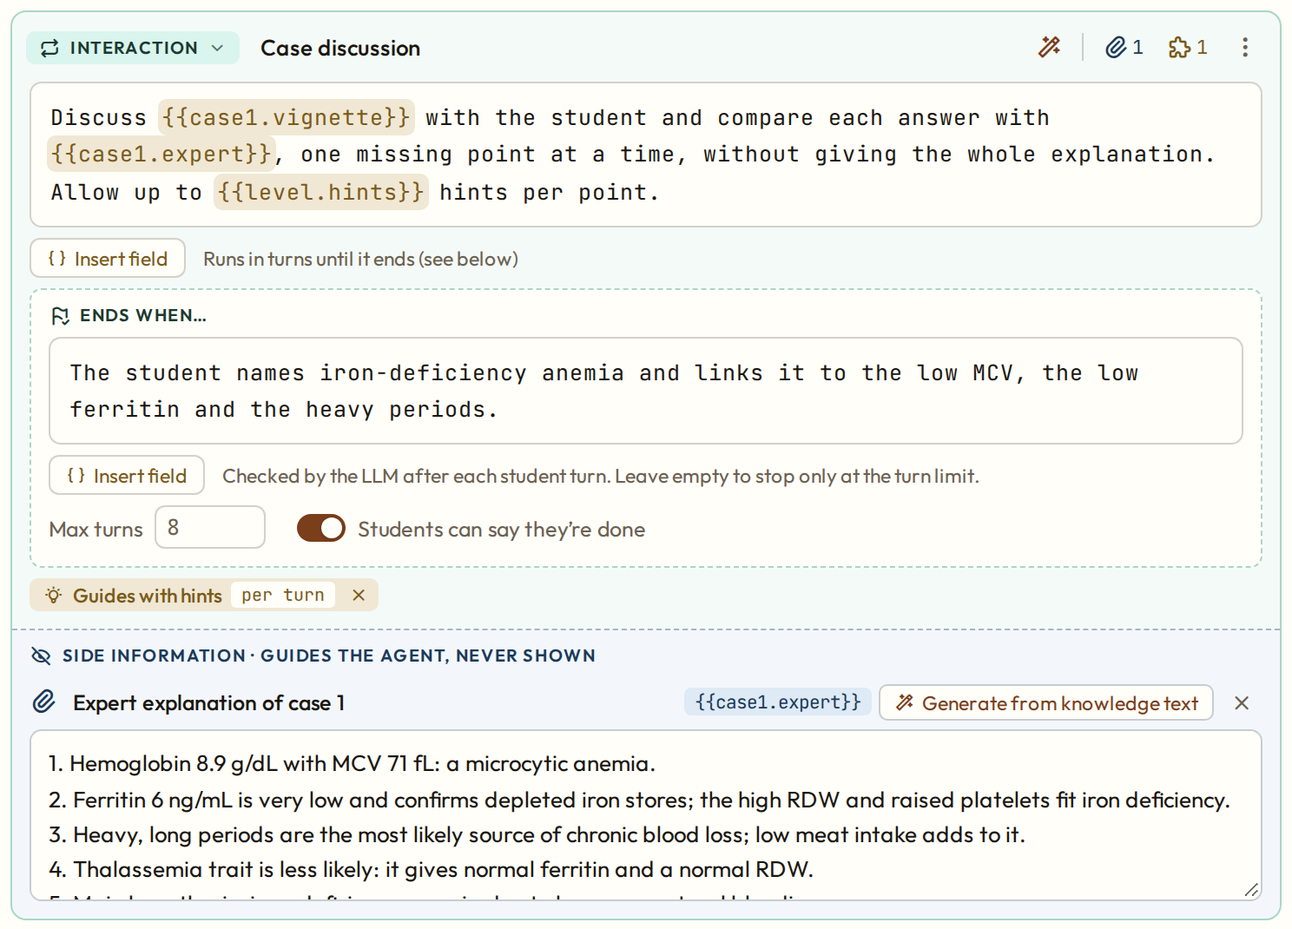
Interaction
A multi-turn conversation between the student and an agent
kind
interaction
strategies
Pick from the popover
text
The agent's prompt: what to discuss, what to compare, how to help
sideInfo
Attach hidden information
endsWhen
Optional end condition, checked by an LLM after each turn
allowStudentExit
Shows an I'm done button (on by default)
maxTurns
Required, 1–50: hard limit on student turns
strategy
Feedback, Patient or Gamification
expert explanation
{{case1.expert}}: the hidden evaluator's checklist
Notes:
The Case discussion of the explain step. The prompt uses fields for the vignette, the expert explanation and the hints allowed at the student's level. The interaction ends by the turn limit, by the 'Ends when…' condition, or when the student presses I'm done. The expert explanation, side information generated from the case, is what the hidden evaluator compares the student's answers with. Realistic limits: 6 to 10 turns for discussions, 8 to 12 for interviews.

Slide 9



How an interaction runs
What the player does with the interaction's settings
After each student turn
Who opens
1
Student replies
The student, if a literal opening question comes just before. Otherwise the agent opens.
In the chat, or presses I'm done
2
Hidden evaluator
Compares the answers with the expert explanation; the tutor sees what is covered or missing
Who the agent is
3
Turn limit
The patient in an interview step, or when a Patient strategy is attached. Otherwise the tutor.
Stops when maxTurns is reached
4
Ends when…
An LLM checks the author's end condition
How it ends
5
Agent replies
Turn limit, the Ends when… condition, or I'm done. At-end strategies then get one closing turn.
Then back to 1, until the interaction ends
Notes:
The evaluator runs only when the element has an expert explanation. Every session action works on a copy of the state and is saved only if all its LLM calls succeed; on a provider error the student can send the message again.

Slide 10



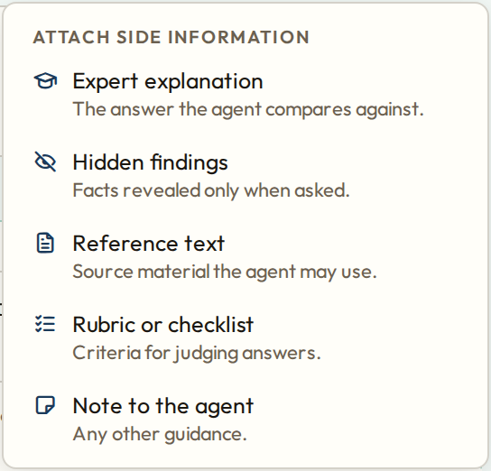
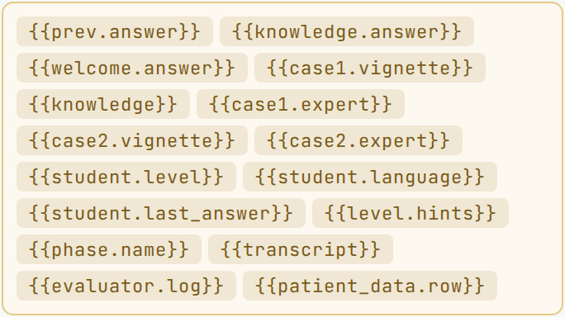
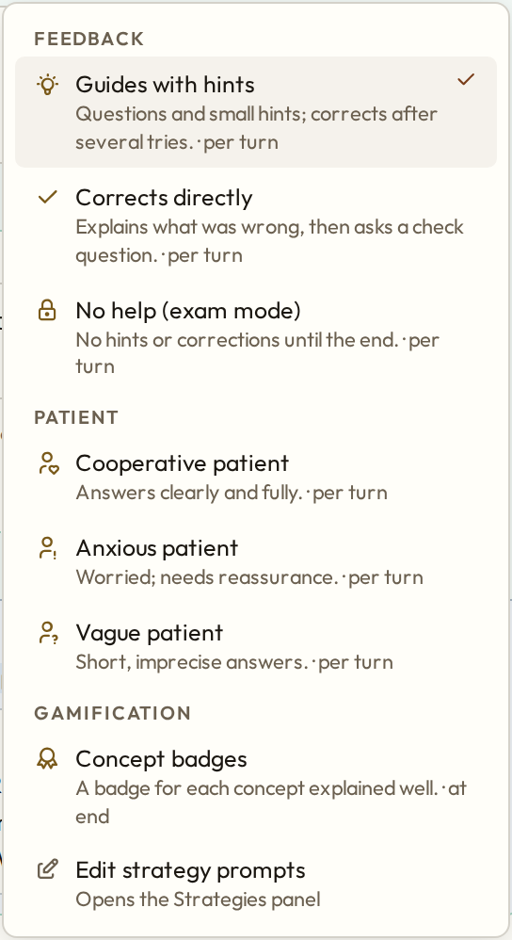
What every element can carry
Side information, fields and strategies connect the pipeline to the agents
Side information
Fields
Strategies
Hidden text attached to an element. The expert explanation is the evaluator's checklist.
{{name}} placeholders filled at run time. Never forward: only what exists at that step.
Reusable instructions with a moment: on start, per turn or at end.
Notes:
Left: the presets for side information. Middle: Insert field lists every field the current step can use; fields that point to something not yet available at that step are flagged in red and block publishing. Right: the strategies an interaction may use, grouped by category, from the content pack; authors edit their texts in the Strategies panel.

