Slide 1
Case Study Exploratory Data Analysis
Lending Club Dataset

Slide 2
Dataset Column Selection for Analysis
Un Ordered Categorical ( Borrower/Customer Attribute )
Purpose of Loan
Home Ownership Status
Loan Verification Status
Residing State of the Loan Applicant
Ordered Categorical ( Loan/Product Attribute)
Loan Amount Range
Interest Rate Range
Total Repayment
Total Received Principal
Total Received Interest
Term/Tenure of Loan
Grade of Loan
Sub Grade of Loan
Loan Issue Year
Loan Issue Month
Ordered Categorical ( Borrower/Customer Attribute )
Annual Income Range
Debt to Income Ratio Range
Employment Tenure of the Loan Applicant
Public Recorded Bankruptcies
Credit Utilization Range

Slide 3
Derived Attributes
Principal Recovery Ratio as the measure of severity of charge-off. The lesser the ratio indicates the more severe is the damage caused by the charge-off.
prncp_recovery_ratio_range = total_rec_prncp / loan_amt
Charge Off Percentage as a measure of percentage of loans charged off across all the dibursals.
charged_off_loan_percentage = round(loan_raw[loan_raw.loan_status == 'Charged Off'].shape[0] / loan_raw.shape[0]
This percentage becomes the benchmark to analyse the performance of Charged-Off loans across different variables/dimensions.

Slide 4
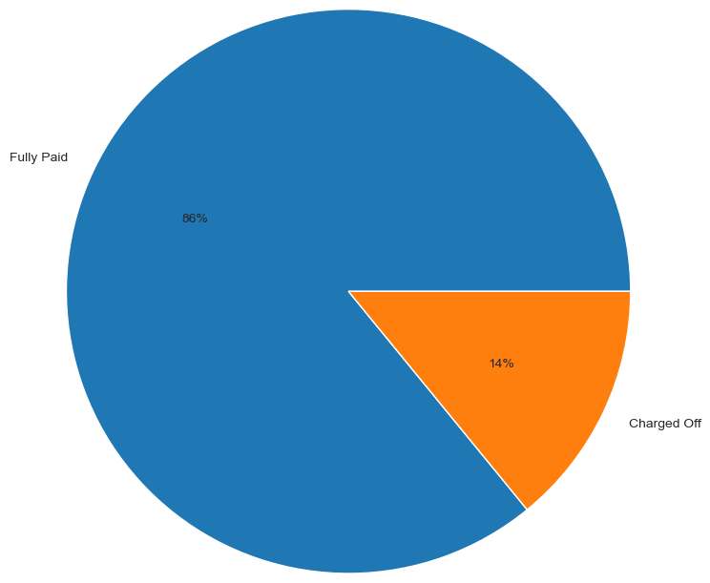
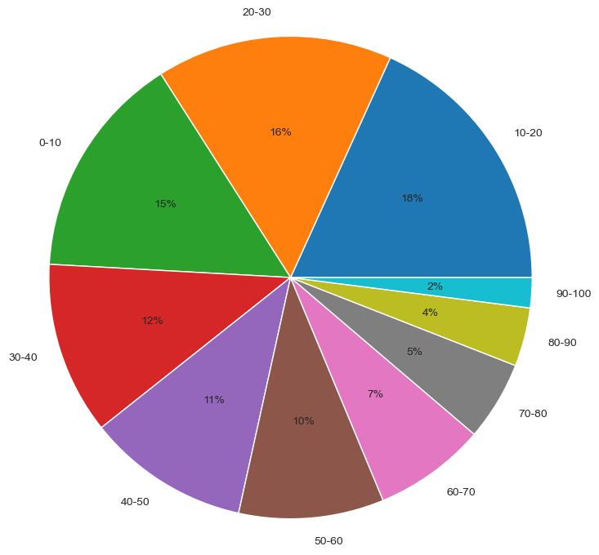
Proportion of Charged-Off loans
Distribution of Loan Status across Loans
Distribution of Principal Recovery Ratio across Charged Off Loans
Analyzing ~34k records indicates the Charged-Off loans
constitutes around ~14% of all the loans disbursed.
Univariate Analysis of all the records to be performed
taking this proportion as the benchmark.
Around ~70% of the charged-off loans ends up paying
< 50% of the principal
Analyzing the customer and loan attributes that affects
the payment of loan based on Principal Recovery Ratio

Slide 5
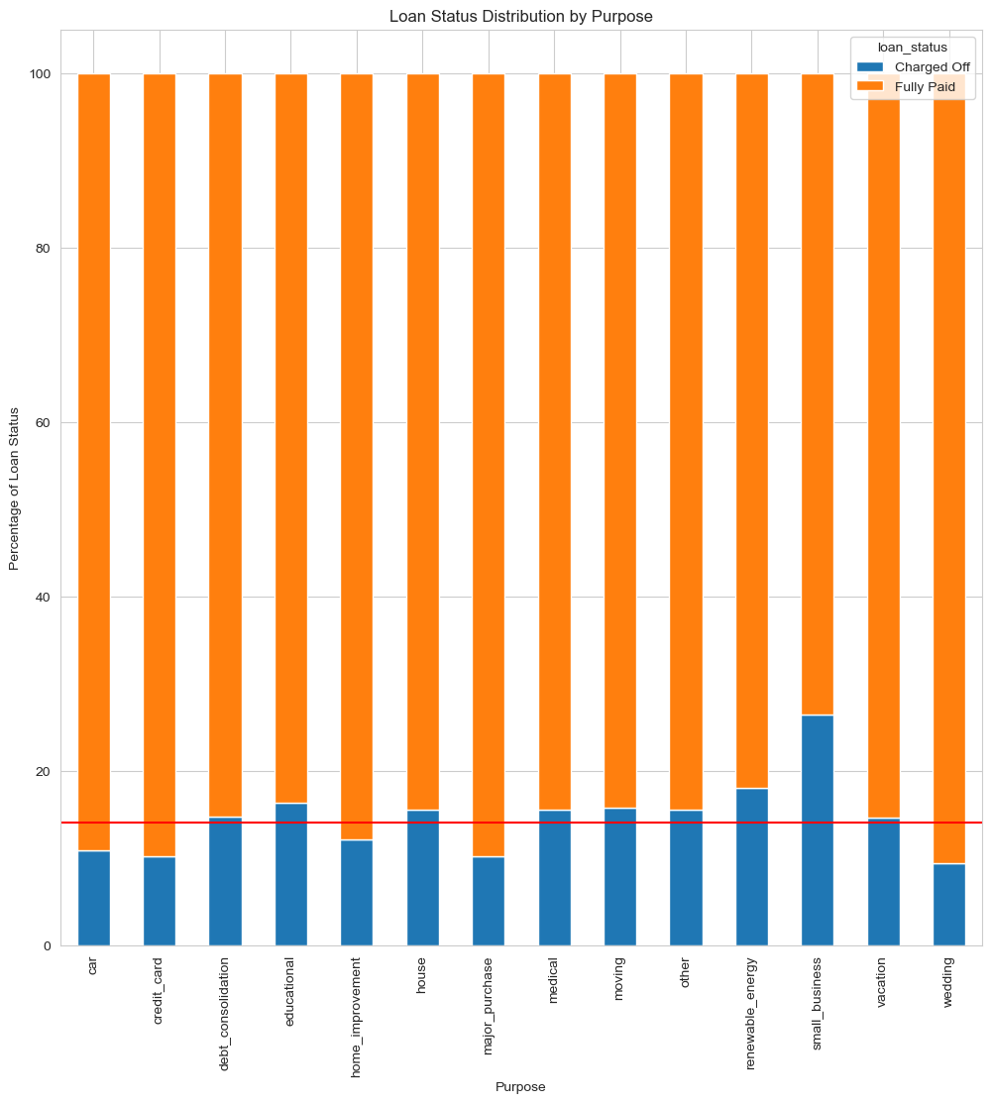
Univariate Analysis of Charged Off Loans
In the small_business and renewable catgory, the ratio of borrowers with "Charged Off" loan status exceeds the overall ratio of "Charged Off" borrowers.
small_business charged-off loans ~30%
renewable charged-off loans ~20%
Hence, the probability of defaulting is more when the Purpose is small_business or renewable.

Slide 6
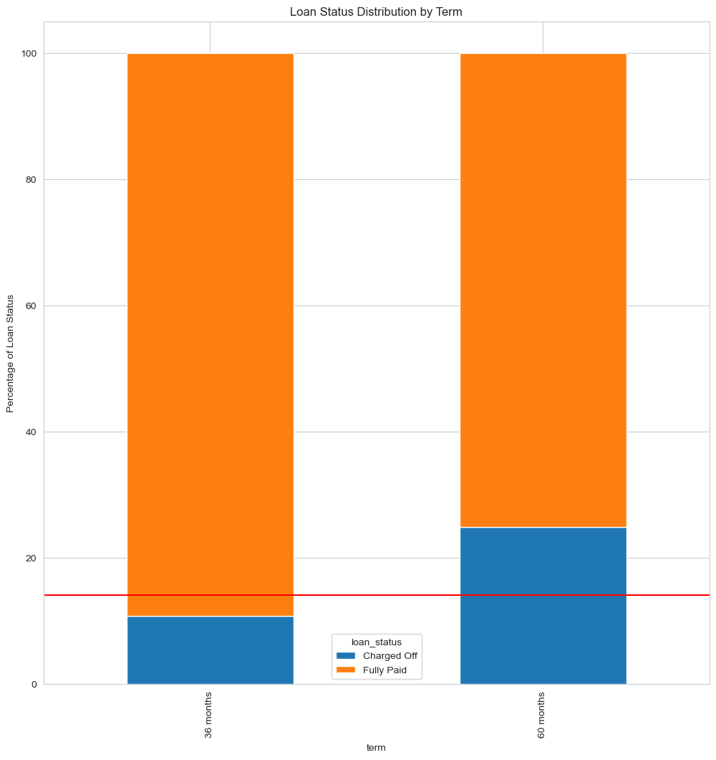
Univariate Analysis of Charged Off Loans
The number or charged-off loans are ~25% for loans with tenure = 60 months which is greater than the benchmark.
Hence, loans with higher tenure are more vulnerable.

Slide 7
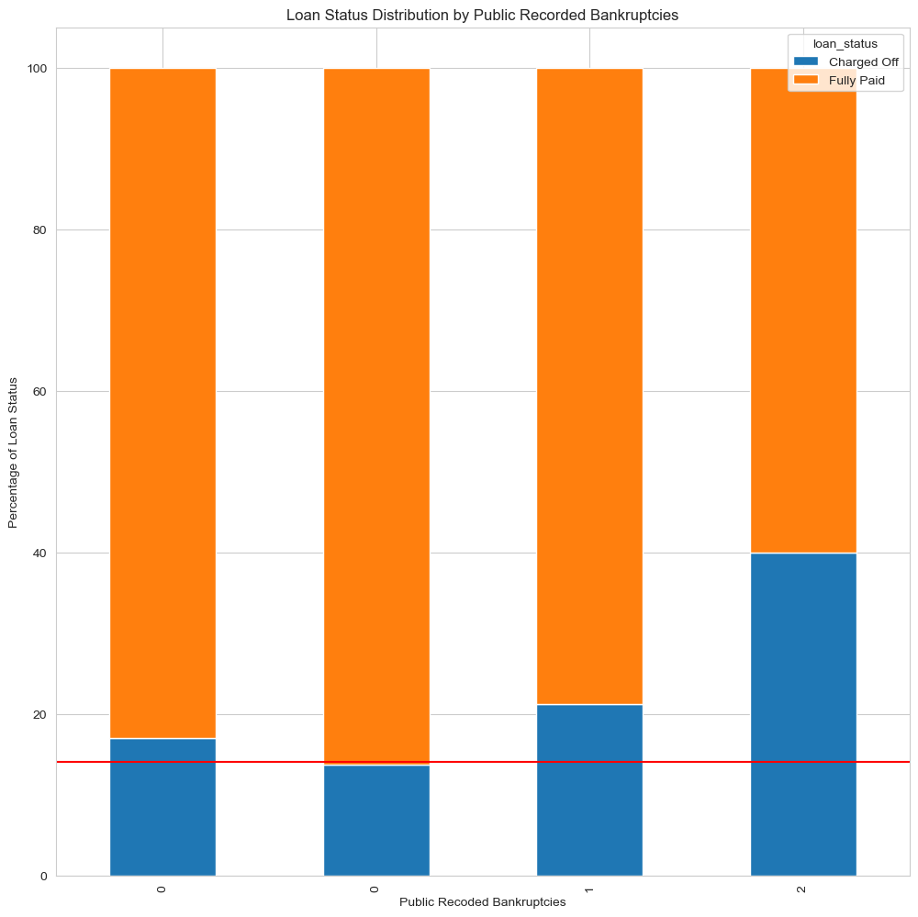
Univariate Analysis of Charged Off Loans
Analysis of loans where applicants have declared >2 public recorded bankruptcies shows that 40% of such loans ends up being Charged-Off.
A clear indicator that such disbursals should be avoided.

Slide 8
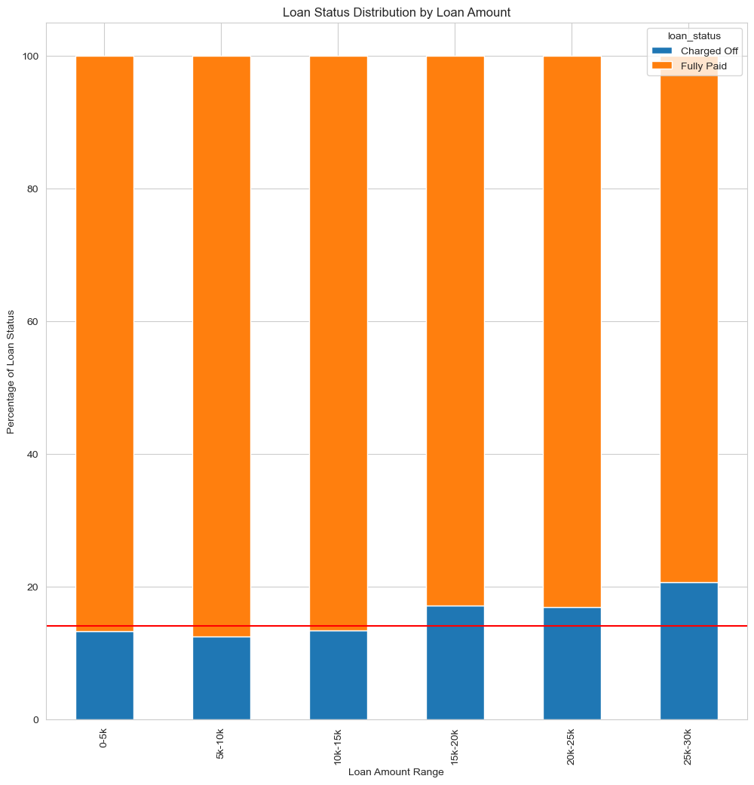
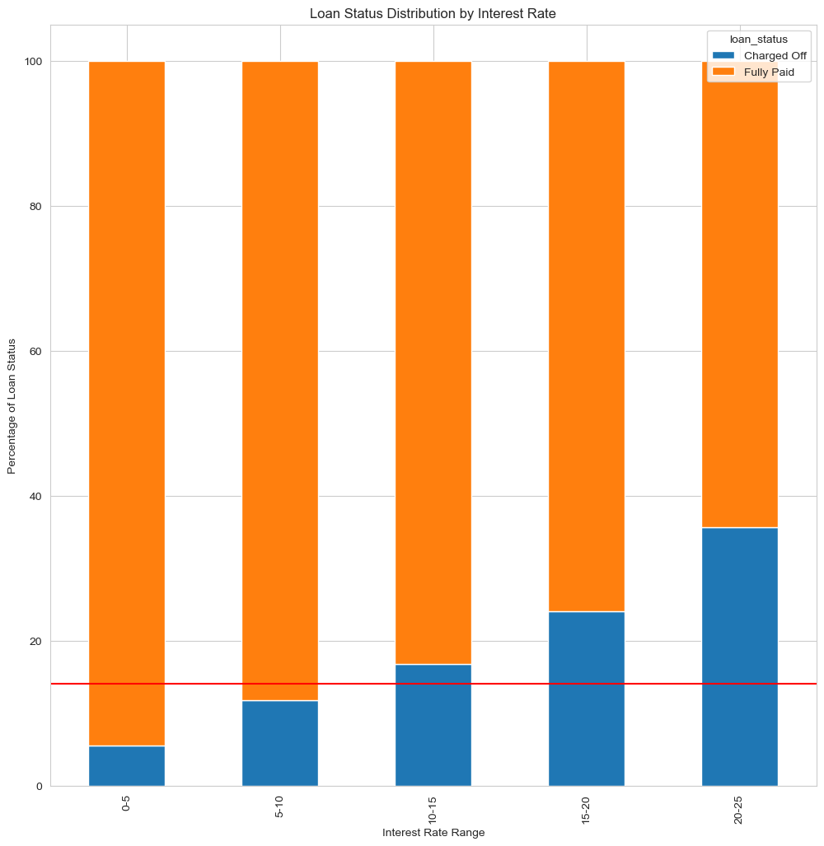
Univariate Analysis of Charged Off Loans
The percentage of ”Charged-Off” loans increases with increasing Loan Amount and Interest Rate.
Interest Rate > 20% tends to have a high impact on the loans being defaulted with ~40% loans being “Charged Off”
Hence, loans offering at higher interest rate should be avoided.

Slide 9
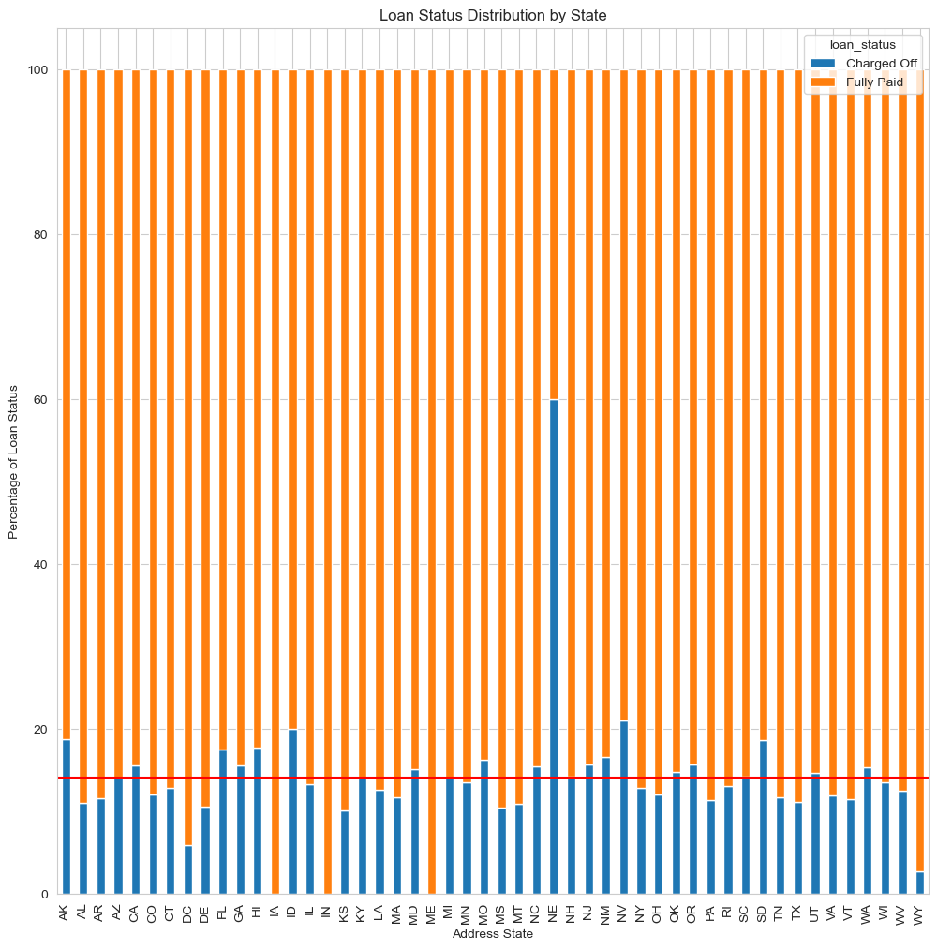
Univariate Analysis of Charged Off Loans
- NV, SD, ID, AK states have higher percentage of “Charged Off” loans.
- NE state seems to have exceptionally high number (~60%) of loans being “Charged Off” which requires further analysis. This could also indicate a lapse in the application verification or recovery processes.

Slide 10
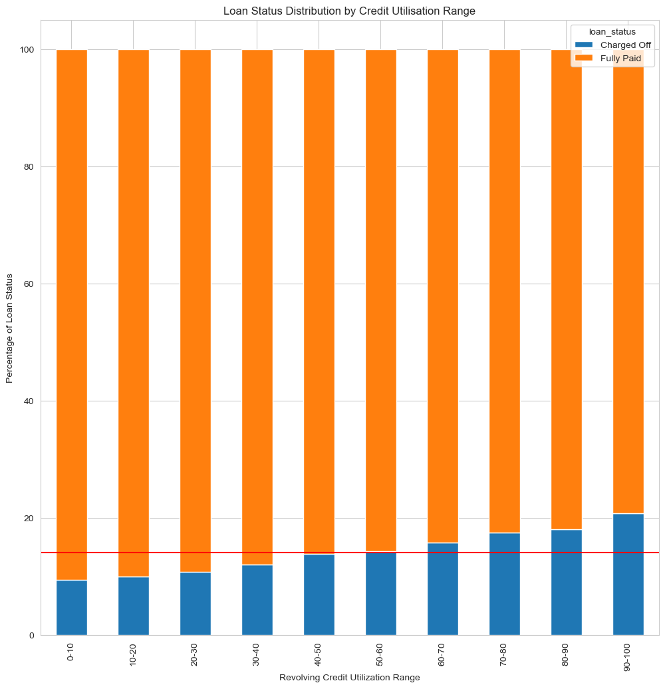
Univariate Analysis of Charged Off Loans
Loan applicants with Higher Credit Utilization Ratio tends to default more.

Slide 11
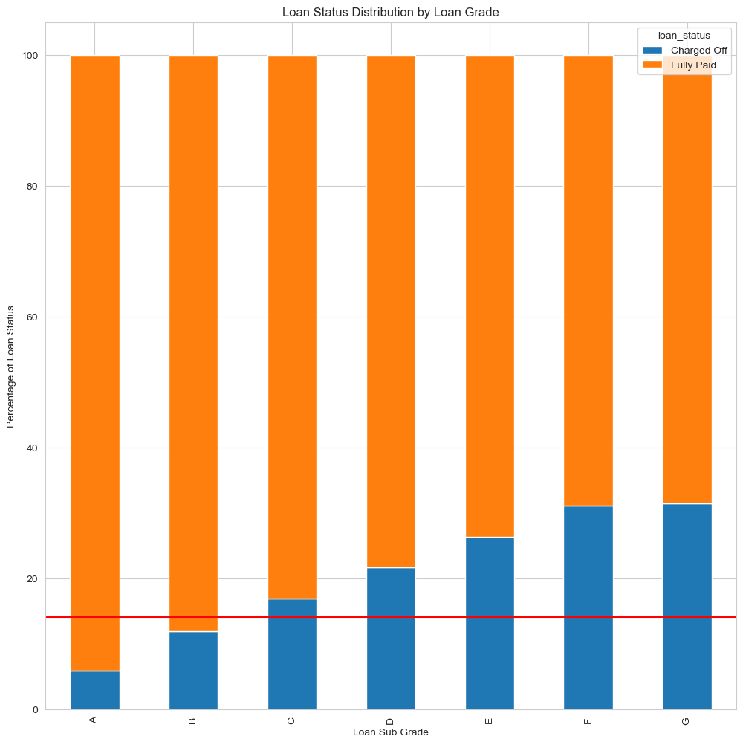
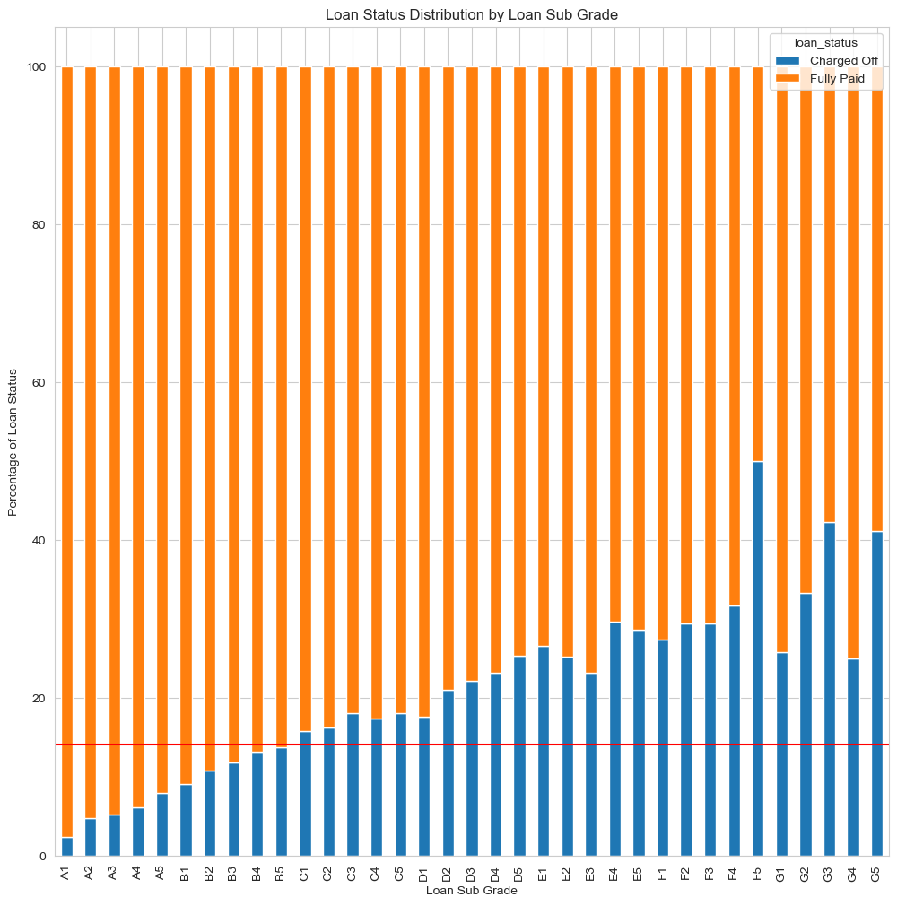
Univariate Analysis of Charged Off Loans
Higher Grade loans E, F, G
tends to result into defaults
Similar trend is observed in the subgrades of loan grade
Hence, higher grade loans should be avoided.

Slide 12
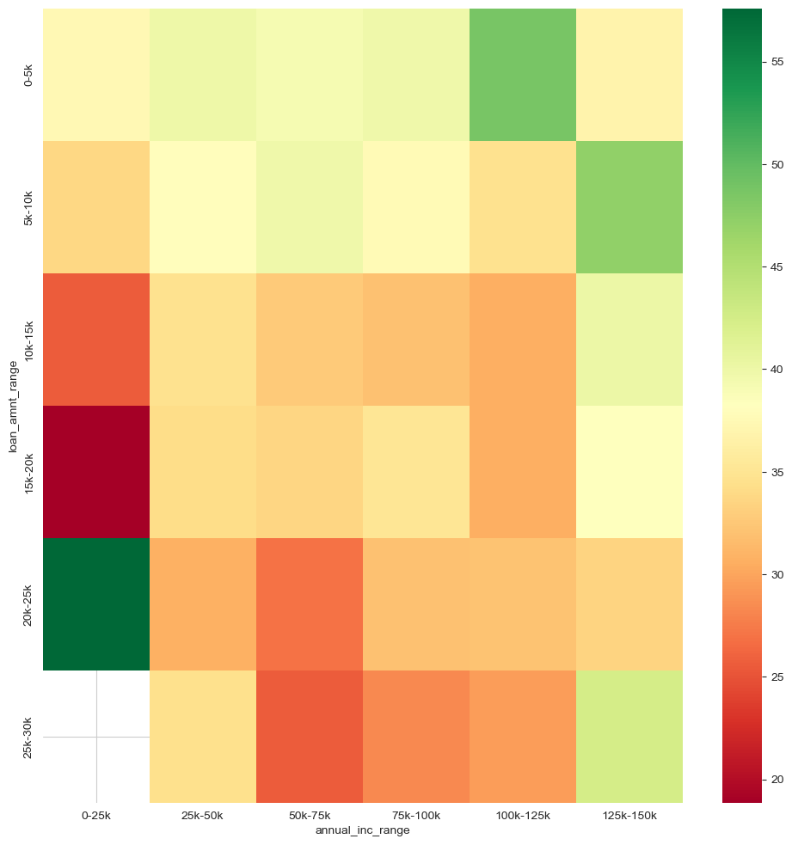
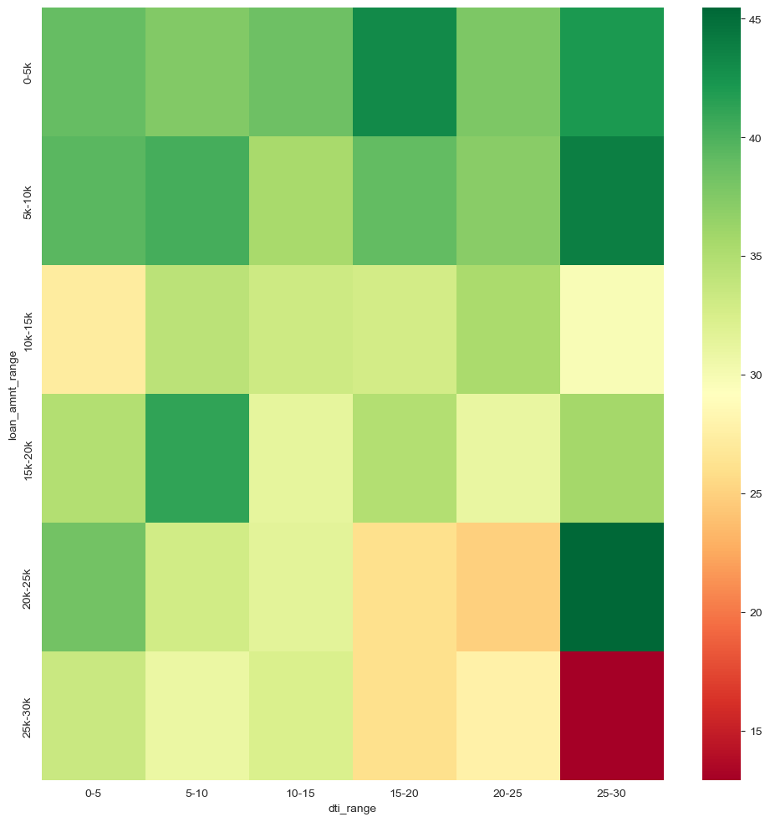
Bivariate Analysis of Charged Off Loans
In general, for all the income groups, the PRR shows a decrease with increasing loan amount. However, for the lowest income group Annual Income < 25000, the PRR decreases with the increase in Loan Amount, the least being for Loan Amount ~ 15-20k range.
This indicates that loan amounts > 15k should be avoided for borrowers with annual income in the range 0-25k
The PRR seems to be dropping below 15% for loans with Loan Amount ~ 25k - 30k and DTI ~ 25 – 30
This indicates that high DTI affects severely the repayment of higher loan amounts
The exceptionally high PRR for Loan Amount ~ 20-25k seems to be an outlier.

Slide 13
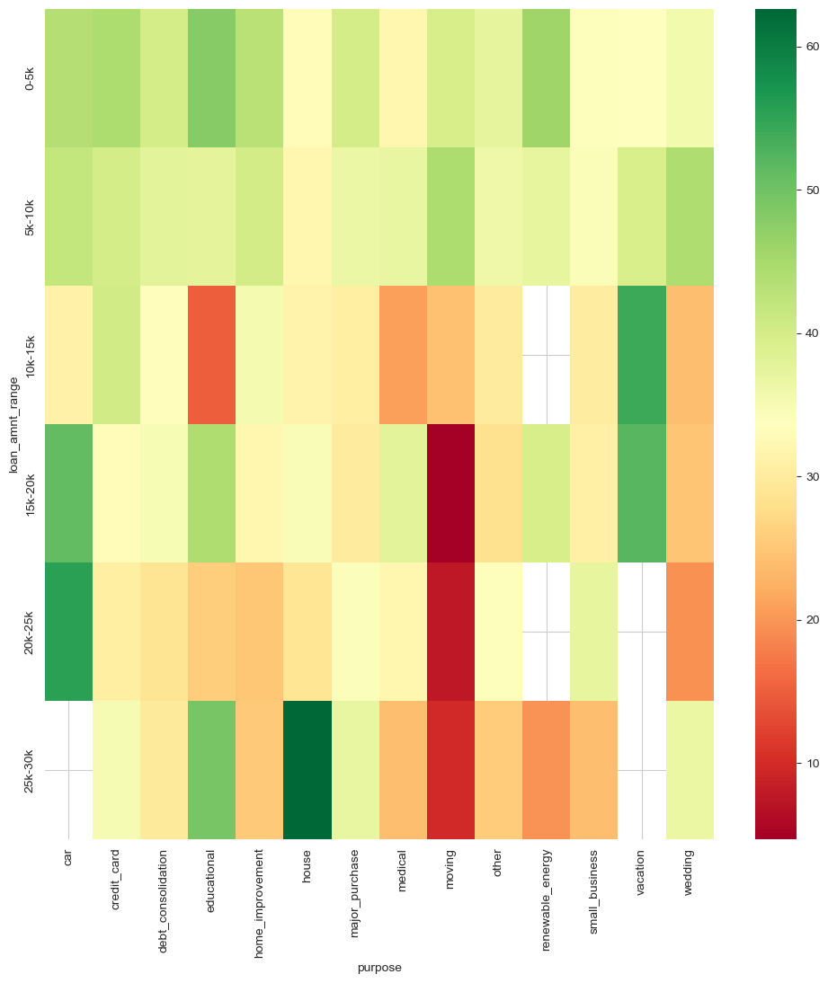
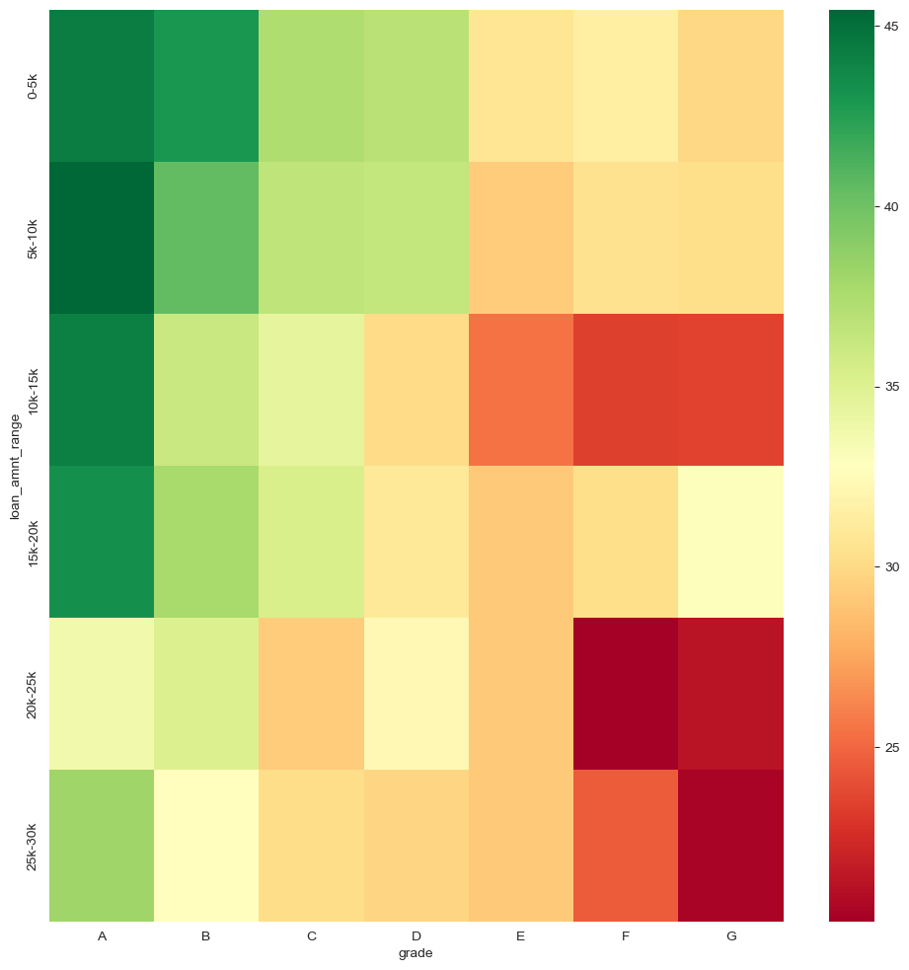
Bivariate Analysis of Charged Off Loans
Amongst all the categories, moving category seems to show exceptionally low PRR’s for Loan Amount > 15k and should be avoided or not supported.
As also pointed out earlier Loan Grade F and G tends to have effect on the loan principal recovery. These grade loans should be discontinued.

Slide 14
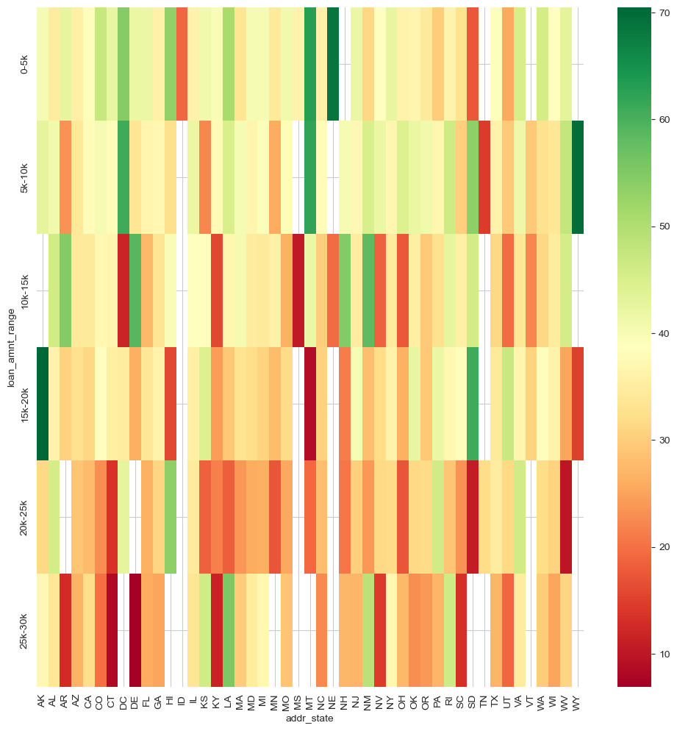
Bivariate Analysis of Charged Off Loans
General pattern is that the PRR decreases with the increase in the Loan Amount. However, few states are exceptional w.r.t the PRR and should be scrutinized. See the section below:
For Loan Amount 25k-30k:
states with least PRR: CT, DE
For Loan Amount 20k-25k:
states with least PRR: WV
For Loan Amount 15k-20k:
states with least PRR: MT
For Loan Amount 10k-15k:
states with least PRR: MS, DC

Slide 15
Bivariate Analysis of Charged Off Loans
General pattern is that the PRR decreases with the increase in the Loan Amount. However, few states are exceptional w.r.t the PRR and should be scrutinized. See the section below:
Annual Income 125k-150k:
states with least PRR: UT
Annual Income 100-125k:
states with least PRR: HI,NV
Annual Income 50k-75k:
states with least PRR: DE, SD
Annual Income 25k-50k:
states with least PRR: MS
Annual Income 0k-25k:
states with least PRR: VT

Slide 16
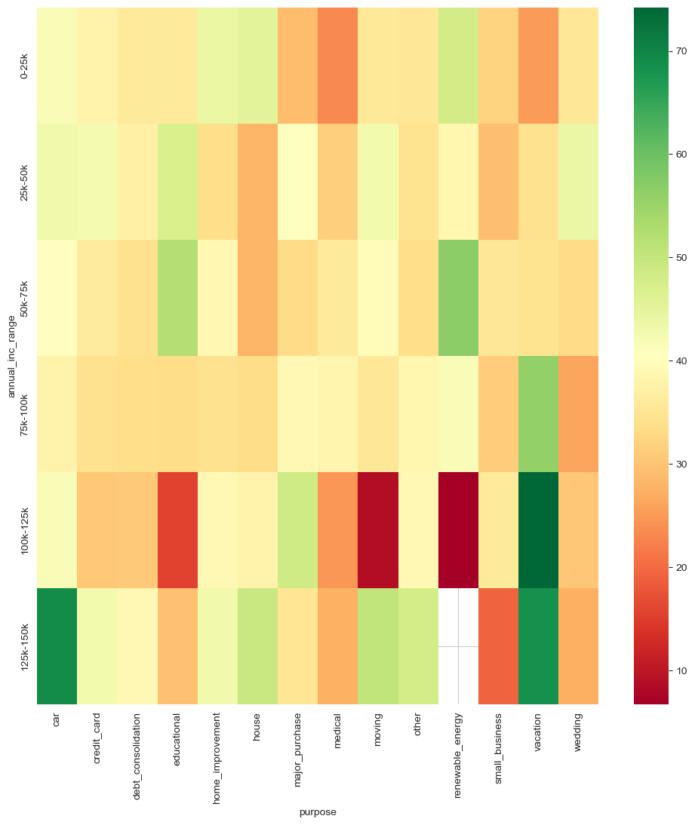
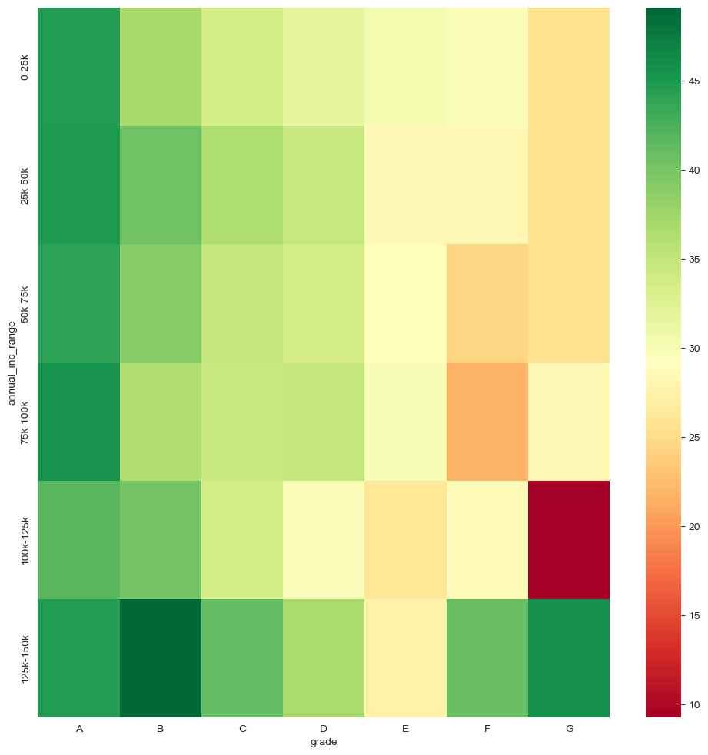
Bivariate Analysis of Charged Off Loans
Below category loans shows exceptionally lower PRR and should be avoided:
moving
renewable_energy
small_business
wedding
Loan Grades E, F, G tends to affects severely the repayment of loan irrespective of the annual income
The exceptionally high PRR for Loan Amount ~ 20-25k seems to be an outlier.

Slide 17
Conclusion
Minor Impact
Higher loan amount
(above 15k)
Applicant’s address state
(NV, SD, AK, ID, NE)
Higher debt to income ratio
(above 15%)
Credit utilization rate
(above 50%)
Major impact
Loan purpose
(small business, renewable energy, educational)
Loan Tenure
( 5 year loans tends to cause more defaults)
Public bankruptcy records
(1 or 2)
Higher interest rate
(above 20%)
Loan grade & sub-grade
(E, F, G)
Higher DTI's affect the payment of Higher Loan Amounts

