Slide 1

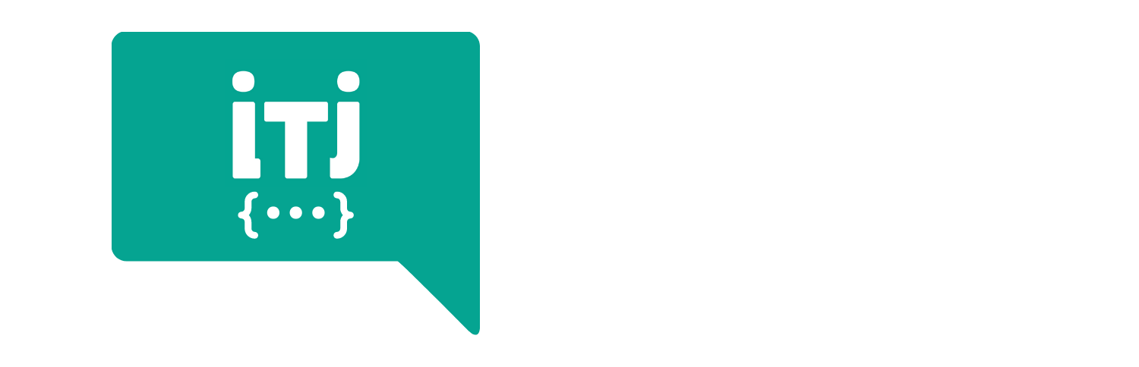
DevOps Bootcamp

Slide 2

HELLO!
I am Noothan Shah
I am here because I am passionate about DevOps.

Slide 3
Ansible Introduction

Slide 4
Agenda
Backstory
Infrastructure as code (IaC)
Configuration Management Tools
Ansible Components
Ansible vs. alternative tools
References & Further Learning

Slide 5
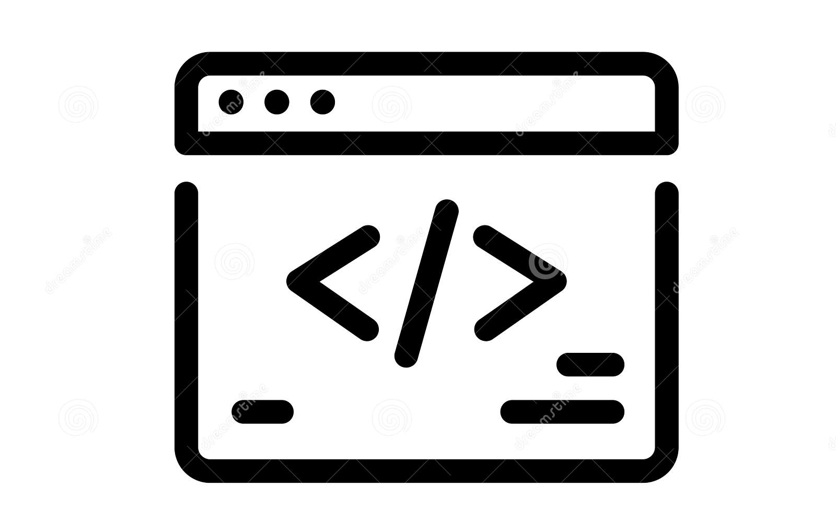
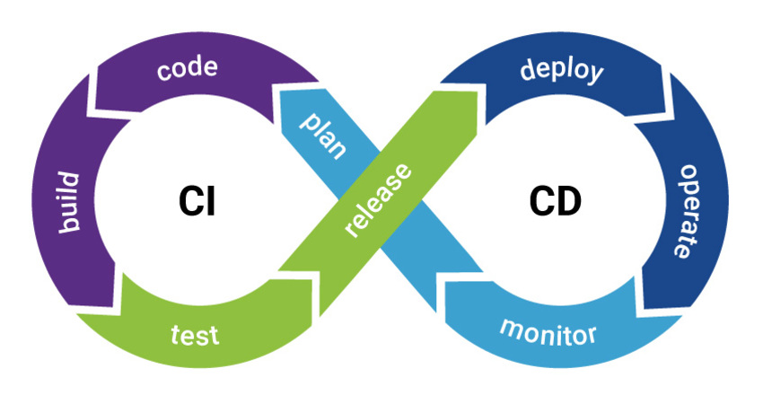


DevOps
Automated
Development
Operations
Manual

Slide 6





Operational Activities
Infrastructure Provisioning
Create User
Software Installation / upgrade
System Reboot
Assign Groups
Rollback

Slide 7
Infrastructure as code (IaC)
Benefits
Keep up with Development activities
Cost reduction
Increase in speed of deployments
Reduce errors
Improve infrastructure consistency
GitOps

Slide 8




Configuration Management Tools

Slide 9
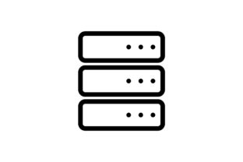
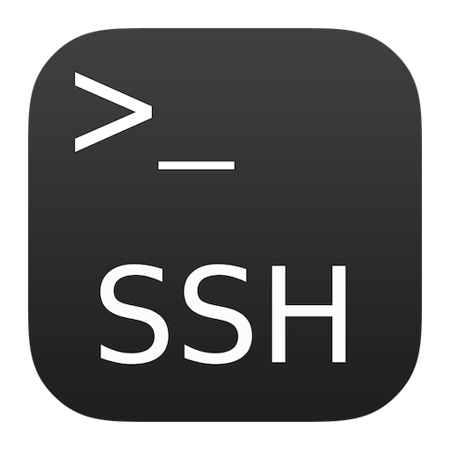

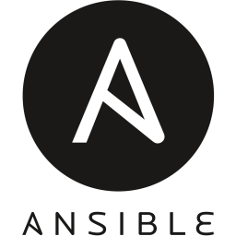
Ansible
Control Machine

Slide 10
Ansible Benefits
Execute tasks from a local machine – no ssh to individual machines
No maintenance on targets
yaml syntax
Re-use the same yaml file multiple times in different environments
More reliable – less errors

Slide 11
Ansible Components
Modules
Inventory
Play
Playbooks

Slide 12
Modules
Small programs that does actual work
Pushed from controller to target
Once task is done, module is removed.
Module
Module
Module
Module
Module
Module
Control Machine

Slide 13
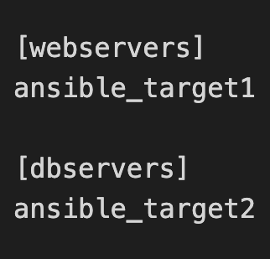
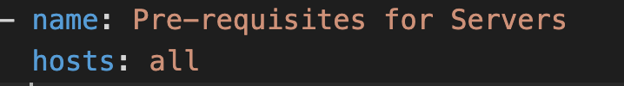

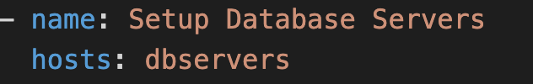
Ansible Inventory

Slide 14
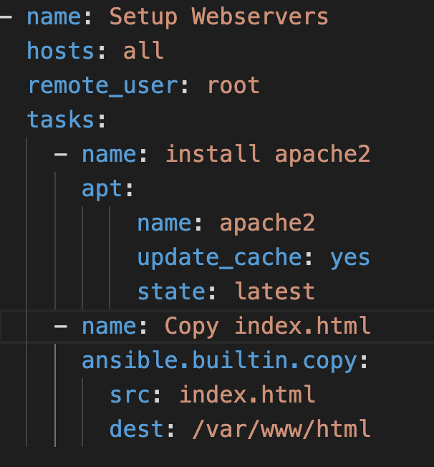
Ansible Play
Modules
Which Hosts
Which User
Arguments
Which Tasks
Tasks
Hosts

Slide 15
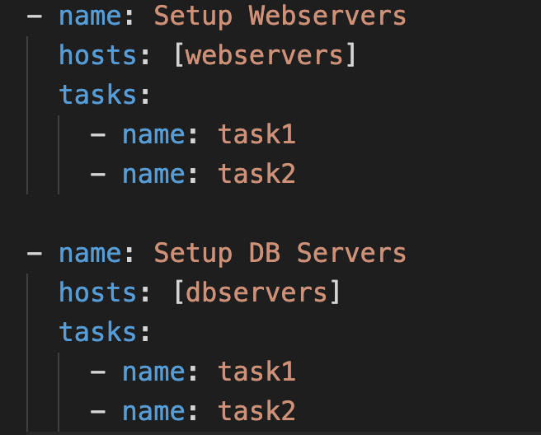
Ansible Playbooks
1 playbook = 1 or more plays
orchestrates

Slide 16
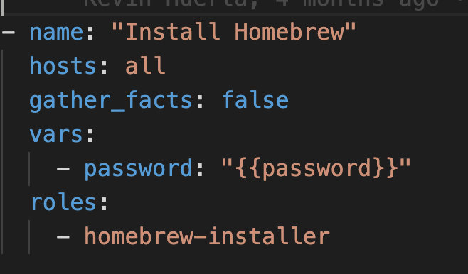
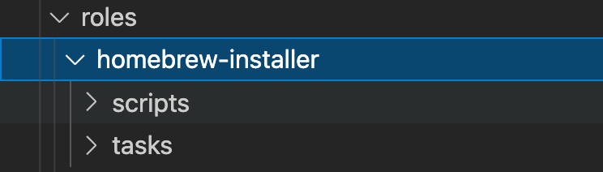
Roles
Handle complex IT tasks
Organized
Re-usable in different playbooks

Slide 17
Useful Commands
ansible –-version
ansible-doc <modulename>
ansible --list-host all

Slide 18
Alternatives
Ansible
Puppet and Chef
Simple Yaml
Agentless
No maintenance
Ruby
Installation needed in targets
Maintenance in all the targets

Slide 19
References & Further Learning
Ansible
Ansible Documentation
Best Practices
Ansible Collections
Ansible Tower

Slide 20
THANKS!
Any questions?
You can find me @noothanshah

