Slide 1


DevOps Bootcamp

Slide 2

HELLO!
I am Ricardo Rivas
Full Stack Engineer.

Slide 3
Docker
Containers

Slide 4
Agenda
Docker setup
Docker overview
Docker examples
Docker Compose

Slide 5
“Dockerize all the things!!”

Slide 6
Setup
Installation:
Mac: Download Docker desktop from here https://docs.docker.com/desktop/mac/install/
Windows: Download Docker for windows from here https://docs.docker.com/desktop/windows/install/
Ubuntu: Follow the instructions described here https://docs.docker.com/engine/install/ubuntu/

Slide 7
Setup
Examples:
Repository: https://github.com/itjuana-bootcamp/DevOps/tree/main/docker-examples
git clone git@github.com:itjuana-bootcamp/DevOps.git
cd docker-examples

Slide 8
Overview
Why do I need to learn docker?
No more “Works on my Machine”
No infrastructure needed
Lightweight
Fast
Can run everywhere

Slide 9
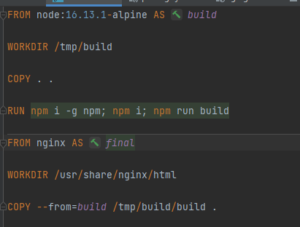
Dockerfile - NodeJS

Slide 10
Dockerfile - NodeJS
FROM
This tells docker what is going to be the starting image
This could be ubuntu, alpine, CentOS, Debian or any Linux flavor you want
There is a windows image on Docker Hub but I’ve never used it
You can use the keyword “AS” at the and to tell docker the stage name

Slide 11
Dockerfile - NodeJS

Slide 12
Dockerfile - NodeJS
WORKDIR
This allows you to setup the starting directory when login in into the container
It could also be represented by “.”

Slide 13
Dockerfile - NodeJS

Slide 14
Dockerfile - NodeJS
COPY
Allows you copy folders and files into your image
Using “COPY . .” will copy the entire content of the docker context into the image’s WORKDIR
The parameter --from=stage tells docker to copy files from another docker stage

Slide 15
Dockerfile - NodeJS

Slide 16
Dockerfile - NodeJS
RUN
Allows to run commands on your image, for example:
apk update
apk add git vim etc
Or any other POSIX command

Slide 17
Dockerfile – Basic Commands
build
run
stop
start

Slide 18
Dockerfile – NodeJS (Practice)

Slide 19
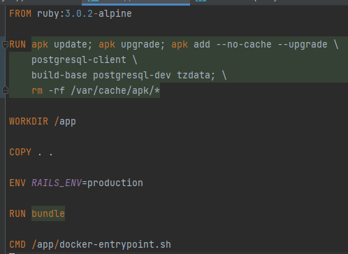
Dockerfile – Rails (Practice)

Slide 20
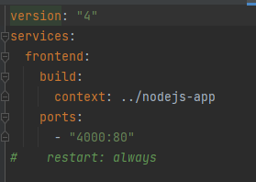
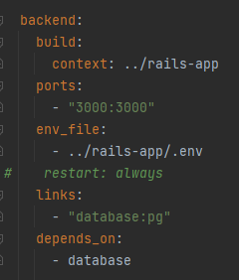
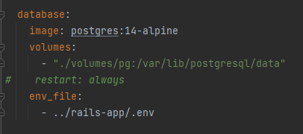
Docker Compose – Practice

Slide 21
THANKS!
Any questions?
You can find me as @richistron

