Slide 1
Introduction to
Java EE (J2EE)
Notes:
.

Slide 2
Session Objectives
Understanding the value propositions of J2EE
Getting a big picture of J2EE architecture and platform
Getting high-level exposure of APIs and Technologies that constitute J2EE
  You don't have to understand all the details
Understanding why J2EE can be used for as a platform for development and deployment of web services
  Umesh Bellur
Notes:
These are the session objectives.
At the end of this session, I expect you to get a big picture of J2EE architecture and platform. So I am trying to cover J2EE at 10,000 feet level. in this session.
I also expect you to understand the value propositions of J2EE, that is, why J2EE is the platform of choice for building and deploying enterprise applications.
I will also cover all the major API's and technologies that constitute J2EE in this session so that you know what they are and how they are related to each other.
Finally, I will talk about why J2EE is the platform of choice not only for building we-based based enterprise applications but also building web services.

Slide 3
What is J2EE?
  Umesh Bellur
Notes:
Now let's talk what J2EE really is, first.

Slide 4

Enterprise Computing
Challenges
Portability
Diverse Environments
Time-to-market
Core Competence
Assembly
Integration
Key Technologies
J2SE™
J2EE™
  JMS
  Servlet
  JSP
  Connector
XML
  Data Binding
  XSLT
Products
App Servers
Web Servers
Components
Databases
Object to DB tools
Legacy
Systems
Databases
TP Monitors
EIS Systems
  Umesh Bellur
Notes:
So what is enterprise computing? What are the challenges that enterprise application developers like yourselves are facing today? We all know the enterprise computing has come a long way from the old, mainframe-based, monolithic model where everything is lumped up together through the client-server model of early 1990s where fat clients are talking to backend databases directly to the current model where applications are web-based, n-tier, well-distributed over the heterogeneous environment where software are to be built as objects and components.
And of course, the set of challenges you face have changed as well. For a start, the applications you are building have to be portable, scalable, reliable, secure, maintainable, and of course, they have to function in high-performance. And they also have to be adaptable and flexibile to accommodate the constant changes in business requirements.
Given the challenges you face, you also have to decide which key technologies and products and architeural platform to use in order to meet those challenges. The problem is there are simply too many of them and it is hard to come up with your own architecture or framework where everything is in a well-integrated and cohesive form.
Another important issue you ask yourself is integration of legacy systems. That is, how are you going to integrate the existing database and EIS systems into the overall architecture?
These are all valid questions and issues of enterprise computing today. The good news is J2EE is specifically designed to address all these issues.

Slide 5
What Is the J2EE?
Open and standard based platform for
  developing, deploying and managing
  n-tier, Web-enabled, server-centric, and component-based enterprise applications
  Umesh Bellur
Notes:
What is J2EE? In short, it is an open, standard-based, development and deployment platform for building n-tier, web-based and server-centric, and component-based enterprise applications.

Slide 6

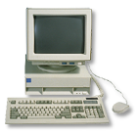
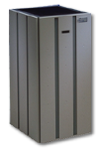


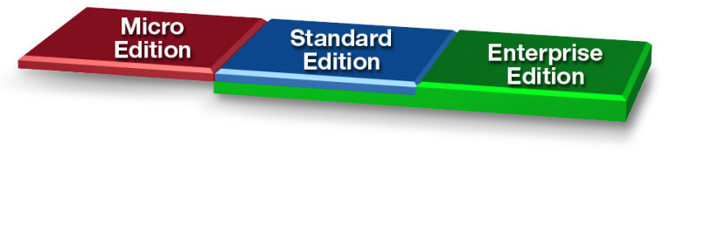
The Java™ Platform
Java Technology
Enabled Devices
Java Technology Enabled Desktop
Workgroup
Server
High-End
Server
  Umesh Bellur
Notes:
By now, most of you know there are three flavors of Java - Micro Edition, Standard Edition, and Enterprise Edition. These three flavors of Java represent three distinct target market segments each of which has unique issues and requirements that need to be addressed somewhat differently.
Micro Edition addresses of market segment of small devices such as PDAs, cell phones and settop boxe, which are typically constrained in terms of memory space and processing power.
Standard Edition represents the Java that we all know and love, a Java for desktop and workgroup server environments that require a full feature functionalities including rich graphical user interface.
Enterprise Edition covers the Java platform for developing and deploying enterprise qualitiy applications which are typically transactional, reliable and secure.
Also note that the “Enterprise Edition” box in the graphic extends into the standard edition, that is, Enterprise edition is built over standard edition.

Slide 7
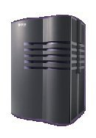
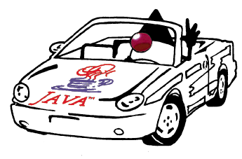

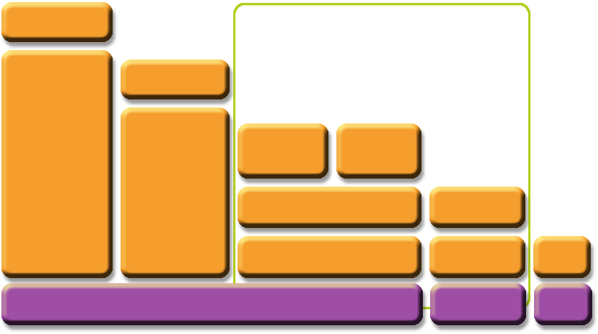





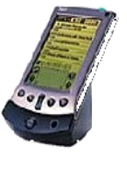

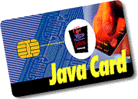
The JavaTM Platform
Java 2 Platform Micro Edition
(J2METM)
Optional
Packages
Optional
Packages
Personal
Basis Profile
Personal Profile
Java 2
Enterprise
Edition
(J2EE)
Java 2
Standard
Edition
(J2SE)
Foundation Profile
MIDP
CDC
CLDC
Java Card APIs
JVM
KVM
CardVM
* Under development in JCP
Notes:
This is another picture that shows three flavors of Java technology. Java is being used at JavaCard at one end and at the supercomputer at the other end.
The key point in this picture is that the syntax and semantics of Java programming language is preserved regardless of which edition you use. And regardless where it is being used, it provides the secure, portable, and robust application development and deployment platform.

Slide 8
What Makes Up J2EE?
API and Technology specifications
Development and Deployment Platform
Standard and production-quality implementation
Compatibility Test Suite (CTS)
J2EE brand
J2EE Blueprints
Sample codes
  Umesh Bellur
Notes:
So now some of you might be ready to ask “What exactly do I get from J2EE?” . This slide shows the list of things that come with J2EE.
First and foremost, J2EE is a set of API and technology specifications. And we will see the detailed list of APIs and technologies of J2EE in the following slide.
J2EE also provides you with a standard development and deployment platform. What does this mean? From developer’s perspective, it means is that J2EE provides a standard framework of building server components. From platform vendors’ perspective, it means their platforms should be able to run any applications that uses J2EE-compliant APIs.
Reference implementation and compatibility suite. Just like any other Java initiative based on Java community process, J2EE also comes with its own reference implementation and compatibility test suite. J2EE is also a brand of all compliant products. That is, J2EE compliant app servers are stamped with J2EE branding after they passed regorous J2EE compatibility testing.
Finally, J2EE also provides something unique called J2EE BluePrints, which is a documentation and sample program in which best practice guidelines and design principles for building J2EE-based enterprise applications are described in detail.

Slide 9
Open and Standard Solution
Use "component and container" model in which container provides system services in a well-defined and as industry standard
J2EE is that standard that also provides portability of code because it is based on Java technology and standard-based Java programming APIs
  Umesh Bellur
Notes:
Open and standard based solution is that a standard specification defines the contract of the component and container model in a well-defined and in an industry-standard.
And J2EE is that standard. And because it is based on Java technology, the portability of code also can be achieved regardless underlying OS or hardware architecture.

Slide 10
Why J2EE?
  Umesh Bellur
Notes:
OK, by now, I assume you get the sense of how enterprise application architecture has evolved into what it is today, namely open standard basedJ2EE framework.
Now I would like to spend some time talking about the concrete value that J2EE provides to different players in the scene of enterprise computing.

Slide 11
Platform Value to Developers
Can use any J2EE implementation for development and deployment
  Use production-quality standard implementation which is free for development/deployment
  Use high-end commercial J2EE products for scalability and fault-tolerance
Vast amount of J2EE community resources
  Many J2EE related books, articles, tutorials, quality code you can use, best practice guidelines, design patterns etc.
Can use off-the-shelf 3rd-party business components
  Umesh Bellur
Notes:
First, let's talk about J2EE platform value to developers.
Now with J2EE, developers do not have to be tied up with particular vendor platform because they can use any J2EE-compliant implementation as their development platform while application portability is still guaranteed. For example, you can use freely available J2EE implementations such as Sun Java System App Server Platform Edition for development while you might want to use high-end commercial platforms for actual production deployment especially when scalability, reliability, fault-tolerance, and high-performance are important factors.
Second,J2EE is, for that matter, Java, is all about community. There is vast amount of J2EE community resource that be leveraged by J2EE developers, for example, books, articles, tutorials, and quality code that you can use, best practice guidelines and design patterns people have spent time to develop. If you think about it, these are very significant value.
Thirdly, because J2EE is based on component model, that is, 3rd party components can be used to build enterprise applications thus saving time and money.

Slide 12
Platform Value to Vendors
Vendors work together on specifications and then compete in implementations
  In the areas of Scalability, Performance, Reliability, Availability, Management and development tools, and so on
Freedom to innovate while maintaining the portability of applications
Do not have create/maintain their own proprietary APIs
  Umesh Bellur
Notes:
So what are the J2EE value proposition to vendors? First vendors work together on creating specifications and then they compete in implementations. And the areas they compete include scalability, performance, reliability, availability, management and development tools, and so on.
This way, vendors have freedom to innovate in their implementations while maintaining the portability of their applications. So bottom line is that vendors can influence the future of Java while they can continue to innovate.
And vendors are free from having to maintain their own proprietary APIs. Instead they focus on better implementations.

Slide 13
Platform Value to Business Customers
Application portability
Many implementation choices are possible based on various requirements
  Price (free to high-end), scalability (single CPU to clustered model), reliability, performance, tools, and more
  Best of breed of applications and platforms
Large developer pool
  Umesh Bellur
Notes:
Now what about the business customers? First and foremost, to customers, application portability is guaranteed, which means they can choose best of breed applications as well as best of breed platforms based on many criteria, for example, price, scalability, reliability, and performance, and tools, and so on.
There are large developer pool they can tap with. And then they can use many quality open source implementations such Tomcat, Struts, Cocoon, and Axis and so on, over the J2EE platform

Slide 14
J2EE APIs &
Technologies
  Umesh Bellur
Notes:
Now let's talk J2EE APIs and technologies. I don't intend to give detail description of these technologies here since we have the remaining sessions talking about these technologies in detail. But I want to give you a big picture so that you understand where these individual technologies fit in under the big picture of J2EE. So if you don't understand the details of these technologies, don't worry about it. Instead just get some sense on the roles these technologies play for particular application requirements.

Slide 15
J2EE 1.4 APIs and Technologies
J2SE 1.4 (improved)
JAX-RPC (new)
Web Service for J2EE
J2EE Management
J2EE Deployment
JMX 1.1
JMS 1.1
JTA 1.0
Servlet 2.4
JSP 2.0
EJB 2.1
JAXR
Connector 1.5
JACC
JAXP 1.2
JavaMail 1.3
JAF 1.0
  Umesh Bellur
Notes:
So this is the summary slide of all Java APIs and technologies that will be part of J2EE 1.4. I put it here for your reference. The ones in red color are newly added features while the ones in blue color are the ones whose functionality is enhanced from the previous version.

Slide 16
Java EE 5
JAX-WS 2.0 & JSR 181
Java Persistence
EJB 3.0
JAXB 2.0
JavaSever Faces 1.2 – new to Platform
JSP 2.1 – Unification w/ JSF 1.2
StAX – Pull Parser – new to Platform
  Umesh Bellur

Slide 17
Servlet &
JSP (JavaServer Pages)
  Umesh Bellur
Notes:
OK. Let's talk about servlet and JSP, which are cornerstone technologies of J2EE.

Slide 18
What is a Servlet?
Java™ objects which extend the functionality of a HTTP server
Dynamic contents generation
Better alternative to CGI, NSAPI, ISAPI, etc.
  Efficient
  Platform and server independent
  Session management
  Java-based
  Umesh Bellur
Notes:
What is Servlet? A servlet is a Java object that extends the functionality of HTTP server by providing the capability of dynamic contents generation.
Now you might remember that people used to use CGI for dynamic contents generation. “What is wrong with CGI?” Lots of things. First, inefficiency. In CGI, every HTTP request from client results in a creating of a new process, even if they are from a same client, which is quite inefficient and of course because of that, cannot scale to handle large number of clients at the same time.
The servlet technology is designed to solve these problems associated with using CGI, or proprietary APIs such as NSAPI or ISAPI. For example, Servlet handles the HTTP client requests much more efficiently than CGI because it does not have to create new process every time there is a new client request. Instead, it creates a new thread. Because it is Java and because it is standard-based, most of the web servers out there support servlet. It also handles session management for you so that you don’t have to deal with it yourself. By being Java code, it is cross-platform technology as opposed to vendor-specific or product-specific technologies such as NSAPI or ISAPI.

Slide 19
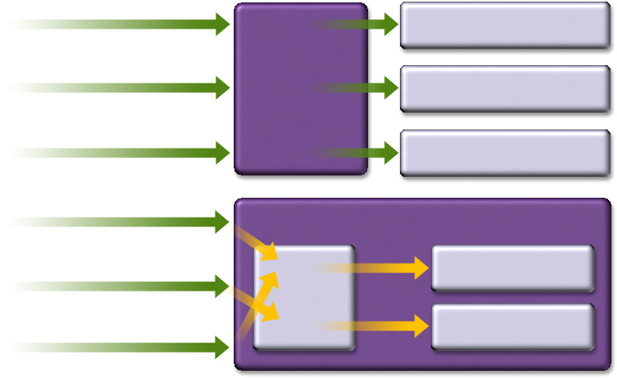

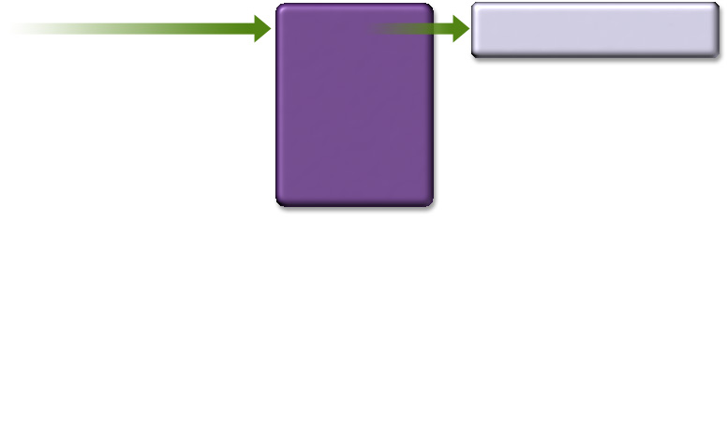
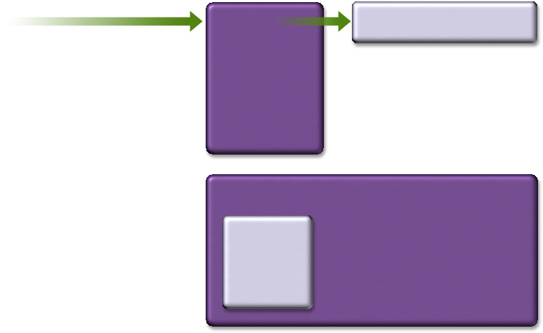
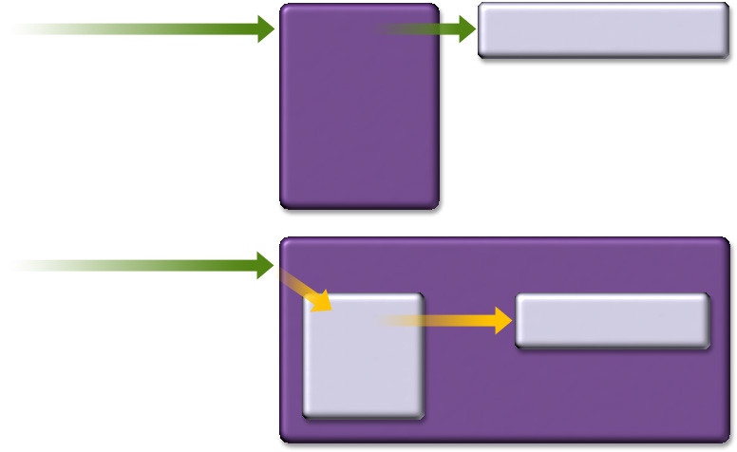
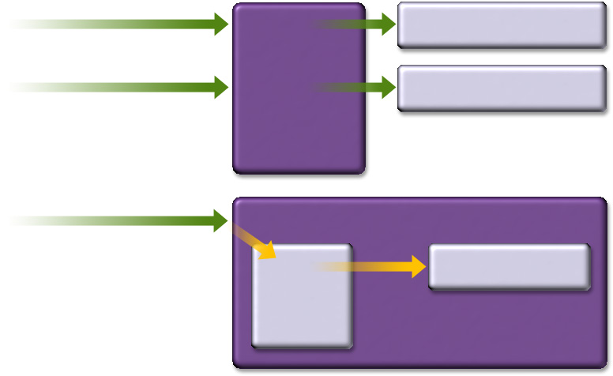
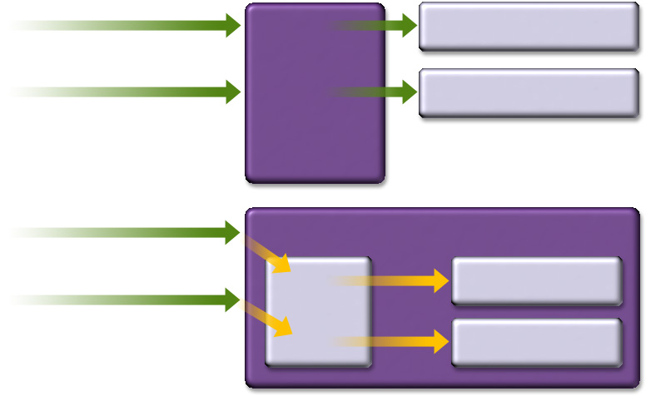
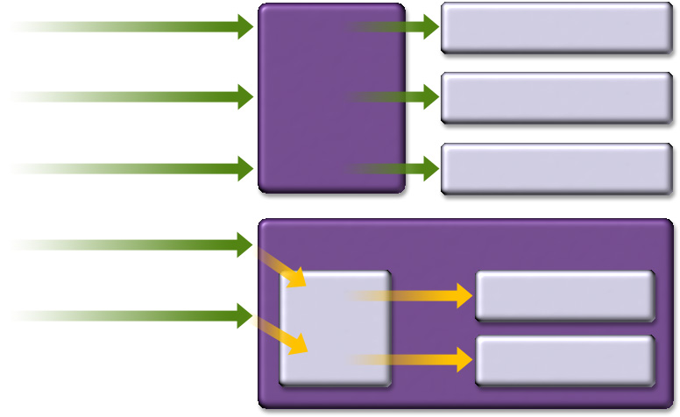
Servlet vs. CGI
Request CGI1
Request CGI1
Request CGI1
Request CGI1
Request CGI1
Request CGI1
Request CGI1
Child for CGI1
Child for CGI1
Child for CGI1
Child for CGI1
Child for CGI1
Child for CGI1
Child for CGI1
CGI
Based
Webserver
CGI
Based
Webserver
CGI
Based
Webserver
CGI
Based
Webserver
CGI
Based
Webserver
CGI
Based
Webserver
CGI
Based
Webserver
Request CGI2
CGI
Based
Webserver
Request CGI2
Request CGI2
Request CGI2
Child for CGI2
Child for CGI2
Child for CGI2
Child for CGI2
Request CGI1
Request CGI1
Child for CGI1
Child for CGI1
Request Servlet1
Request Servlet1
Request Servlet1
Request Servlet1
Request Servlet1
Servlet Based Webserver
Servlet Based Webserver
Servlet Based Webserver
Servlet Based Webserver
Servlet Based Webserver
Servlet Based Webserver
Request Servlet2
Servlet1
Servlet1
Servlet1
Servlet1
Request Servlet2
Servlet1
Request Servlet2
JVM
JVM
JVM
JVM
JVM
JVM
Request Servlet1
Servlet2
Servlet2
Servlet2
  Umesh Bellur
Notes:
This picture shows difference between CGI and servlet-based model. In CGI, for every HTTP request, a new process has to be created while in servlet model, it is the thread that gets created in the same Java VM (Virtual Machine) and that thread can stay there for serving other requests.

Slide 20
What is JSP Technology?
Enables separation of business logic from presentation
  Presentation is in the form of HTML or XML/XSLT
  Business logic is implemented as Java Beans or custom tags
  Better maintainability, reusability
Extensible via custom tags
Builds on Servlet technology
  Umesh Bellur
Notes:
JSP, Java Server Pages, was introduced as a follow-on technology to the Servlet. Even though the Servlet solves many problems associated with CGI for dynamic contents generation, it has one downside. The downside is that, under Servlet, the presentation, typically HTML pages, has to be generated as part of the servlet Java code, for example, using printf statement. What this means is that whenever you have to make some change to the presentation, the Java code has to be changed and then recompiled, redeployed. This in turn result in maintenance problem of your applications. Also it makes web-page prototyping effort rather a difficult task.
JSP is designed to address of this shortcoming of the Servlet while maintaining all the benefits of Servlet. That is, it provides a clear separation between the presentation and business logic code. That is, the presentation will be designed by Web page designers in the form of either HTML or XML or JSP page while the business logic will be implemented by Java programmers either in the form of Java Beans or custom tags. This separation will result in a better maintainability of both presentation pages and business code. And because the business logic is encapsulated into Java beans or custom tags, it increased reusability of the code as well.
I mentioned about custom tags. Custom tags are basically specialized Java beans which encapsulate the application-specific business logic. The functionality of enterprise applications can be extended by building more custom tags.
Finally, JSP technology is built over servlet. In fact, JSP pages when deployed get converted into servlet first. Because it is built over servlet, it maintains all the benefits of servlet. For example, all the ready-to-use objects in a servlet such as session objects can be also available to JSP page designers and custom tag developers.

Slide 21
EJB
(Enterprise Java Beans)
  Umesh Bellur

Slide 22
What is EJB Technology?
A server-side component technology
Easy development and deployment of Java technology-based application that are:
  Transactional, distributed, multi-tier, portable, scalable, secure, …
  Umesh Bellur
Notes:
What is EJB? In short, it is a server-side component technology, which enable the easy development and deployment of Java-based enterprise applications in the form of components that have to be enterprise-quality, meaning they are transactional, distributed, multi-tier, portable, scalable, secure, and reliable, and the list can go on.

Slide 23
Why EJB Technology?
Leverages the benefits of component-model on the server side
Separates business logic from system code
  Container provides system services
Provides framework for portable components
  Over different J2EE-compliant servers
  Over different operational environments
Enables deployment-time configuration
  Deployment descriptor
  Umesh Bellur
Notes:
Why EJB? By providing a standard component model on the server side, it leverages all the benefits that are inherent in component technology, for example, simplified development and deployment and reuse of the code.
Another key benefit of EJB is the separation of business logic from system code. That is, the EJB server platform provides all the system services such as resource management, transaction coordination and persistence management. Since the system services are provided by the server platform itself, you, as a developer, can now focus your development effort to building business logic components rather than system code.
Because EJB is built around industry-standard component framework, because it is based on Java, it allows portability of your components. That is, the business logic components you build will be portable across different vendors’ server platforms as well as different operational environments without any change in your code or without even recompiling. It is truly binary portability we are talking about.
Now you might want to ask? How do these components adapt themselves to the different operational environments? That is, different operational environments have different requirements on security policy, they have different databases in place , different transactional model maybe have to be used. How do you instruct your business components to a different behavior without actual change of code? It is done by what is called deployment descriptor. The deployment descriptor is essentially an XML file that specifies the runtime behavioral characteristics of your business component. And it gets constructed or changed at the time of deployment not at the time of code development.

Slide 24
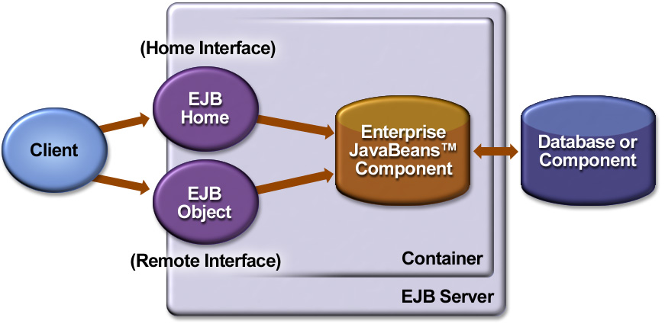
EJB Architecture
  Umesh Bellur
Notes:
This picture shows a somewhat simplified architecture of EJB. We will talk about the concept of containers and components later on. But a key architectural concept of EJB is that there is a separation of business logic components from the hosting execution environment in which those components are running. The business logic components under EJB architecture are represented as EJB beans while the hosting environment is represented by EJB container (sometimes called as EJB server).
As a business component developer, you have to write three Java files and a deployment descriptor. First you have to write EJB home interface which defines the methods that will be used by clients in order to create and locate your bean through the container. Second, you have to write EJB remote interface which defines the business methods of your bean. Finally, you will build your bean and deployment descriptor which specifies which Java interface is home interface and which Java interface is remote interface, and which class is in fact your bean class.
Now container, at the time of deployment of your beans, will create two internal and intermediary objects, EJB home object and EJB remote object. These objects are implementation of home and remote interface you have defined. So when the client wants to invoke some business methods of the EJB bean you created, it is actually talking to these two intermediary objects instead. Why this indirection? This is to allow the container to intercept the calls so that it can provide system services such as security, transaction, persistence, resource management, life cycle management, and so on.

Slide 25
Enterprise JavaBeans
Enterprise JavaBeans
Synchronous communication
Asynchronous communication
Session Bean
Entity Bean
Message-Driven Bean
Stateless
Stateful
Bean managed
Persistence
(BMP)
Container managed
Persistence
(CMP)
  Umesh Bellur
Notes:
Now EJB has three bean type - session bean, entity bean, and message driven bean. And session bean can be either stateful or stateless session bean. And entity bean can be either bean managed or container managed.
And you as a developer choose which bean type to use depending on the needs and requirements of your application. For example, you use session bean when you have to have a client session and you use entity beans to reflect persistent data and you use message driven bean to receive messages in an asynchronous fashion. And we will talk about these bean types and their usage in gory detail later in this course.

Slide 26
JMS
(Java Message Service)
  Umesh Bellur
Notes:
Now let’s talk about JMS, Java Messaging Service. The Java Message Service (JMS) API has been developed by Sun working in close cooperation with the leading enterprise messaging vendors.

Slide 27
Java Message Service (JMS)
Messaging systems (MOM) provide
  De-coupled communication
  Asynchronous communication
  Plays a role of centralized post office
Benefits of Messaging systems
  Flexible, Reliable, Scalable communication systems
Point-to-Point, Publish and Subscribe
JMS defines standard Java APIs to messaging systems
  Umesh Bellur
Notes:
Messaging has been around for quite a while even before JMS as a way to build reliable, flexible, and scalable communication system. Some of you might have heard the term, Message-Oriented-Middleware, or MOM in short. In fact, in the mainframe world, product like IBM’s MQ_Series has been around for quite a while. Now let’s talk about the concept of messaging and get some sense of what it is and why you want to use it and when you want to use it.
Messaging enables de-coupled communication (or sometimes called loosely coupled communication) in that the sender does not have to know the details of the receiver, for example, the sender does not have to know whether a receiver is a live process or not or the location information of it such as IP address or port number. Instead the sender and receiver of messages communicate via an intermediary communication framework called messaging system. This is a departure from tightly-coupled communication systems such as RPC, socket, or RMI in which the communicating parties are talking each other directly instead of an intermediary server. In this sense, messaging server functions like a post office. It provides an asynchronous communication in that a sender of a message does not have to wait for an acknowledgment from the receiver. Or the receiver of the message can be notified when a message arrives. And because the sender and receiver are de-coupled, the only means of communication is via sending and receiving messages.
The benefits of using messaging system is that it provides a flexible, reliable, and scalable communication systems. For example, it provides flexible communication system because the sender and receiver do not have to know each other, it provides reliable communication system because the intermediary server handle persistently maintain the message until there is an acknowledgment from the receiver. It is scalable because the system can handle larger number of clients by adding more server capability at the messaging system itself.
I mentioned that under the model of de-coupled communication, there is an intermediary communication framework called messaging system. And it is this underlying messaging system, by playing a role of a post office, that provides necessary support so that applications can send or receive messages.

Slide 28
Connector Architecture
  Umesh Bellur

Slide 29
Connector Architecture
Defines standard API for integrating J2EE technology with EIS systems
  CICS, SAP, PeopleSoft, etc.
Before Connector architecture, each App server has to provide an proprietary adaptor for each EIS system
  m (# of App servers) x n (# of EIS's) Adaptors
With Connector architecture, same adaptor works with all J2EE compliant containers
  1 (common to all App servers) x n (# of EIS's) Adaptors
  Umesh Bellur
Notes:
As more businesses move towards an e-business strategy, integration with existing Enterprise Information Systems (EIS) becomes a key to success. Enterprises with successful e-businesses need to integrate their existing EISs with new web-based applications. They need to extend the reach of their EISs to support business-to-business (B2B) transactions.
Before the J2EE Connector architecture was defined, no specification for the Java platform addressed the problem of providing a standard architecture for integrating EISs to J2EE application server in a standard-fashion. Most EIS vendors and application server vendors use non-standard vendor-specific adaptors to provide connectivity between application servers and enterprise information systems.
The J2EE Connector architecture provides a Java solution to the problem of connectivity between the many application servers and EISs already in existence. By using the J2EE Connector architecture, EIS vendors no longer need to customize their product for each application server. Application server vendors who conform to the J2EE Connector architecture do not need to add custom code whenever they want to add connectivity to a enterprise information system. So it solves the m (appservers) times n (enterprise information systems) adaptor problem. That is with connector architecture, the number of adaptors that need to be developed are the same number of enterprise information systems since a common adaptor can be used for all J2EE compliant application servers.

Slide 30
m x n Problem Before Connector Architecture
m
n
App
Server1
SAP
App
Server2
EIS2
App
Server3
EIS3
App
Server
EIS4
  Umesh Bellur
Notes:
So this picture shows the m times n adaptor problem before connection architecture. Again, the connector architecture will reduce it to 1 times n adaptor scenario.

Slide 31
JAAS (Part of J2SE 1.4)
(Java Authentication &
Authorization Service)
  Umesh Bellur
Notes:
Now let's talk about a bit on JAAS, Java Authentication and Authorization Service. It is now part of J2SE 1.4. That is, every J2SE 1.4 should have JAAS. Before J2SE 1.4, it used to be an optional package and J2EE 1.3 specifies that JAAS is to be supported by any J2EE 1.3 compliant implementation.

Slide 32
JAAS: Authentication
Pluggable authentication framework
  Userid/password
  Smartcard
  Kerberos
  Biometric
Application portability regardless of authentication schemes underneath
  JAAS provides authentication scheme independent API
  Authentication schemes are specified Login configuration file, which will be read by JAAS
  Umesh Bellur
Notes:
JAAS addresses both authentication and authorization. So let's talk about authentication aspect of JAAS first.
JAAS provides pluggable authentication framework. It is expected that different business organizations would employ different authentication schemes. Examples of authentication schemes they might use include userid/password based authentication, smartcard, Kerberos, or Biometric authentication.
The idea of JAAS pluggable authentication framework is to allow Java application that performs the authentication to be portable regardless of the underlying authentication schemes. So JAAS provides authentication scheme independent API that can be used by the Java application. There is also login configuration file that contains information on the authentication schemes that are deployed for a particular operational environment. And this login configuration file will be read by JAAS runtime.

Slide 33
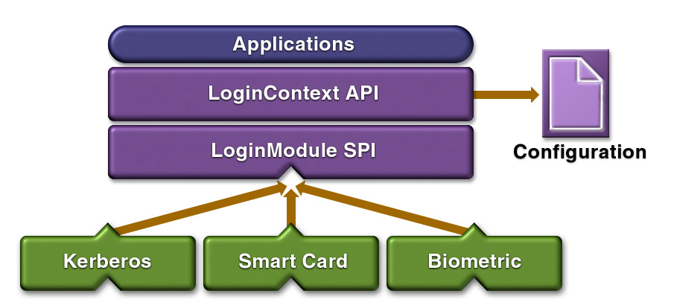
JAAS Pluggable Authentication
  Umesh Bellur
Notes:
This picture shows the pluggable authentication framework of JAAS. The application uses the API that is provided by the JAAS runtime implementation. So the boxes of purple color represents the implementation code that is provided by the JAAS. And this code reads the login configuration file during runtime. And each authentication scheme should provide a class file that is compliant to loginModule service provider interface that JAAS architecture defines.

Slide 34
Other J2EE APIs &
Technologies
  Umesh Bellur
Notes:
Now let's go over other Java programming APIs and technologies that constitute J2EE.

Slide 35
JNDI
Java Naming and Directory Interface
Utilized by J2EE applications to locate resources and objects in portable fashion
  Applications use symbolic names to find object references to resources via JNDI
  The symbolic names and object references have to be configured by system administrator when the application is deployed.
  Umesh Bellur
Notes:
JNDI stands for Java naming and directory interface and it is a common method for locating resources or objects under J2EE framework.
JNDI is utilized by J2EE applications to locate resources and objects in a portable fashion. That is, in your application, you are using a symbolic name to refer an object assuming that symbolic name has been configured to real object reference or resource by the system administrator. Because the system administrator can configure the association of the symbolic name and actual object at the time of deployment, the code portability is still assured.

Slide 36
JDBC
Provides standard Java programming API to relational database
  Uses SQL
Vendors provide JDBC compliant driver which can be invoked via standard Java programming API
  Umesh Bellur

Slide 37
J2EE Management (JSR-77)
Management applications should be able to discover and interpret the managed data of any J2EE platform
Single management platform can manage multiple J2EE servers from different vendors
Management protocol specifications ensure a uniform view by SNMP and WBEM management stations
Leverages JMX
  Umesh Bellur
Notes:
With J2EE 1.2 and recently with 1.3, pretty much all architectural components that are considered as fundamental aspects of J2EE have been standardized. During the past year or so, J2EE community also has been working on tools standardization mainly in the areas of management, deployment, performance bench mark, and portability because they felt that as more and more J2EE applications and platforms are being deployed, these issues are increasingly becoming more important.
So let's talk about, the J2EE Management Specification effort, JSR-77, first. The goal of JSR-77 is to provide server vendors and tool vendors with a standard model for managing the J2EE Platform.
What are the things J2EE management is trying to address? First, management applications should be able to discover managed objects and then interpret the data collected in a standard fashion.
Second, a single management platform should be able to manage multiple J2EE servers which might be from different vendors.
Thirdly, uniform view should be presented regardless what management protocols are used to access the data. For example, whether data is collected using SNMP or WBEM, the data should be consistent.
Finally it leverages JMX (Java Management Extension), which is an framework and APIs for creating Java based management agents.

Slide 38



J2EE Deployment (JSR-88) - J2EE 1.4
Tools
J2EE Platforms
Standard
Deployment API
(Universal Remote)
IDEs
Vendor Deploy Tools
Management Tools
  Umesh Bellur
Notes:
Now let's talk about J2EE deployment.
J2EE platform vendors currently implement their own proprietary deployment interface to their server because there is no standard deployment API. This makes it cumbersome for companies who need to deploy J2EE applications over J2EE platforms from different vendors, because they must run the different deploy tool for different servers.
A standard deployment API will enable any J2EE application to be deployed by any deployment tool that uses the deployment APIs onto any J2EE compatible environment. In this sense, the standard deployment API functions as a universal remote control that can be used to perform the deployment process over multiple J2EE platforms from different vendors.

Slide 39
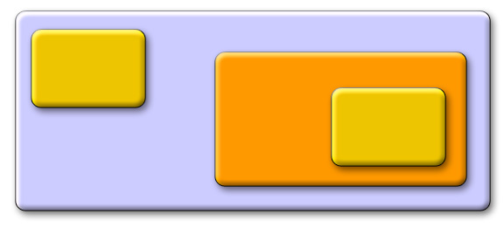
JMX
JMX API into
the J2EE 1.4 platform
Dynamic Deployment
JMX
JMX
App
J2EE App Server
JMX defacto
A single technology for the J2EE platform
  Umesh Bellur

Slide 40
J2EE is an End-to-End
Architecture
  Umesh Bellur
Notes:
Now let's talk about J2EE as an end-to-end architecture. One important aspect of J2EE as an architecture is that it covers end-to-end. That is, it covers from the client tier on the left all the way to the enterprise information systems on the rightmost tier.

Slide 41
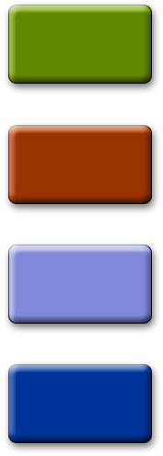
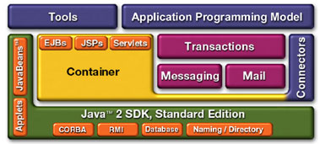
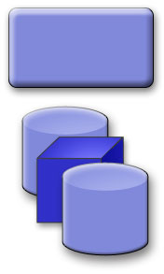
The J2EE Platform Architecture
B2B
Applications
Existing
Applications
B2C
Applications
Web
Services
Application Server
Enterprise
Information
Systems
Wireless
Applications
  Umesh Bellur
Notes:
This is somewhat simplified J2EE platform architecture. The key point in the picture is that regardless of who is the user of the service that is provided by the J2EE, that is, whether it is B2B application, or B2C application, or web services client, or J2ME based wireless devices, J2EE platform is the platform of choice for implementation because it provides highly scalable, highly available, highly reliable, and high performing implementation platform regardless of the fact that whether the services are exposed as web services or not.

Slide 42
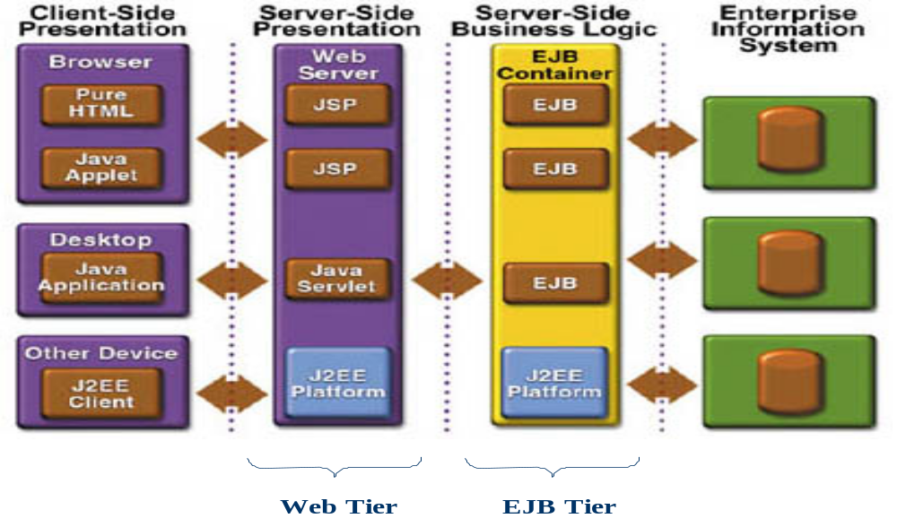
N-tier J2EE Architecture
  Umesh Bellur
Notes:
This picture shows the same architecture in which web-tier and EJB tier are more clearly divided.

Slide 43
J2EE
Component & Container
Architecture
  Umesh Bellur
Notes:
OK, one of the most significant architectural characteristics of J2EE, in my mind, is its component and container model. So let's talk about it in a bit more detail.

Slide 44
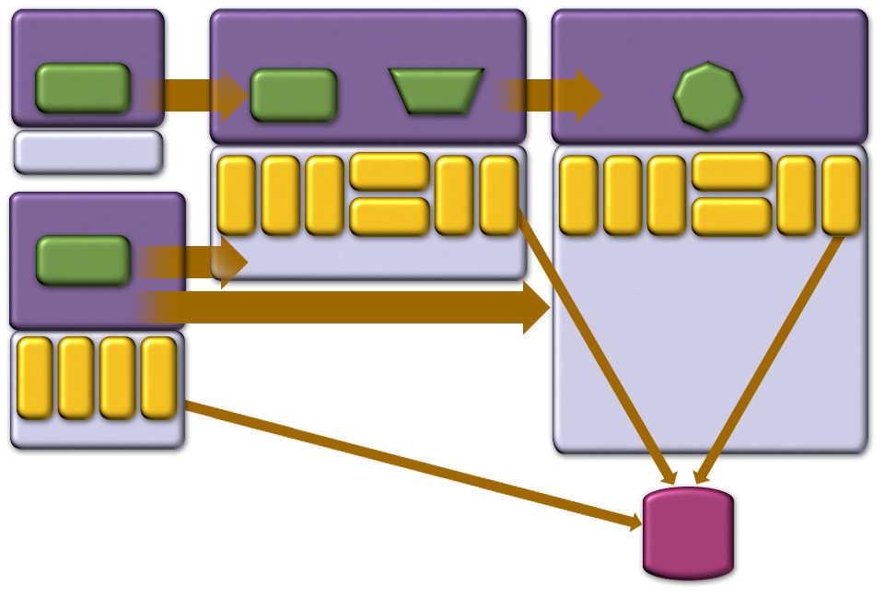
J2EE Containers & Components
Applet Container
Web Container
EJB Container
Applet
HTTP/
HTTPS
JSP
Servlet
RMI
EJB
J2SE
JavaMail
JavaMail
JNDI
JMS
JTA
RMI/IIOP
JDBC
App Client Container
JDBC
JNDI
JMS
JTA
RMI/IIOP
JAF
JAF
App
Client
HTTP/
HTTPS
J2SE
RMI
JNDI
RMI/IIOP
JMS
JDBC
J2SE
J2SE
Database
  Umesh Bellur
Notes:
This is what I call the J2EE Container & components diagram. As this diagram illustrates, containers and components are the key concepts of J2EE.
As for the relationship between components and containers, as you might have guessed it, the components are running within containers. That is, the containers provides the host execution environments for the components. In this picture, the components are colored in green and the containers are in purple. The types of components within J2EE environment are
•Client components that are running on client either as a stand-alone or applet
JSP or servlet as web components running inside web container
•EJB beans as business components running inside EJB container
And you developers are responsible for the implementation of these components. On the other hand, the containers are provided by the platform vendors. The containers provide runtime system services such as life-cycle management of the components, transaction coordination, persistence management, resource pooling
The containers are also responsible for providing the enterprise APIs, shown in gold, and the distributed communication protocols, shown in brown.
In a typical multi-tier, thin client enterprise application, most of the development effort will be focused on building web-tier components at web-tier and enterprise Java beans at EJB tier..

Slide 45

Containers
Handle
Components
Handle
Concurrency
Security
Availability
Scalability
Persistence
Transaction
Life-cycle management
Management
Presentation
Business Logic
  Umesh Bellur
Notes:
We touched upon the roles of container and components a bit in the previous slide. Now let’s compare the tasks that are being performed by containers and the ones performed by components side by side. As we talked about in the previous slide, the platform vendors provide containers while you, as application developers, develop your applications in the form of components and deploy them over the containers. As you probably will notice, many of the tasks that the containers perform are system services that a typical enterprise application would need.
First., container handles concurrency. That is, it handles concurrent access from multiple clients to your business component so that you don’t have to deal with it. Each platform vendor might use different synchronization schemes to support concurrency, however. Second, containers provide built-in security framework so that implementing secure applications can be a matter of configuring some options on authentication and access control at the time of deployment not at the time of code development. Next, availability and scalability. We mentioned already that platform vendors compete in their implementations especially in the area of availability and scalability. For example, one J2EE container vendor might provide high availability by maintaining session state on a persistent storage. Another vendor might choose to implement it in a different way.
Persistence and transaction can be also handled by the container if you choose to do so. Or you might want to implement them on your own in your code, if more customized behavior is desired. Life-cycle management. Containers handle the creation and destruction of your component instances according to its own implementation scheme. Finally management and administration, some vendors might provide better management tool for managing and administering various resources in the container.
So what do you have to do as developers? Very little really. You handle only presentation and focus majority of your development effort on building business components.

Slide 46
Containers & Components
Containers do their work invisibly
  No complicated APIs
  They control by interposition
Containers implement J2EE
  Look the same to components
  Vendors making the containers have great freedom to innovate
  Umesh Bellur
Notes:
This container based architecture is the key to J2 EE’s simplicity and flexibility.
It decouples the component from the container so both are free to handle their part of the problem in the most effective way.
As the slide says, containers don’t have complicated API’s, they exert their control transparently.
This gives the container vendors great flexibility to provide innovation that is immediately accessible to all components.

Slide 47
J2EE Application
Anatomies
  Umesh Bellur
Notes:
Now I would like to spend sometime talking about various ways J2EE applications can be created. As you will see there is no single fixed way of developing J2EE applications. Some people think that in order to build J2EE application, you have to use EJB. That is not really true. Using EJB is just one way of building J2EE application.

Slide 48
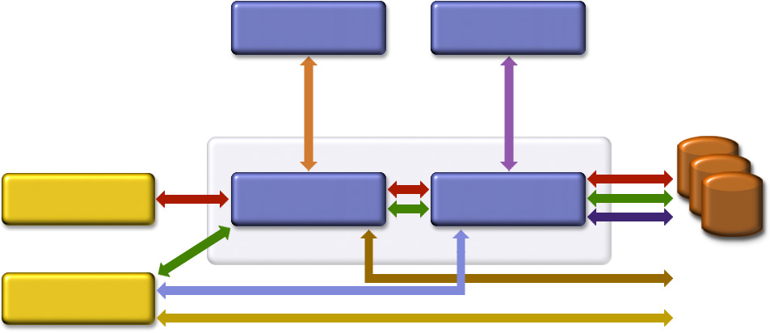
Possible J2EE Application Anatomies
Web Server
EJB Server
DB & EIS
Resources
Browser
Web Server
EJB Server
Stand-alone
  Umesh Bellur
Notes:
So this slide shows several different ways J2EE application can be built. Different forms of J2EE application can be built by combining the path between tiers.
One of the most common forms of J2EE application is represented in combined red arrows. In this form, browser talks to web tier in which servlet and and JSP components are created and deployed and these web tier components then talk to EJB tier in which EJB beans are created and deployed and these EJB beans in turn talk to backend databases or enterprise information systems.
Another common form is browser talks to web-tier and then the web-tier components talk to directly to backend databases or enterprise information systems. It is represented by red arrow between browser and web server and then dark brown arrow between web server and backend database.
It is also possible that the client could be standalone application, which can talk to directly to web-tier, EJB tier, or even directly to backend databases.
Also web tier components and EJB tier components can use components deployed in other web-tier or EJB tiers.
The point of this slide is to show that there are several different ways to build J2EE applications.

Slide 49
J2EE Application Anatomies
4-tier J2EE applications
  HTML client, JSP/Servlets, EJB, JDBC/Connector
3-tier J2EE applications
  HTML client, JSP/Servlets, JDBC
3-tier J2EE applications
  EJB standalone applications, EJB, JDBC/Connector
B2B Enterprise applications
  J2EE platform to J2EE platform through the exchange of JMS or XML-based messages
  Umesh Bellur
Notes:
So this slide is just recapturing what I just said. So depending on how you build J2EE applications, they can be in fact in several different forms.

Slide 50
Which One to Use?
Depends on several factors
  Requirements of applications
  Availability of EJB tier
  Availability of developer resource
  Umesh Bellur
Notes:
Now you might want to ask which form of J2EE application should I build? The answer is of course “it depends”. It depends on the requirements of application or even non-technical factors such as availability of EJB tier or availability of developer resource.

