Slide 1

Author: DoanNX
Time: 45’

Slide 2

OOP concepts
OOP in Java

Slide 3
OOP concepts
OOP in Java

Slide 4

Object Oriented Programming or OOP is the technique to create programs based on the real world.
Unlike procedural programming, programs are organized around objects and data rather than actions and logic.
OOP offers greater flexibility and compatibility and is popular in developing larger application.

Slide 5
OOP’s features
  Encapsulation
    This is an important programming concept that assists in separating an object's state from its behavior.
    In Java, the basis of encapsulation is the class.
  Inheritance
    Classes can inherit some common behavior and state from others. Inheritance in OOP allows to define a general class and later to organize some other classes simply adding some details with the old class definition.
    In Java, this is the concept of super class and sub class.
  Polymorphism
    It describes the ability of the object in belonging to different types with specific behavior of each type.

Slide 6
OOP’s benefits
  Objects are more “real-world”.
  Objects provide the flexibility and control necessary to deal with evolving requirements.
  Object use facilitates collaboration.
  Objects help manage complexity.
  Reusability, maintainability and extensibility.

Slide 7
OOP concepts
OOP in Java

Slide 8

Class and Object
Overloading and overriden
Abstract class
Interface
Polymorphism
Package
Modifiers

Slide 9

Objects are key to understanding object-oriented technology.
  Real-world objects share two characteristics: They all have state and behavior. Dogs have state (name, color, breed, hungry) and behavior (barking, fetching, wagging tail).
Software objects are conceptually similar to real-world objects: they too consist of state and related behavior
  An object stores its state in fields and exposes its behavior through methods (functions).

Slide 10
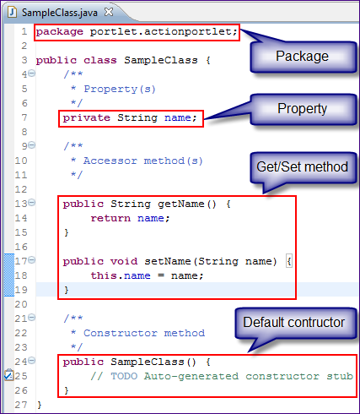
Declare one class in Java

Slide 11

Overloading
  Allows you to define more than one function or constructor with the same name
    Overloaded functions or constructors must differ in the number of types of their arguments (or both) => Java can always tell which one you mean.
  Example
  // square(4) is 16
  public int square(int x) { return (x*x);}
  // square(“four”) is “four four”
  public String square(String s) {
  return (s + “ “ + s); }

Slide 12
Overriden
  When a class defines a method using the same name, return type and argument(s) as a method in the superclass, then the class overrides this method in the its superclass.
    Only non-static methods can be overriden.
  If there is a locally defined method and an inherited method that have the same name and take the same arguments, you can use the following to refer to this inherited method
  super.methodName(…)

Slide 13

Abstract class permits declaration of class that define only part of an implementation, leaving the subclass to provide the details.
A class is considered abstract if at least one method of this class has no implementation
  An abstract method has no implementation.
  Any class with an abstract method must be declared abstract.
An abstract class can contain instance variables and methods that are fully implemented.

Slide 14
  Any subclass can override a concrete method inherited from the superclass and declare the method abstract.
An abstract class can’t be instantiated, however references to an abstract class can be declared.
  public abstract ThreeDShape {
  public abstract void drawShape(Graphics g);
  public abstract void resize(double scale);
  }
  ThreeDShape s1;

Slide 15

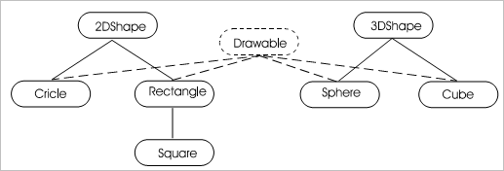
Interface defines a Java type consisting purely of constants and abstract methods.
An interface doesn’t implement any of the methods, but imposes a design structure on any class that uses the interface.
A class that implements an interface must either provide definitions for all methods or declare itself abstract.

Slide 16
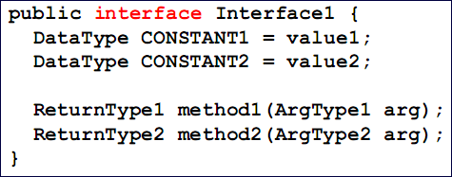
All methods in an interface are implicitly abstract and the keyword abstract is not required in the method declaration.
Data fields in an interface are implicitly static final (constants).
All data fields and methods in an interface are implicitly public.

Slide 17
Interface can extend another interface => sub-interfaces and super-interfaces.
Unlike class, an interface can extend more than one interface at a time.
public interface Displayable extends Drawable, Printable {…}
Interface provides a form of multiple inheritance b/c a class can implement more than one interface at a time.
public class Circle extends ThreeDShape
implements Drawable, Printable {…}

Slide 18

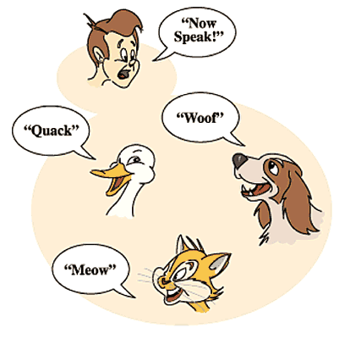
Polymorphic literally means “of multiple shapes” and in the context of OOP, polymorphic means “having multiple behavior”.

Slide 19
A polymorphic method results in different actions depending on the object being references
  Also known as run-time binding.
Overloading and overriding are two types of polymorphism. Now we will look at the third type: dynamic method binding.

Slide 20
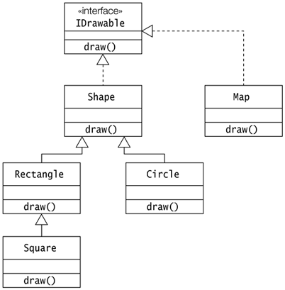
Example

Slide 21

A package lets you group classes in subdirectories to avoid accidental name conflicts.
The package statement must be placed at the first line in the file.
If a package statement is omitted from file, then the code is part of the default package that has no name.

Slide 22

Visibility modifiers
  public
    This modifier indicates that the variable or method can be accessed anywhere an instance of this class is accessible.
    A class may also be designated public, which means that any other class can use the class definition.
    The name of a public class must match the file name, so a file can have only one public class.

Slide 23
Visibility modifiers
  private
    A private variable/ method is only accessible from methods within the same class.
    Declaring a class variable private “hides” the data within class, and only accessing the class data through accessor methods.
  protected
    Protected variables/ methods can only be accessed by methods within the class/ classes in the same package/ within subclasses.
    Protected variables/ methods are inherited by subclasses of the same or different package.

Slide 24
Visibility modifiers
  [default]
    A variable/ method has default visibility if a modifier is omitted.
    Default visibility indicates that the variable/method can be accessed by methods within the class, and within classes in the same package.
    Default variables are inherited only by subclasses in the same package.

Slide 25
Other modifiers
  final
    For a class, indicates that it can’t be subclass.
    For a variable/method, indicates that it can’t be changed at runtime or overriden in subclasses.
  synchronized
    Sets a lock on a section of code or method.
    Only one thread can access the same synchronized code at any given time.
  transient
    Variables aren’t stored in serialized objects sent over the network or stored to disk.

Slide 26
Other modifiers
  native
    Indicates that the method is implemented using C/C++.

Slide 27

Overloaded method/constructor, except for the argument list, have identical signatures.
Use extends to create a new class that inherits from a super class
  Java doesn’t support multiple inheritance.
An inherited method in a subclass can be overriden to provide custom behavior
  The original method in the parent class is accessible through super.methodName(…)
Interfaces contain only abstract methods and constants

Slide 28
  A class can implement more than one interface.
With polymorphism, binding of a method to an object is determined at run-time.
Packages help avoid namespace collisions
  The package statement must be first statement in the source file before any other statements.
Four visibility modifires are: public, private, protected and default (no modifier).

