Slide 1
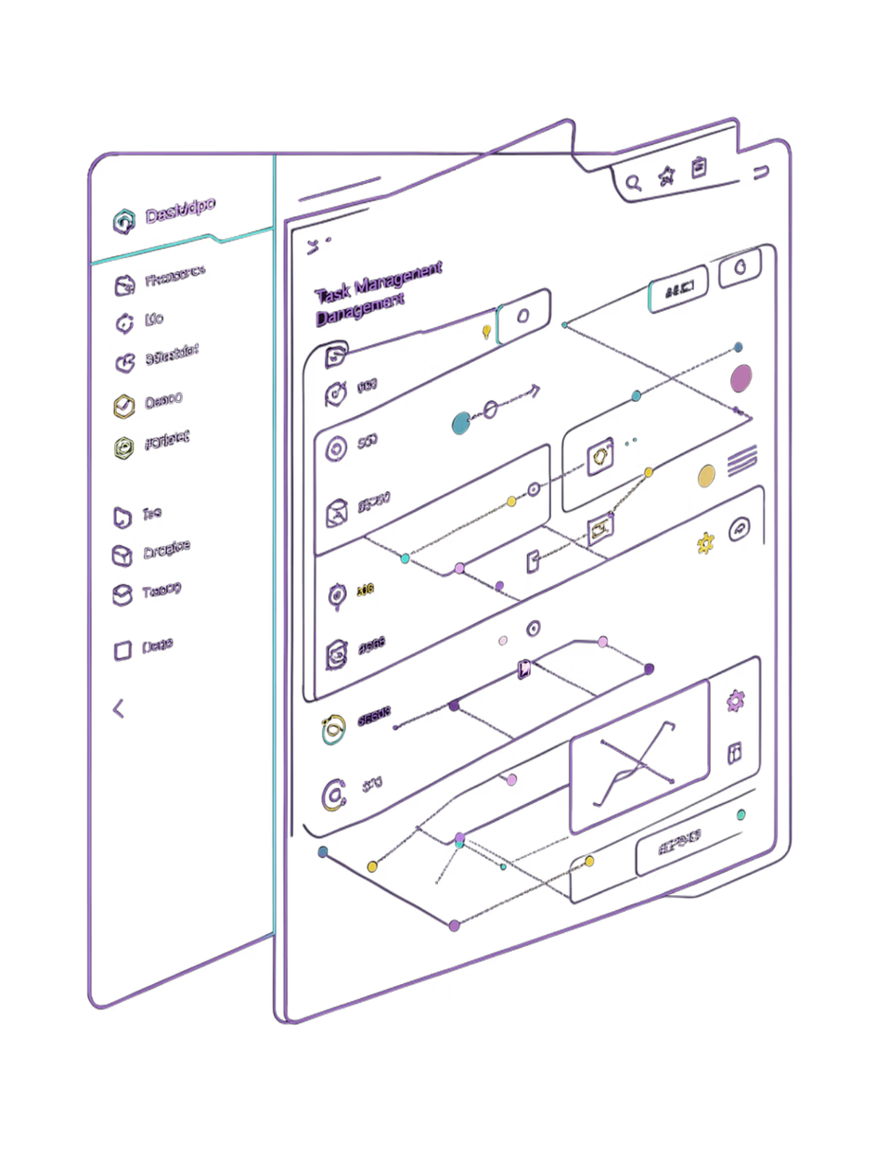
TASIK
Task Manager Web App
Muneeb Ijaz · Veltrix IT Solutions ·
🔗 Live Demo →
Notes:
1

Slide 2

PROJECT OVERVIEW
What is TASIK?
The Problem
Daily tasks scattered across notes, emails, and memory — no secure, centralized system.
The Solution
A full-stack web app where users register, log in, and manage tasks in a secure, organized interface with real-time session protection.
Notes:
2

Slide 3




TECH STACK
Built With Modern Tools
Frontend
Backend
HTML · CSS · JavaScript
Node.js · Express.js
Deployed on Vercel
Deployed on Render
Database
Auth
MongoDB Atlas
JWT · bcryptjs
Cloud-hosted
Secure sessions
Notes:
3

Slide 4




FEATURES
What TASIK Can Do
Auth & Sessions
Task Management
Register, login, JWT-protected routes, auto-logout on expiry
Add, edit, delete, view — filter by Active / Inactive
Glassmorphism UI
Toast Notifications
Animated bubble background, responsive on all devices
Real-time feedback on every user action
Notes:
4

Slide 5
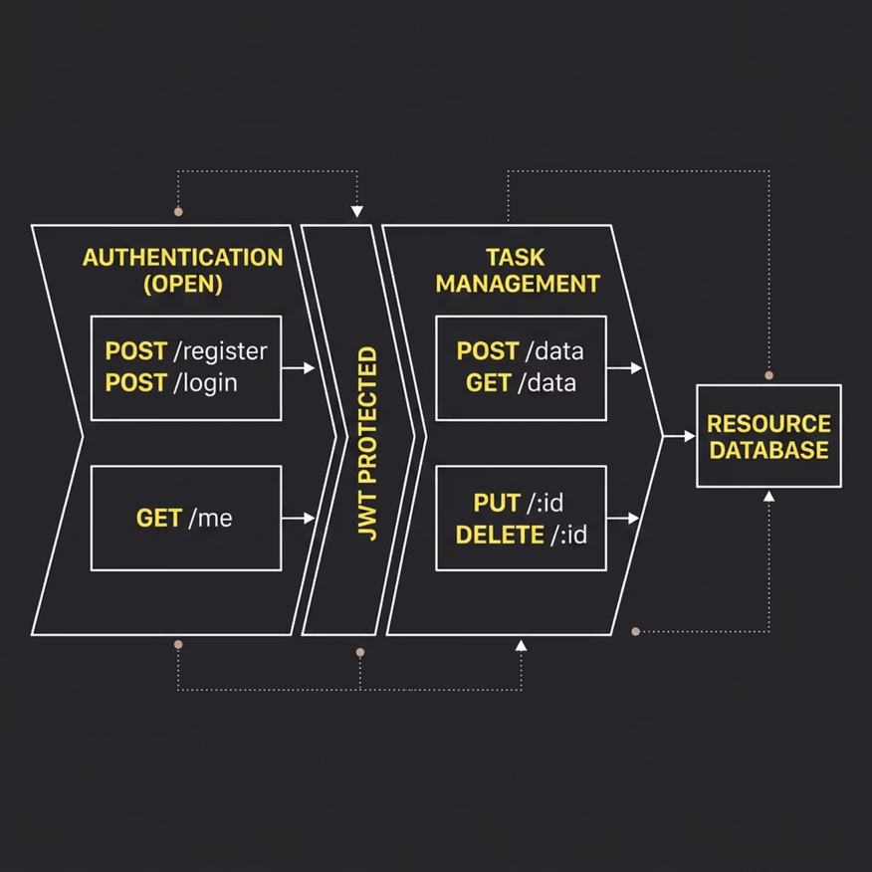

BACKEND
Database & API Design
Data Models
Users: name, email, hashed password, role, timestamps
Tasks: title, description, category, status, createdBy → user
Notes:
5

Slide 6

ARCHITECTURE
Frontend ↔ Backend Connection
Login
Fetch API
Auth Header
Verify & Response
Every protected request carries the JWT in the header. Expired tokens trigger an automatic logout — seamless and secure.
Notes:
6

Slide 7




SECURITY
Authentication Flow
Register
Login
Password hashed with bcrypt → saved to MongoDB
Password verified → JWT generated → sent to frontend
Access
Expire
Token in header on every request → verified by middleware
7-day expiry → server returns 401 → auto logout
Notes:
7

Slide 8
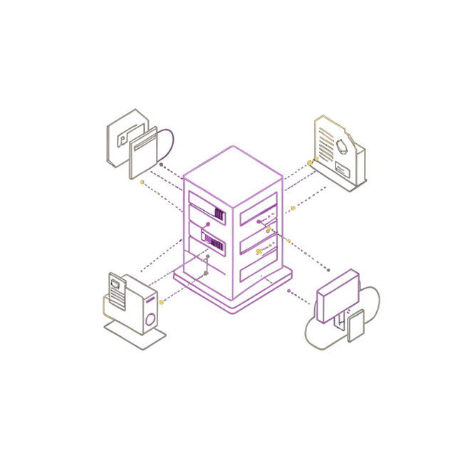
DEPLOYMENT
Live Architecture
🌐 Vercel
⚙️ Render
☁️ MongoDB Atlas
Frontend — auto-deploys on every GitHub push
Backend API — UptimeRobot keeps it alive 24/7
Cloud database — globally accessible
🔗 Live App →
Notes:
8

Slide 9

LESSONS LEARNED
Challenges & Solutions
1
2
dotenvx Blocking Env Vars
CORS Errors
Manually read .env via Node.js fs module
Added cors() middleware, fixed origin array syntax
3
4
MongoDB Timeout
Render .env Missing
Whitelisted all IPs in Atlas Network Access
Switched to Render environment variables in production
Notes:
9

Slide 10


Thank You
"This internship turned my theoretical knowledge into real-world skills."
— Muneeb Ijaz
🌐 Live App
⚙️ Backend API
tasik.vercel.app
veltrix-internship.onrender.com
📂 GitHub
github.com/muneeb-i78
Special thanks to Veltrix IT Solutions for the opportunity and mentorship.
Notes:
10

