Slide 1

PROBLEM STATEMENT 26153
AI-based Network Attack
Forecasting
from Network Traffic Data
World models for proactive cyber defence — forecasting infiltration before the kill chain completes, not classifying it after.
National Technical Research Organisation (NTRO) · Smart India Hackathon 2026
Notes:
Title slide. Swap in team name / ID before submission.

Slide 2
From Isolated Flows to Trajectories
Why a world model catches what a per-flow classifier misses
TRADITIONAL CLASSIFIER
WORLD MODEL (OURS)
Each flow scored alone
The trajectory is the signal
benign · benign · benign · MALICIOUS · benign — each label independent of the others
forecast: infiltration in ~K windows
Discards attack order — port-probe sequence, SYN-before-flood timing
Blind to slow reconnaissance designed to evade per-flow thresholds
Reacts after compromise, not before
Learns P(next state | recent history) over a 5-minute window
Rolls forward 1 minute, free-running on its own forecasts
Flags the trajectory before the kill chain completes
Notes:
Core pitch: temporal dynamics vs per-flow classification. Left panel = status quo, right = our approach.

Slide 3
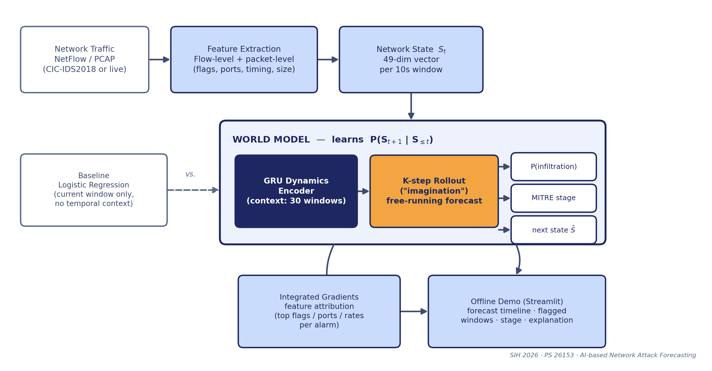
System Architecture
Traffic → network state → K-step forecast → stage + explanation, benchmarked against a memoryless baseline
Notes:
Full pipeline diagram — same one used in the architecture document. Walk left to right.

Slide 4
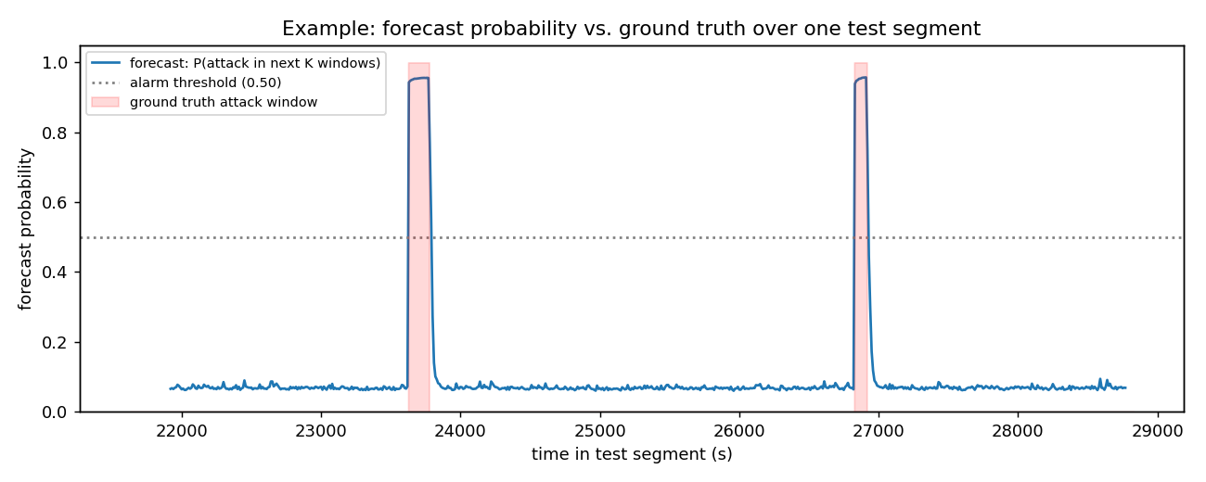
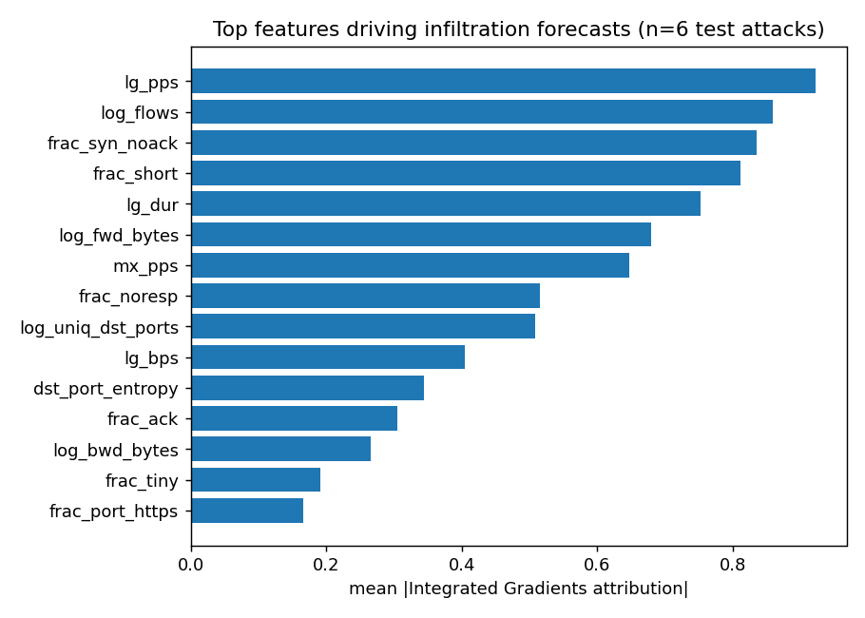
Validation: The Temporal Signal Is Real
Preliminary run on synthetic traffic matching the CIC-IDS2018 schema — confirms the pipeline end-to-end ahead of the full-dataset benchmark
0.72
0.87
0.61
0.8%
F1 score
AUROC
AUPRC
False-positive rate
vs. logistic-regression baseline (same features, no temporal context): F1 = 0.00 at the same operating point.
Forecast probability rises sharply at each injected attack and returns to baseline elsewhere
Integrated Gradients: flood-style attack correctly attributed to rate + SYN features
Notes:
These are real outputs from the real code on synthetic schema-matched data. Full CIC-IDS2018 numbers replace these after training on target hardware.

Slide 5
Built for the SOC, Ready to Scale
◉
Air-gapped by design
Fully offline inference and demo interface — no cloud dependency, fits CII environments where telemetry cannot leave the perimeter.
◉
Explainable by construction
Every alarm ships with Integrated-Gradients attribution to specific flags, ports and rates — not a black-box score.
◉
Lightweight enough to matter
A few hundred thousand parameters: trains in minutes on a 6 GB laptop GPU, infers in real time on CPU.
ROADMAP
Full benchmark on the real 16M-flow CIC-IDS2018 dataset
Fuse in CIC-IDS2017 for labelled Reconnaissance coverage
GNN variant over the live flow graph for lateral-movement patterns
Notes:
Closing slide, bookends the dark title slide. Roadmap items map directly to the architecture doc's limitations section.

