Slide 1
ECG Deep Diagnoses & Report Generation
Automatic ECG Diagnostic System

Slide 2
Overview
In this Project, we have developed an AI app which processes 12 Lead ECG sensor data, auto-diagnose the heart diseases or conditions thorugh deep learning model, and then utilize LLM (gpt-4o-mini) to generate simple ECG reports explaining the diagnosed heart conditions and recommendations for user understanding.
Technologies Used:
Deep Learning with tensorflow for building model
gpt-40-mini for report generation
streamlit libraries for building web dashboard app

Slide 3
Flow diagram of Project
Raw ECG Signals
Noise Removal
&
Preprocessing
Deep Learning
Model
Multilabel
Classification
Report Generation

Slide 4
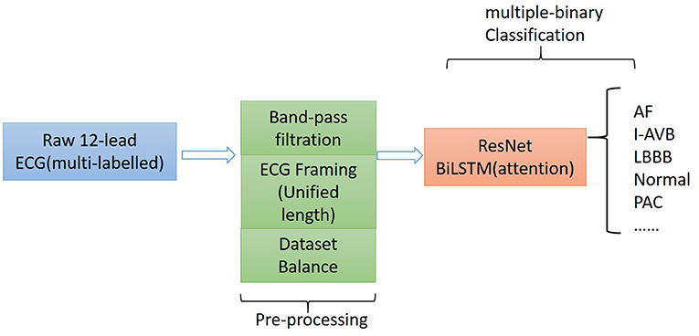
Model:
The proposed algorithm for classifying 12-lead ECG with multi-labeling consists of components of data denoising, framing blocking, and dataset balance for data preprocessing and a neural network structure based on ResNet in combination with attention-based bidirectional long short-term memory (BiLSTM)
Reference: https://www.frontiersin.org/journals/cardiovascular-medicine/articles/10.3389/fcvm.2021.616585/full

Slide 5
Dataset: Physionet 12 Lead ECG Dataset
A large scale 12-lead electrocardiogram database for arrhythmia study
Jianwei Zheng , Hangyuan Guo , Huimin Chu
Link: https://physionet.org/content/ecg-arrhythmia/1.0.0/WFDBRecords/01/010/#files-panel

Slide 6
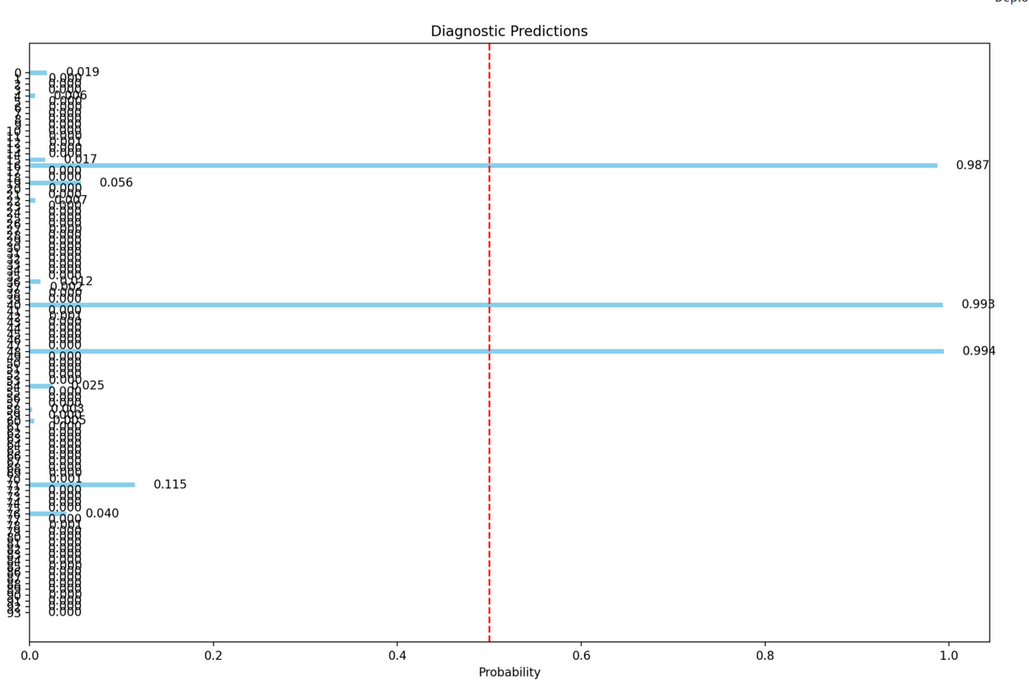
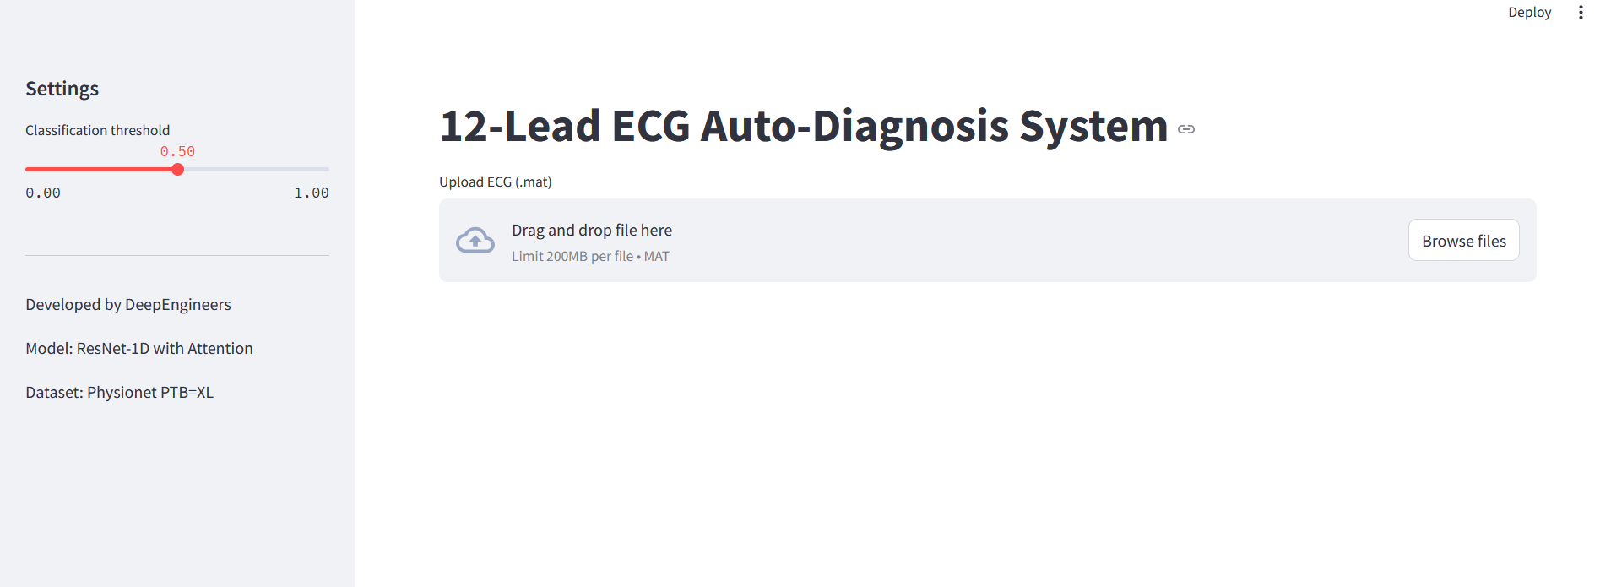
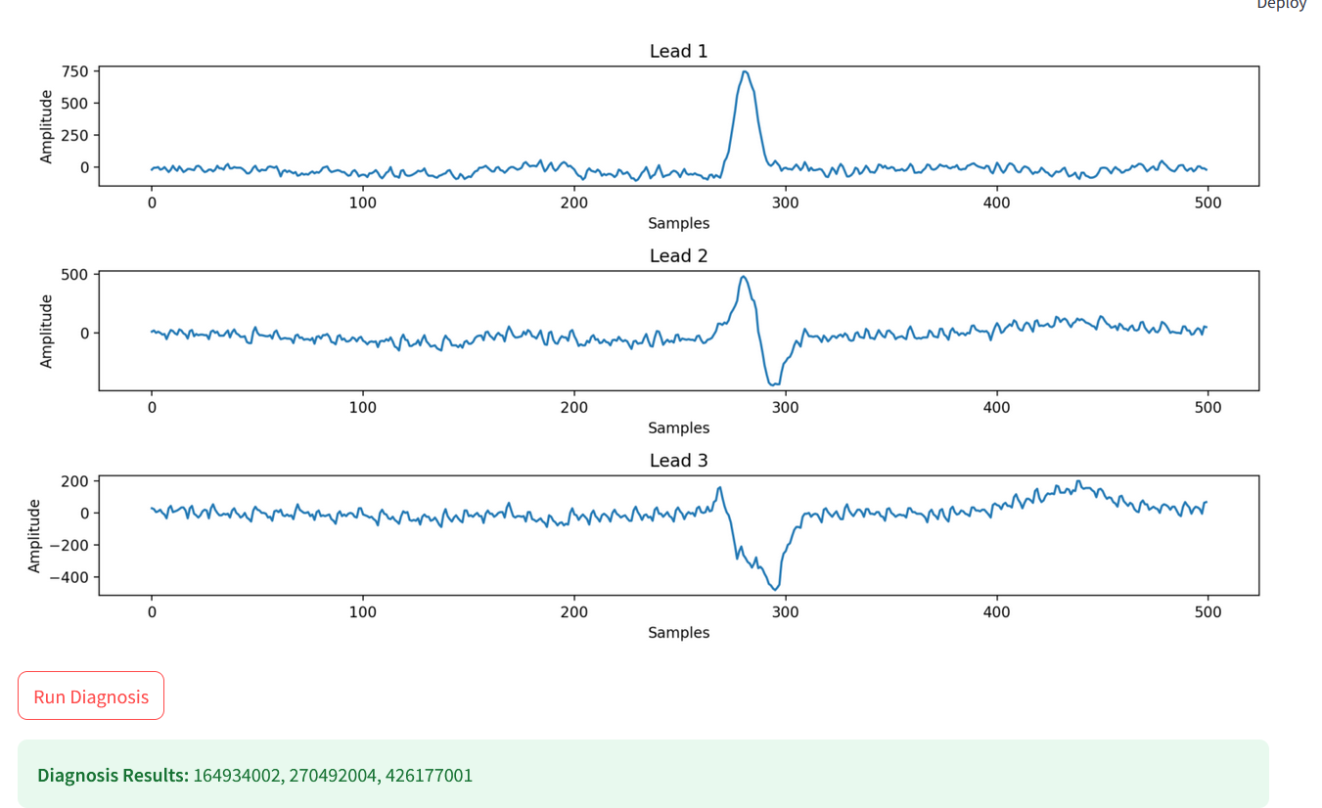
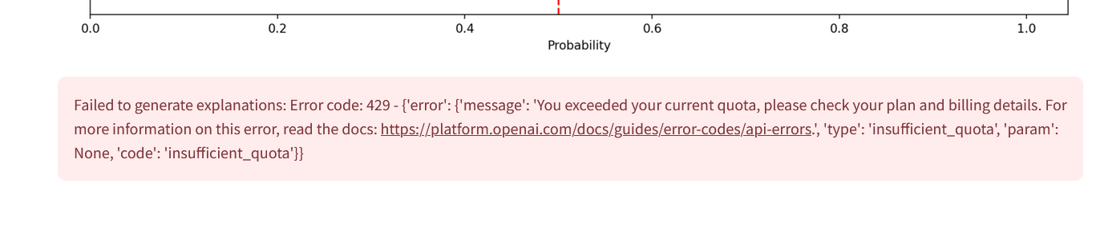
Results:

