Slide 1
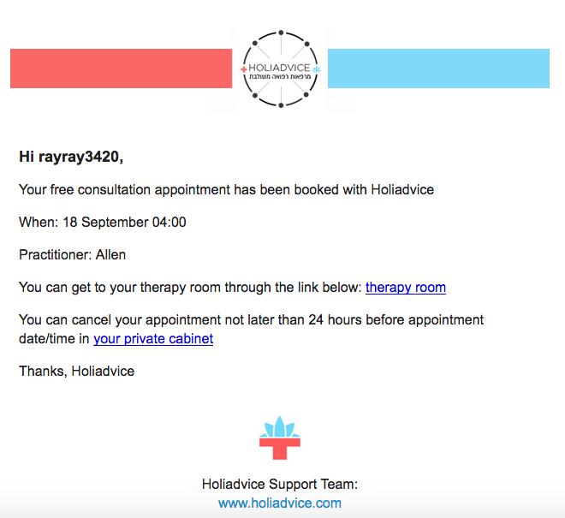

For any changes you can contact your practitioner at any time in his or
hers phone number: +972524245083

Slide 2
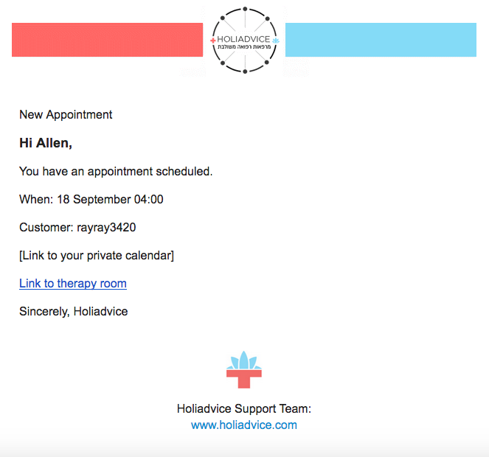
For any changes you can contact your patient at any time in his or
hers phone number: +972524245083

