Slide 1

Screen Recording
Web Real time communication

Slide 2





TEAM Members
Muneeb Hashmi
Nameer Anjum
Abdullah Qureshi
Ibtisam Arif
Ali Sadiq

Slide 3
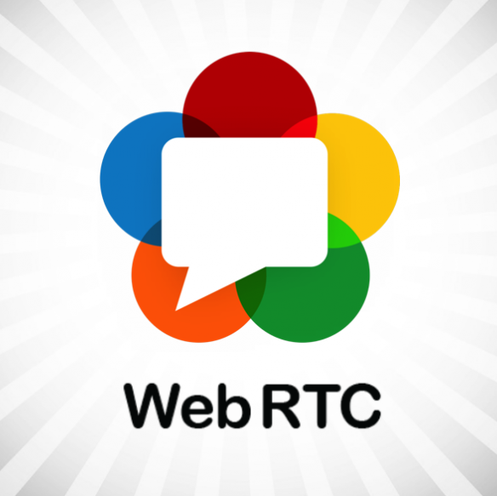
What is WebRTC
Web Real Time Communication (webRTC) is a free open source project
Provides web browser and mobile application real time communication via simple APIs.
WebRTC Components have been optimized to best server this purpose.

Slide 4
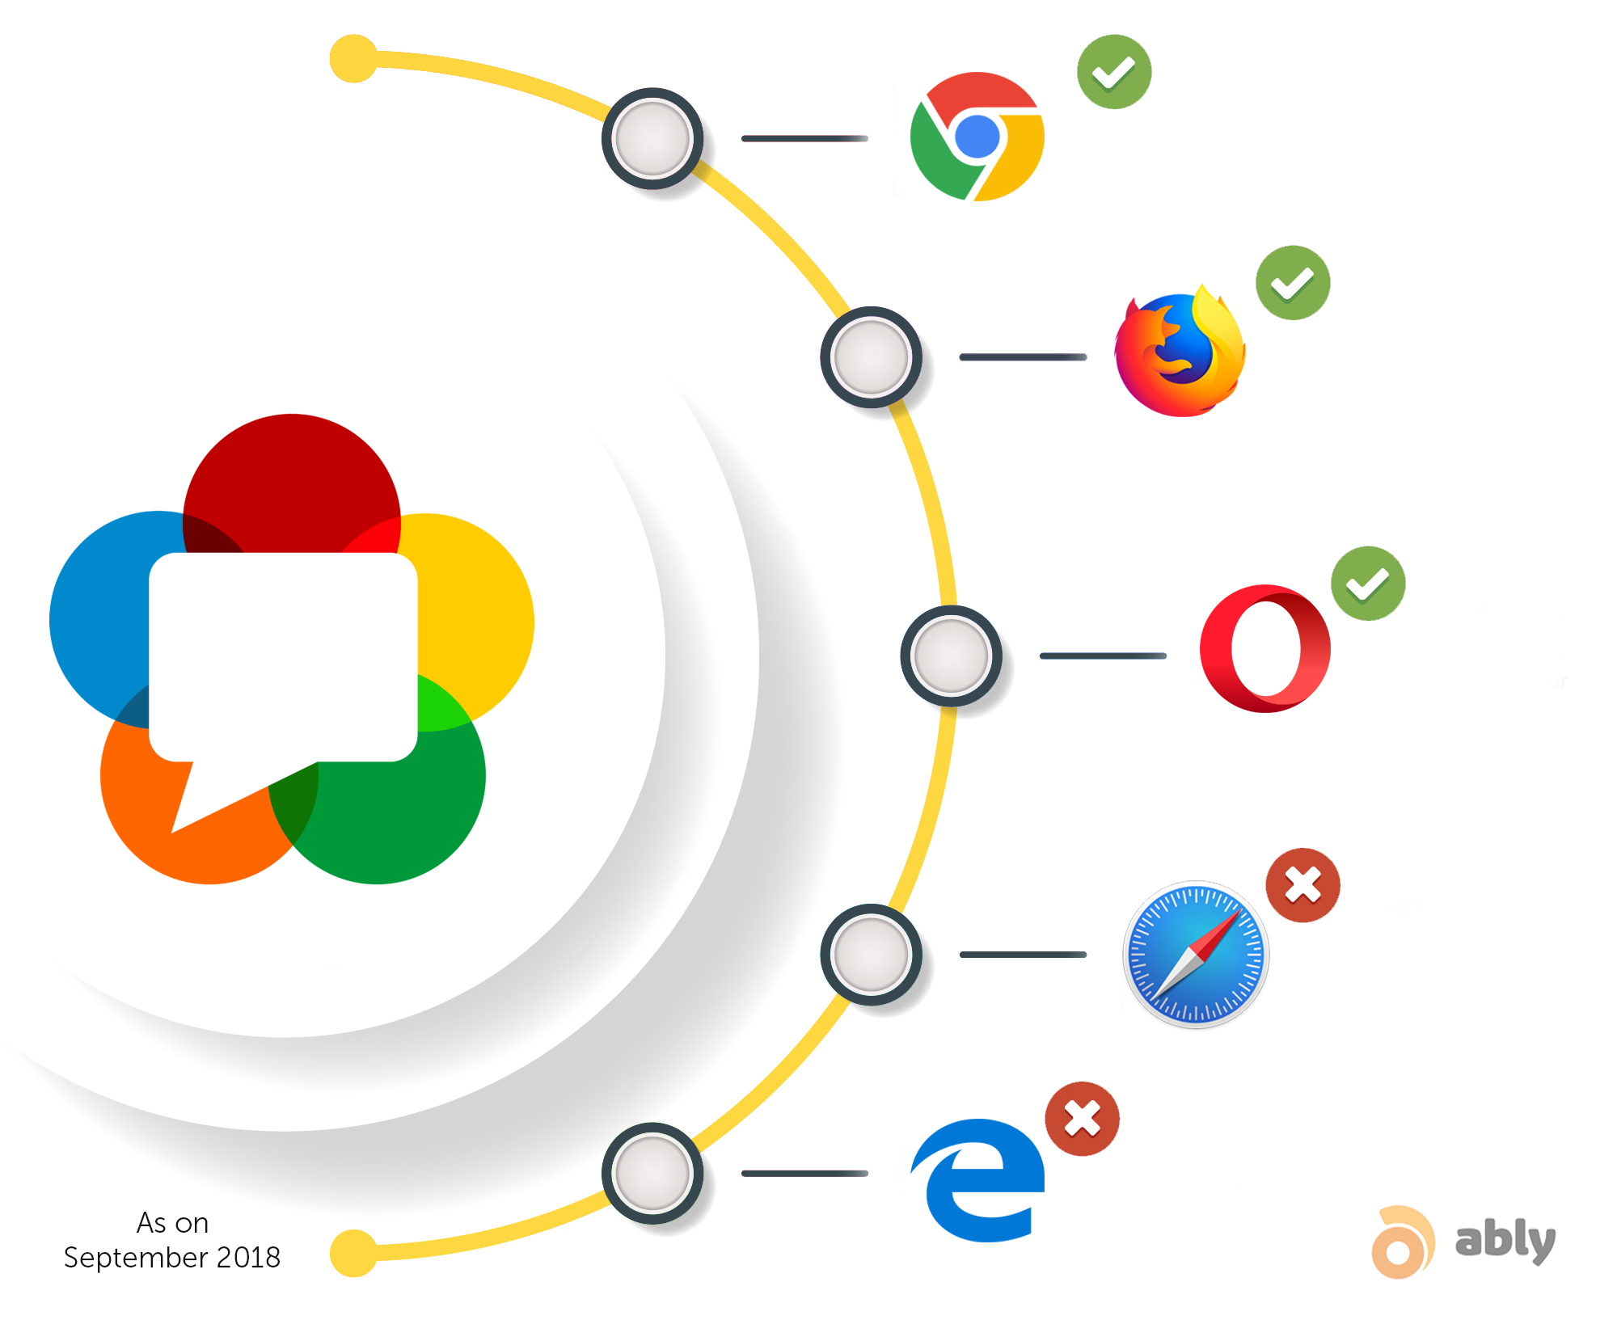
WEBRTC Mission
High quality RTC applications to be developed for the browser, mobile platform and IoT Devices.
Allows them to communicate via common set of protocols.
Allows Audio and Video communication inside web-pages using peer-to-peer communication.
Eliminates the need to install plugins or native apps.
Supported by Google, Mozilla, Opera, Apple and Microsoft.

Slide 5
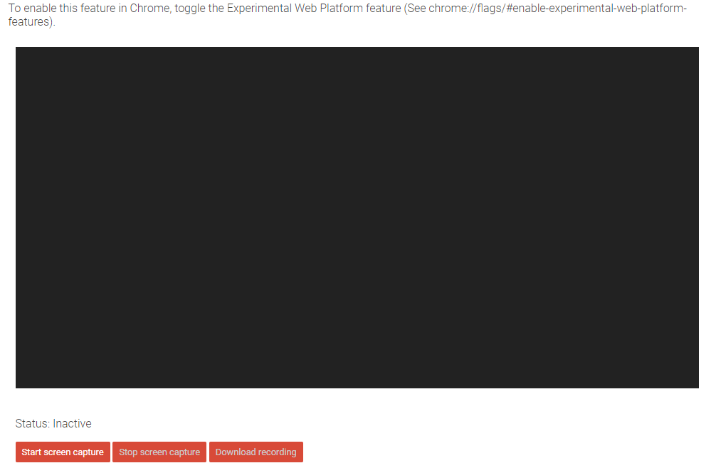
Screen Recording

Slide 6
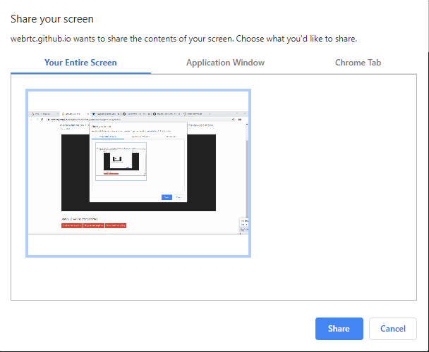
Screen Recording
Clicked on Start Recording
Ask content of your screen to share
Your Entire Screen
Application Window
Chrome Tab
Start Recording

Slide 7
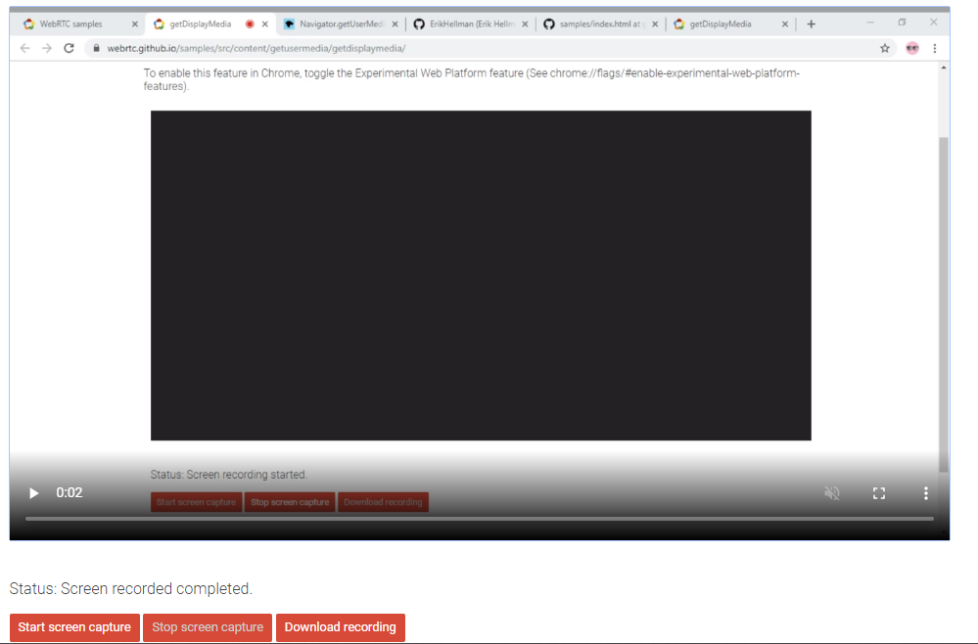

Screen Recording
Clicked on Stop Recording
View Your Recording
Download Recording
Again Start Recording

Slide 8
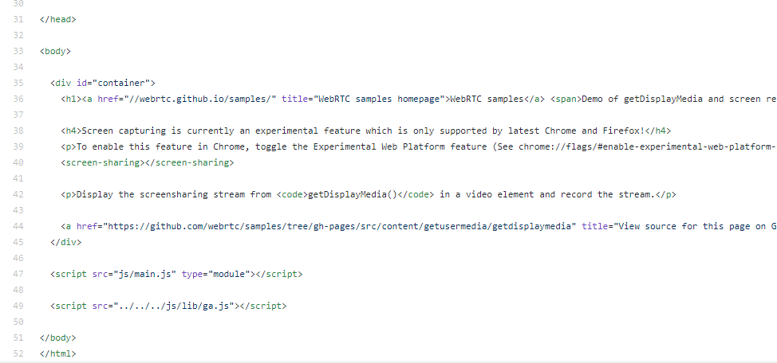
Screen Recording Code
HTML FILE

Slide 9
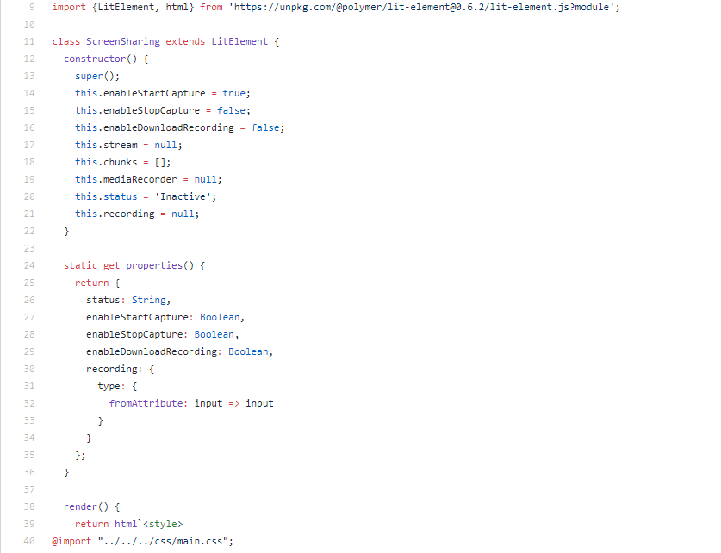
Screen Recording CODE
ScreenSharing Class

Slide 10
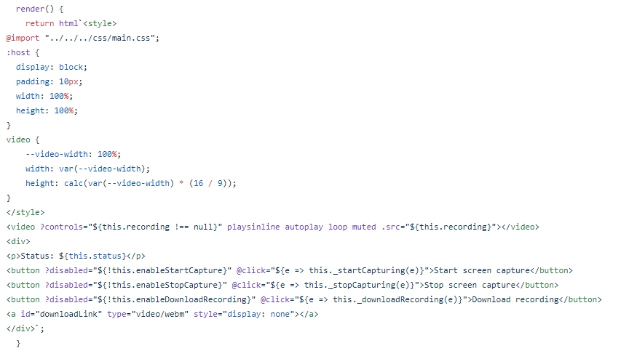
Screen Recording CODE
Render Function

Slide 11
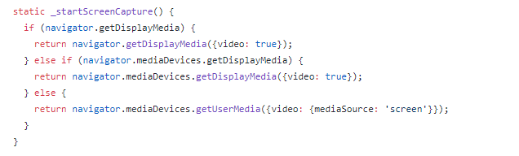
Screen Recording CODE
ScreenCaptureType
Capture Entire Screen
Application Window
Specific Chrome Tab

Slide 12
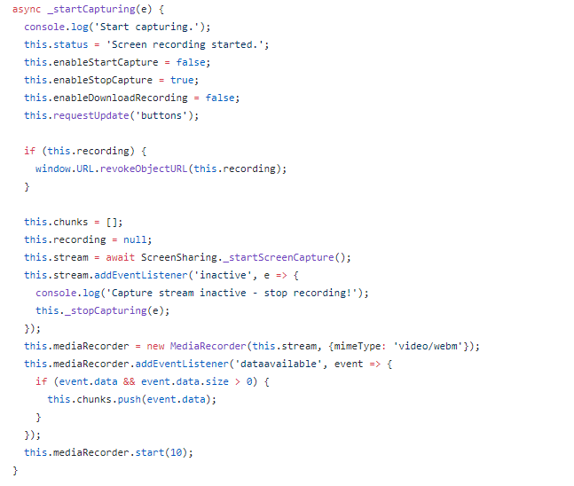
Screen Recording CODE
StartScreenCapture Function

Slide 13
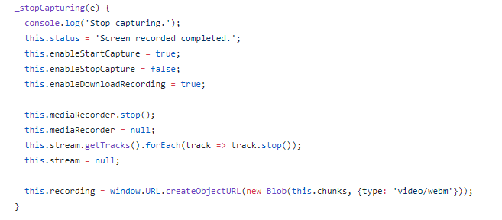
Screen Recording CODE
StopScreenCapture Function

Slide 14
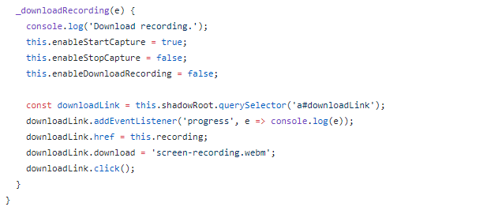
Screen Recording CODE
Download ScreenCapture

Slide 15

Thank you
https://webrtc.github.io/samples/src/content/getusermedia/getdisplaymedia/

