Slide 1
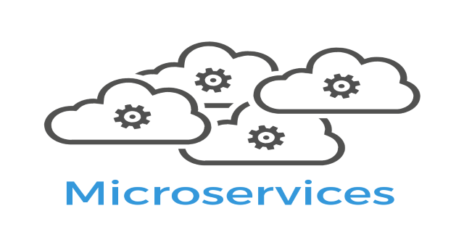



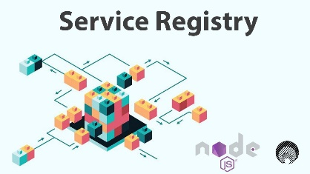
Flow of on-go-services-ms
Bitbucket
Jenkins
Developer
Application Server contain all services.
Development
Pull /Push code
Contain Jenkins file
All environment variables
All source code
deploye.sh file contain all steps
jib -> entrypoint.sh file use to create image of required container.
Deploye1.sh file use to create container
Run pipeline
Perform all steps from Jenkins file
Create deploy.sh file and copy it into Application server.
All other linked services also perform using env-variable
All services register here!

