Slide 1
CHAPTER 9
MEMBERSHIP FUNCTIONS

Slide 2
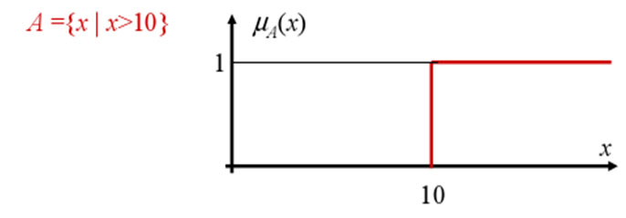
CRISP MEMBERSHIP FUCNTIONS
  Crisp membership functions (μ) are either one or zero.
  Consider the example: Numbers greater than 10. The membership curve for the set A is given by

Slide 3
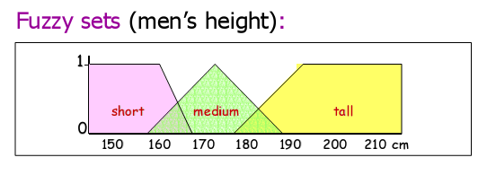
REPRESENTING A DOMAIN IN FUZZY LOGIC

Slide 4
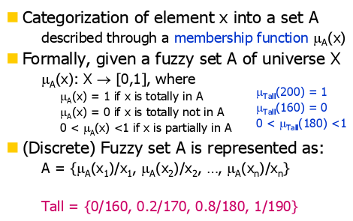
FUZZY MEMBERSHIP FUCNTIONS

Slide 5
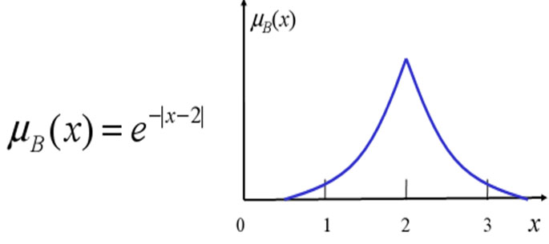
The set B of numbers approaching 2 can be represented by the membership function

Slide 6
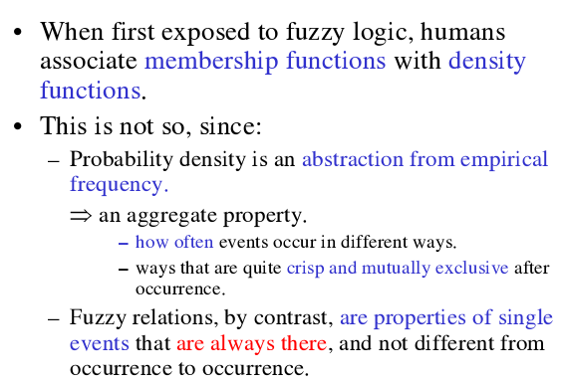
FUZZINESS vs PROBABILITY

Slide 7
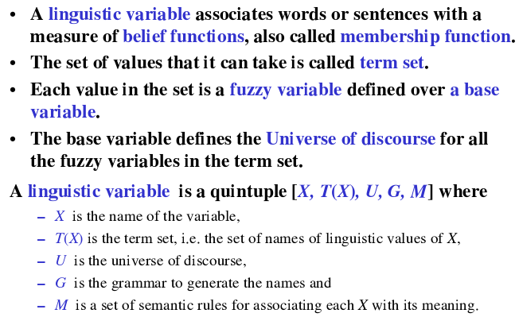
LINGUISTIC VARIABLE

Slide 8
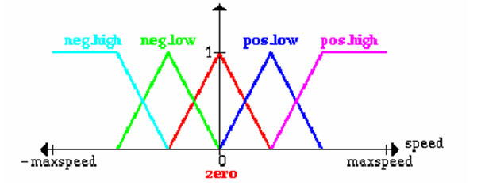
LINGUISTIC VARIABLE
Let x be a linguistic variable with the label “speed”.
Terms of x, which are fuzzy sets, could be “positive low”, “negative high” from the term set T:
T = {PostiveHigh, PositiveLow, NegativeLow, NegativeHigh, Zero}
Each term is a fuzzy variable defined on the base variable which might be the scale of all relevant velocities.

Slide 9
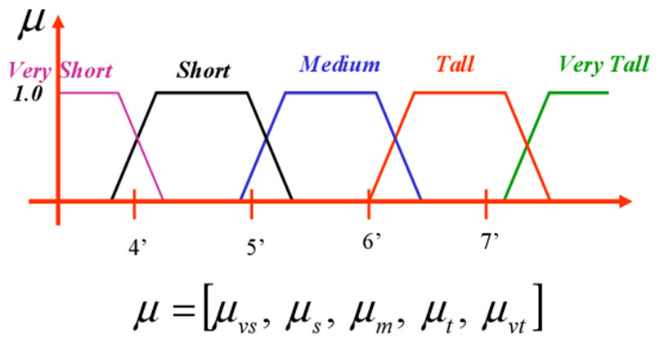
MEMBERSHIP FUCNTIONS

Slide 10
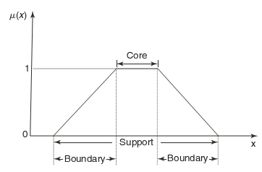

FEATURES OF MEMBERSHIP FUNCTIONS
CORE:
SUPPORT:
BOUNDARY:

Slide 11
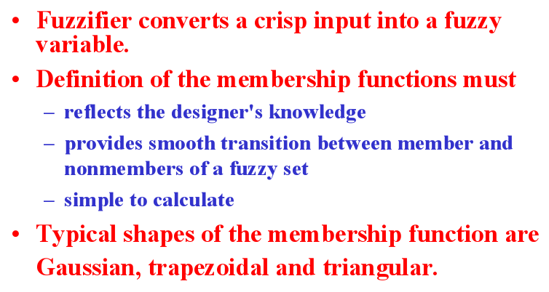
FUZZIFICATION

Slide 12
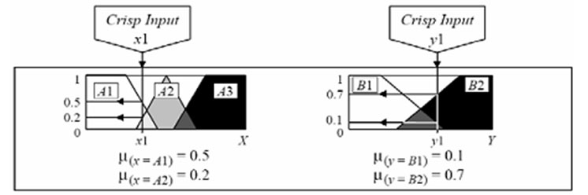
Use crisp inputs from the user.
Determine membership values for all the relevant classes (i.e., in right Universe of Discourse).

Slide 13
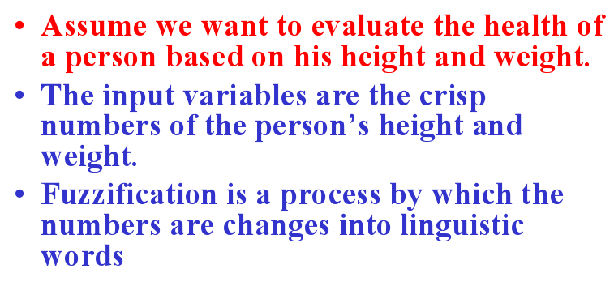
EXAMPLE - FUZZIFICATION

Slide 14
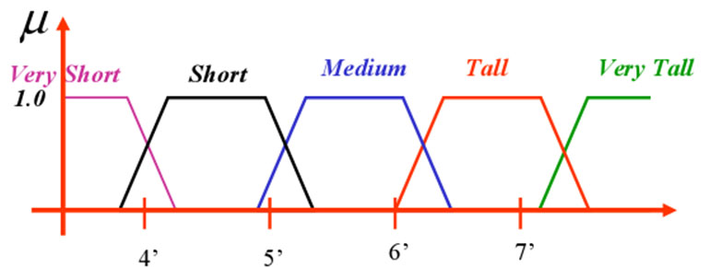
FUZZIFICATION OF HEIGHT

Slide 15
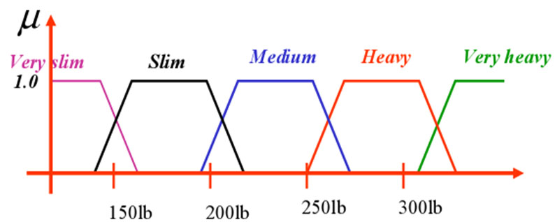
FUZZIFICATION OF WEIGHT

Slide 16
METHODS OF MEMBERSHIP VALUE ASSIGNMENT
The various methods of assigning membership values are:
Intuition,
Inference,
Rank ordering,
Neural networks,
Genetic algorithm,
Inductive reasoning.

Slide 17
SUMMARY
The contents discussed in this chapter include:
Membership functions – Definition and properties.
Linguistic variables.
Fuzzification process.

