Slide 1
The Operations of Fuzzy Set

Slide 2
Outline
Standard operations of fuzzy set
Fuzzy complement
Fuzzy union
Fuzzy intersection
Other operations in fuzzy set
Disjunctive sum
Difference
Distance
Cartesian product
Notes:
Crisp set:complement、union、intersection是唯一的，但Fuzzy卻是多樣的

Slide 3
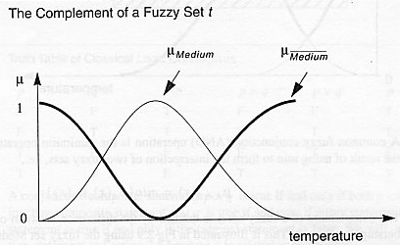
Standard operation of fuzzy set
Complement

Slide 4
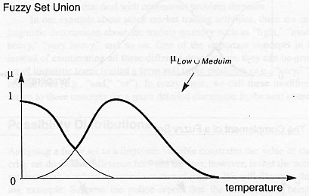
Standard operation of fuzzy set
Union

Slide 5
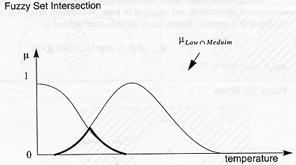
Standard operation of fuzzy set
Intersection

Slide 6


Fuzzy complement
C:[0,1]→[0,1]

Slide 7
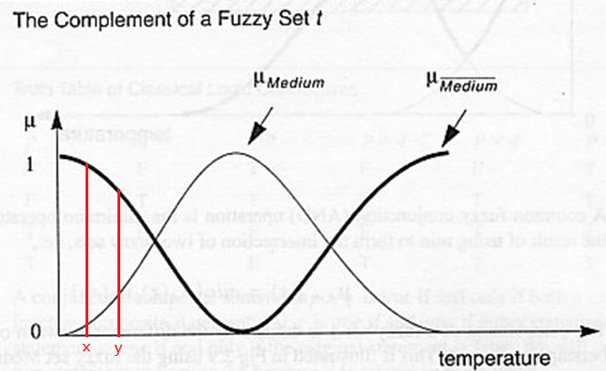


Fuzzy complement

Slide 8
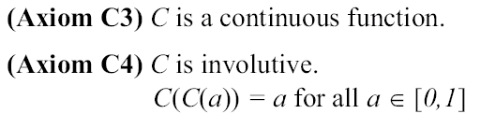
Fuzzy complement
Axioms C1 and C2 called “axiomatic skeleton ” are fundamental requisites to be a complement function, i.e., for any function C:[0,1]→[0,1] that satisfies axioms C1 and C2 is called a fuzzy complement.
Additional requirements
Notes:
Involutive:
1.bijective(對射):x屬於X y屬於Y y=f(x) , y存在唯一一個x與之對應
2.Symmetric: for all a,b 屬於x, aRb => bRa

Slide 9



Fuzzy union
Notes:
Commutativity 交換律

Slide 10
Fuzzy union
Axioms U1 ,U2,U3 and U4 called “axiomatic skeleton ” are fundamental requisites to be a union function, i.e., for any function U:[0,1]X[0,1]→[0,1] that satisfies axioms U1,U2,U3 and U4 is called a fuzzy union.
Additional requirements
Notes:
Idempotency 冪等 二元運算:自己重複運算的結果等於自己 ex 0*0=0 1*1=1
一元運算:任一元素作用兩次與作用一次的結果相同

Slide 11
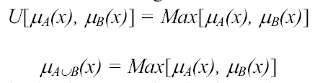
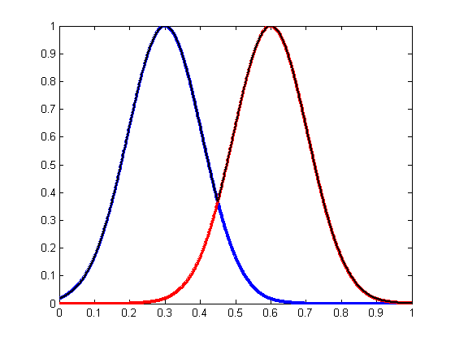
Fuzzy union
Example 1 : Standard function
Axiom U1
Axiom U2
Axiom U3
Axiom U4
Axiom U5
Axiom U6

Slide 12
Fuzzy union
Some frequently used fuzzy unions
Probabilistic sum (Algebraic Sum):
Bounded Sum (Bold union):
Drastic Sum:
Hamacher’s Sum
Notes:
Bounded sum等於Yager w=1的特例

Slide 13
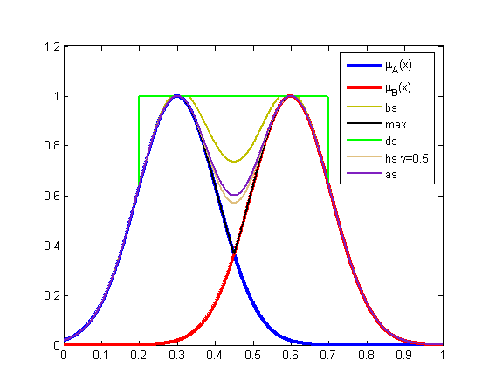
Fuzzy union

Slide 14



Fuzzy intersection

Slide 15

Fuzzy intersection
Axioms I1 ,I2,I3 and I4 called “axiomatic skeleton ” are fundamental requisites to be a intersection function, i.e., for any function I:[0,1]X[0,1]→[0,1] that satisfies axioms I1,I2,I3 and I4 is called a fuzzy intersection.
Additional requirements
Notes:
Idempotency 冪等 二元運算:自己重複運算的結果等於自己 ex 0*0=1 1*1=1
一元運算:任一元素作用兩次與作用一次的結果相同

Slide 16
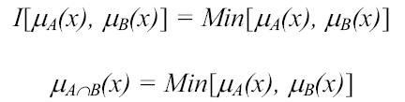
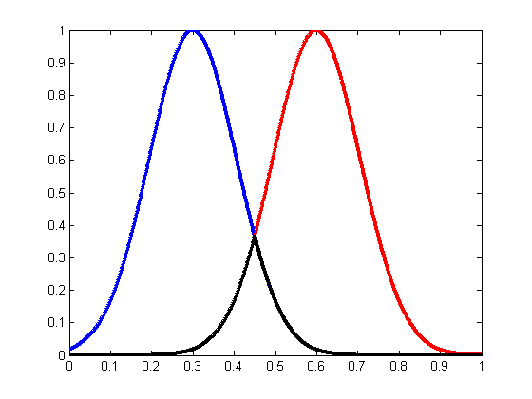
Fuzzy intersection
Example 1 : Standard function
Axiom I1
Axiom I2
Axiom I3
Axiom I4
Axiom I5
Axiom I6

Slide 17
Fuzzy intersection
Some frequently used fuzzy intersections
Probabilistic product (Algebraic product):
Bounded product (Bold intersection):
Drastic product :
Hamacher’s product
Notes:
AP:滿足commutativity、associativity、identity、De Morgan’s law
BP:commutativity、associativity、identity、De Morgan’s law

Slide 18
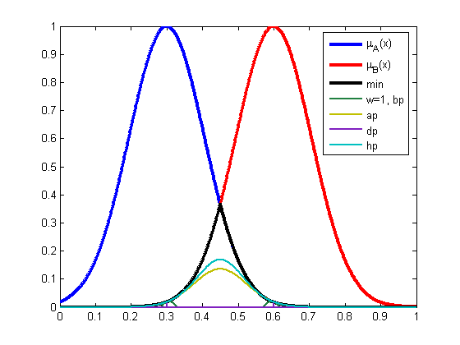
Fuzzy intersection

Slide 19
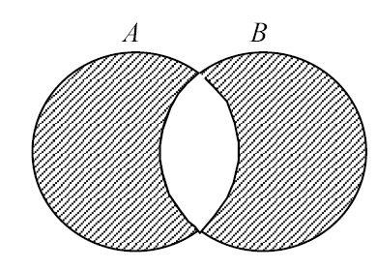

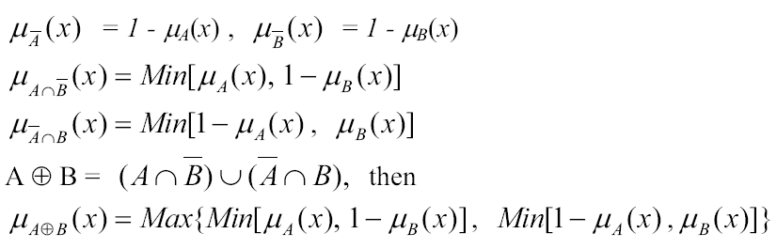
Other operations
Disjunctive sum (exclusive OR)
Notes:
Disjunctive分裂；分離

Slide 20
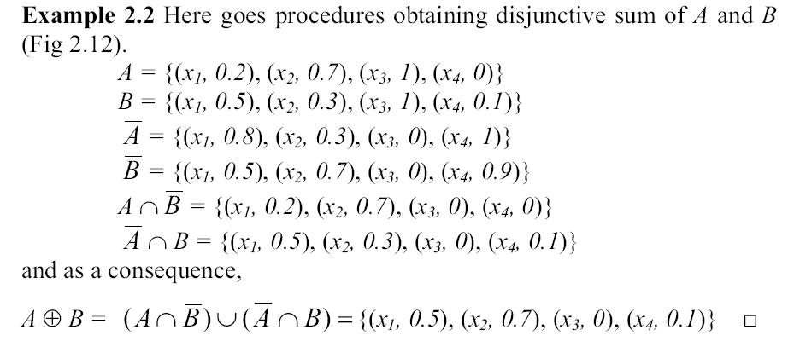
Other operations

Slide 21
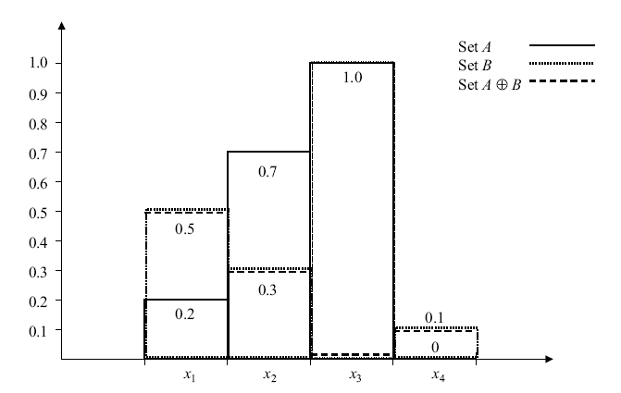
Other operations

Slide 22

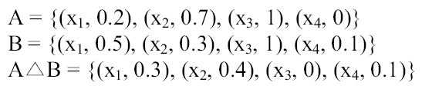
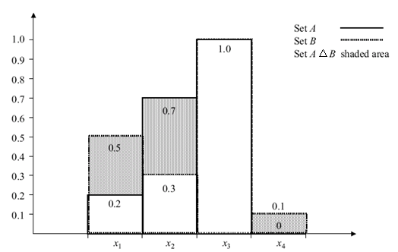
Other operations
Disjoint sum (elimination of common area)

Slide 23
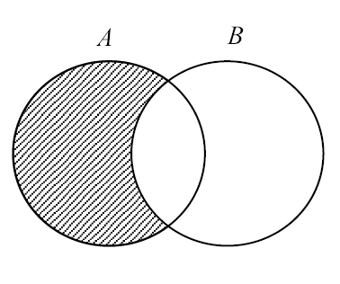

Other operations
Difference
Crisp set
Fuzzy set : Simple difference
By using standard complement and intersection operations.
Fuzzy set : Bounded difference

Slide 24
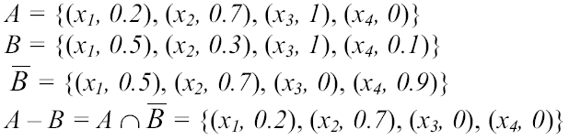
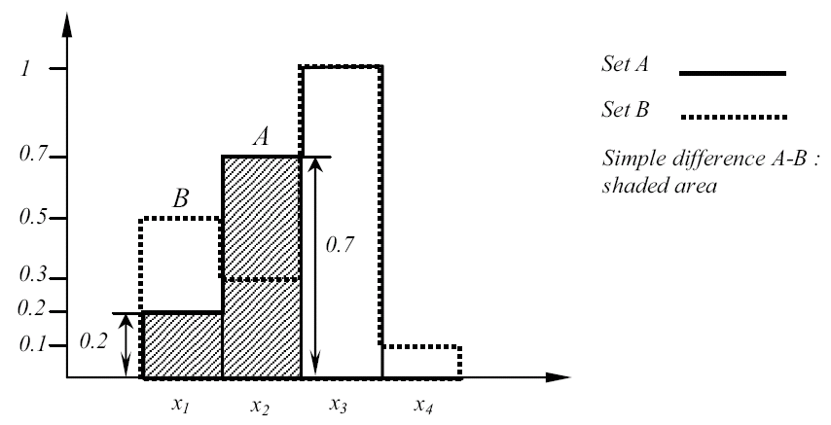
Other operations
Example
Simple difference

Slide 25

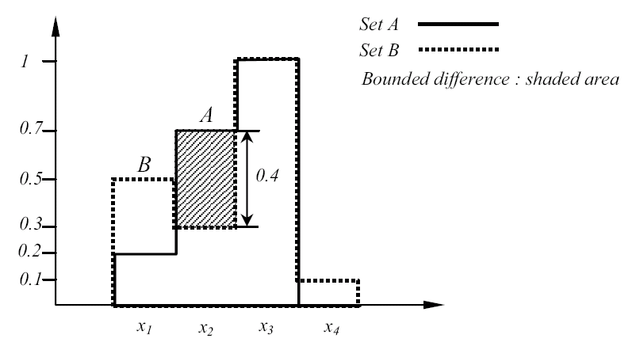
Other operations
Example
Bounded difference

Slide 26
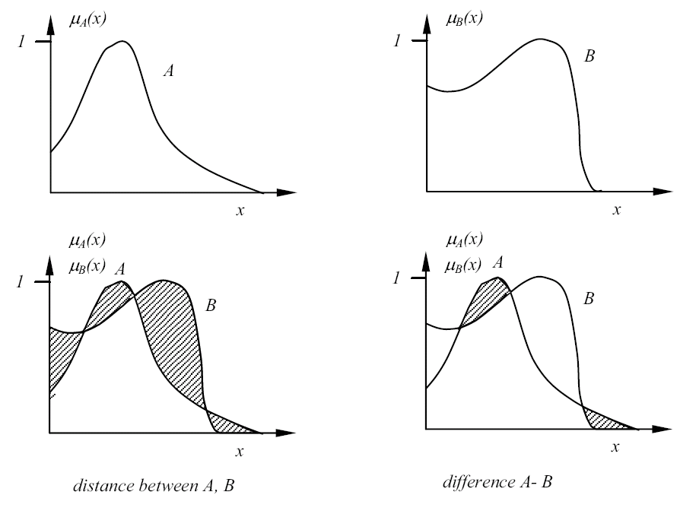
Other operations
Distance and difference
Notes:
Distance 描述差異性

Slide 27

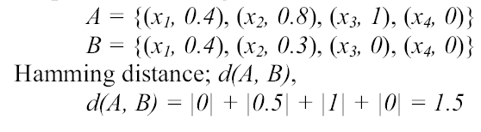

Other operations
Distance
Hamming distance
Relative Hamming distance

Slide 28

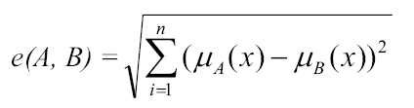


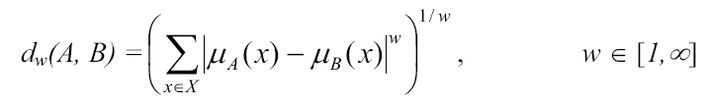
Other operations
Euclidean distance
Relative Euclidean distance
Minkowski distance
(w=1-> Hamming and w=2-> Euclidean)

Slide 29



Other operations
Cartesian product
Power
Cartesian product
Notes:
Cartesian product兩兩一組的排列組合

Slide 30

Other operations
Example:
A = { (x1, 0.2), (x2, 0.5), (x3, 1) }
B = { (y1, 0.3), (y2, 0.9) }

Slide 31
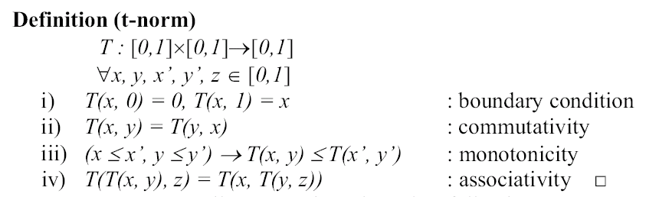
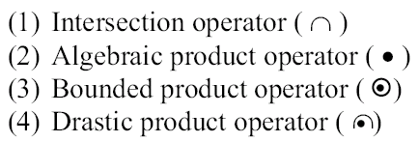
t-norms and t-conorms (s-norms)
Notes:
In mathematics, a t-norm (also T-norm or, unabbreviated, triangular norm) is a kind of binary operation used in the framework of probabilistic metric spaces and in multi-valued logic, specifically in fuzzy logic. A t-norm generalizes intersection in a lattice and conjunction in logic. The name triangular norm refers to the fact that in the framework of probabilistic metric spaces t-norms are used to generalize triangle inequality of ordinary metric spaces.

Slide 32
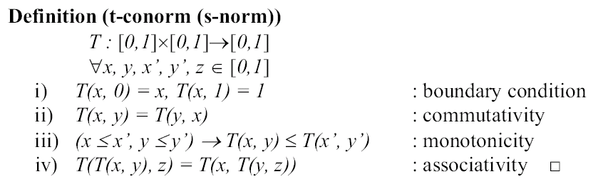
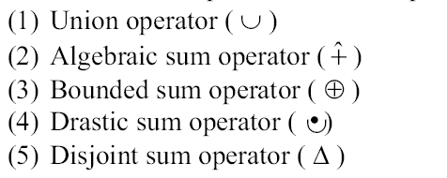
t-norms and t-conorms (s-norms)

Slide 33
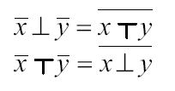
t-norms and t-conorms (s-norms)
Duality of t-norms and t-conorms
Applying complements
DeMorgan’s law

