Slide 1
Simple Membership
Introduction and Implementation

Slide 2
How to Enable Simple Membership in ASP.Net Web Forms Application
Create a brand-new ASP.NET WebForms application project
Open the Package Manager Console
Tools > NuGet Package Manager > Package Manager Console
Run these commands:
Uninstall-Package Microsoft.AspNet.WebHelpers
Uninstall-Package Microsoft.AspNet.WebPages.OAuth
Uninstall-Package Microsoft.AspNet.WebPages.WebData
Uninstall-Package Microsoft.AspNet.WebPages.Data
Install-Package Microsoft.AspNet.WebPages.Data
Install-Package Microsoft.AspNet.WebPages.WebData
Install-Package Microsoft.AspNet.WebPages.Oauth
Install-Package Microsoft.AspNet.WebHelpers

Slide 3
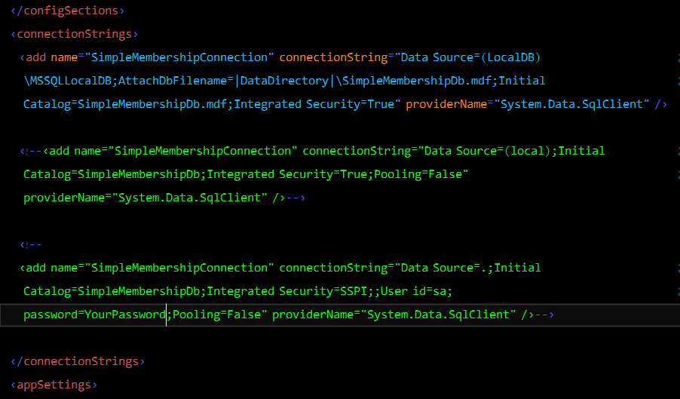
Connection String
Open web.config and create connection string to your database

Slide 4
Web.config
Remove the <profile> element. You’ll manage user profile information by accessing the user table directly.
In system.web, replace the <membership> and <roleManager> elements with:
<membership defaultProvider="SimpleMembershipProvider">
<providers>
<add name="SimpleMembershipProvider" type="WebMatrix.WebData.SimpleMembershipProvider, WebMatrix.WebData" enablePasswordRetrieval="false" enablePasswordReset="false" requiresQuestionAndAnswer="false" requiresUniqueEmail="false" maxInvalidPasswordAttempts="3" minRequiredPasswordLength="4" minRequiredNonalphanumericCharacters="0" />
</providers>
</membership>
<roleManager defaultProvider="SimpleRoleProvider">
<providers>
<add name="SimpleRoleProvider" type="WebMatrix.WebData.SimpleRoleProvider, WebMatrix.WebData" />
</providers>
</roleManager>

Slide 5
AppSettings In Configuration Section
Add an <appSettings> section under <configuration>
Add following lines
<appSettings>
<add key="webPages:Version" value="3.0.0.0" />
<add key="DefaultConnectionName" value="SimpleMembershipConnection"/>
<add key="UsersTableName" value="Users"/>
<add key="UsersPrimaryKeyColumnName" value="Id"/>
<add key="UsersUserNameColumnName" value="Email"/>
</appSettings>

Slide 6
Config.cs
Add new Class file, named Config
Add following properties
public static string ConnectionStringName => ConfigurationManager.AppSettings["DefaultConnectionName"] ?? "DefaultConnection";
public static string UsersTableName => ConfigurationManager.AppSettings["UsersTableName"] ?? "Users";
public static string UsersPrimaryKeyColumnName => ConfigurationManager.AppSettings["UsersPrimaryKeyColumnName"] ?? "Id";
public static string UsersUserNameColumnName => ConfigurationManager.AppSettings["UsersUserNameColumnName"] ?? "Email";

Slide 7
Global.asax.cs
Add a new method, and then call this method in Application_Start()
void InitializeSimpleMembership()
{
try
{
WebSecurity.InitializeDatabaseConnection(
Config.ConnectionStringName,
Config.UsersTableName,
Config.UsersPrimaryKeyColumnName,
Config.UsersUserNameColumnName,
autoCreateTables: true);
}
catch (Exception ex)
{
throw new InvalidOperationException(
"The ASP.NET Simple Membership database could not be initialized. For more information, please see http://go.microsoft.com/fwlink/?LinkId=256588",
ex);
}
}

