Slide 1
Netflix Movie Recommendation and Rating Prediction System
2021-MS-DS-115

Slide 2
Why Recommendation System Important?
Enhanced User Experience
Personalized content suggestions help users quickly find shows and movies they'll enjoy, reducing decision fatigue.
Increased Engagement
Relevant recommendations keep users watching longer, increasing retention and satisfaction.
Content Discovery
Introduces users to niche or lesser-known content, maximizing the value of Netflix's extensive library.
Revenue Growth
By keeping users engaged, Netflix reduces churn rates and attracts new subscribers, boosting profitability.
Efficient Content Investment
Insights from user preferences guide decisions on new content production and licensing, ensuring alignment with audience interests.
Competitive Edge
A robust recommendation engine differentiates Netflix from competitors, solidifying its position as a leader in streaming services.

Slide 3
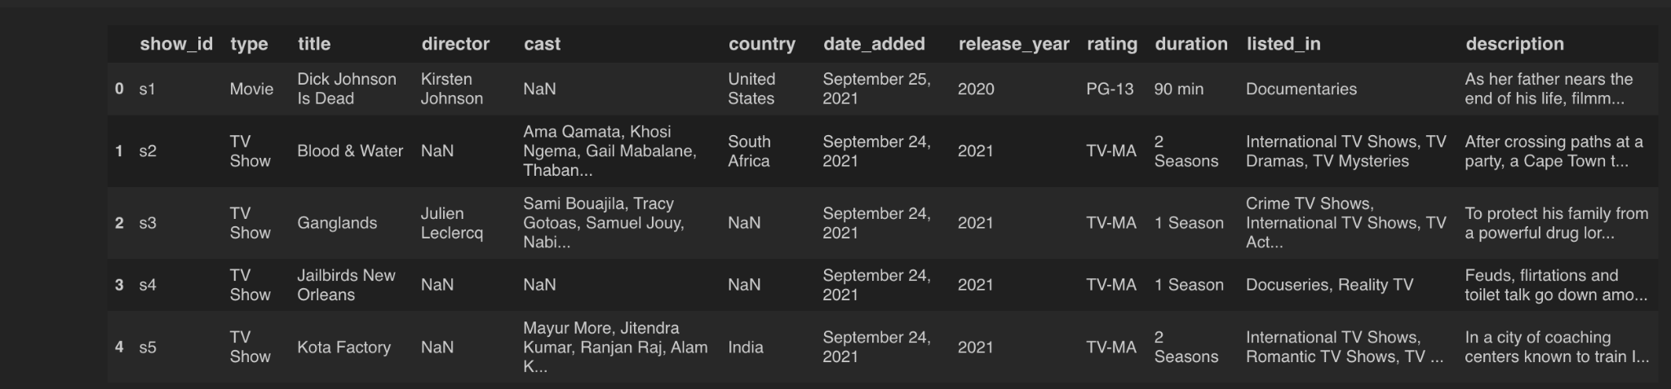
Dataset Overview
Below is the head of the dataset
We have fields like show_type, director, country, release_year,rating and description etc.

Slide 4
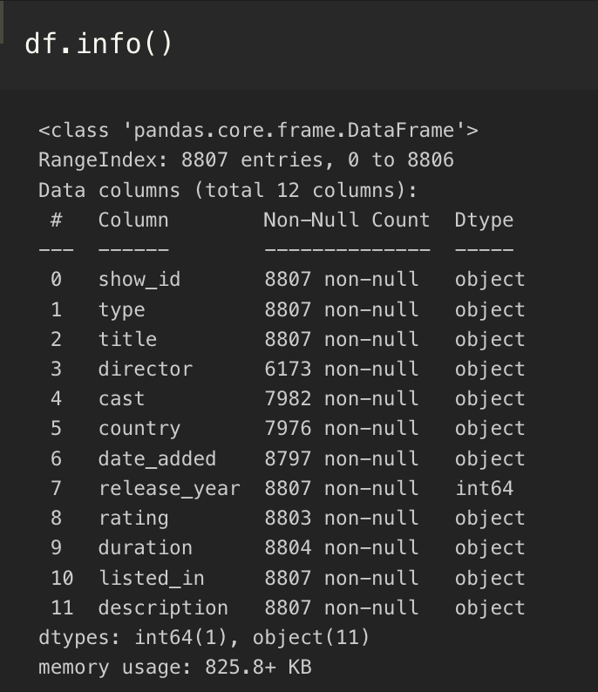
Dataset Overview
Here is the information of the dataset.
Here we can see all the features are object type except release year.

Slide 5
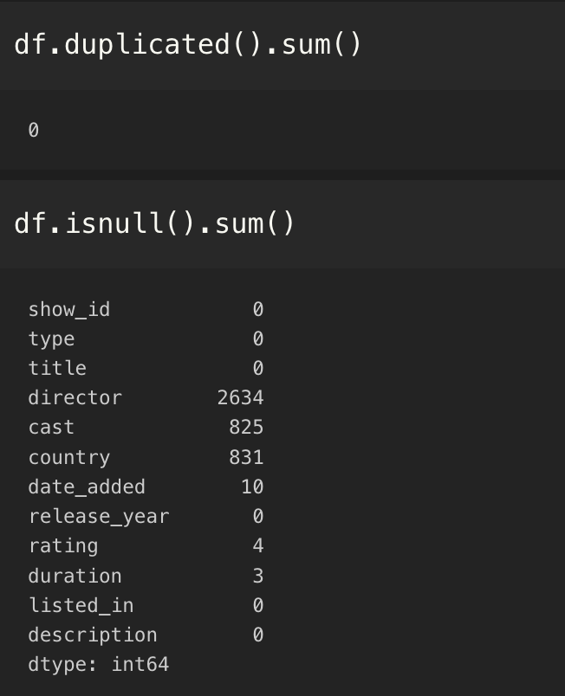
Problems in Dataset
The dataset have six column containing null values.
Names:
Director
Cast
Country
Date_added
Rating
Duration

Slide 6
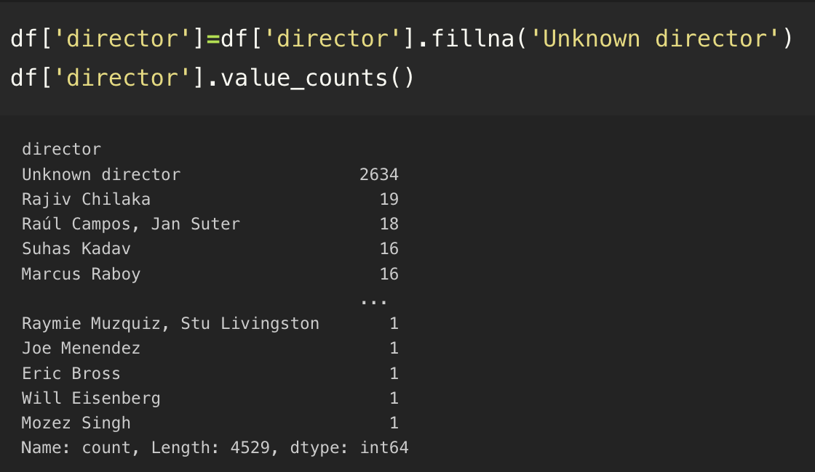
Solution for Director
From null count we can see there are 2634 values which are null in director column.
So it is not possible to remove all these records.
We replace the null values with ‘Unknown Director’.

Slide 7
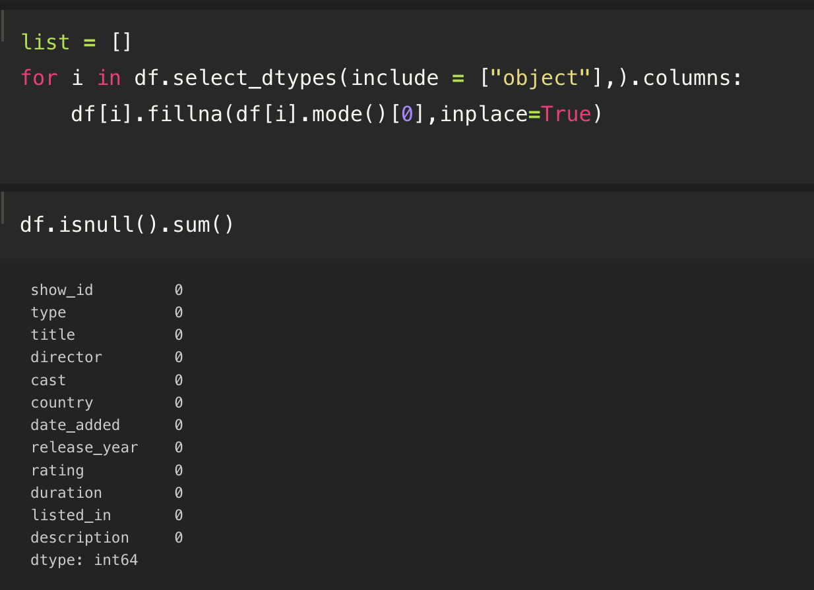
Solution for Other Null Values
For other all null values replace null with the mode of that column.
Then we can see there is no null values remaining.

Slide 8
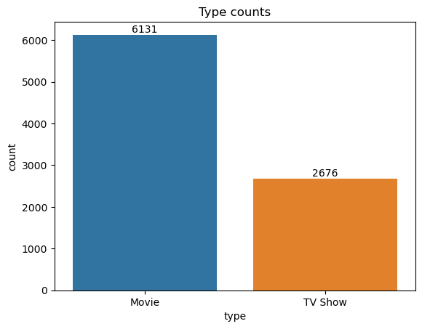
EDA
Bar plot of count of Movie and Tv_shows.

Slide 9
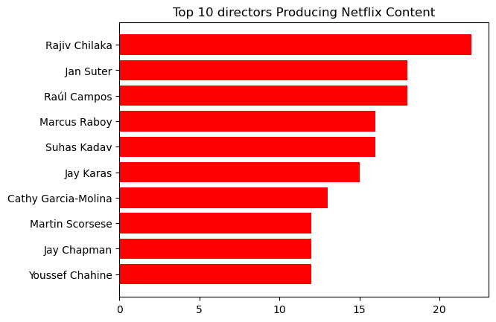
EDA
Top 10 directors producing content on Netflix.

Slide 10
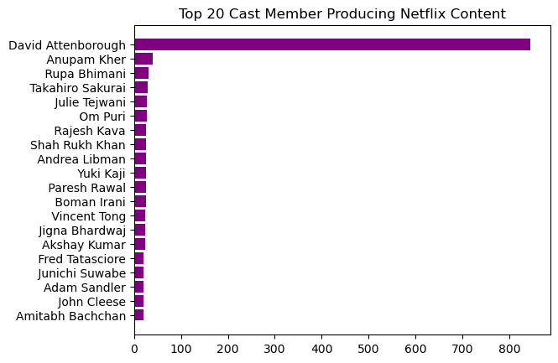
EDA
Top 20 Cast Members producing content on Netflix.

Slide 11
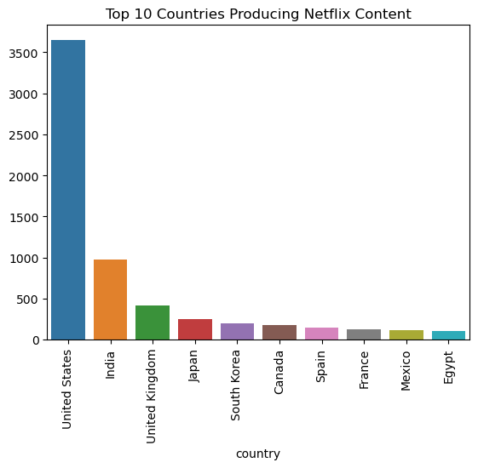
EDA
Top 10 Countries producing content on Netflix.

Slide 12
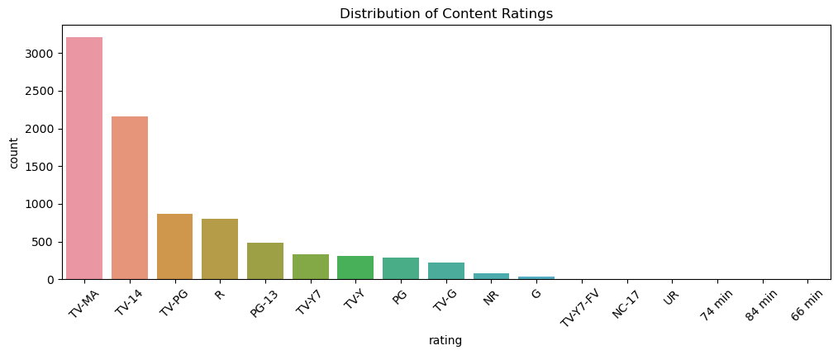
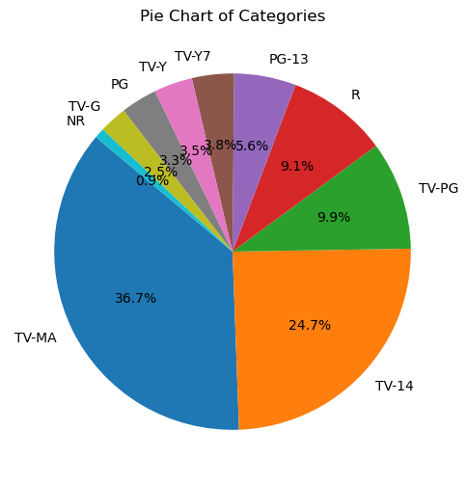
EDA
Rating count of distribution of Content Rating

Slide 13
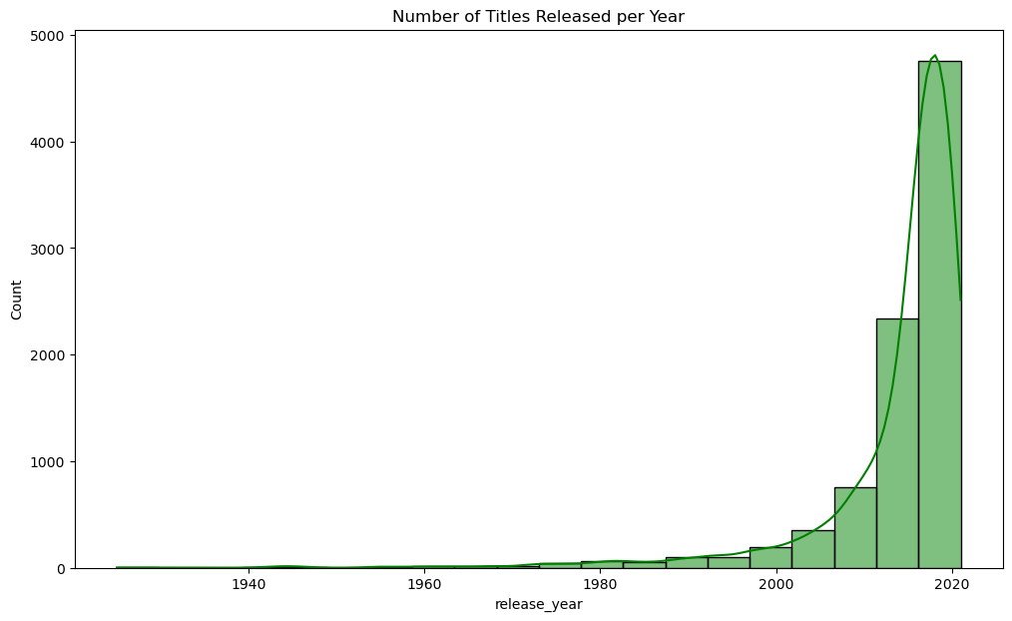
EDA
Number if netflix content released every year.

Slide 14
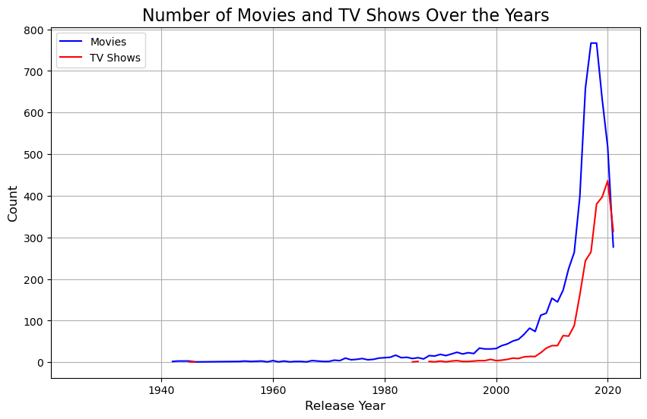
EDA
Number if netflix content released every year separated by movies and tv_shows.

Slide 15
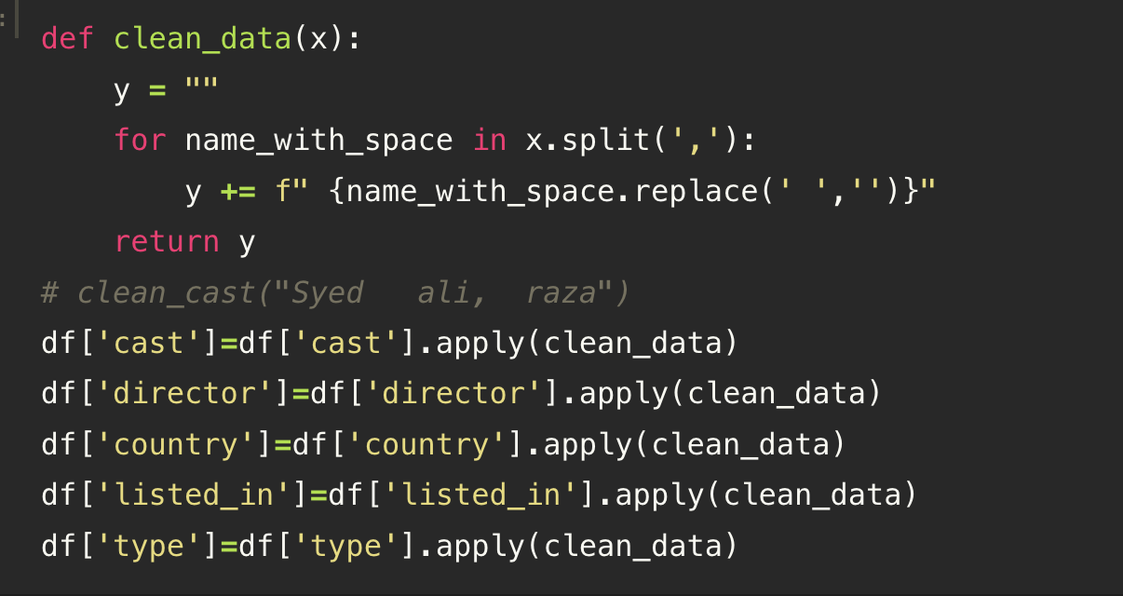
Data Preprocessing
As we have data in natural language form so we clean data.
Remove extra spaces.
Remove punctuations.
Remove use-less data.

Slide 16
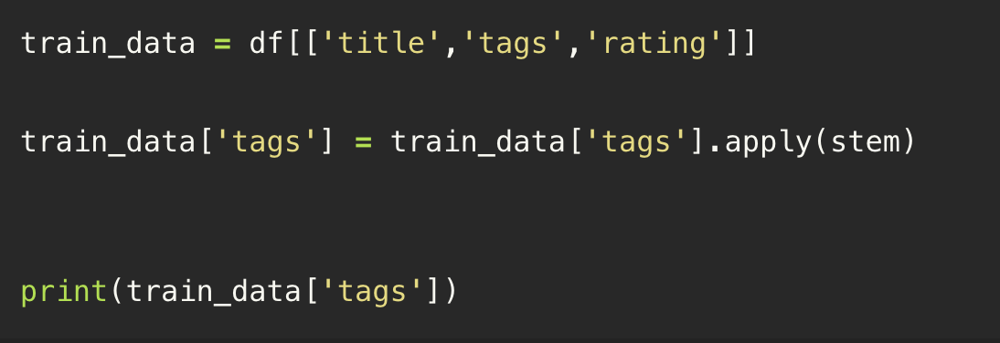
Data Preprocessing
We will add a new column which contain all the columns data.
As shown in image below

Slide 17
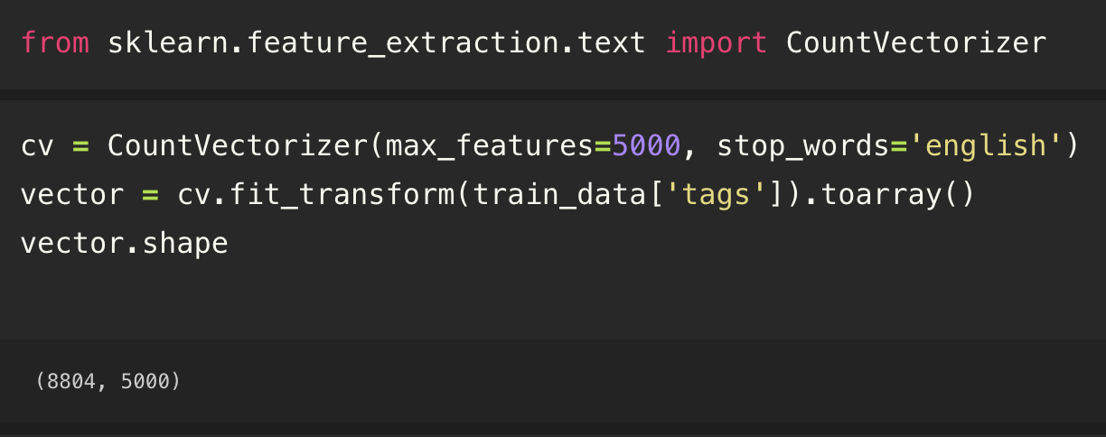
Feature Extraction
For feature extraction we use Countvectorizer

Slide 18
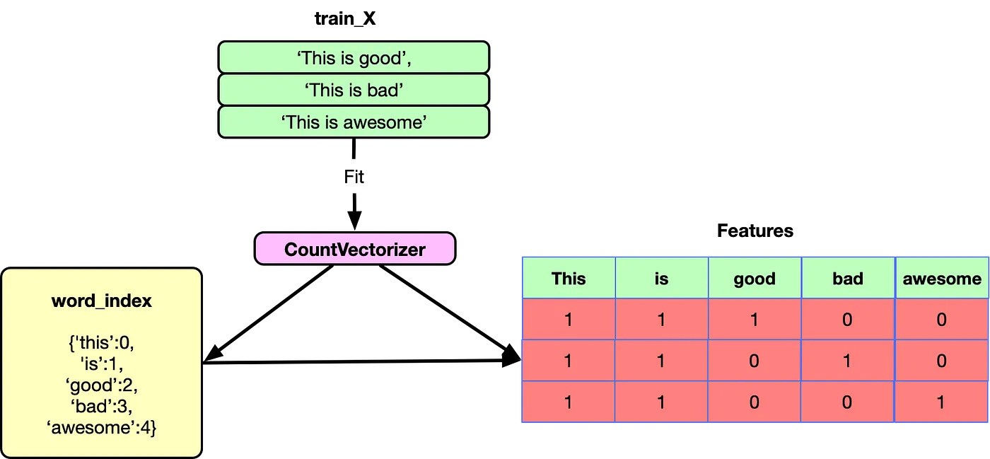
Working of CountVectorizer

Slide 19
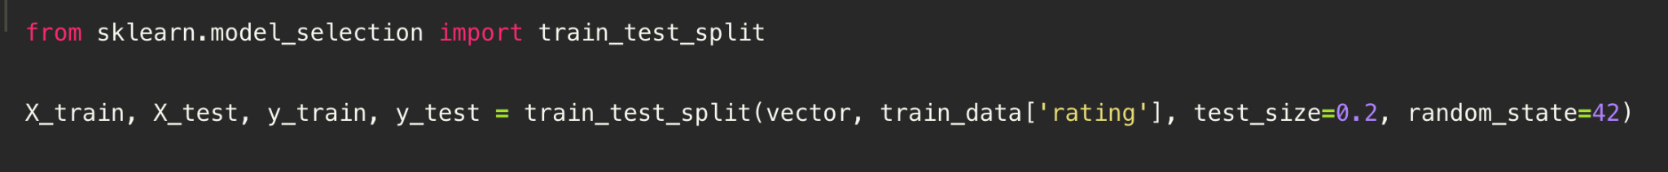
Train Test Split
Split the data in training set and test set.
Used library is scikit-learn.

Slide 20
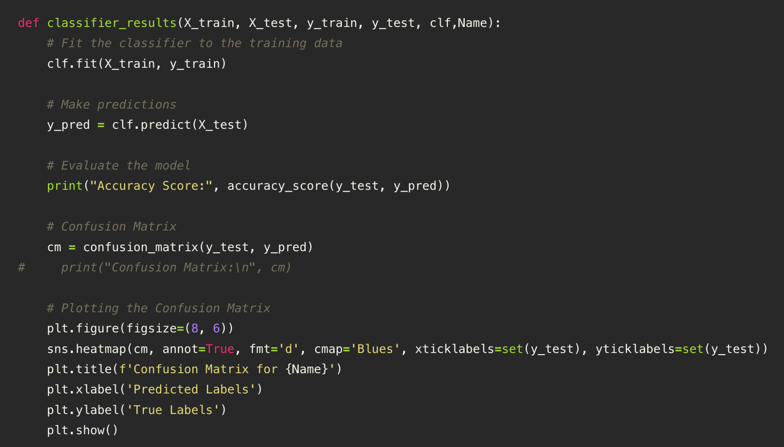
Model Reusable Function
He is a function which get x_train,y_train,x_test, y_test and classifier as input and plot the results.

Slide 21
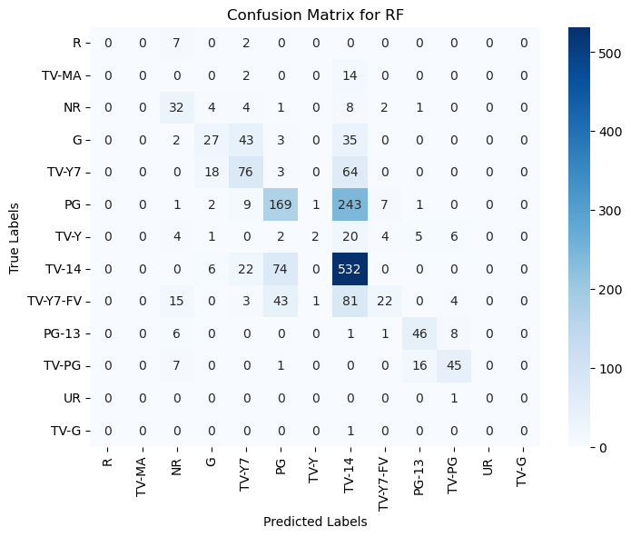
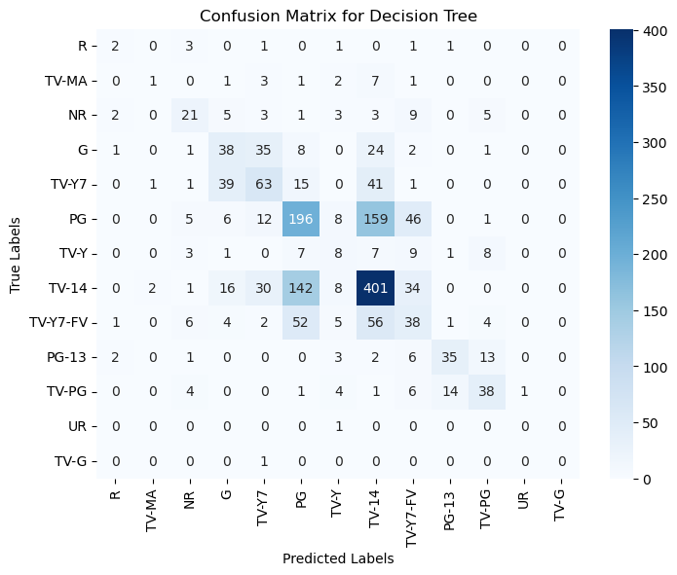
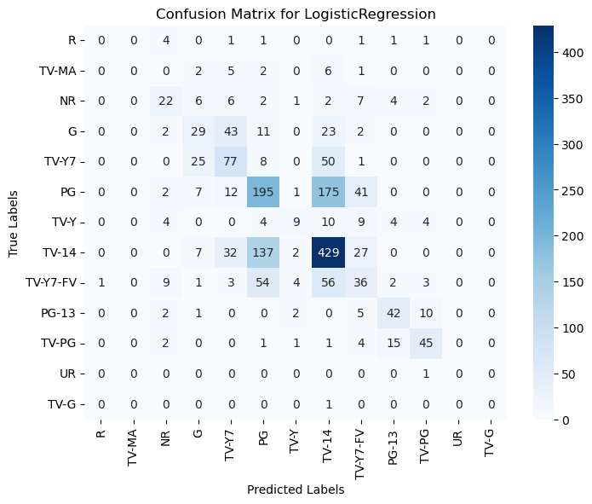
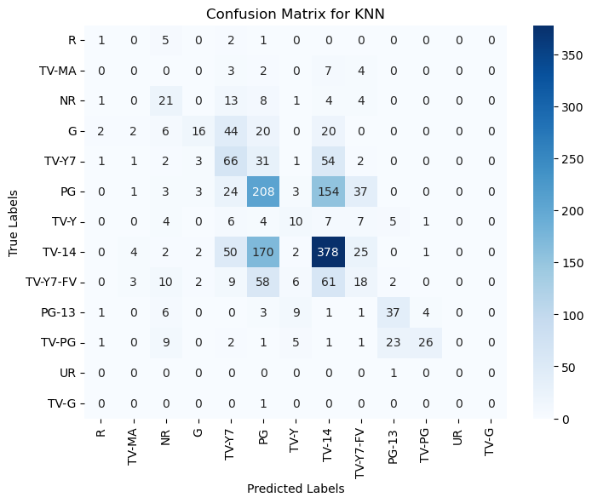
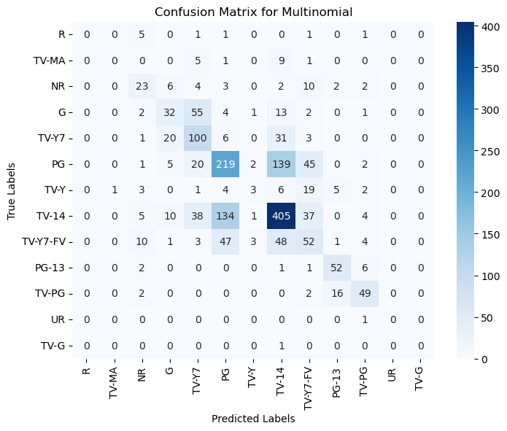
Result in Confusion Matrix
Here we can see that Random forest has more accuracy as compare to other model then we have Multi Model model at second.

Slide 22
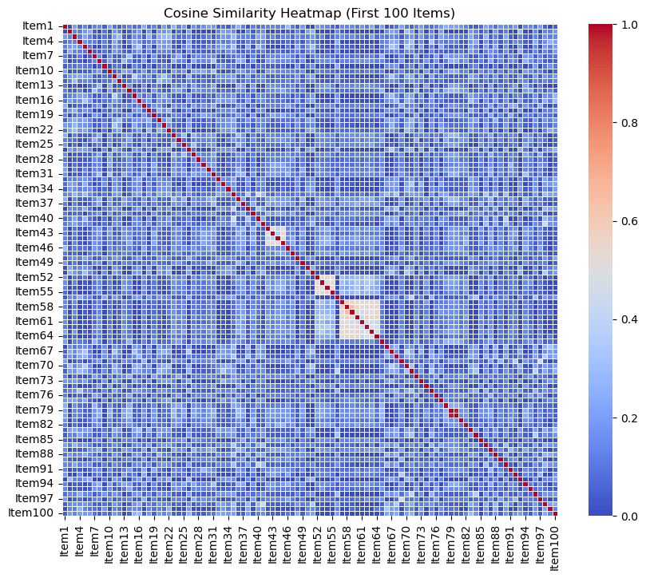
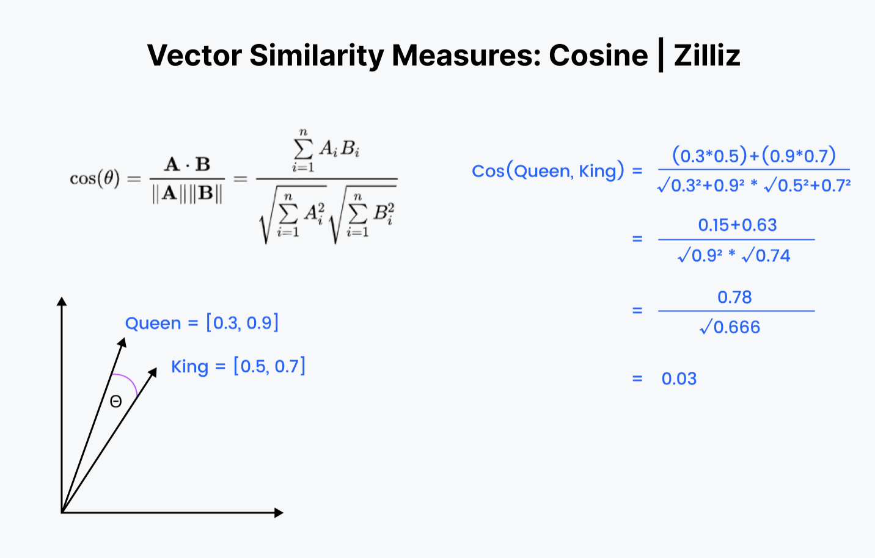
Finding Similarities
To find similarity we use Cosine similarity

Slide 23

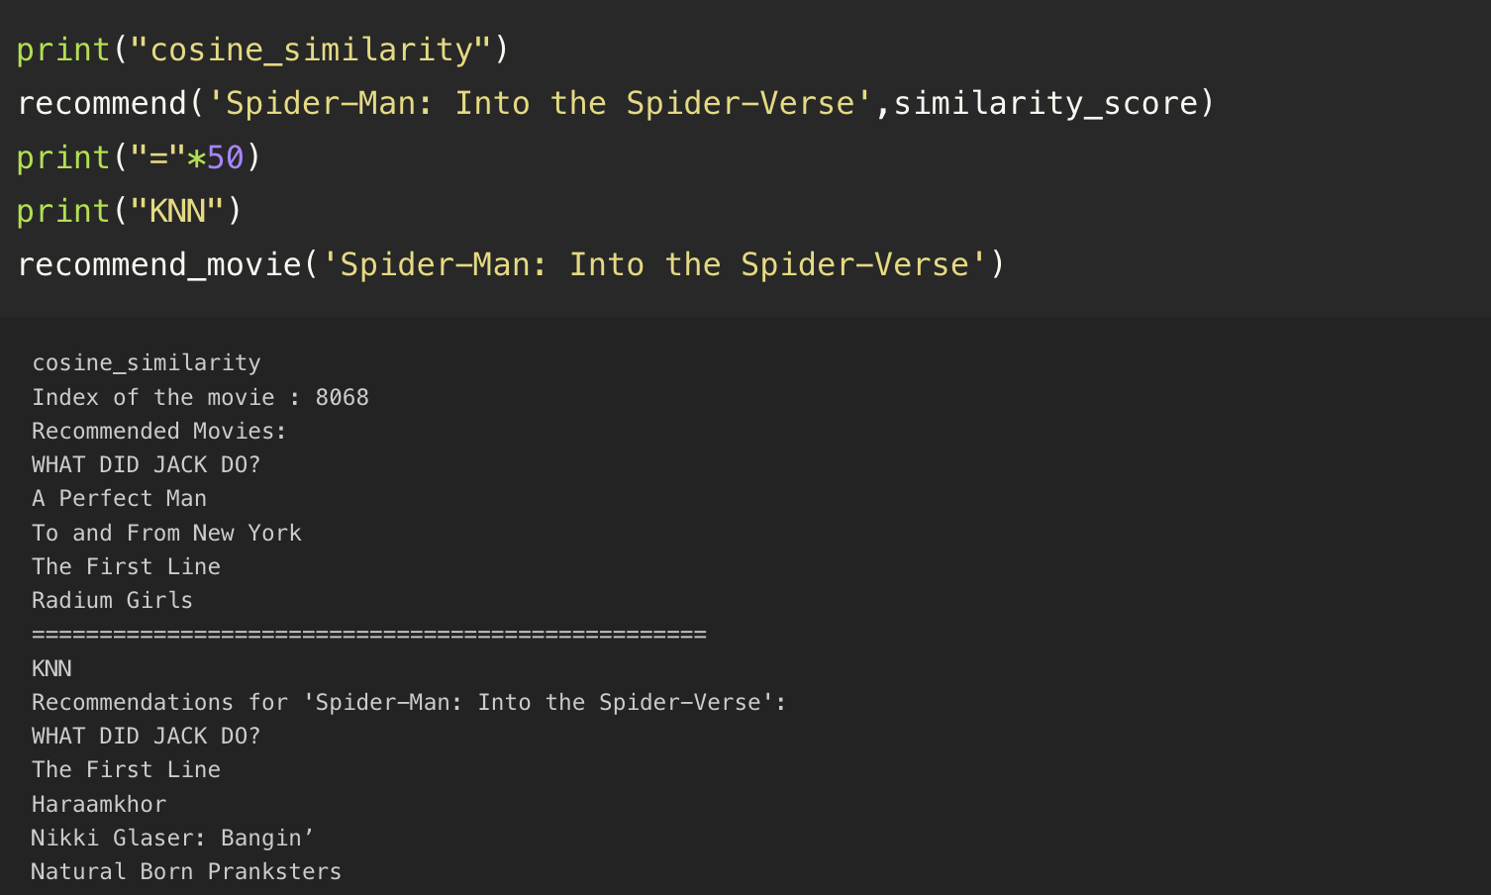
Recommendation

