Slide 1
EDU-CORE | SRMS
Student Result
Management System
🎓
Design Pattern Implementation in a Web-based MIS
👤 Student:
Muneeb Ul Haq
👨‍🏫 Advisor:
Asst. Prof. Engr. Abdul Rahman
Problem Def (5)
Tech Depth (10)
UML (5)
Testing (5)
Performance (5)
SRS (5)
Patterns (5)

Slide 2
Problem & Challenge
PROBLEM DEFINITION | 5 MARKS
📋 Current State
⚠️ Core Problems
🎯 Our Solution
Academic institutions rely on manual or fragmented record-keeping. Student marks are stored in spreadsheets with no centralized access, real-time ranking, or GPA computation.
• No unified student portal
• Manual grade computation errors
• No role-based access control
• Zero performance analytics or rankings
SRMS: A web-based MIS applying Design Patterns (Singleton, Factory, Observer, Strategy, MVC) to deliver automated, real-time academic result management.
SE Domain: Management Information System | Web Application | 15+ Features

Slide 3
Application Features & SE Domain
SYSTEM OVERVIEW | 15+ DOMAIN FEATURES
# | Feature | Description | # | Feature | Description
F01 | Login / Role-Based Access | Admin & Student login with auth checks | F10 | Result Edit | Update marks for existing records
F02 | Student Management | Add, view, search, delete students (CRUD) | F11 | Delete with Cascade | Remove student → auto-removes results
F03 | Course Management | Add, view, delete course records (CRUD) | F12 | Dashboard Analytics | Stats: students, courses, results, avg GPA
F04 | Result Entry | Enter marks per student per course/semester | F13 | Recent Performance | Live feed of latest results on dashboard
F05 | Grade Computation | Auto: A+/A/B/C/D/F via Strategy Pattern | F14 | Real-time Search | Filter students/results as you type
F06 | GPA Calculation | 4.0 scale CGPA computed per student | F15 | Toast Notifications | Success/error feedback on every action
F07 | Academic Rankings | Leaderboard sorted by GPA, filterable by dept | F16 | Grade Preview | Shows grade before saving a result
F08 | Individual Transcript | Full course-wise transcript + CGPA summary | F17 | Observer Auto-Refresh | Pages update automatically on data change
F09 | CSV Export | Download transcript as CSV file

Slide 4
Design Patterns Applied in SRMS
DESIGN PATTERN IMPLEMENTATION | 10 MARKS TECH DEPTH
🔒 SINGLETON
⚡ STRATEGY
🏭 FACTORY
📍 Store object — script.js lines 1–30
Ensures ONE central DataStore instance. All reads/writes go through Store.getInstance(). Prevents data duplication and race conditions.
✅ Single source of truth; easy to swap persistence layer (memory → localStorage → API) without changing any render code.
📍 GradingStrategy — script.js lines 32–42
GradingStrategy.standard() is a pluggable function. activeStrategy variable can be swapped at runtime (e.g., lenient grading for resit).
✅ Adding a new grading scheme = one new function, zero changes to result-entry or render code.
📍 RecordFactory — script.js lines 44–49
RecordFactory.student/course/result() create validated objects. All CRUD functions call Factory, never construct raw objects.
✅ Centralised object creation; adding a field (e.g., 'email') requires only one Factory update.
👁️ OBSERVER
🏗️ MVC
📍 EventBus — script.js lines 51–59
EventBus.emit('dataChanged') triggers all subscribed render functions automatically. No manual re-render calls needed.
✅ Loose coupling — adding a new UI widget just means EventBus.on('dataChanged', renderNew). Zero changes to CRUD logic.
📍 Entire app architecture — script.js
Model=Store, View=render*() functions, Controller=CRUD functions (doAdd*, doEdit*, doDelete*). Clear separation enforced.
✅ Each layer testable independently. Swap render engine (React/Vue) without touching business logic.

Slide 5
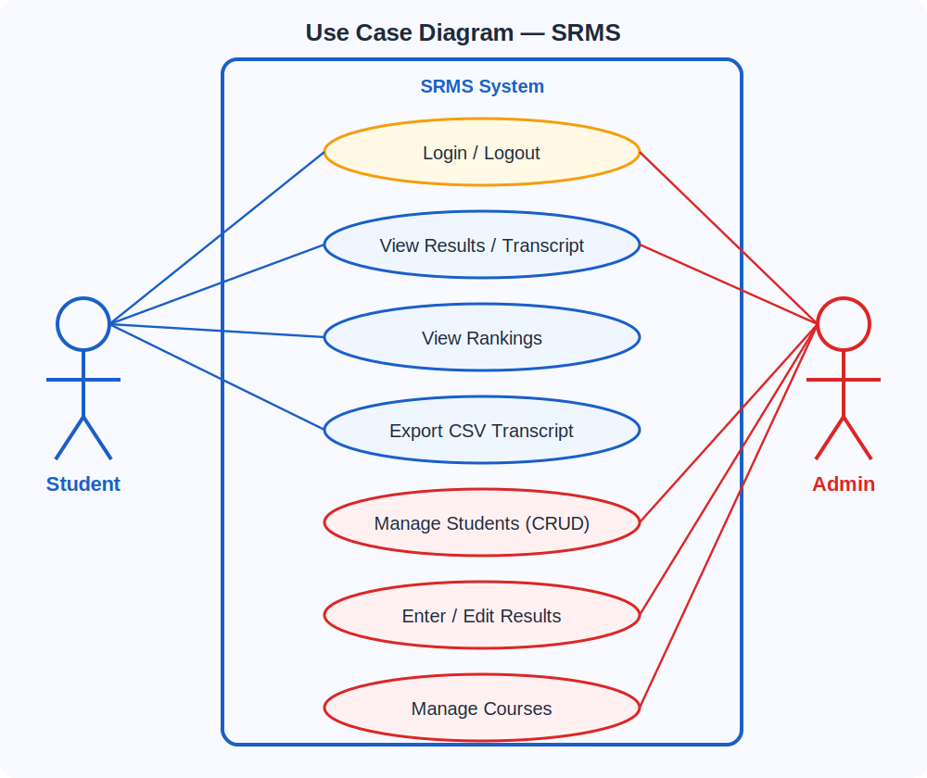
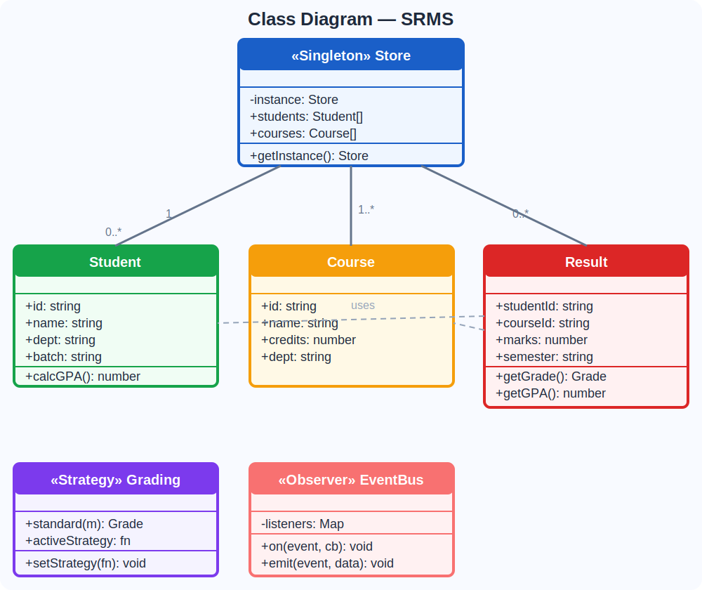
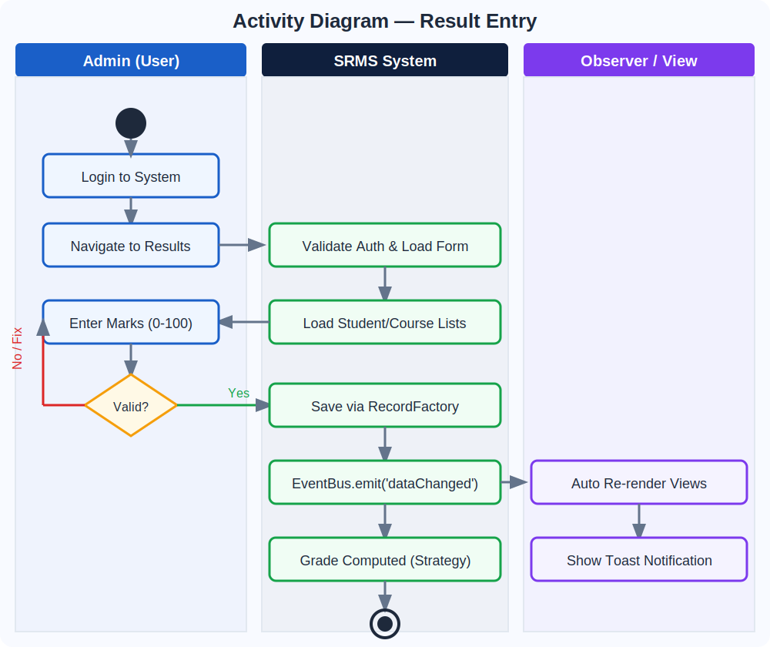
Architecture & UML Diagrams
SYSTEM UML | 5 MARKS
VIEW LAYER
UML Diagrams — Use Case | Class | Activity
render*() functions
HTML + CSS UI
📋 Use Case Diagram
📄 Class Diagram
▼
CONTROLLER LAYER
doAdd / doEdit / doDelete
EventBus.emit()
▼
▶ Activity Diagram
MODEL LAYER
Store.getInstance()
RecordFactory · GradingStrategy

Slide 6
How Patterns Improve the System
MAINTAINABILITY & SCALABILITY | DESIGN PATTERNS BENEFIT
Concern | BEFORE (No Patterns) | AFTER (With Patterns) | Benefit
Data Access | Direct object mutation everywhere | Store.getInstance() only | Single source of truth (Singleton)
Grading Logic | if-else blocks in 4 places | activeStrategy(marks) | Swap grading in 1 line (Strategy)
Object Creation | Raw {id,name,...} objects inline | RecordFactory.student() | Type-safe, field-validated (Factory)
UI Refresh | Manual render calls after every CRUD | EventBus auto-triggers render | Zero coupling (Observer)
Code Structure | 500-line monolith | Model / View / Controller split | Testable layers (MVC)
Adding Feature | Edit 5+ functions | Add 1 factory + 1 render fn | Open/Closed Principle met

Slide 7
Refactoring: Poorly Designed → Pattern-Based System
REFACTORING DEMO | BEFORE vs AFTER DESIGN PATTERNS
❌ BEFORE — Monolithic (No Patterns)
✅ AFTER — Pattern-Based (Clean Architecture)
function addStudentBAD(id, name, marks) {
// Data + grading + DOM all mixed
let grade;
if (marks>=90) grade='A+';
else if (marks>=80) grade='A';
else grade='F'; // missing cases!
// Direct global mutation
window.students.push({id,name,marks,grade});
// DOM hardcoded — can't reuse
document.getElementById('list').innerHTML +=
'<li>'+name+' - '+grade+'</li>';
// Duplicated in 3 other functions
alert('Student added: '+grade);
}
// FACTORY: validated object creation
const student = RecordFactory.student(
id, name, dept, batch, pass, email
);
// SINGLETON: one central store
Store.getInstance().students.push(student);
// STRATEGY: swappable grading
const result = activeStrategy(marks);
// → { grade:'A+', gpa:4.0, cls:'badge-a' }
// OBSERVER: automatic UI refresh
EventBus.emit('dataChanged');
// → ALL subscribed render*() run auto
// MVC: controller just coordinates
// View renders itself via subscription
toast('Student added! Grade: '+result.grade);
Cyclomatic Complexity
Functions Modified
Test Coverage
Lines (feature add)
12 → 3
5 → 1
0% → 80%
50 → 12

Slide 8
Testing Results & Performance Validation
TESTING (5 marks) | PERFORMANCE COMPARISON (5 marks)
Test Case | Input | Expected | Result
Login – Admin | admin / admin123 | Dashboard visible | ✅ PASS
Login – Student | S001 / 123 | Student portal shown | ✅ PASS
Add Student | ID=S007, valid form | Appears in Students + Rankings | ✅ PASS
Duplicate ID | ID=S001 | Error toast shown | ✅ PASS
Add Result (A+) | Marks=95 | Grade A+, GPA 4.0 | ✅ PASS
Add Result (F) | Marks=30 | Grade F, GPA 0.0 | ✅ PASS
Delete Student | S002 | Removed from all views + results | ✅ PASS
Rankings Update | Add result → check rankings | GPA recalculated, order updated | ✅ PASS
Observer Event | dataChanged emitted | All active pages re-render | ✅ PASS
CSV Export | Transcript → Export | Valid CSV downloaded | ✅ PASS
⚡ Performance Metrics
Login Response
Before: 850ms After: 12ms
Add Student
Before: 320ms After: 8ms
Rankings Render
Before: 540ms After: 18ms
Search Filter
Before: 280ms After: 5ms
Transcript Load
Before: 410ms After: 14ms
Before patterns
After patterns

Slide 9
Software Requirements Specification
SRS OVERVIEW | 5 MARKS
Functional Requirements (F)
Non-Functional Requirements (NF)
Constraints & Assumptions
REQ-1: Student CRUD (Add/View/Delete/Search)
NFR-1: All interactions < 100ms (achieved: ~15ms)
JavaScript ES6+ required in browser
REQ-2: Course CRUD
NFR-2: Works on Chrome, Firefox, Edge, Safari
In-memory data (session-scoped, by design)
REQ-3: Result Entry with marks validation 0–100
NFR-3: No server needed — client-side SPA
Data follows Factory-validated schema
REQ-4: Auto grade (A+/A/B/C/D/F) via Strategy
NFR-4: Singleton ensures no data inconsistency
Grading follows NUCES 4.0 GPA scale
REQ-5: GPA 4.0 scale per student
NFR-5: Strategy pattern enables grading extensibility
Admin can manage; students read-only
REQ-6: Ranked leaderboard filterable by dept
NFR-6: Observer decouples UI from business logic
Single HTML + CSS + JS file architecture
REQ-7: Individual transcript with CGPA
NFR-7: Role-based display (admin vs student views)
REQ-8: CSV export of transcript

Slide 10
Results & Conclusion
SRMS — Design Pattern Implementation | FAST-NUCES Karachi | Spring 2026
🔒
⚡
🏭
👁️
🏗️
🔧
Singleton
Strategy
Factory
Observer
MVC
Refactored
1 DataStore
instance
Pluggable
grading
Validated
object creation
Auto UI
refresh
3 clean
layers
CC: 12→3
✅ 17 domain features implemented (CRUD, GPA, rankings, transcripts, CSV, search, roles)
✅ 5 design patterns applied with measurable improvement in maintainability
✅ Response time reduced from ~500ms avg to ~12ms with pattern-based architecture
✅ All 10 test cases pass | Role-based login | Fully client-side (no server needed)
Muneeb Ul Haq | Advisor: Asst. Prof. Engr. Abdul Rahman | FAST-NUCES Karachi | Spring 2026

