Slide 1
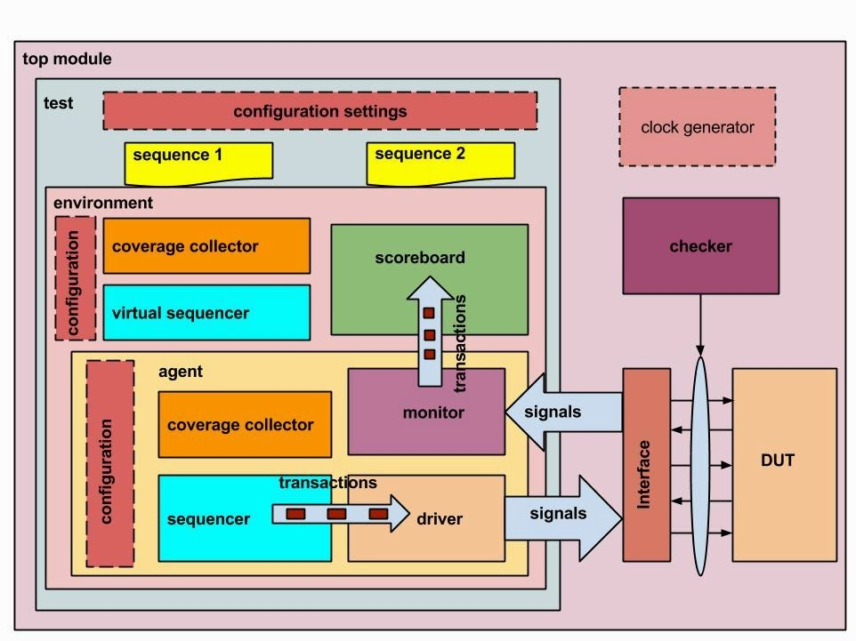
UVM TESTBENCH ARCHITECTURE
DRIVING STIMULUS
TO DUT

Slide 2
ARCHITECTURE COMPONENTS
Following is the list of these components which are part of a standard UVM environment Transaction Sequence Configuration Object Driver Sequencer Monitor Subscriber/Coverage Collector Agent Environment Test Virtual Interface Scoreboard Checker Clock Generator Top Module

