Slide 1
Real time Leaderboard System
A Real-Time Leaderboard System dynamically ranks users instantly based on their updated scores

Slide 2
A Real-Time Leaderboard System is used to display rankings of users based on their performance or scores instantly. It is commonly used in gaming, coding platforms, sports analytics, and online competitions. The system updates rankings dynamically whenever a user’s score changes. It ensures fast and efficient data processing to handle frequent updates. Advanced data structures like heaps are used to quickly identify top performers. Hashing techniques help in storing and accessing user data efficiently. It improves user engagement by providing instant feedback on performance. The main goal is to maintain accurate, up-to-date rankings in real time with high efficiency.
INTRODUCTION

Slide 3
A Real-Time Leaderboard System is used to display rankings of users based on their performance or scores instantly.
It is commonly used in gaming, coding platforms, sports analytics, and online competitions.
The system updates rankings dynamically whenever a user’s score changes.
It ensures fast and efficient data processing to handle frequent updates.
Advanced data structures like heaps are used to quickly identify top performers.
Hashing techniques help in storing and accessing user data efficiently.
It improves user engagement by providing instant feedback on performance.
The main goal is to maintain accurate, up-to-date rankings in real time with high efficiency.
OBJECTIVES

Slide 4
WORKING OF THE PROJECT
The system accepts user names and their scores as input.
Scores are stored and updated using a hashing technique for quick access.
Whenever a new score is added, the system updates the existing score if the user already exists.
A heap data structure is used to efficiently sort and maintain the top-ranked users.
The leaderboard is dynamically updated and displayed after every score change.
Users can view real-time rankings, ensuring accurate and instant performance tracking.

Slide 5
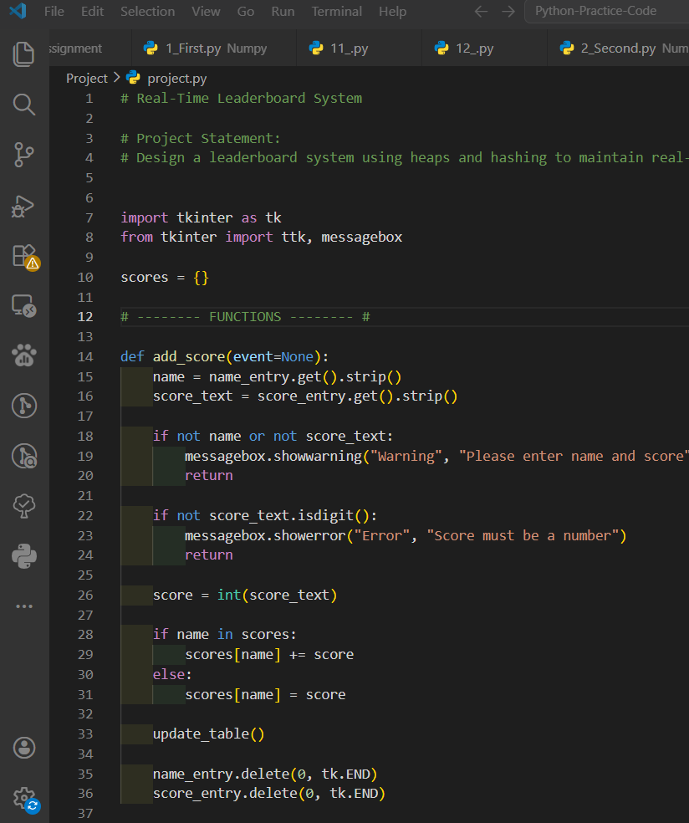
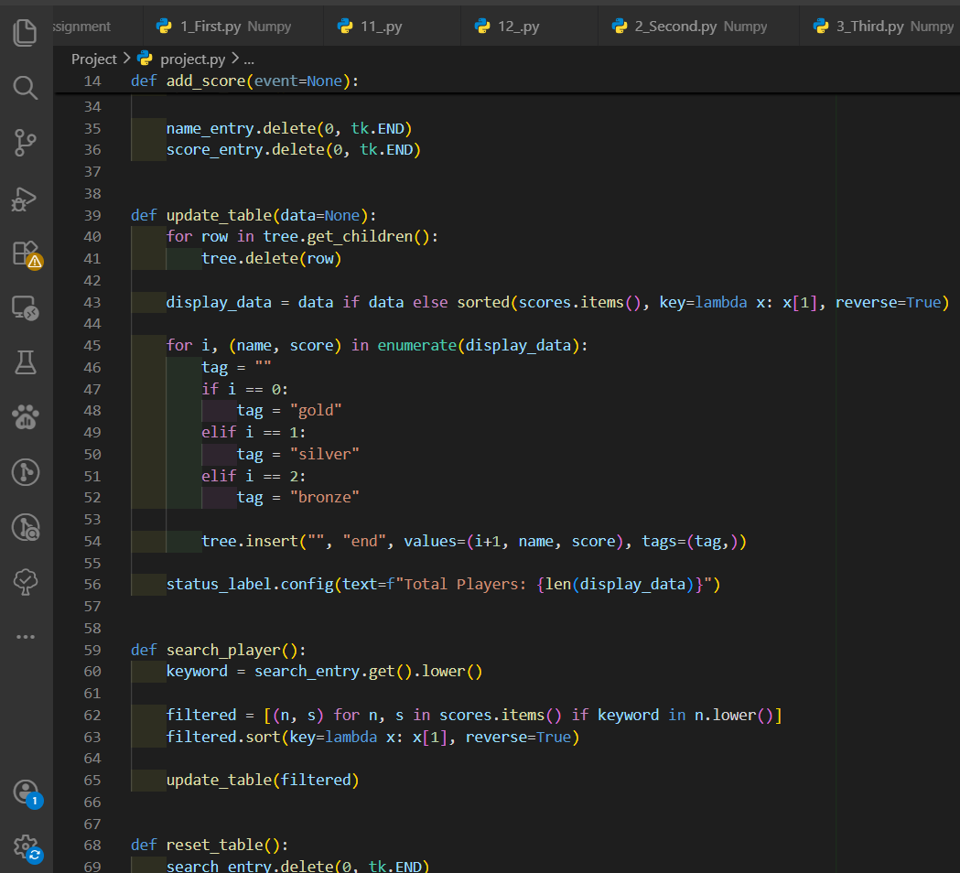
CODE

Slide 6
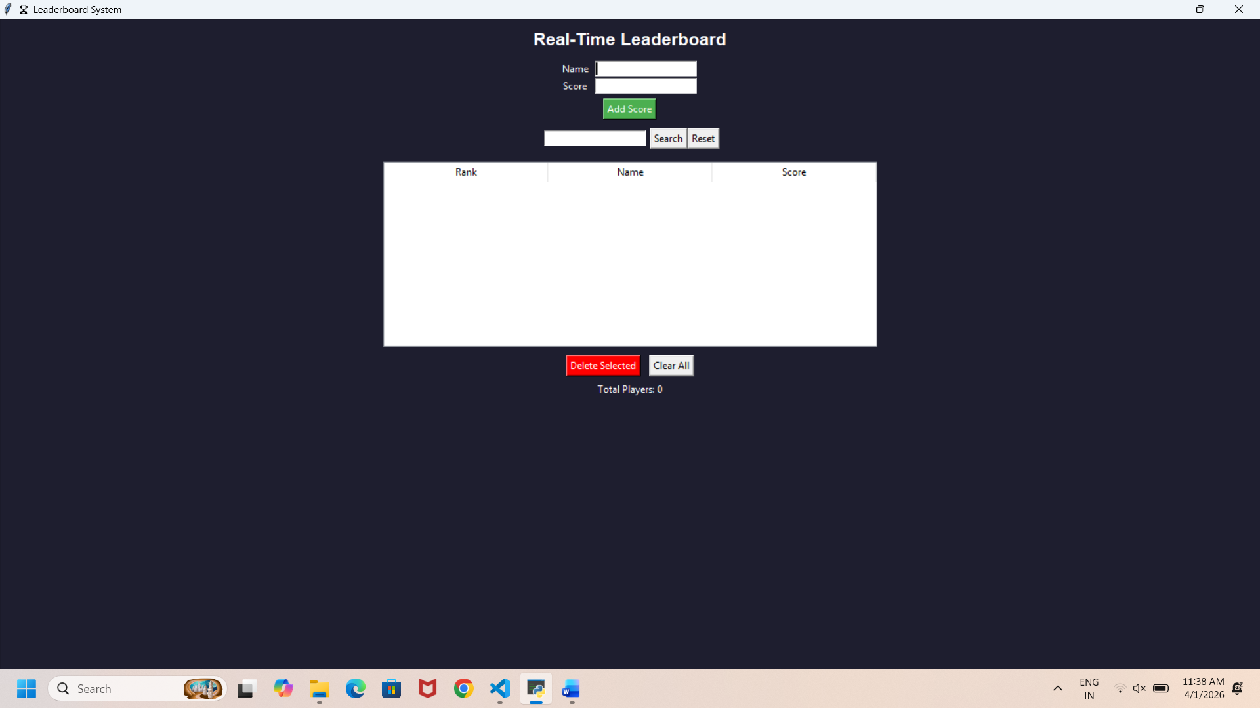
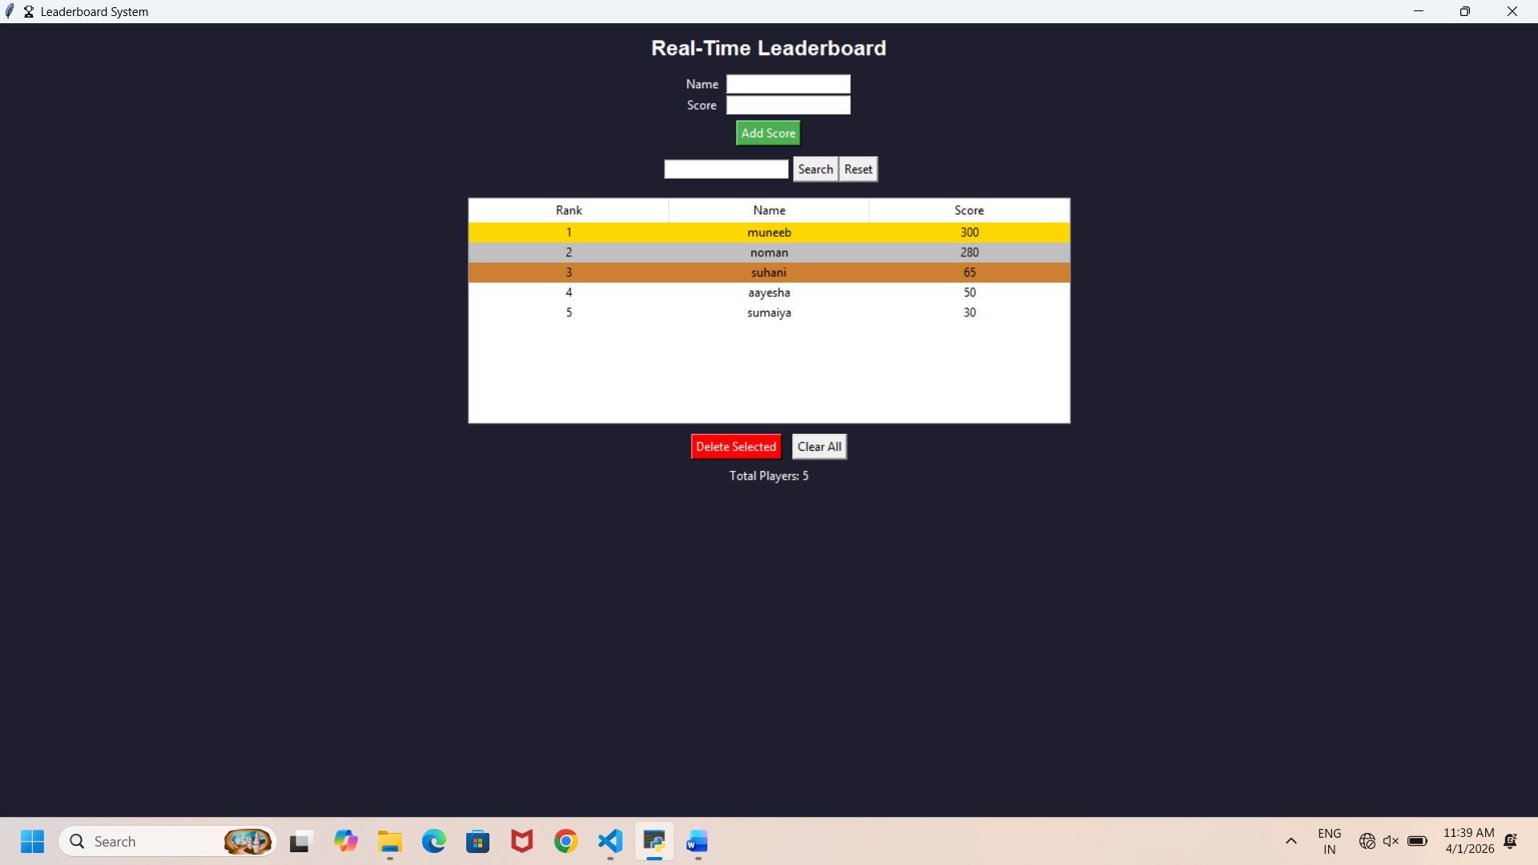
OUTPUT

Slide 7
Conclusion
The Real-Time Leaderboard System provides an efficient and dynamic way to manage and display user rankings based on continuously changing scores. By using advanced data structures like heaps and hashing, the system ensures fast updates, quick data access, and accurate ranking in real time. It enhances user engagement by offering instant feedback on performance and maintaining transparency in rankings. Overall, this project demonstrates how optimized algorithms and data structures can be effectively applied to solve real-world problems requiring speed, scalability, and reliability.

