Slide 1

Welcome,
Novamed Rescue Medical Treatment Facilitation Services
Trusted By 7000+SMEs
WELCOME TO FINANSHELS
Welcome to Finanshels, Novamed Rescue Medical Treatment Facilitation Services! We're excited to streamline your accounting and tax processes, ensuring compliance and efficiency.
www.finanshels.com
01

Slide 2
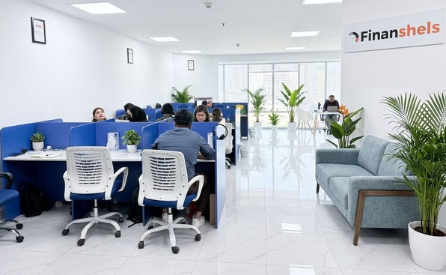
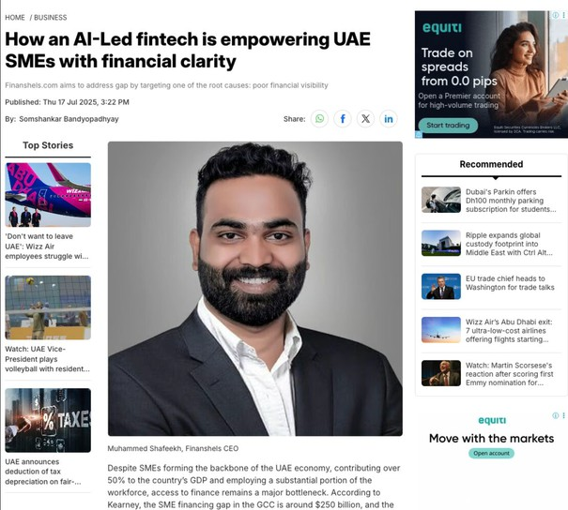




Our Story
Trusted By 7000+SMEs
7000+
Happy Founders
“From starting our own businesses in the past, we know that running the back-
office was a major distraction; and working with technically challenged accountants was no fun at all. Of all industries out there, accounting was one of the view few that had yet to be modernized. We are not just an accounting firm, we want to completely change the way that business owners think about their finances, and taking care of their backoffice affairs in our way of doing that.”
4.9
Trust Pilot Rating
- Muhammed Shafeekh (Founder & CEO, Finanshels.com)
136+
Smart Solutions Team
9.4
NPS SCORE
Backed by :
www.finanshels.com
02

Slide 3
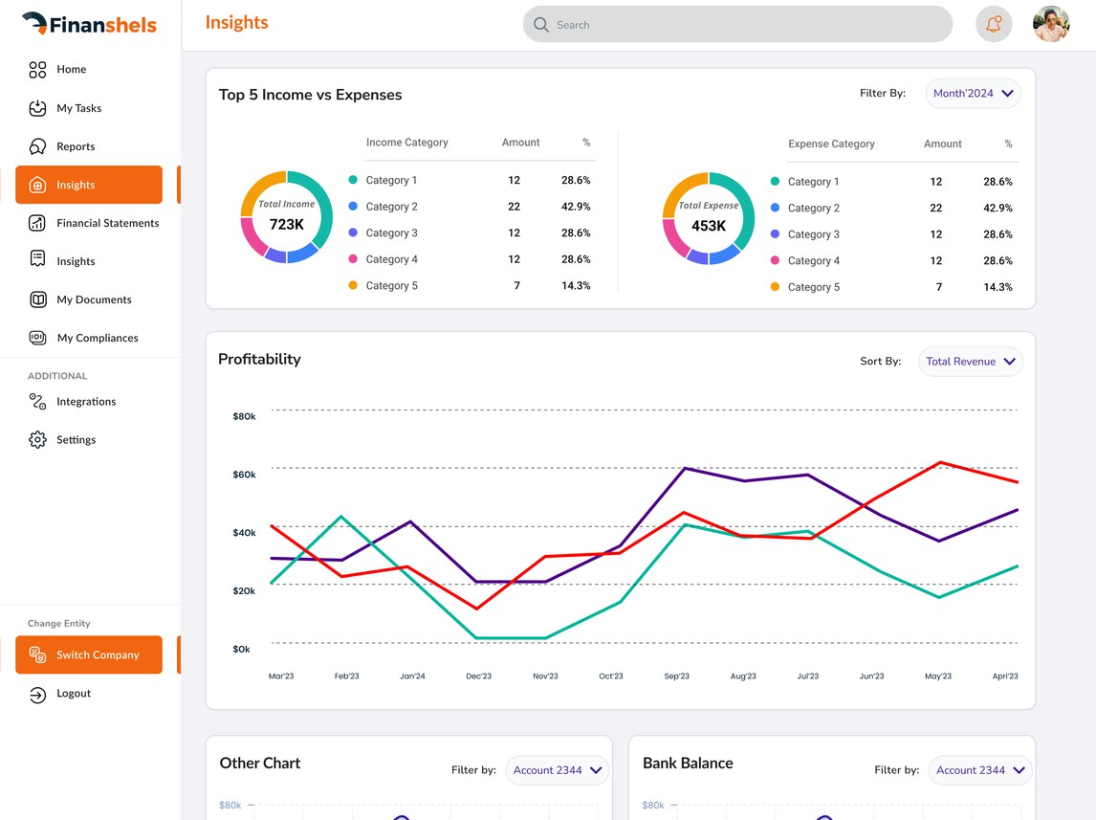
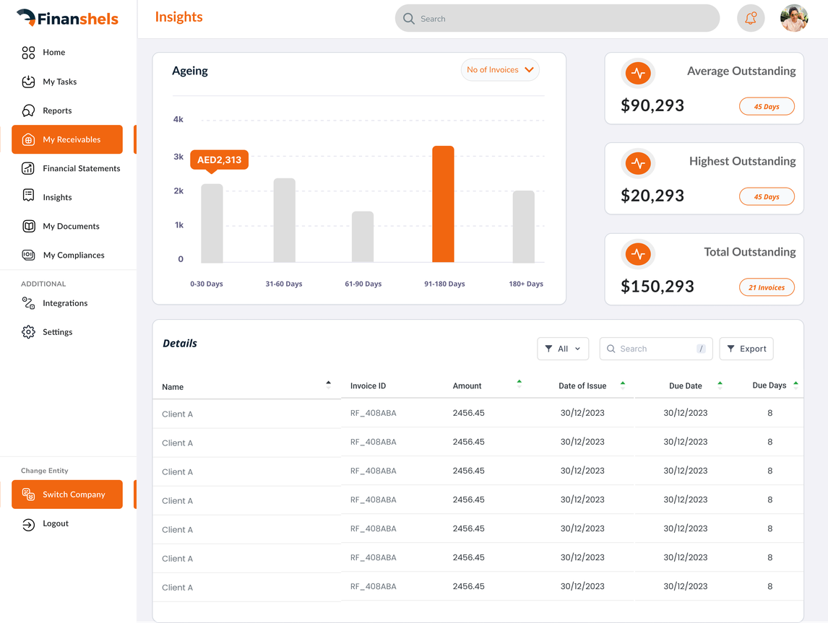
Our Mission & Values
Trusted By 7000+SMEs
Our mission is to help you grow your business
We are on a mission to simplify financial life for SMEs through a technology-first approach that focuses on providing tools and resources for a new generation of founders to manage their finance seamlessly.
A great story always starts with a great Vision
Financial mastery is the idea that everyone, regardless of economic standing, should have full control of their finances. It’s more than knowing how to read an account statement—it’s giving people the tools they need to stay on top of their finances and improve their lives.
01
Personalized Service: Tailoring solutions to your specific business needs.
02
Transparency & Compliance: We ensure that all regulations are met and provide clear communication.
03
End-to-End Support: From planning to execution, we provide continuous support to ensure your success.
www.finanshels.com
03

Slide 4






Services that grow with you
Trusted By 7000+SMEs
Below is a list of the services we offer to help you navigate your business's accounting, tax, and compliance needs:
Accounting & Analytics
VAT Registration & Filing
Corporate Tax Registration & Filing
Audit
Efficient financial management and insightful analytics to support business growth.
Ensure financial accuracy and compliance with expert audit services.
Ensure timely VAT filing and register with the Federal Tax Authority for compliance.
Ensure your business is registered and file corporate taxes accurately to avoid penalties.
Outsourced Finance Operations
AML
Liquidation
Fractional CFO
Comprehensive services ensuring your business complies with all relevant laws and regulations.
Close Your Business with Confidence – Expert Liquidation Services for DDA Compliance.
Access to experienced CFOs without the full-time commitment, supporting your financial decision-making.
Tailored financial strategies and operations management to optimize efficiency.
www.finanshels.com
04

Slide 5



Your Onboarding Roadmap
Trusted By 7000+SMEs
01
02
03
04
05
Kickoff & Discovery
Compliance Review
Software Setup
Secure Data
Communication & Go-Live
Understanding your business model and financial structure.
CT, VAT and WPS aligned to UAE law.
Configuring and optimising your accounting platform.
Organising and securing your financial documents.
Channels set, full operations launched.
www.finanshels.com
05

Slide 6
PHASE 2
Trusted By 7000+SMEs
What We Understood
Industry: Healthcare & Medical services. Entity Type: Free Zone company.
Scope: Monthly accounting and bookkeeping.
Catch-Up Project: One-time books cleanup by May 2026.
WHAT WE UNDERSTOOD — PLEASE CONFIRM
The information available is limited due to the generic email domain. Please confirm the details of Novamed Rescue Medical.
www.finanshels.com
06

Slide 7



PHASE 2
Trusted By 7000+SMEs
Ensuring Compliance
Corporate Tax
VAT
WPS / Payroll
Trade Licence — renewal
Ensure timely Corporate Tax registration and filing within 9 months of year-end.
VAT registration and quarterly filing are included in the service.
Not specified
We will track the trade licence renewal/expiry date and remind you before it lapses.
www.finanshels.com
07

Slide 8
PHASE 3
Trusted By 7000+SMEs
Accounting Software
If you have existing software
Our recommendation · Zoho Books
We will review any existing accounting tools for integration.
Zoho Books suits them for its healthcare-specific features.
Plan: Standard — suitable for basic accounting needs.
Note: the accounting software subscription is billed by the provider (e.g. Zoho) and paid by the client — not included in our service fees.
www.finanshels.com
08

Slide 9
PHASE 4
Trusted By 7000+SMEs
Secure Data Management
OUR SOLUTION
DOCUMENTS WE'LL NEED
A dedicated, encrypted Google Drive organised by year and document type — controlled access, easy retrieval.
Trade licence MOA & AOA
Owner passports & Emirates IDs CT registration
VAT certificate (if any) Prior financial statements Bank statements Commercial contracts
Documents attached by our Sales team as of now (already received, no need to resend): NOVAMED License. PDF (1).pdf, Corporate Tax Registration Certificate (6).pdf, VAT Certifcate.jpeg
www.finanshels.com
09

Slide 10




How We Stay Connected
Trusted By 7000+SMEs
PHASE 5
Email
WhatsApp
Slack
Formal documentation, reports and major updates.
Daily operational queries and quick support.
Optional real-time collaboration if you prefer.
www.finanshels.com

Slide 11
ENGAGEMENT
Trusted By 7000+SMEs
Scope of Work
WHAT WE'LL DO
This contract includes monthly recurring accounting and bookkeeping services and a one-time prior-period catch-up and books cleanup project.
INCLUDED IN SCOPE
OUT OF SCOPE
Accrual basis accounting
Chart of accounts design/setup
Transaction recording & coding (up to 10 transactions/month) Journal entries
Bank/credit card reconciliation AR & AP ageing reports
Monthly financial statements (P&L, Balance Sheet, Cash Flow) VAT & Corporate Tax registration and filing
Dedicated support manager
Client portal access with unlimited email/chat support
Accounting software subscription costs
Finance operations (invoicing, accounts receivable/payable collection, payroll, and daily cash flow management)
On-site visits External audits
Specialized tax advisory Transfer pricing
Transactions exceeding the 10/month limit for recurring or 100 total for catch-up
www.finanshels.com

Slide 12
ENGAGEMENT
Trusted By 7000+SMEs
Engagement Terms
PAYMENT
DURATION
One-Time Total: AED 1,500.00 (Requires 100% full payment upfront). Recurring Total: AED 1,000.00/month (Automatically debited at the start of each monthly billing cycle).
VAT (5%): AED 125.00.
Estimated Initial Total: AED 2,625.00.
All payments are strictly non-refundable once service begins. Prices auto-renew with up to a 10% annual increase.
Jun 2026 onwards
WHAT WE NEED FROM YOU
The client must provide necessary financial documents and system access through the client portal.
www.finanshels.com

Slide 13

Immediate Next Steps
Trusted By 7000+SMEs
Welcome Email
Document Upload
Begin Setup
Send a welcome email with secure client-portal link.
Client uploads required documents and grants system access from the portal.
Start the setup process for accounting and bookkeeping services.
www.finanshels.com

Slide 14
























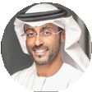



Why founders choose us ?
Trusted By 7000+SMEs
Finanshels serves a diverse range of clients, from startups to multinational corporations, built on trust and a reputation for tailored, top-tier service. We’ve helped 4,000+ businesses in less than 3 years across the UAE, catering to industries like real estate, technology, retail, and more, ensuring compliance and optimized business operations.
Supported By
Loved By Entrepreneurs
“Fast, Friendly, and very professional. I love how communicative they were handling our Corporate tax registration.”
“I’ve worked with Finanshels in auditing our financial statements & submitting the corporate tax return. They were very professional & finished on the agreed timeline. Thanks for all team & special thanks for: Sunaifa, Afsal, Ekta and Shamil. ”
Abdulla Al-Ogail OLYMON
Co-founder & CEO
"Over 7,000+ Startups & SMEs trust us, with more than USD 2 billion in transactions accounted and 2 million transactions processed."
Maged Yousry Estaie Tech
Manager
“Always very responsive, supportive, having a business mindset, providing visuals and on top of all that, open for feedback so they can keep improving. Very happy that i took the decision to work with them.”
“They designed an accounting system tailor made to our needs & completely automated our finance operations just like they promised. They’ve been super helpful for us to scale.”
Szilvia Vitos
Founder
LIVVITY
Jeremy Khatar
CEO
Ronin Global LLC, USA
www.finanshels.com

Slide 15

Thank you!
Trusted By 7000+SMEs
Ready to grow together. Let's begin your journey with Finanshels.
www.finanshels.com

