Slide 1
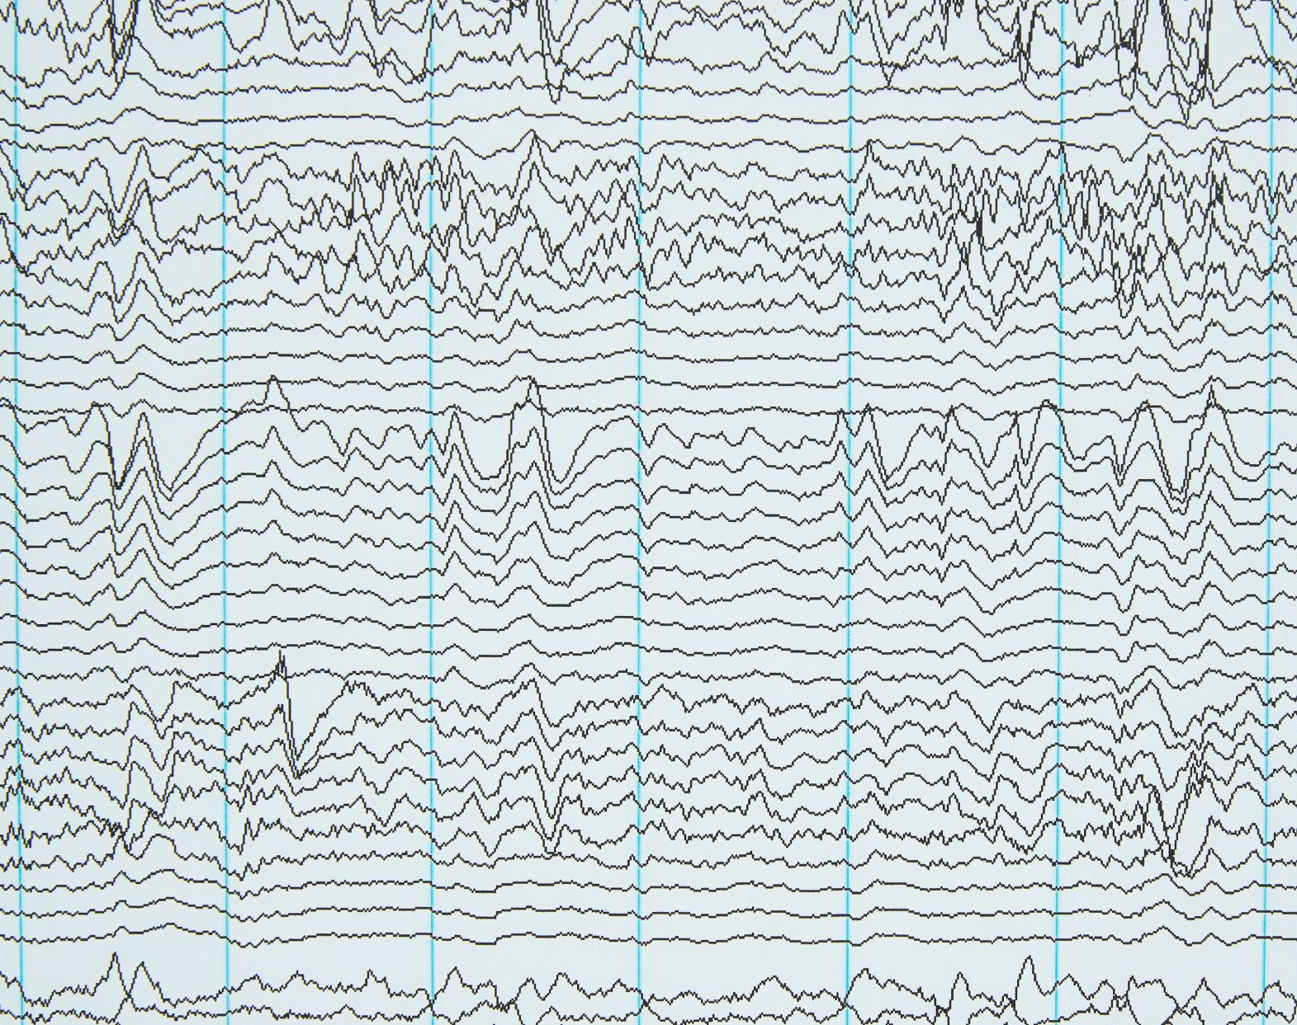
EEG Signal Classification Using Machine Learning
By: Muneezé Malik
Instructor: Dr. Adnan Amin
Course: Machine Learning Lab
Date: April 22, 2025

Slide 2
Introduction to EEG
🧠 What is EEG?
- EEG stands for Electroencephalography
- A non-invasive technique to record brain activity
- Measures electrical signals using electrodes placed on the scalp
📈 EEG Signals:
- Represent voltage fluctuations from neuron activity
- High temporal resolution — used in neuroscience, sleep studies, BCI, and more

Slide 3
Project Overview
📊 What Are We Trying to Do?
- We aim to classify EEG signals into different mental states (eye states)
- Use machine learning models to recognize patterns in EEG waveforms
🧪 Approach:
1. Preprocess raw EEG data from .edf format
2. Visualize and understand data distribution
3. Train ML models with and without feature engineering
4. Apply SMOTE to handle class imbalance
5. Compare model performance using F1-score

Slide 4
Why It Matters
🧩 Importance of EEG Classification:
- Helps in diagnosing neurological conditions
- Enables development of brain-computer interfaces (BCI)
- Enhances real-time cognitive state detection
⚙️ ML + EEG:
- Manual EEG analysis is complex and time-consuming
- Machine Learning helps automate and improve accuracy

Slide 5
Introduction
🔍 Objective:
- Classify EEG signals using machine learning
- Evaluate models with and without:
• Feature Engineering
• Data Balancing (SMOTE)
🎯 Goal:
- Achieve the highest possible F1-scores using preprocessing techniques

Slide 6
Dataset Description
📦 EEG Dataset (Mendeley Data)
- 6 folders containing .edf EEG recordings
- Eye state classification (4 classes)
📐 Input Shape:
- x_train: (5499, 19, 500)
- 19 channels, 500-time samples per signal

Slide 7
Data Preprocessing
🔄 Preprocessing Steps:
- Converted .edf to .npy using MNE-Python
- Flattened EEG signals for raw modelling
- Extracted statistical features (mean, std, max, min)
🧹 Libraries Used:
- MNE, NumPy, Scikit-learn, SMOTE

Slide 8
Visualization
📉 Class Imbalance Observed:
- Class 3 had very few samples
📈 EEG Signal Plot:
- Time-series plots for 3 sample channels
- Visual verification of signal patterns
📊 Used Countplot & Line Plot

Slide 9
Machine Learning Models
🧠 Models Used:
1. Logistic Regression
2. Random Forest
3. Support Vector Machine
🧪 Evaluation Metric:
- Weighted F1-Score
- Confusion Matrix

Slide 10
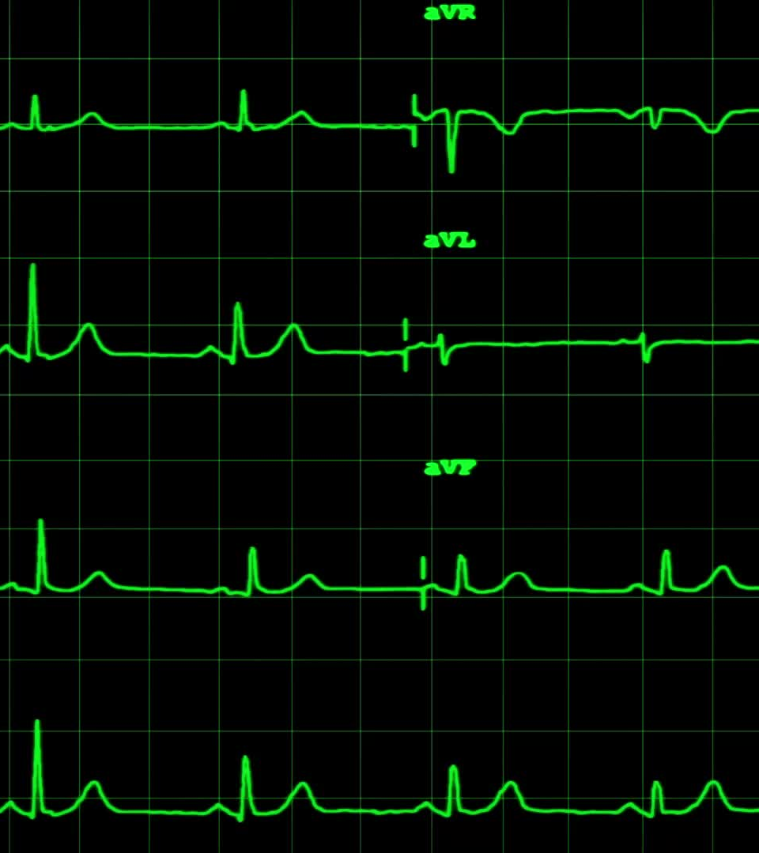
Results – Raw Data
⚙️ Input: Flattened EEG signals (9500 features)
📊 F1 Scores:
- Logistic Regression: 0.4541
- Random Forest: 0.8732
- SVM: 0.6815
⚠️ Class 3 was not recognized well by any model

Slide 11
Feature Engineering & SMOTE
📌 Feature Engineering:
- Mean, Std, Max, Min → 76 features
⚖️ Data Balancing:
- SMOTE is used to oversample minority classes
📈 Result: Balanced class distribution

Slide 12
Results – After Feature Engineering
📊 F1 Scores (Balanced Data):
- Logistic Regression: 0.8904
- Random Forest: 0.9375
- SVM: 0.8961
🎯 Observation:
- Accuracy improved significantly
- Best performance by Random Forest

Slide 13
Final Comparison Table
🏆 Best Model: Random Forest (F1 = 0.9375)
Model | Raw F1 Score | Balanced F1 Score
Logistic Regression | 0.4541 | 0.8904
Random Forest | 0.8732 | 0.9375
SVM | 0.6815 | 0.8961

