Slide 1
MRLite – Light Weight MapReduce
Group
Sheikh Muneeb
muneeb118@gmail.com
Notes:
Problem Characteristics: Large scale – inherently parallel computations
Use novel architecture and cheap components (infrastructure)
for efficient and robust computations
Network commodity PCs
Employ data replication and redundant computations
Use FP inspired programming model : Map Reduce

Slide 2

MapReduce - Google
Notes:
Even with Lucene, we had to tweak parameters to get proper performance for XML Index and Search
because of its usage of disk for B-Trees implementation for DBLP dataset (337 MB)

Slide 3
Hadoop – Apache and Yahoo
Limitations
  Homogeneous
  Metadata
  Excess Communication
  Dynamic Scheduling
  Scalability

Slide 4
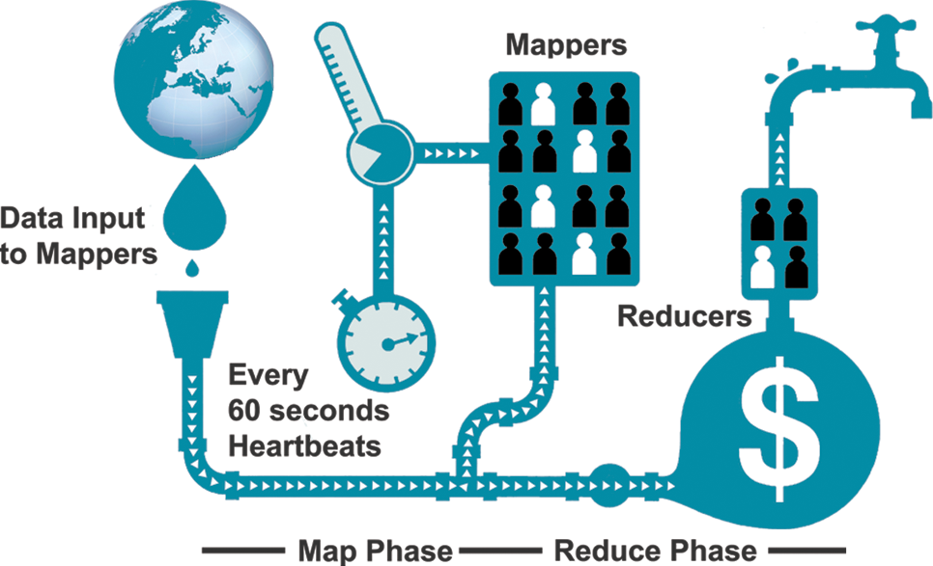
MRLite
Notes:
On the software side: what is the programming model?
On the hardware side: how to deal with failures – hardware and data corruption?

Slide 5
Features - MRLite
Advantages
  Heterogeneous
  Heartbeats - Effective Resource Utilization
  Isolation (JVM/Threads)
  Smart Data Distribution
    Save communication time for another record from DFS
    Replication
  Scalable
  Delimiter Separated Text Splitting
  Heap
    Dynamic Window (Reading and Writing)

Slide 6
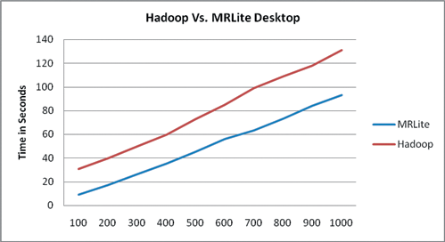
Evaluation Testbed

Slide 7
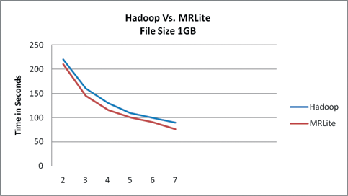
Evaluation Testbed

Slide 8
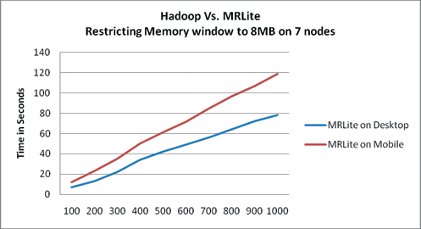
Evaluation Testbed

Slide 9
Limitations
Since MRLite allows heterogeneous devices, smart devices have limited battery.

Slide 10
Past Work and Project Achievements
Many attempts have been made for porting Hadoop on Android but this project does not have any existence before.
Got 2nd Position at IMTIC’12 jointly held by University of Aalborg, Denmark and MUET, Pakistan.

