Slide 1
Fit.ly Customer Churn Analysis
Prepared by: Munem Shariar Shams
Notes:
“Hello everyone, My name is Munem Shariar Shams and I will now be presenting my findings on customer churn at Fit.ly, based on three validated datasets: account information, user activity, and customer support.”

Slide 2
Executive Summary
Fit.ly is experiencing elevated customer churn across free and paid plans.
Engagement and support interactions strongly correlate with churn.
Three datasets were validated, cleaned, and analyzed using R.
Clear patterns emerged to guide effective retention initiatives.
Notes:
“Fit.ly is experiencing elevated churn across both free and paid plans. My analysis shows that engagement and support interactions are strongly linked to churn. After cleaning and validating the datasets, several clear behavioral patterns emerged that can directly inform retention strategy.”

Slide 3

Business Problem
Fit.ly is losing customers at a rate that impacts revenue and long-term growth.
Leadership needs to understand:
Who is churning
Why they are churning
What actions can reduce churn
Goal: Provide data-driven insights and actionable recommendations.
Notes:
“The leadership team wants to understand who is churning, why they are churning, and what actions can reduce churn. The purpose of this analysis is to provide data-driven insights and recommendations that are immediately actionable.”

Slide 4

Data Validation
Validated 3 datasets: account information, customer support, and user activity
Cleaned churn labels, removed whitespace, created is_churn flag
Constructed key features:
Event count and engagement buckets
Ticket count and ticket group buckets
Ensured all user IDs matched; retained 0-activity and 0-ticket users.
Notes:
“All three datasets were validated for completeness and consistency. I standardized churn labels, constructed a churn flag, and created derived variables such as engagement buckets and ticket groups. No users were removed; missing activity was treated as meaningful behavior.”

Slide 5
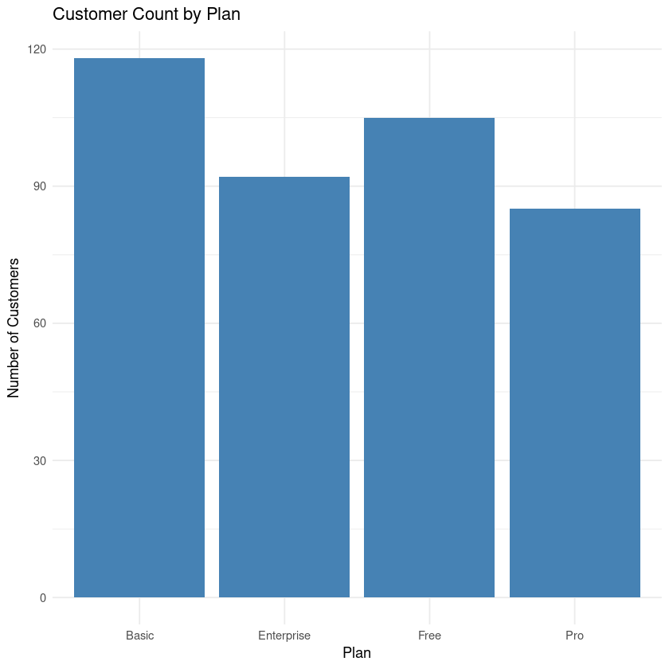
Customer Distribution by Plan
Key insights:
Free and Basic tiers dominate the customer base.
All paid plans have meaningful churn, not isolated to one tier.
Free users represent a major opportunity for improved activation.
Notes:
“Across the customer base, Free and Basic tiers are the largest. Churn exists across all paid plans, indicating that retention issues extend beyond pricing. The Free tier represents a major opportunity for improving onboarding and activation.”

Slide 6
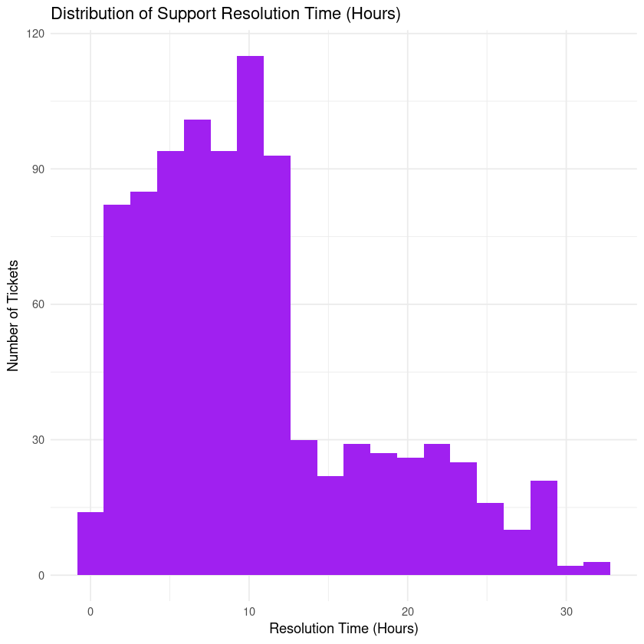
Support Resolution Time Distribution
Key insights:
Free and Basic tiers dominate the customer base.
All paid plans have meaningful churn, not isolated to one tier.
Free users represent a major opportunity for improved activation.
Notes:
“Most support issues are resolved within 5 to 14 hours. However, there is a long tail of cases that exceed 24 hours. These delays may contribute to dissatisfaction, especially for technical or account-related tickets.”

Slide 7
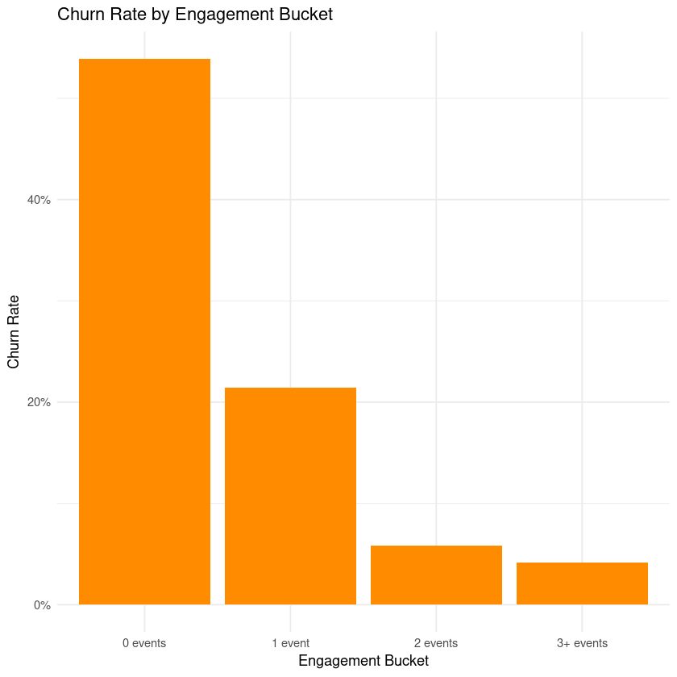
Churn by Engagement Level
Key insights:
0-event users churn at 53.9%, highest of any group.
After just 2+ events, churn drops to 5–6%.
Engagement is the strongest predictor of retention.
Notes:
“Engagement is the strongest predictor of retention. Users who record zero events churn at nearly 54%, while churn drops below 6% for users who complete two or more actions. This highlights the importance of driving early product engagement.”

Slide 8

Churn by Support Interaction
0 tickets: 15.2% churn
1 ticket: 28.6%
2–3 tickets: 30.6%
4+ tickets: 28.9% Interpretation: Users contacting support are twice as likely to churn.
Notes:
“Users who contact support churn at roughly double the rate of those who never open a ticket. This suggests that product friction or unresolved issues are key factors.”

Slide 9

Proposed Business Metric
Primary Metric: Monthly Churn Rate
Tracks % of customers lost each month
Should be monitored by:
Plan tier
Engagement bucket
Support intensity
Current baseline (overall): 28.5%
Notes:
“I recommend monitoring Monthly Churn Rate as the primary KPI, segmented by plan, engagement level, and support intensity. The current baseline churn rate is 28.5%.”

Slide 10
Recommendations
Strengthen early engagement - Drive users to complete 2+ actions in first week.
Proactive support for high-risk users - 0-event users, multi-ticket users.
Improve support response times - Especially for technical/account issues.
Enhance Free tier activation - Better onboarding, in-app nudges, upgrade guidance.
Establish churn dashboards - Track monthly churn segmented by behavior and plan.
Notes:
“To reduce churn, I recommend five actions. First, strengthen early engagement to ensure users complete at least two meaningful actions. Second, proactively contact high-risk users, such as those with zero events or multiple tickets. Third, focus on reducing long-tail support resolution times. Fourth, improve Free tier onboarding. And finally, establish churn dashboards to track progress over time.”

