Slide 1
Cardiovascular Disease
By Munirah Abdullah Alraqibah
T5’s project

Slide 2
Problem
predicting heart disease of the patient by using classification techniques.

Slide 3
DATASET
Variable | Description
ID | id number, int
Age | Objective Feature,int, age in days
Gender | Objective Feature, int, gender in categorical code "Female=1 , Male=2"
Height | Objective Feature,int, height in cm
Weight | Objective Feature,float, weightin in kg
Systolic blood pressure: | Examination Feature, int, ap_hi
Diastolic blood pressure | Examination Feature, int, ap_lo
Cholesterol | Examination Feature, int, cholesterol "normal=1 , above normal=2, well above normal=3"
Glucose | Examination Feature,int, gluc "normal=1, above normal=2, well above normal=3"
Smoking | Subjective Feature, int, smoke in binary "smoke=1, not smoke=0"
Alcohol intake | Subjective Feature,int, alco in binary "drink=1, not drink=0"
Physical activity | Subjective Feature, int, active in binary "active=1 , not active=0"
Presence or absence of cardiovascular disease | Target Variable, int, cardio in binary "cardiovascular disease=1, no cardiovascular disease=0"
70,000 observations.
13 Features.

Slide 4
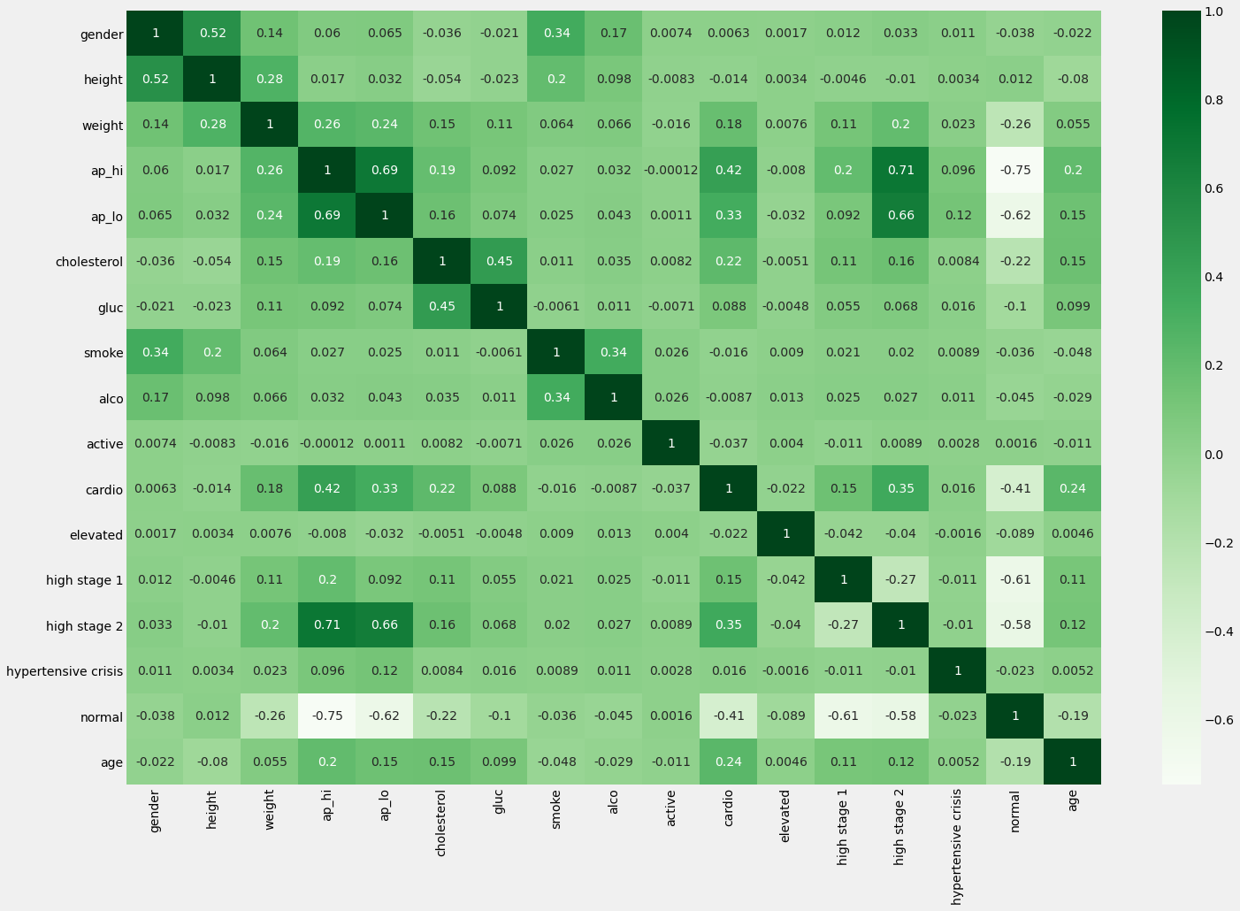
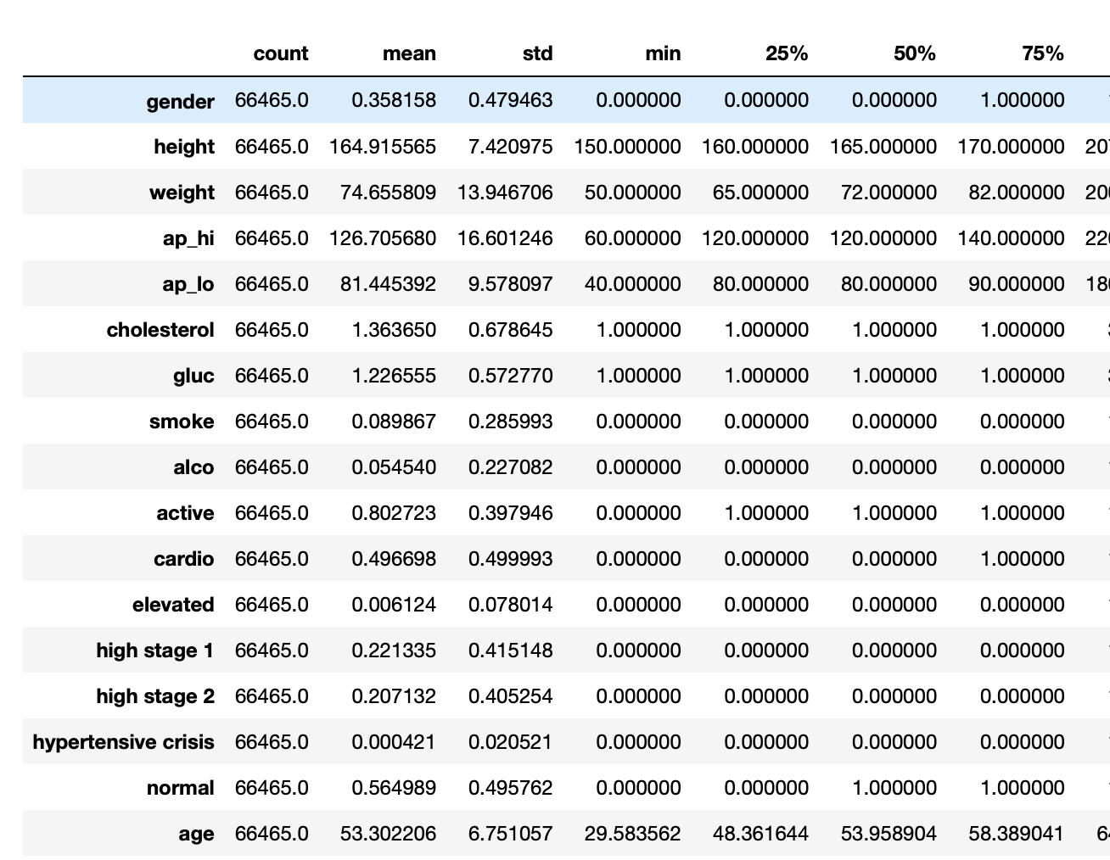
DATA Process
Cleaning the data:
Dropping unnecessary features.
Checking the outliers and duplicates.
Changing data type of string to dummy
Plotting the correlation between target and features

Slide 5
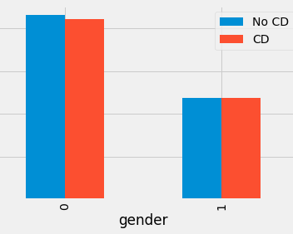
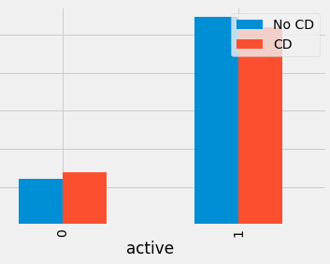
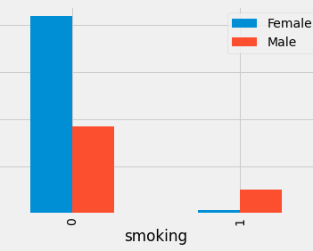
Exploring

Slide 6
Modeling
80% of the data was used to train the model and 20% for test.
Logistic Regression
KNNeighbors
Gradient Boosting Machines
Random Forest
Naive Bayes
Decision Tree (0.9995,-0.46210)

Slide 7
Result
 | Train accuracy | Test accuracy | F1 score | False Negative | True Positive
Logistic Regression | 72.32 | 72.578 | 0.71 | 2228 | 4371
KNNeighbors | 73.21 | 72.69 | 0.713 | 2082 | 4517
Gradient Boosting Machines | 73.51 | 73.79 | 0.72 | 2060 | 4539
Random Forest | 99.97 | 70.90 | 0.71 | 2035 | 44564
Naive Bayes | 80.26 | 80.27 | 0.66 | 1 | 13334

Slide 8
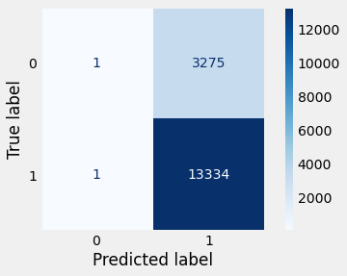
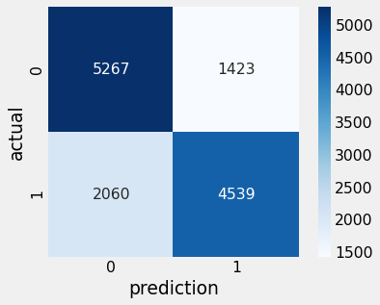
conclusion
The highest accuracy rate was Naive Bayes with 13334 True positive. And False positive is high so in this case it may not seem to be the accurate model.
Gradient Boosting Machines seems fairly fit the model.

Slide 9
Question

Slide 10
Thank you ☺

