Slide 1
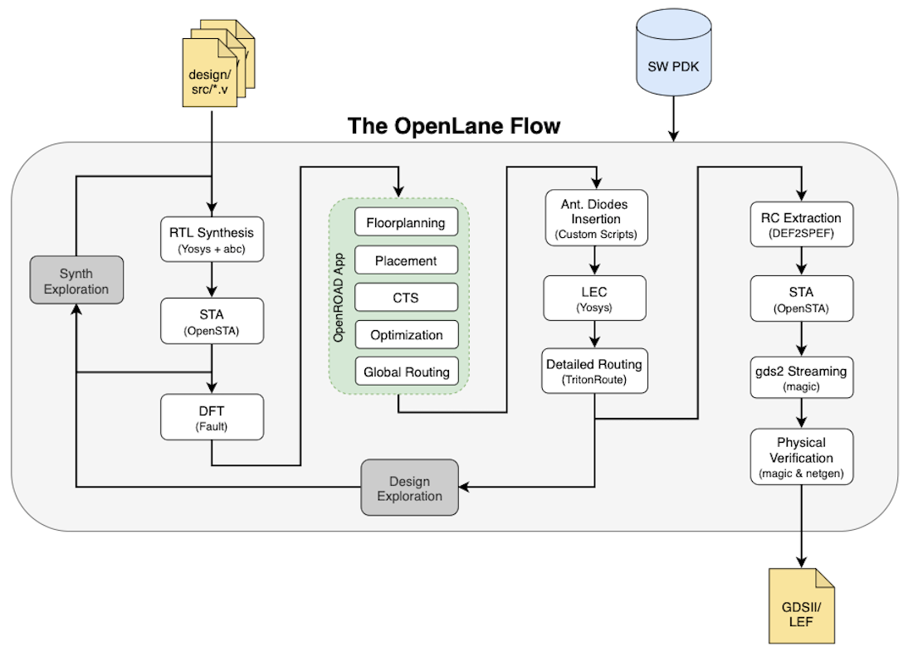

Slide 2
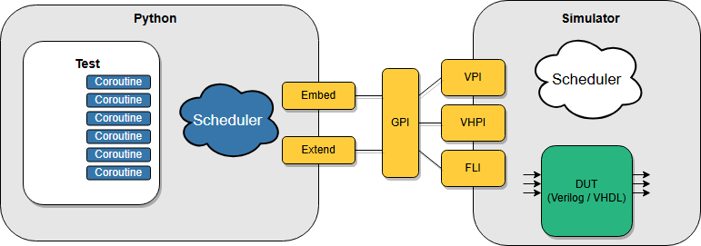

Slide 3
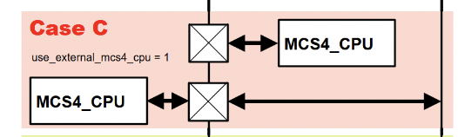
Tiny Tapeout向けMCS4_CPU (4004)の最上位記述
ttsky25a_MCS4_CPU/src/tt_um_mcs4_cpu.v
//---------------------
// I/O Connection
//---------------------
assign test = ui_in[0];
assign uo_out[0] = sync_n;
assign uo_out[1] = cm_rom_n;
assign uo_out[2] = 1'b0;
assign uo_out[3] = 1'b0;
assign uo_out[4] = cm_ram_n[0];
assign uo_out[5] = cm_ram_n[1];
assign uo_out[6] = cm_ram_n[2];
assign uo_out[7] = cm_ram_n[3];
assign data_i[0] = uio_in[0];
assign data_i[1] = uio_in[1];
assign data_i[2] = uio_in[2];
assign data_i[3] = uio_in[3];
assign uio_out[0] = 1'b0; // open drain
assign uio_out[1] = 1'b0; // open drain
assign uio_out[2] = 1'b0; // open drain
assign uio_out[3] = 1'b0; // open drain
assign uio_out[4] = 1'b0;
assign uio_out[5] = 1'b0;
assign uio_out[6] = 1'b0;
assign uio_out[7] = 1'b0;
assign uio_oe[0] = data_oe & ~data_o[0]; // open drain
assign uio_oe[1] = data_oe & ~data_o[1]; // open drain
assign uio_oe[2] = data_oe & ~data_o[2]; // open drain
assign uio_oe[3] = data_oe & ~data_o[3]; // open drain
assign uio_oe[4] = 1'b0;
assign uio_oe[5] = 1'b0;
assign uio_oe[6] = 1'b0;
assign uio_oe[7] = 1'b0;
// List all unused inputs to prevent warnings
wire _unused = &{ena, uio_in[7:4], 1'b0};
//--------------------
// MCS-4 4004 CPU Core
//--------------------
MCS4_CPU U_MCS4_CPU
(
.CLK (clk), // clock
.RES_N (rst_n), // reset_n
//
.SYNC_N (sync_n), // Sync Signal
.DATA_I (data_i), // Data Input
.DATA_O (data_o), // Data Output
.DATA_OE (data_oe), // Data Output Enable
.CM_ROM_N (cm_rom_n), // Memory Control for ROM
.CM_RAM_N (cm_ram_n), // Memory Control for RAM
.TEST (test) // Test Input
);
`default_nettype none
//======================================
// Module : MCS-4 4004 CPU Chip
//======================================
module tt_um_mcs4_cpu
(
input wire [7:0] ui_in, // Dedicated inputs
output wire [7:0] uo_out, // Dedicated outputs
input wire [7:0] uio_in, // IOs: Input path
output wire [7:0] uio_out, // IOs: Output path
output wire [7:0] uio_oe, // IOs: Enable path (active high: 0=input, 1=output)
input wire ena, // always 1 when the design is powered, so you can ignore it
input wire clk, // clock
input wire rst_n // reset_n - low to reset
);
integer i;
//---------------------
// Interface Signals
//---------------------
wire sync_n; // Sync Signal
wire [ 3:0] data_o; // Data Output
wire data_oe; // Data Output Enable
wire [ 3:0] data_i; // Data Input
wire cm_rom_n; // Memory Control for ROM
wire [ 3:0] cm_ram_n; // Memory Control for RAM
wire test; // Test Input
endmodule
FPGA
MCS4_SYS
信号衝突時のデバイス破壊を防止するため、出力はオープン・ドレイン（＋プルアップ抵抗）とする

Slide 4
Tiny Tapeout向けMCS4_CPU (4004)のプロジェクト情報
ttsky25a_MCS4_CPU/info.yaml
# Tiny Tapeout project information
project:
title: "MCS-4 4004 CPU" # Project title
author: "Munetomo Maruyama" # Your name
discord: "munetomo_85572" # Your discord username, for communication and automatically assigning you a Tapeout role (optional)
description: "MCS-4 4004 CPU" # One line description of what your project does
language: "Verilog" # other examples include SystemVerilog, Amaranth, VHDL, etc
clock_hz: 750000 # Clock frequency in Hz (or 0 if not applicable)
# How many tiles your design occupies? A single tile is about 167x108 uM.
tiles: "1x1" # Valid values: 1x1, 1x2, 2x2, 3x2, 4x2, 6x2 or 8x2
# Your top module name must start with "tt_um_". Make it unique by including your github username:
top_module: "tt_um_mcs4_cpu"
# List your project's source files here.
# Source files must be in ./src and you must list each source file separately, one per line.
# Don't forget to also update `PROJECT_SOURCES` in test/Makefile.
source_files:
- "tt_um_mcs4_cpu.v"
- "mcs4_cpu.v"
# The pinout of your project. Leave unused pins blank. DO NOT delete or add any pins.
# This section is for the datasheet/website. Use descriptive names (e.g., RX, TX, MOSI, SCL, SEG_A, etc.).
pinout:
# Inputs
ui[0]: "TEST"
ui[1]: ""
ui[2]: ""
ui[3]: ""
ui[4]: ""
ui[5]: ""
ui[6]: ""
ui[7]: ""
# Outputs
uo[0]: "SYNC_N"
uo[1]: "CM_ROM_N"
uo[2]: ""
uo[3]: ""
uo[4]: "CM_RAM_N[0]"
uo[5]: "CM_RAM_N[1]"
uo[6]: "CM_RAM_N[2]"
uo[7]: "CM_RAM_N[3]"
# Bidirectional pins
uio[0]: "DATA[0]"
uio[1]: "DATA[1]"
uio[2]: "DATA[2]"
uio[3]: "DATA[3]"
uio[4]: ""
uio[5]: ""
uio[6]: ""
uio[7]: ""
# Do not change!
yaml_version: 6

Slide 5
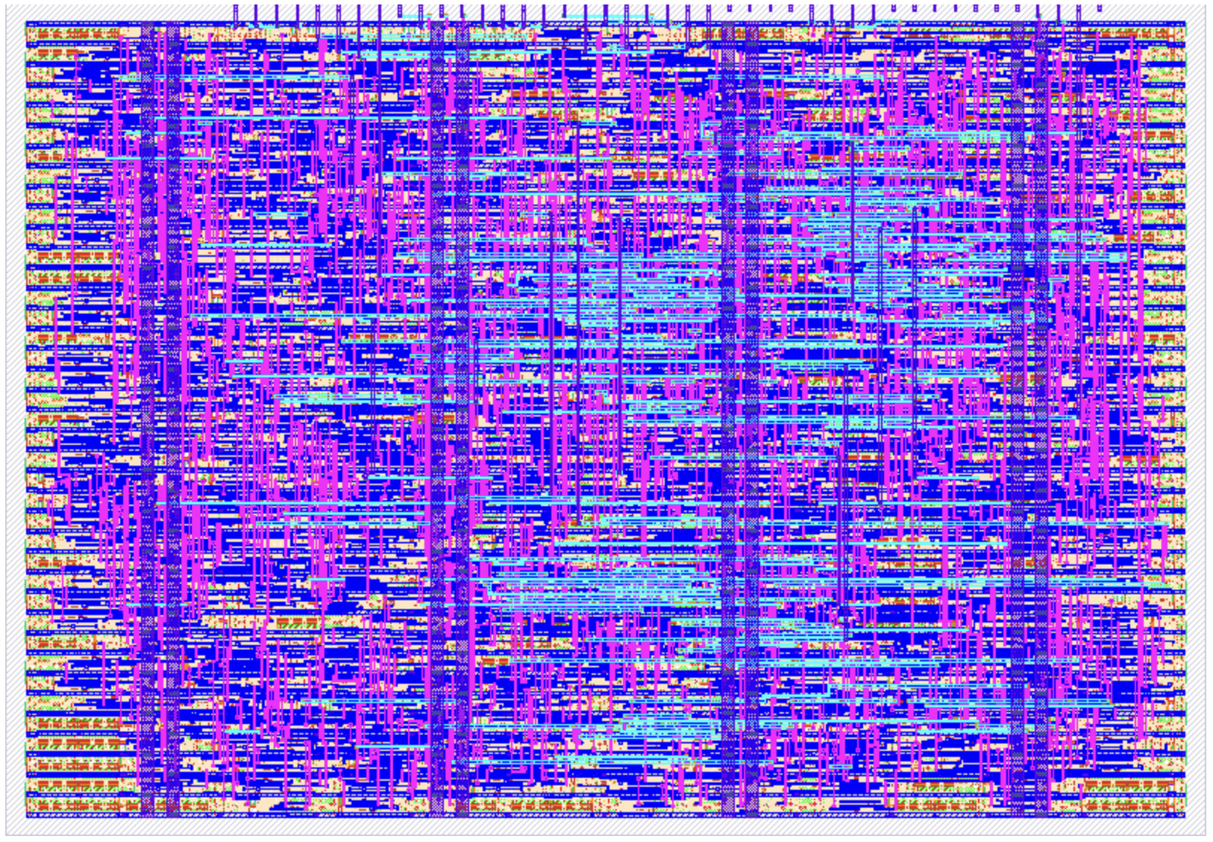
モジュールMCS4_CPU（4004）のレイアウト結果
https://tinytapeout.com/chips/ttsky25a/tt_um_mcs4_cpu

Slide 6
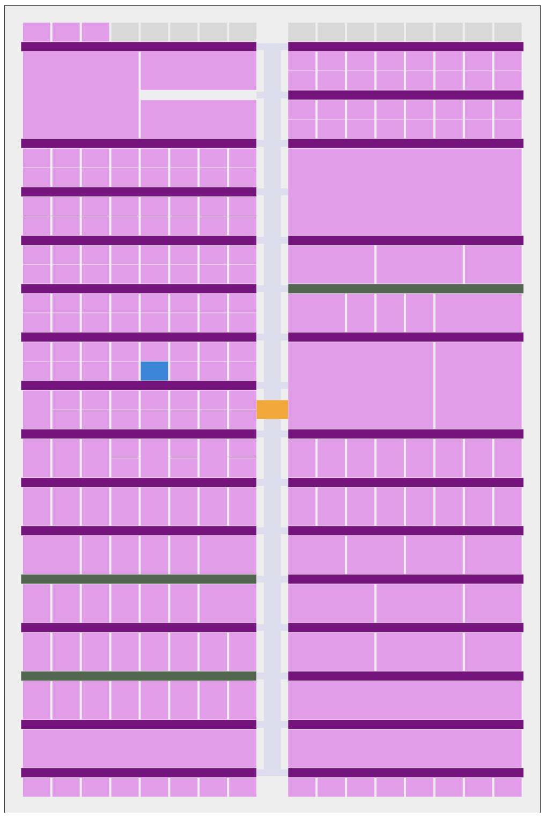
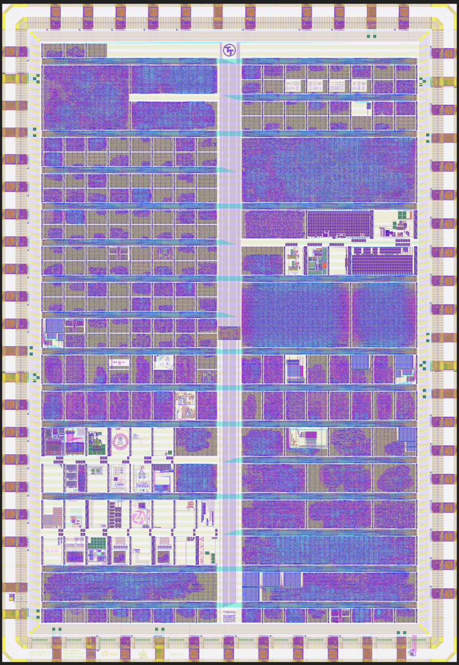
Tiny Tapeout TTSKy25a にテープアウトしたMCS4_CPU(4004)
https://tinytapeout.com/chips/ttsky25a/

Slide 7
Hold Timing Issue between Different Devices (1)
(a)
1333.33ns (750kHz)
C_CLK (CPU)
C_SYNC_N
C_CM_ROM_N
C_CM_RAM_N[3:0]
cpu out
cpu_out
(b)
skew
S_CLK(SYS)
S_SYNC_N
S_CM_ROM_N
S_CM_RAM_N[3:0]
cpu out
cpu_out
hold violation
(c)
tCYC/4
=133.33ns
S_CLK_F
hold met
S_SYNC_N_F
S_CM_ROM_N_F
S_CM_RAM_N_F[3:0]
cpu out
cpu_out
internal control
internal control
internal control

Slide 8
Hold Timing Issue between Different Devices (2)
(a)
1333.33ns (750kHz)
C_CLK (CPU)
C_DATA[3;0]
cpu out
cpu_out
(b)
skew
S_CLK(SYS)
S_DATA_I[3:0]
cpu out
cpu_out
hold violation
(c)
tCYC/4
=133.33ns
S_CLK_F
hold met
S_DATA_I_F[3:0]
cpu out
internal control
internal control

Slide 9
Hold Timing Issue between Different Devices (3)
(a)
skew
S_CLK(SYS)
S_DATA_O[3:0]
S_DATA_OE
sys out
(b)
1333.33ns (750kHz)
C_CLK (CPU)
C_DATA[3;0]
sys out
hold violation
tCYC/4
=133.33ns
(c)
S_CLK_B
S_DATA_O_B[3:0]
S_DATA_OE_B
sys out
C_CLK (CPU)
hold met
C_DATA[3;0]
sys out

Slide 10
Critical timing of Bi-Directional Data Bus
C_CLK
1333.33ns (750kHz)
DATA
cpu out
cpu_in
cpu out
cpu out
tCYC/4
=133.33ns
tCYC/4
=133.33ns
cpu_in
S_CLK
S_CLK_fwd
S_CLK_bwd
dev out
dev out
dev_in
C_CLK
SYNC_N
CM_ROM_N
CM_RAM_N[]
cpu out
dev_in

