Slide 1
SVS (Surround View System) TEAM SPIRIT

Slide 2
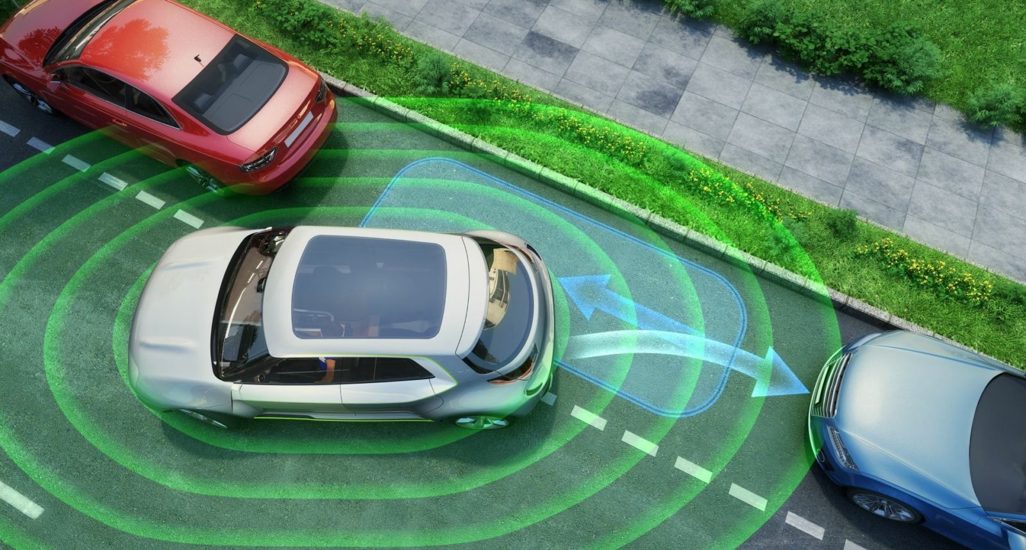
Problem statement
SVS(Surround View System): The Surround View System (SVS) is the 360° degree camera captures the surrounding of the car with 4 cameras installed around the car. Processed images are presented to the driver via the multimedia system to assist in parking and maneuvering. This feature uses OpenCV, OpenGL and OSG to archive it. This feature offers a lot of view options to the driver like 2D/3D views, bird eye view. The API is typically used to interact with a graphics processing unit (GPU), to achieve hardware-accelerated rendering.

Slide 3





PLAN FOR GETTING THE ACTUAL OUTPUT
Camera AND IMAGES
Filter images
REMOVE Repeated Part
COMBINE VIEW
Providing 2d/3d Output
-Get Input in the form of images using 4 different cameras.
-Access these images using cv2 library.
-Standardize the images.
-Enhanced quality and make the images in one format like .png, .jpg, etc.
--Clean Images without Repetition.
-Remove redundant part
-Combine All the Images.
-Make 360 degree using 4 cameras.
-Object identification
-Parking and availability for the vehicle.

Slide 4
THANK YOU

