Slide 1
Step 2: is the long-time b6 threshold robust to initial-condition changes?
D1: one-at-a-time IC scan | D2: cleaner replot + 0.1x / 10x supplement
Goal: test whether the long-time b6 switch is a real model feature rather than a baseline-IC artifact.
Step 2 setup
Direct CTL formulation fixed
b5 fixed at 1e-4
T = 10,000 days
Changed one compartment at a time
IC multipliers: 0.1x, 0.2x, 0.5x, 1x, 2x, 5x, 10x
Baseline initial conditions
Variable | Baseline IC
Tumor(0) | 2
MDSC(0) | 500
NK(0) | 2.29e+05
CTL(0) | 0
B(0) | 1.43e+05
Readout : long-time thresholds for T(10000) < 1e5 and T(10000) < 1e3, plus near-threshold state trajectories.
B-cell MDSC model | Step 2 IC robustness

Slide 2
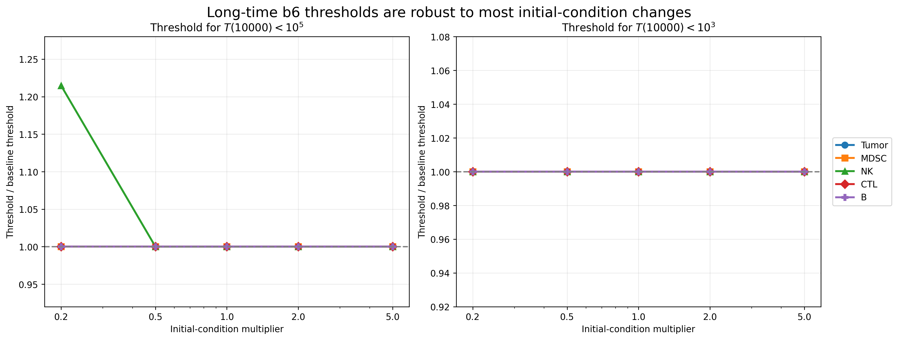
Finding 1: most IC changes barely move the long-time b6 threshold
Relative threshold view makes the robustness pattern visible
Readout
For T(10000) < 1e5, almost all IC perturbations stay near the same b6 threshold.
Only NK(0) = 0.2x baseline clearly shifts the loose threshold upward.
For T(10000) < 1e3, the stricter threshold is essentially unchanged across tested ICs.
Interpretation: the long-time threshold is robust; low NK mainly affects how much b6 is needed for partial control.
B-cell MDSC model | Step 2 IC robustness

Slide 3
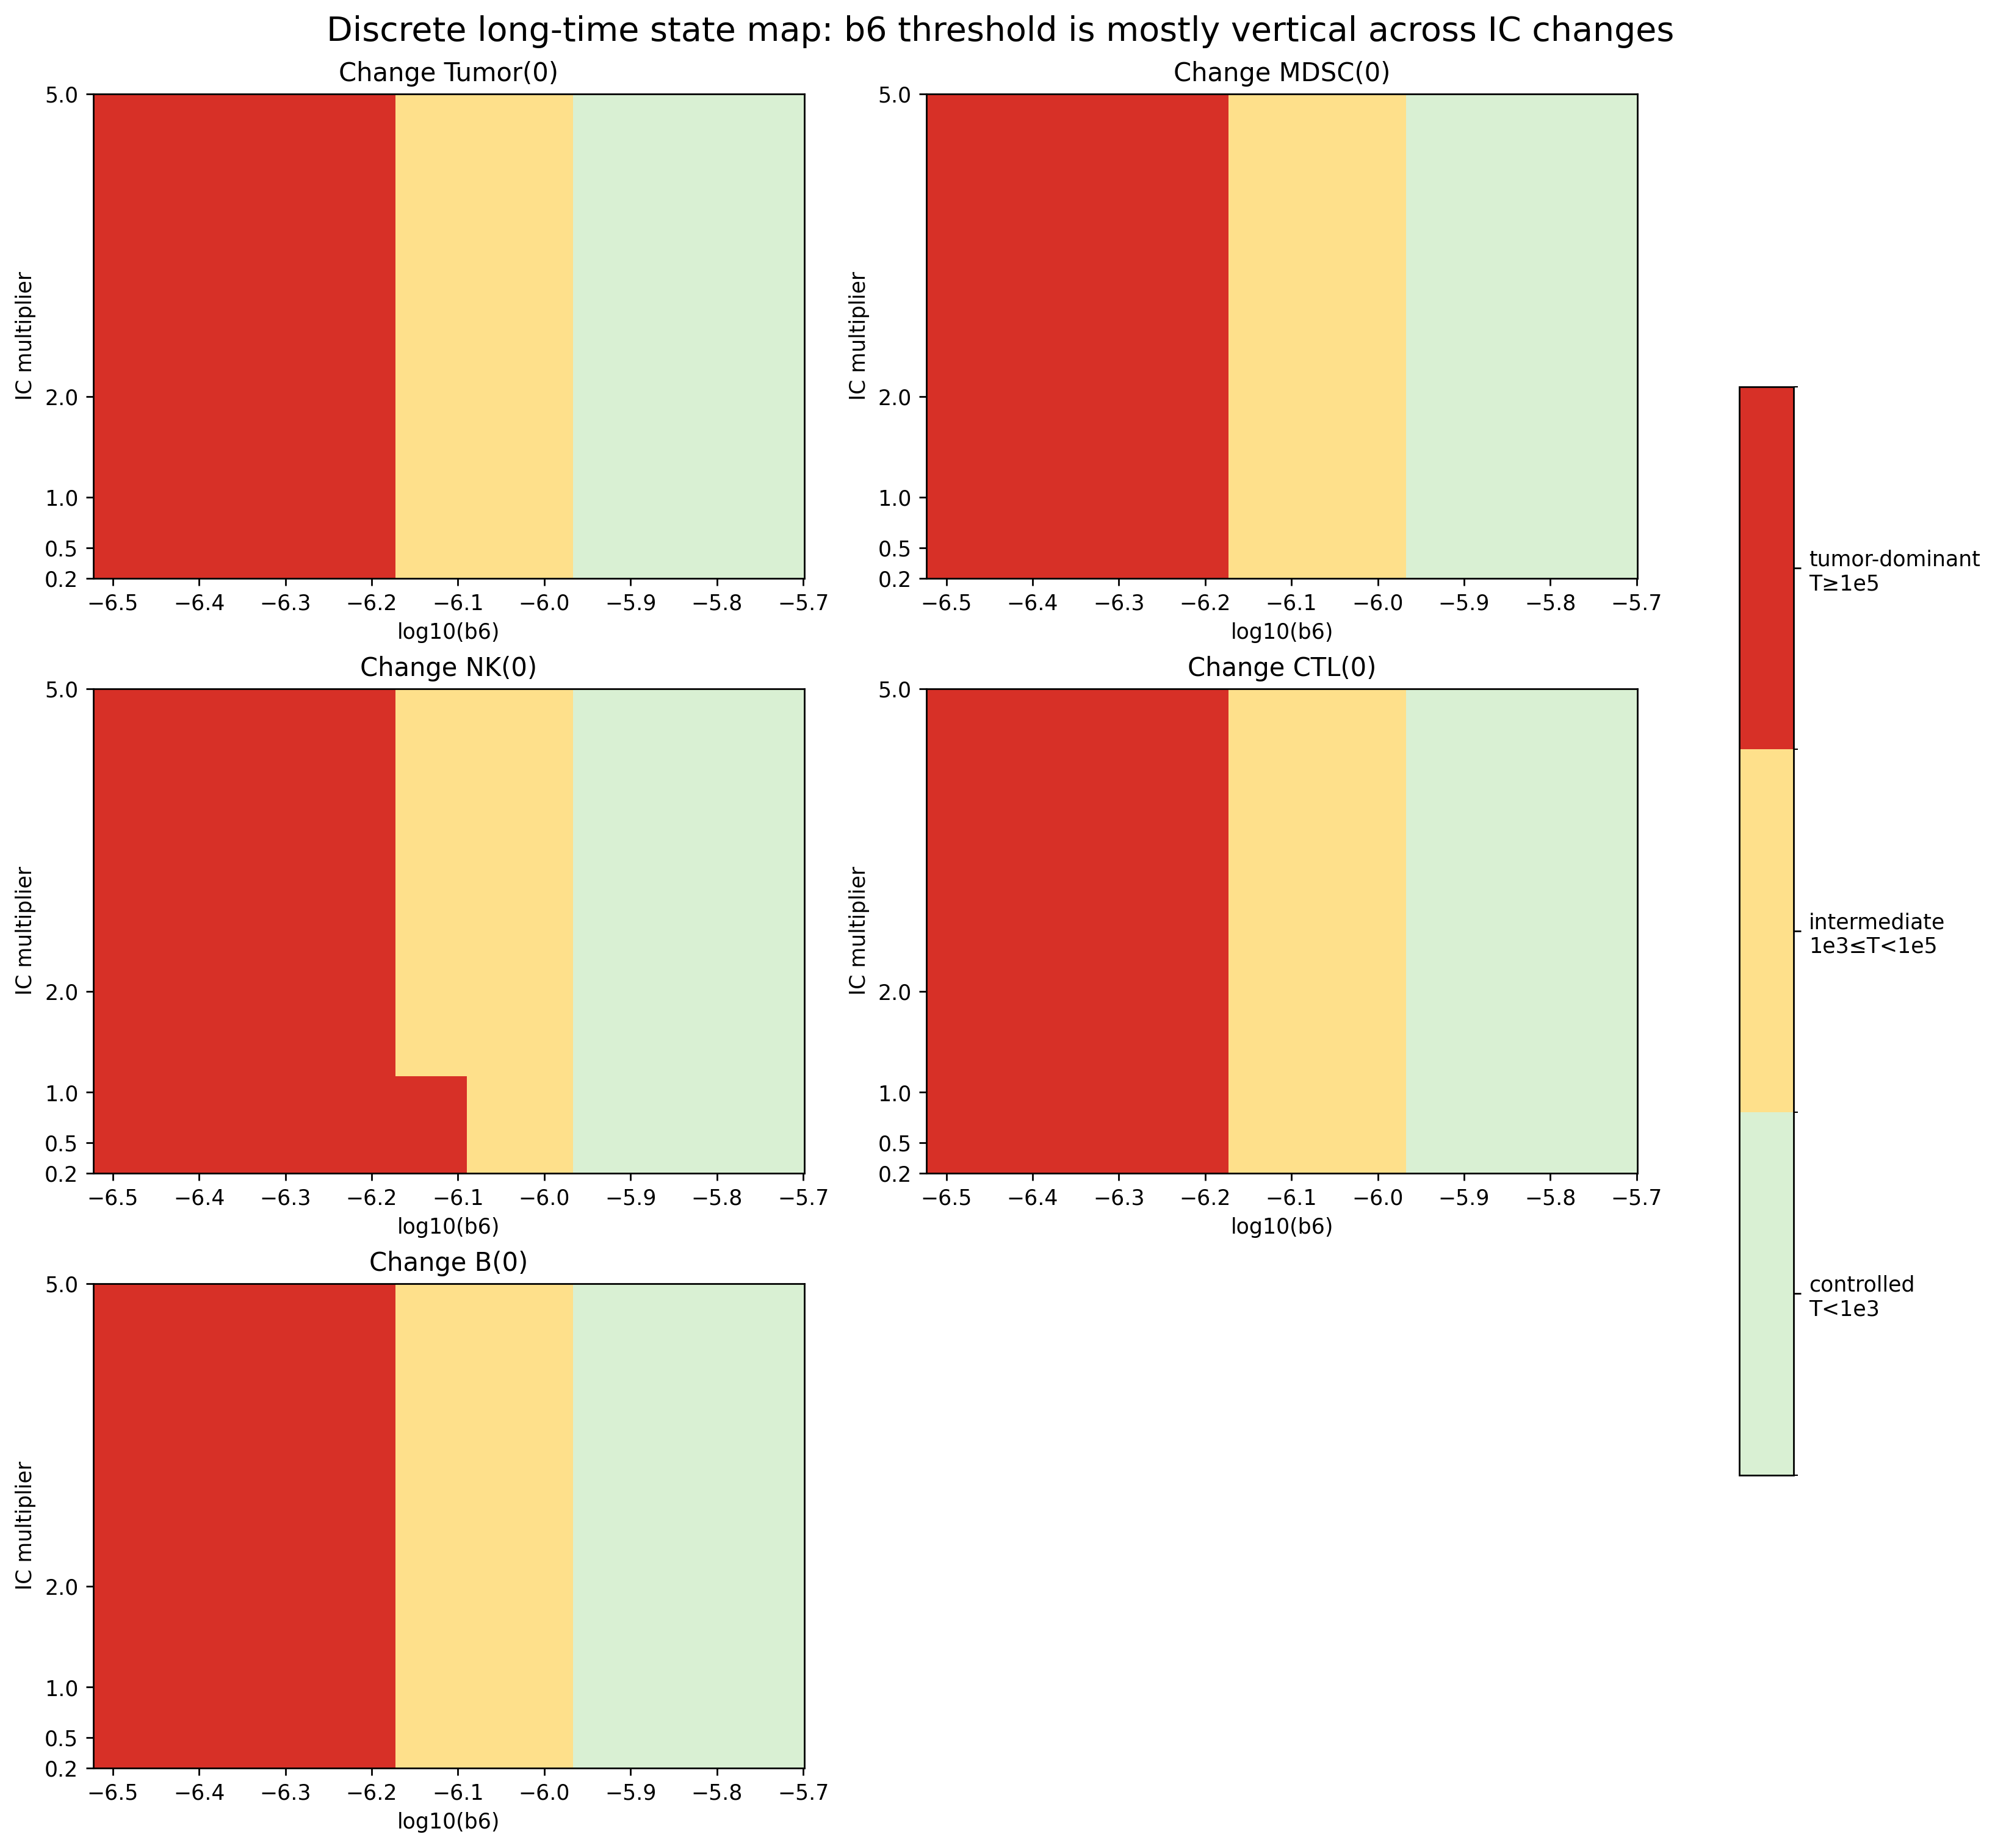
Finding 2: the phase boundary stays almost vertical across IC changes
Phase-style heatmap: controlled / intermediate / tumor-dominant regimes
What the heatmap shows
Across Tumor(0), MDSC(0), CTL(0), and B(0), the regime boundary barely shifts.
The main exception is low NK(0), which modestly pushes the boundary to the right.
This supports a parameter-driven transition rather than a baseline-IC artifact.
Takeaway: b6 controls the regime, while most IC changes do not.
B-cell MDSC model | Step 2 IC robustness

Slide 4
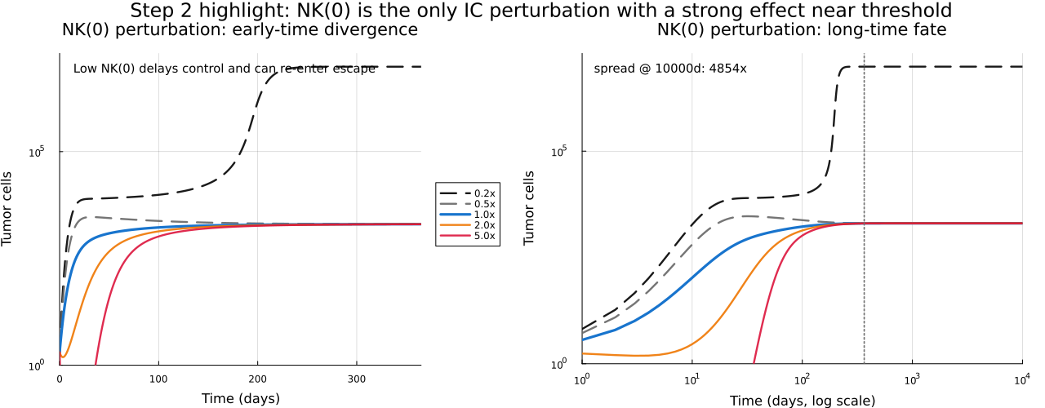
Finding 3: near the threshold, low NK(0) is the only clearly visible sensitivity
Representative trajectories at b6 = 8e-7
Varying Tumor(0), MDSC(0), CTL(0), or B(0) gives very similar long-time tumor trajectories
Reducing NK(0) makes tumor control harder near the threshold
NK is the main IC sensitivity to carry forward.
Takeaway: if we extend IC tests, NK-focused perturbations are the most informative.
B-cell MDSC model | Step 2 IC robustness

Slide 5
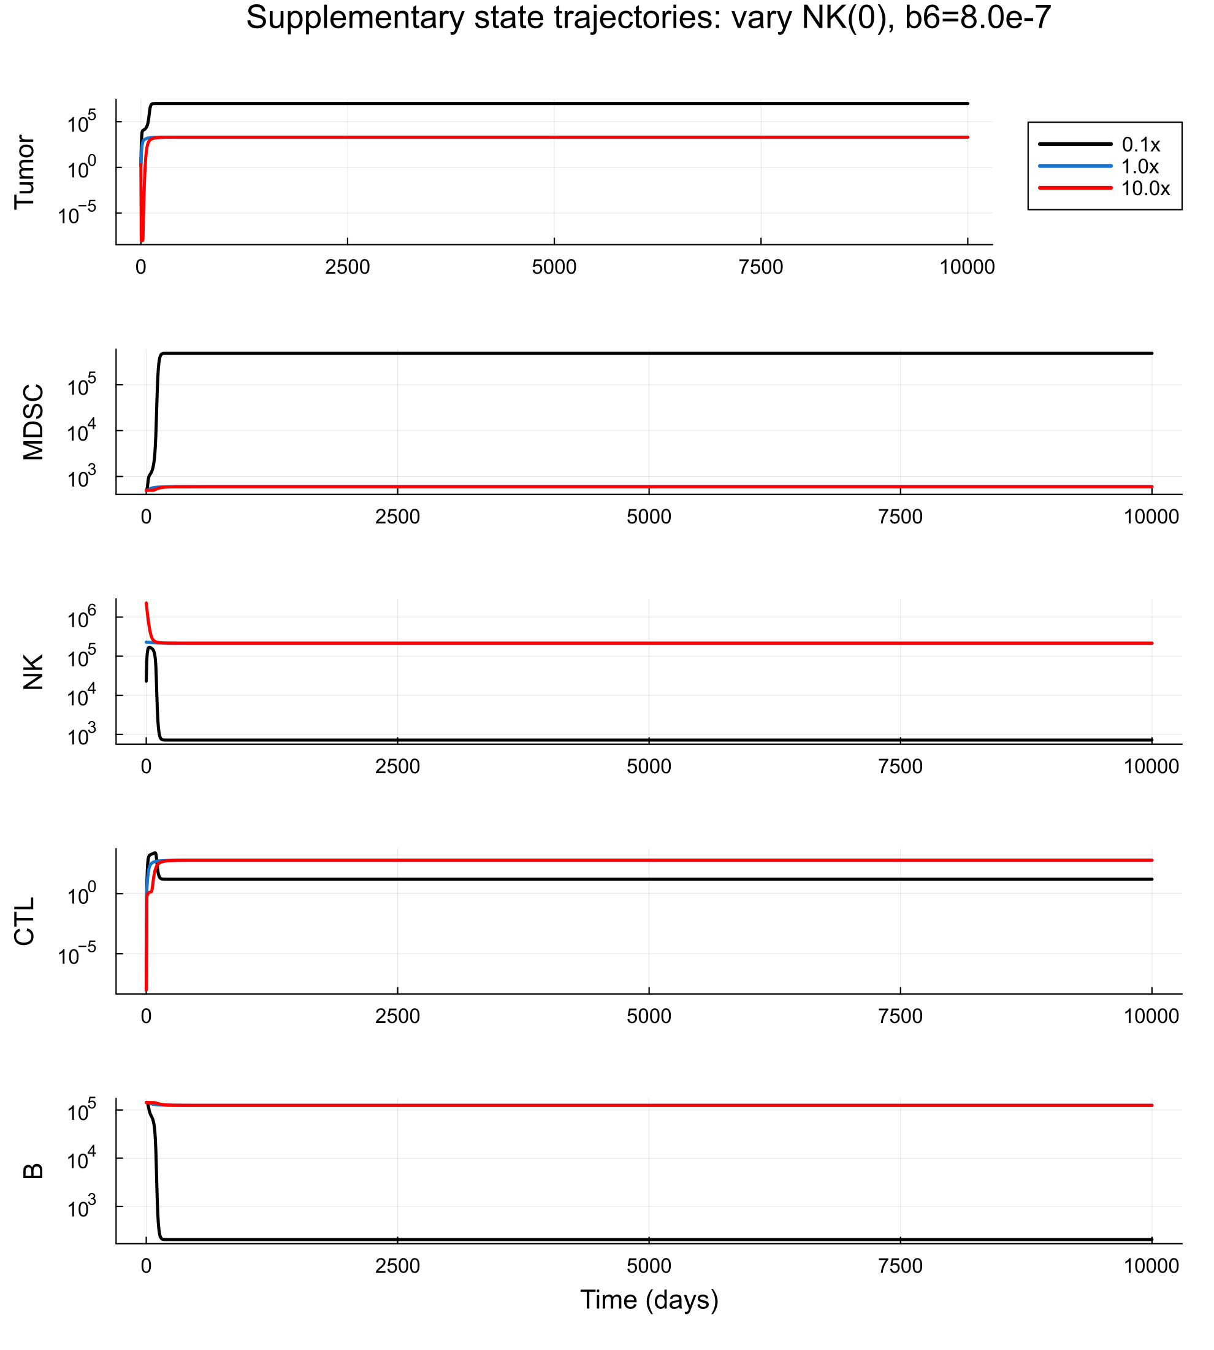
Finding 3: low NK(0) is the only clear sensitivity near the threshold
Full-state trajectories at b6 = 8e-7
Why NK matters
Reducing NK(0) makes tumor control harder near the threshold.
Other IC changes do not produce a comparably strong long-time effect.
This is consistent with the NK-rich baseline setting of the original model.
If more IC tests are needed, NK-focused perturbations are the most informative.
B-cell MDSC model | Step 2 IC robustness

Slide 6
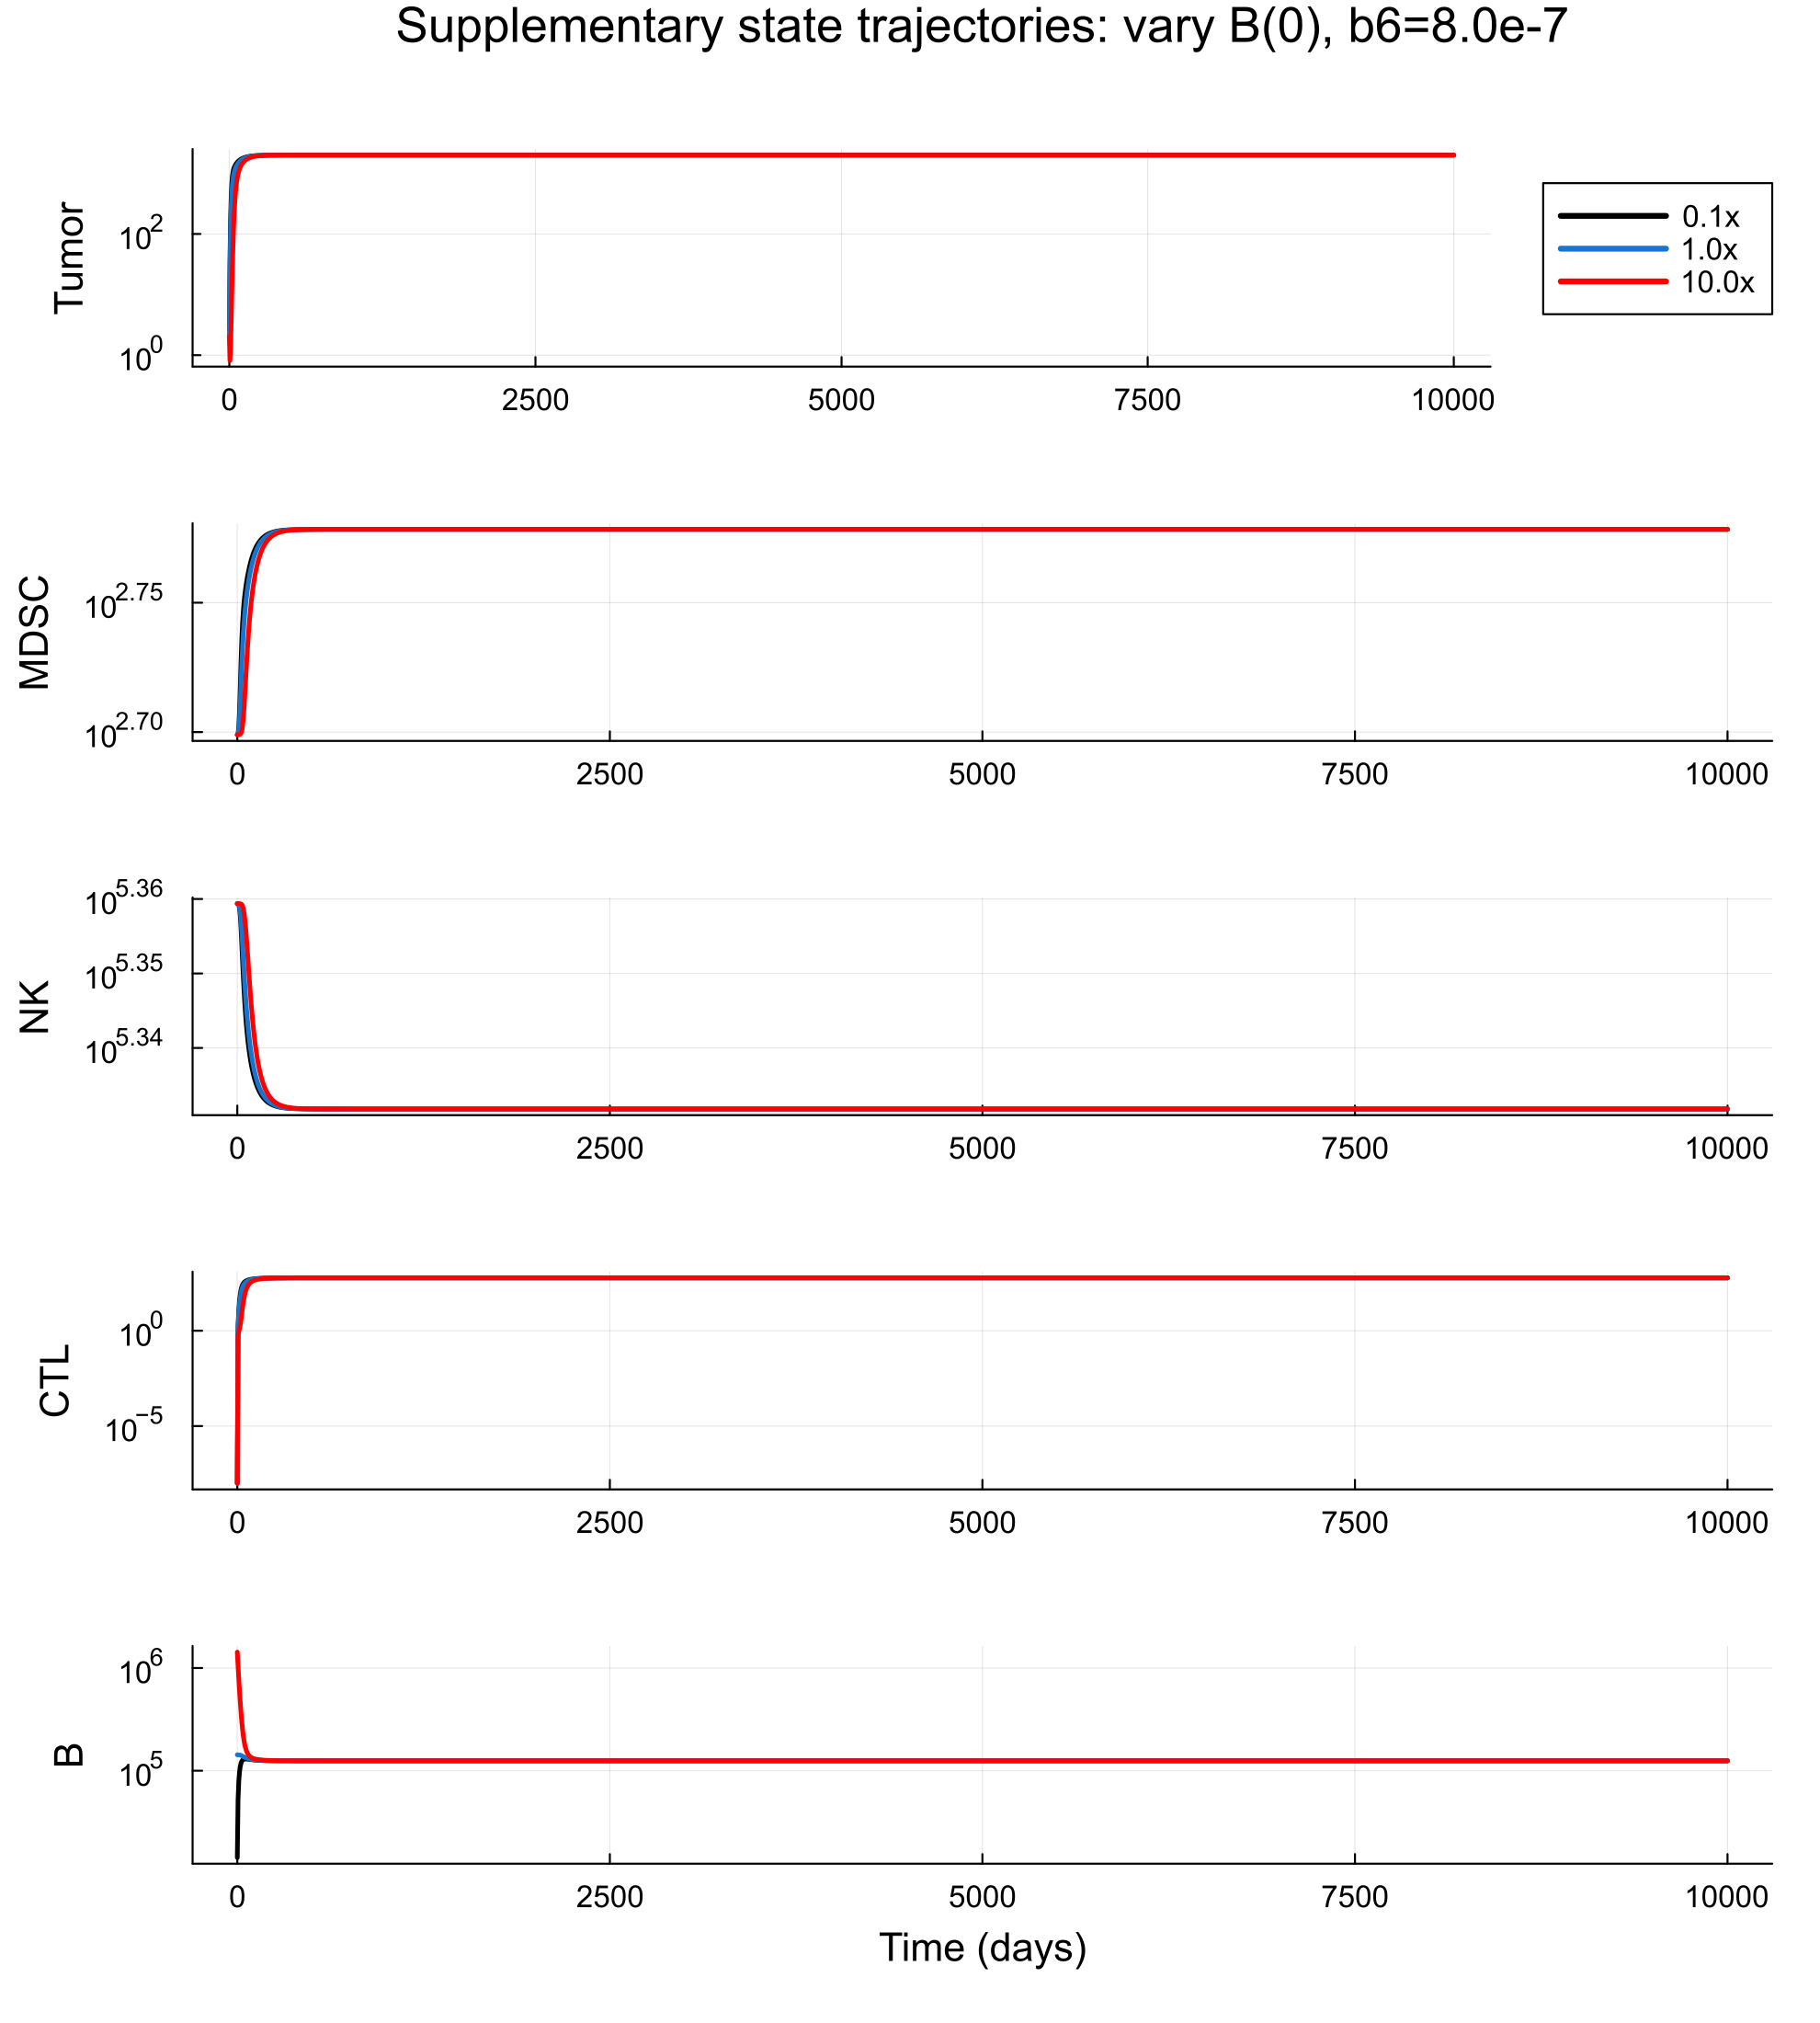
Supplementary check: lowering B(0) does not change the threshold story
Expanded IC range includes 0.1x and 10x
Why this was added
Low B(0) was tested because Adam noted simulated B may be higher than biologically realistic.
Even with 0.1x and 10x checks, the qualitative threshold story stays the same.
So the switch-like behavior is not simply driven by a large baseline B compartment.
Expanded 0.1x-10x checks support the same main conclusion.
B-cell MDSC model | Step 2 IC robustness

Slide 7
Summary and next steps
Step 2 asks whether the long-time b6 switch survives IC perturbations
What Step 2 establishes
The long-time b6 threshold persists under most one-at-a-time IC changes.
The stricter control threshold is especially stable.
Low NK(0) is the only clear sensitivity in the tested range.
Expanded 0.1x-10x checks do not change the main conclusion.
Potential next steps
Refine the long-time b5 × b6 phase diagram.
Run up-sweep / down-sweep continuation to test switch vs bifurcation-like behavior.
If more IC testing is needed, prioritize more extreme or combined NK-focused conditions.
Return to SDE only after the long-time ODE transition is fully characterized.
Bottom line: keep the direct CTL model, treat b6 as the main parameter, and use NK-focused checks to probe the transition further.
B-cell MDSC model | Step 2 IC robustness

Slide 8
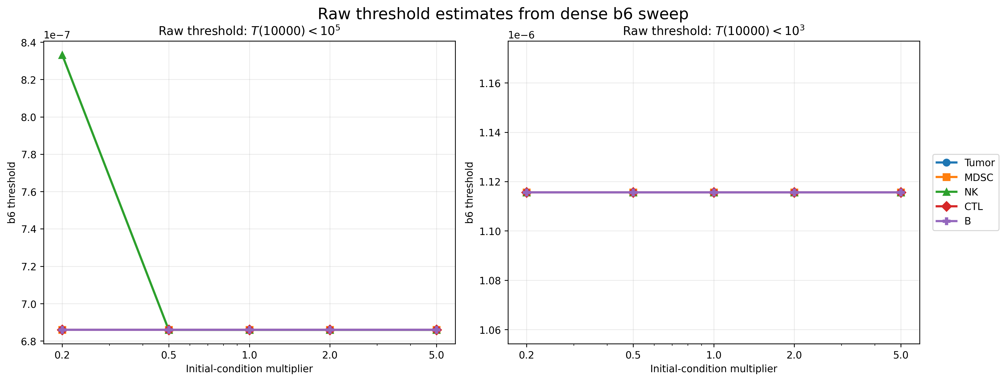
Appendix: raw threshold values
Supporting view of the same robustness result
The raw plot is consistent with the relative plot, only low NK(0) showing a noticeable shift
B-cell MDSC model | Step 2 IC robustness

