Slide 1
Step 3: b5 × b6 phase diagram
Goal: test whether MDSC suppression of B (b5) shifts the long-time b6 control threshold
Fixed model
10,000 days
b5 × b6 grid
Question
Expected interpretation
Does stronger b5 make it harder for b6 to control tumor growth?
b6 = B anti-tumor strength.
b5 = MDSC suppression of B.
If b5 increases, B is suppressed more.
Therefore, larger b6 may be needed for control.
Direct CTL formulation kept fixed.
Baseline initial condition kept fixed.
Readout: long-time tumor burden T(10000).
Main visual: phase-style b5 × b6 map.
Step 3 summary | 1

Slide 2
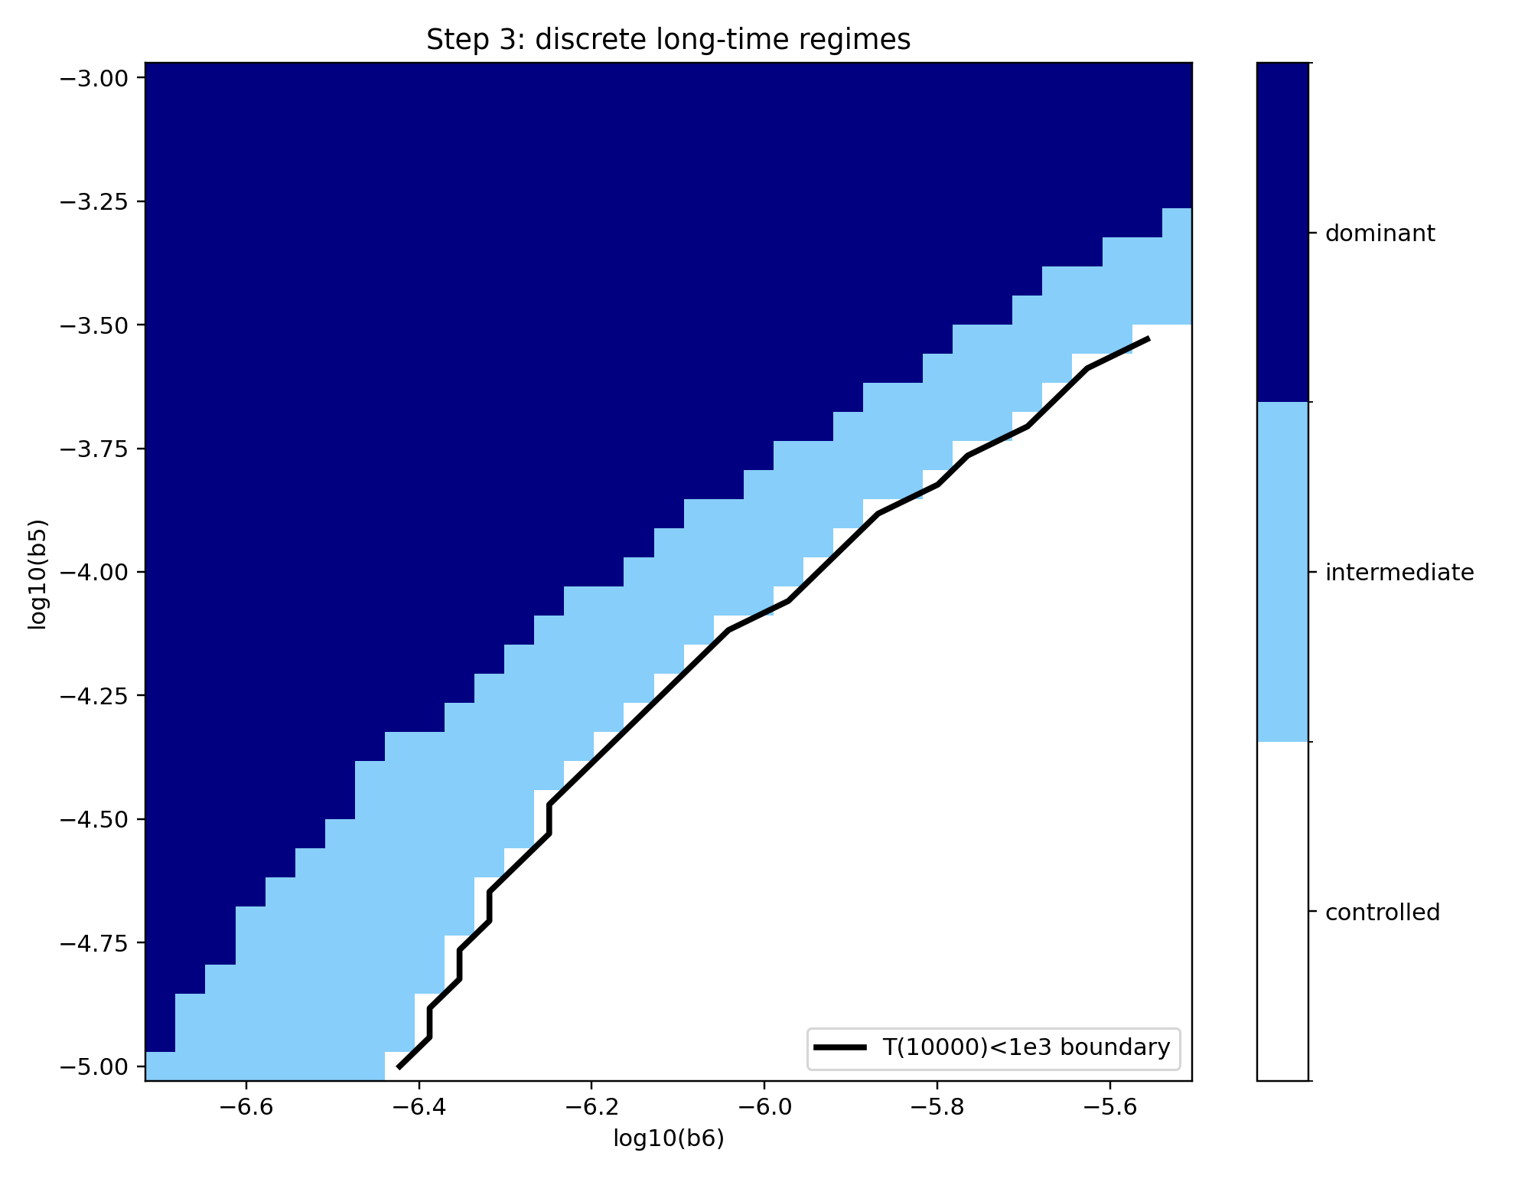
Finding 1: b5 × b6 forms a clear long-time phase boundary
Discrete regimes summarize long-time tumor outcome.
The boundary is diagonal, not random.
Higher b5 shifts the control region toward higher b6.
This supports the “b5 gates b6” interpretation.
Main message
b5 changes how much b6 is needed for long-time tumor control.
Step 3 summary | 2

Slide 3
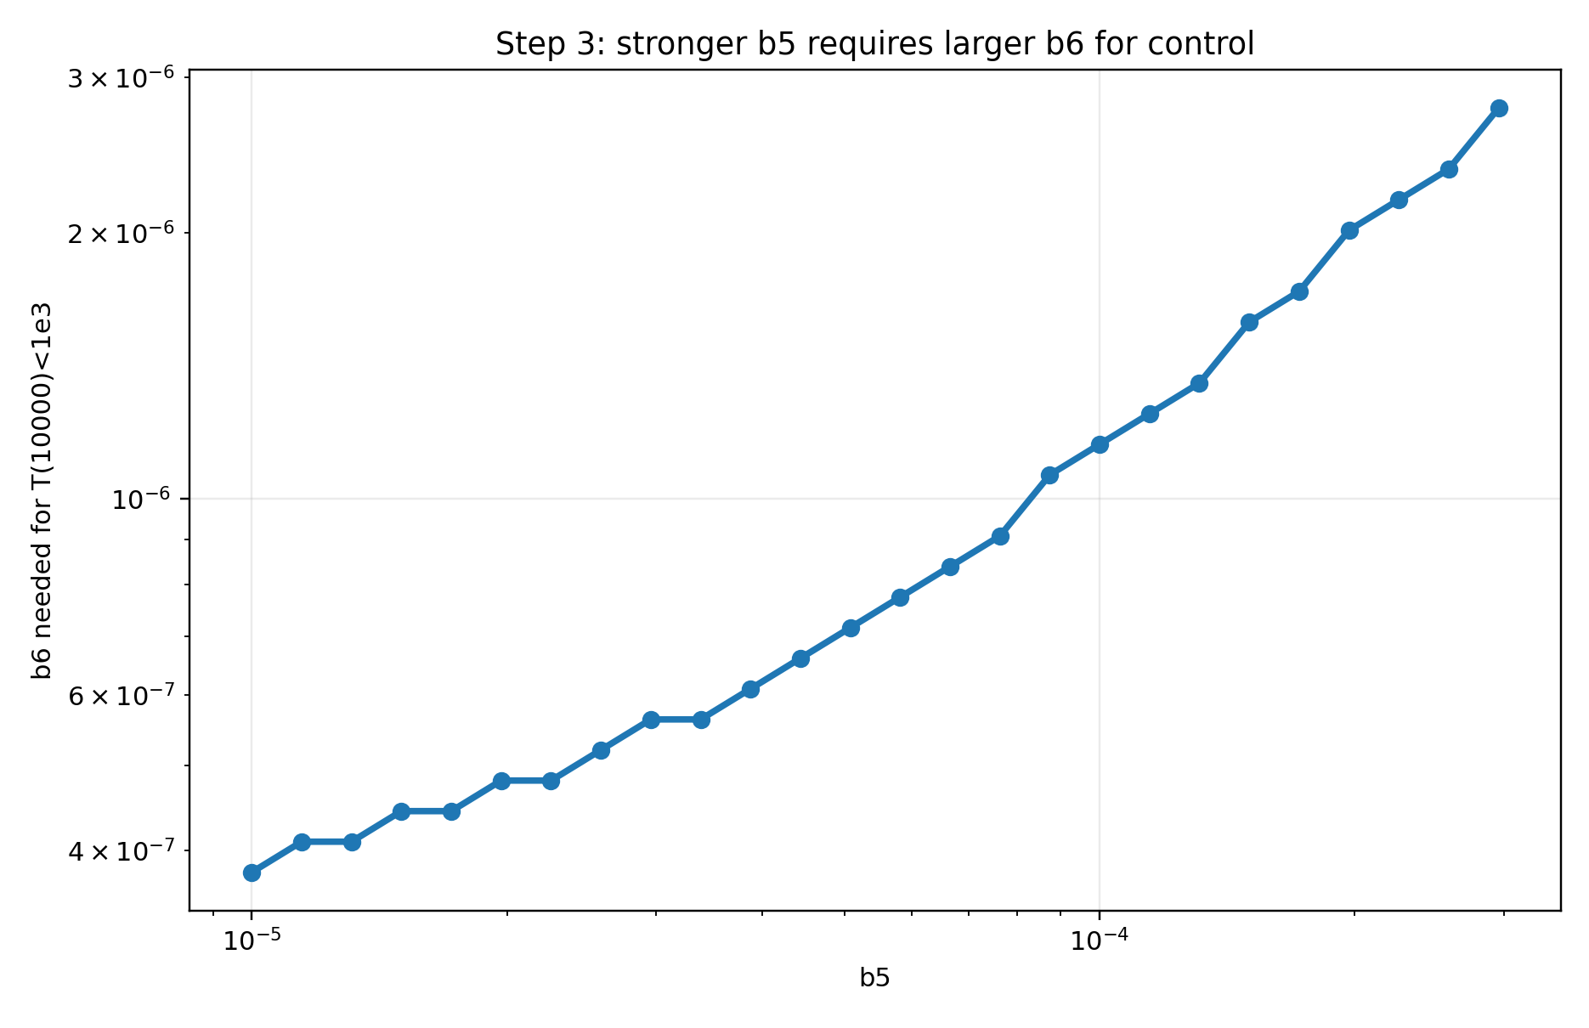
Finding 2: stronger b5 requires larger b6 for control
Each point = smallest b6 with T(10000) < 10^3.
Boundary increases monotonically with b5.
Low b5: smaller b6 is enough for control.
High b5: control requires larger b6.
Very high b5 may exceed the scanned b6 range.
Quantified gatekeeper effect
This plot turns the heatmap boundary into a simple trend.
Step 3 summary | 3

Slide 4
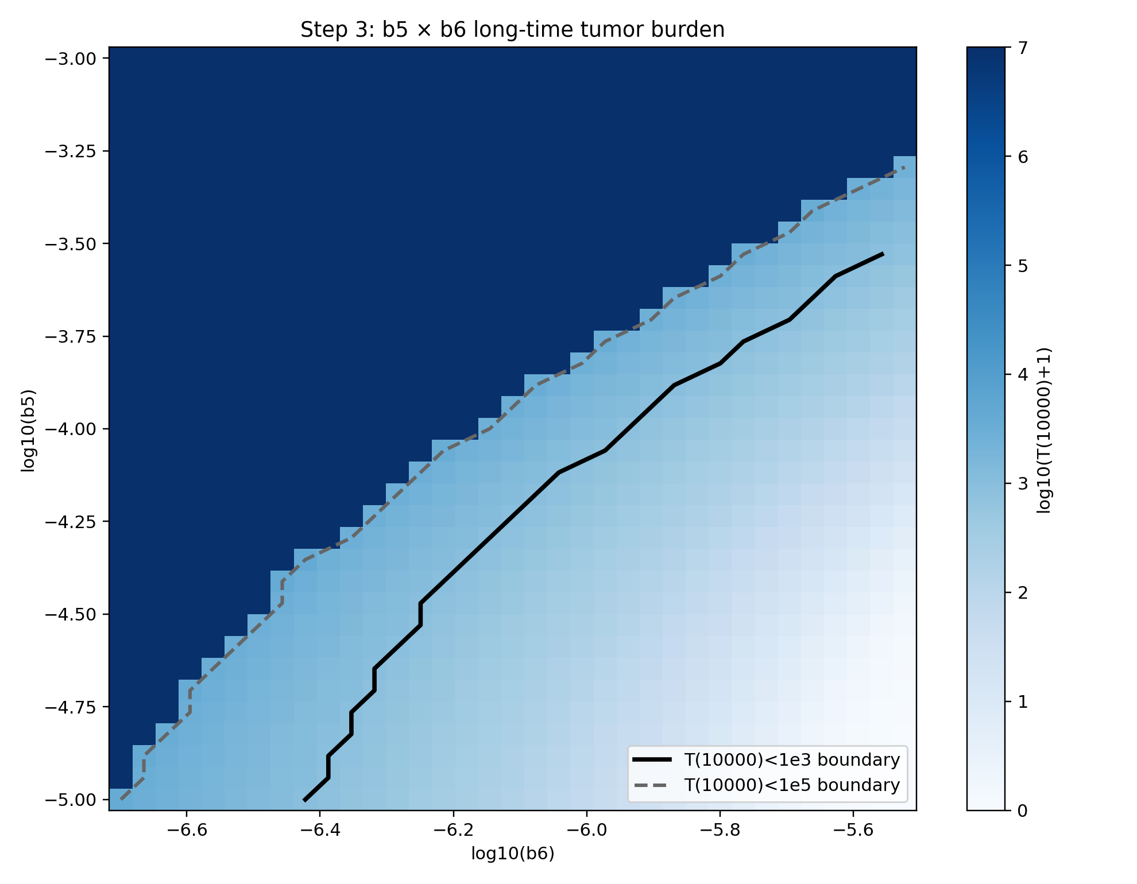
Finding 3: log tumor burden confirms the same structure
Color = log10(T(10000)+1).
Log scale avoids raw-zero color artifacts.
Black line: strict control boundary T(10000)<10^3.
Dashed line: looser low-tumor boundary T(10000)<10^5.
Both boundaries move upward with b5.
This is the corrected continuous heatmap; the earlier version mixed raw-T contours with a log heatmap.
Step 3 summary | 4

Slide 5
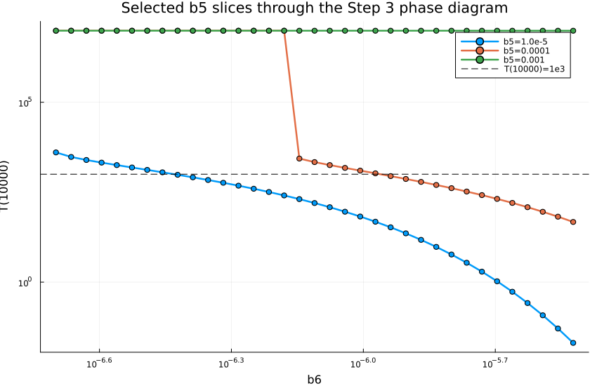
Finding 4: b5 slices show the transition in a simpler 1D view
Low b5 slice: tumor can fall below the control line.
Medium b5 slice: threshold shifts to larger b6.
High b5 slice: tumor stays high in the scanned range.
This cross-section supports the phase map and boundary plot.
Interpretation
b5 suppresses B, so a larger b6 is needed to overcome that suppression.
Step 3 summary | 5

Slide 6
Step 3 summary: b5 is a gatekeeper for the b6 effect
Main findings
Step 3 confirms a structured b5 × b6 long-time landscape.
Higher b5 pushes the control boundary to larger b6.
This supports the mechanism: MDSC ⊣ B reduces B-mediated tumor control.
The discrete phase map is the clearest main figure.
Next steps?
Next modeling question: up-sweep / down-sweep to test switch vs bifurcation-like behavior.
Do we need to return to SDE?
Step 3 summary | 6

