Slide 1
Effector B-cell tumor model
PI update · Jul 2026
Validating stochastic tumor establishment near the B-cell fold
Notes:
This update asks a narrow question: after validating the stochastic implementation, do one-year trajectories show a change near the deterministic B-cell fold?
[Sources]
- https://pmc.ncbi.nlm.nih.gov/articles/PMC10155038/
- https://github.com/maclean-lab/ModelingMDSCs
- /workspace/scratch/a86a8733f137/user-repo/README.md

Slide 2
The old SDE “success” rate was a numerical artifact
Earlier scripts could stop when any state became negative, then classify the incomplete path from its last stored tumor value.
That allowed a failed solve to be labeled as a successful tumor.
Early stop + T > 1
= “success”
Day 365 or explicit
T < 1 removal
Retcode unchecked
Day 365 not required
Non-tumor failure counted
Termination reason logged
Invalid paths excluded
Every seed auditable
2
Notes:
The apparent near-100% result was not biological. A negative immune state could terminate integration while tumor remained near its initial value; the old classifier then counted that incomplete path as success.
[Sources]
- /workspace/scratch/a86a8733f137/user-repo/results/post_meeting/sde_validation/README.md
- /workspace/scratch/a86a8733f137/user-repo/code/post_meeting/sde_validation/EffectorBSDE.jl

Slide 3
The rebuilt pipeline validates definitions, numerics, and scale
1 · Criterion
2 · Solver
3 · Regression
Define the event
Paper: T never falls below 1 during 365 days. A stricter criterion is reported separately.
Verify trajectories
Zero noise, small noise, seed repeatability, nonnegativity, and time resolution.
Recover the paper
Match the published four-state probability before testing the five-state extension.
3
Notes:
The pipeline first fixes the event definition, then checks solver behavior, and only then asks whether the original four-state result can be recovered. The five-state near-fold pilot is blocked unless these gates pass.
[Sources]
- https://pmc.ncbi.nlm.nih.gov/articles/PMC10155038/
- https://github.com/maclean-lab/ModelingMDSCs
- /workspace/scratch/a86a8733f137/user-repo/code/post_meeting/sde_validation/README.md

Slide 4
All six validation gates passed before the near-fold pilot
The corrected implementation reproduces the original stochastic benchmark and removes hidden invalid trajectories.
Unit tests: 26/26 passed.
0
0.330
0.0395
invalid paths
in the final pilot
paper regression
published: 0.3217
small-noise mean error
acceptance: < 0.10
4
Notes:
Key checks: zero-noise error versus ODE was 5.12e-7; the paper regression was 0.330 with the published 0.321711 inside the 99% Wilson interval; the three time-resolution estimates spanned 0.07, within the 0.10 gate.
[Sources]
- /workspace/scratch/a86a8733f137/user-repo/results/post_meeting/sde_validation/validation_gates.csv
- /workspace/scratch/a86a8733f137/user-repo/results/post_meeting/sde_validation/time_resolution_estimates.csv

Slide 5
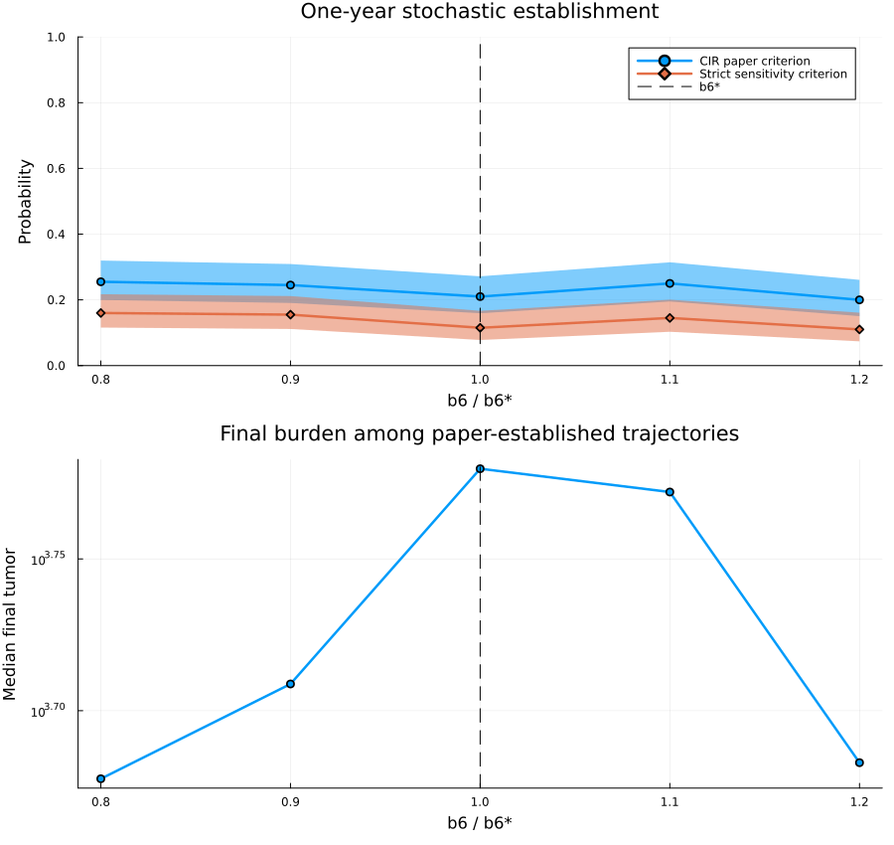
The pilot does not resolve a stochastic threshold near b₆*
All 95% confidence intervals overlap, and the estimated curve is non-monotonic.
0.200–0.255
0.110–0.160
paper criterion
strict criterion
5
Notes:
The pilot used 200 trajectories at each of five b6 values, for 1,000 valid trajectories total. Because every trajectory starts from a two-cell inoculation state, this measures establishment or early fate selection, not stochastic switching between established attractors.
[Sources]
- /workspace/scratch/a86a8733f137/user-repo/results/post_meeting/sde_validation/near_fold_pilot_summary.csv
- /workspace/scratch/a86a8733f137/user-repo/results/post_meeting/sde_validation/near_fold_establishment_probability.png

Slide 6
DECISION
Keep the saddle-node as the primary result.
Choose: establishment or true switching.
Then design the next test.
Notes:
Recommendation: retain the deterministic saddle-node as the primary current result. If the scientific question is establishment, next calibrate noise scale and run sensitivity analyses. If the question is true switching, initialize near established attractors and define basin-crossing events.
[Sources]
- /workspace/scratch/a86a8733f137/user-repo/README.md
- /workspace/scratch/a86a8733f137/user-repo/results/post_meeting/sde_validation/README.md

