Slide 1
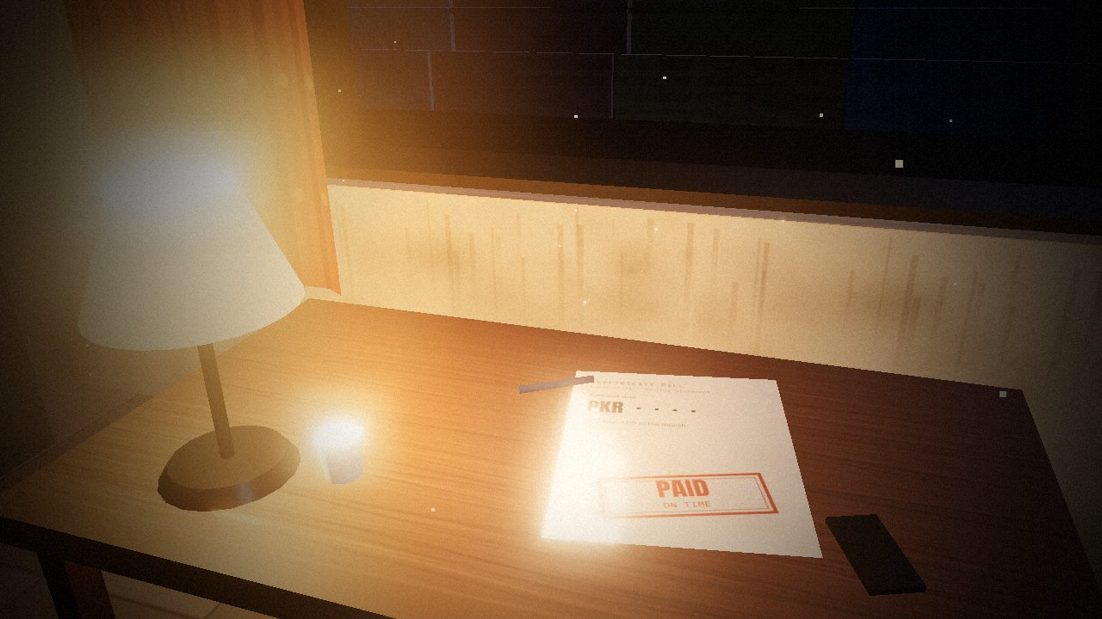
K-ELECTRIC · LOAD-SHEDDING · CORPORATE ACCOUNTABILITY
Paid. On time.
When a company faces a collective financial problem, how much of the burden can it fairly place on an individual customer who has fulfilled their responsibility?
Karachi School of Business and Leadership · Business Ethics & Law · Dr Faryal Razzaq
Munhib Alam Khan · Rabie Sami · Abdullah Khan · Karan Kumar
Notes:
Submission copy of the live presentation. Each following slide is one advance of the talk: its motion plays automatically when the slide opens and holds on the final frame. Speaker notes carry the script for that advance, the cue, qualifications and sources. The live interactive version: https://munhib-alam-khan.github.io/ke-ethics-midterm/

Slide 2
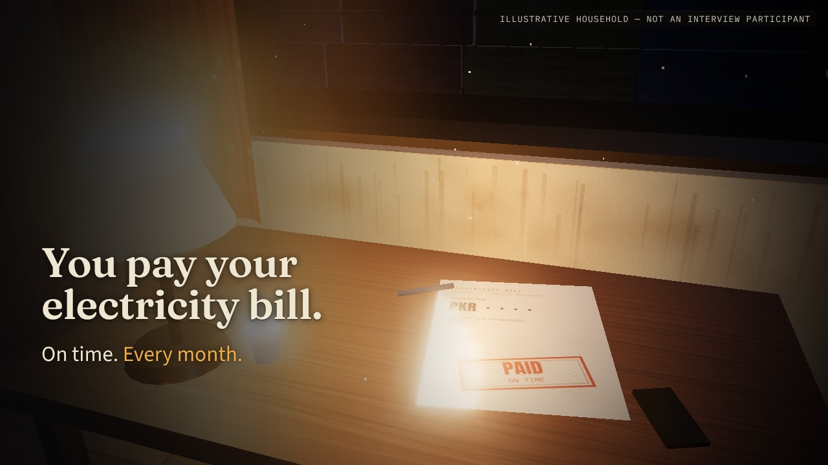
Notes:
Opening — The household · scene 1/22 · reveal 1/2 · advance 1/37
SCRIPT
You pay your electricity bill.
On time.
Every month.
ON SCREEN
Lamp-lit room at night. Close on the paid bill; the fan turns, the router blinks, a pot is on.
QUALIFICATIONS
Begin without an introduction. The household is illustrative, not one of our participants. Let the lights-out moment land before speaking.

Slide 3
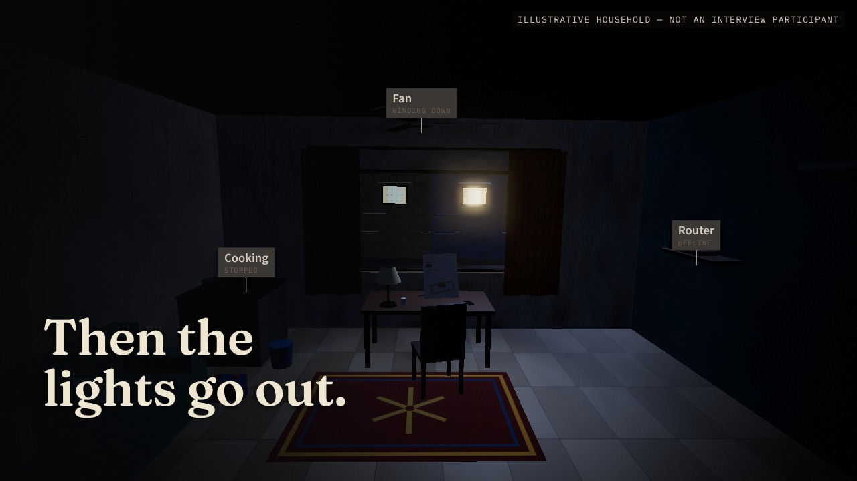
Notes:
Opening — The household · scene 1/22 · reveal 2/2 · advance 2/37
SCRIPT
Then the lights go out.
ON SCREEN
ADVANCE → the bill lifts toward us; router lights die, the lamp stutters out, the tube light and stove cut, the fan winds down. Through the window the whole street goes dark with us.
QUALIFICATIONS
Begin without an introduction. The household is illustrative, not one of our participants. Let the lights-out moment land before speaking.

Slide 4
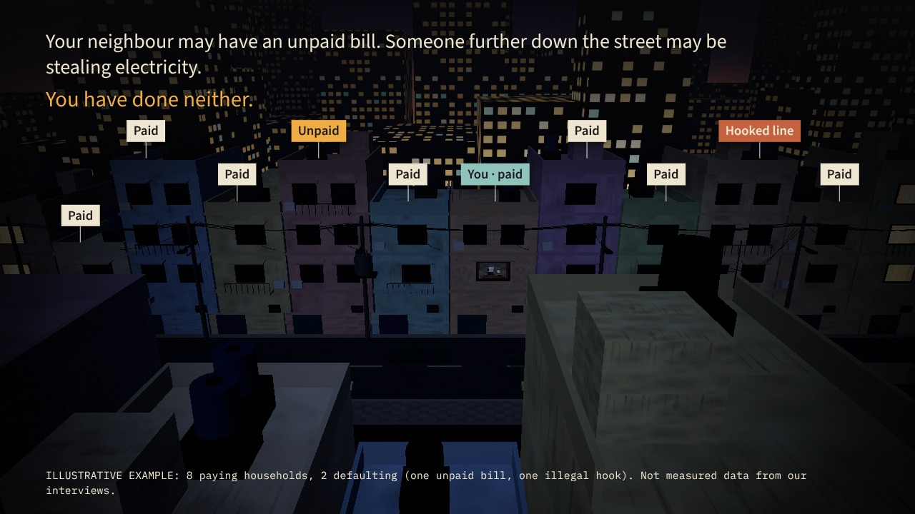
Notes:
Opening — Shared darkness · scene 2/22 · reveal 1/3 · advance 3/37
SCRIPT
Your neighbour may have an unpaid bill. Someone further down the street may be stealing electricity. You have done neither.
ON SCREEN
The camera lifts over the bill and flies out through the open window, turns, and finds the whole feeder dark; illustrative tags land on ten houses (8 paying, 2 defaulting).
QUALIFICATIONS
The 8/2 split is an invented teaching example and is labelled as such on screen. Do not describe it as interview data.

Slide 5
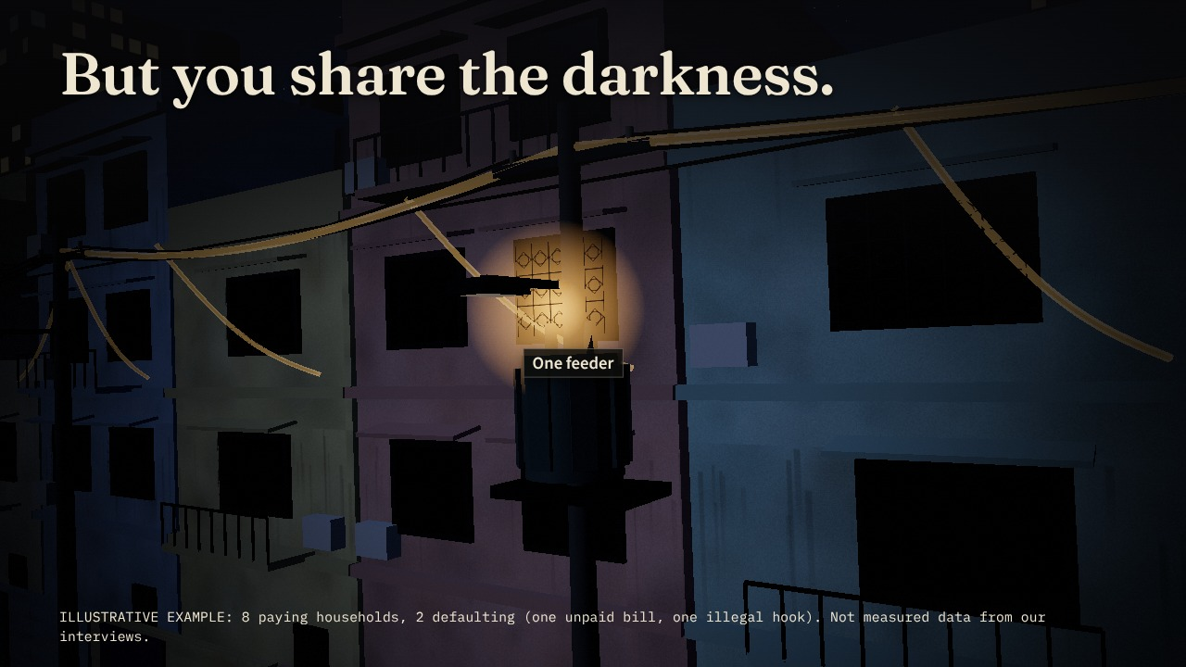
Notes:
Opening — Shared darkness · scene 2/22 · reveal 2/3 · advance 4/37
SCRIPT
But you share the darkness.
[Pause.]
ON SCREEN
ADVANCE → close on the transformer; a pulse runs down the line into every house — paying or not.
QUALIFICATIONS
The 8/2 split is an invented teaching example and is labelled as such on screen. Do not describe it as interview data.

Slide 6
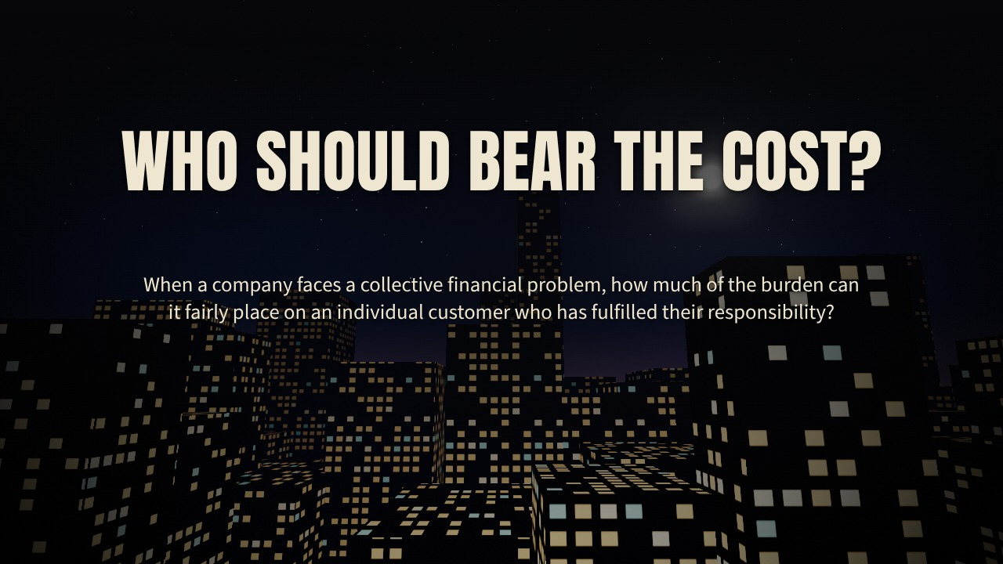
Notes:
Opening — Shared darkness · scene 2/22 · reveal 3/3 · advance 5/37
SCRIPT
That is the question behind our K-Electric case:
When a company faces a collective financial problem, how much of the burden can it fairly place on an individual customer who has fulfilled their responsibility?
ON SCREEN
ADVANCE → tags clear; the camera cranes up past the roofs into the night sky; the case question lands.
QUALIFICATIONS
The 8/2 split is an invented teaching example and is labelled as such on screen. Do not describe it as interview data.

Slide 7
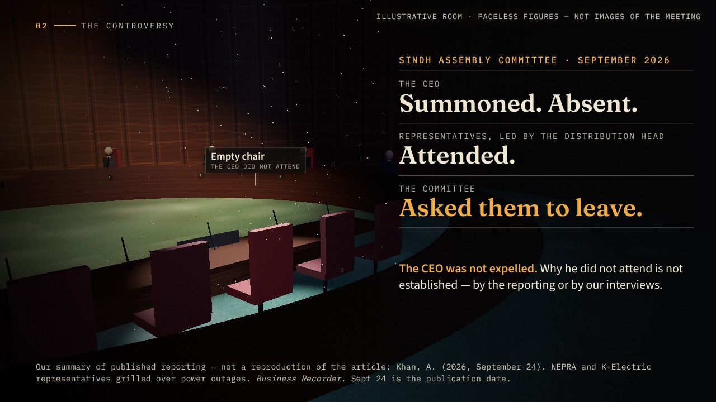
Notes:
The controversy — The public confrontation · scene 3/22 · reveal 1/1 · advance 6/37
SCRIPT
In September 2026, that question reached a Sindh Assembly committee.
The CEO had been summoned. He did not attend. Representatives led by the distribution head appeared instead.
The committee was dissatisfied with their responses and asked them to leave.
That confrontation became the headline.
ON SCREEN
Whip into an illustrative committee room. From high above, the camera settles behind the witness table: the centre chair is empty under a cold light; the representatives stand, then walk out through the lit door. The triad lands on the right.
QUALIFICATIONS
Accuracy: the CEO was summoned and absent; the delegates (led by the distribution head) were asked to leave. The distribution head apologised on the CEO's behalf and said they did not hold the CEO's authority (Khan, 2026). Sept 24 is the article's publication date. Do not suggest a motive for the absence.
SOURCES
Khan, A. (2026, September 24). NEPRA and K-Electric representatives grilled over power outages. Business Recorder. https://www.brecorder.com/news/40440981

Slide 8
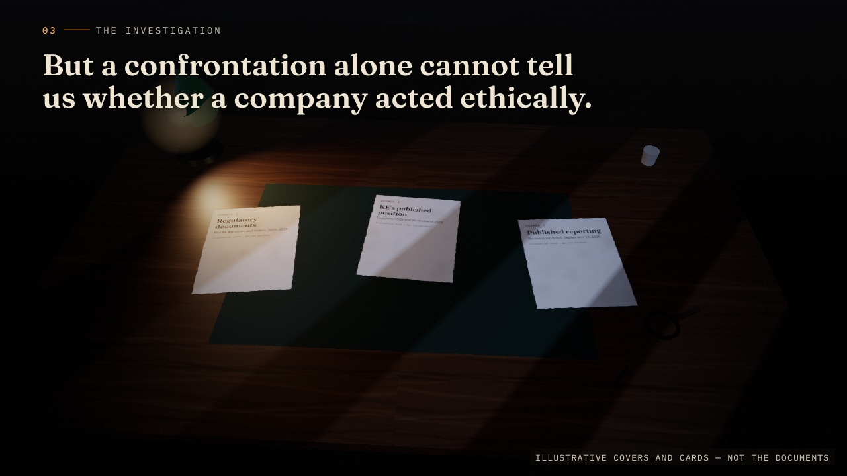
Notes:
The investigation — Beyond the headline · scene 4/22 · reveal 1/2 · advance 7/37
SCRIPT
But a confrontation alone cannot tell us whether a company acted ethically.
We needed to examine what happened before the meeting, what customers were experiencing, and what people inside the company could explain.
So we brought together regulatory documents, KE’s published position,
ON SCREEN
Noir evidence desk under blinds light. Three source documents fly in and land on the blotter (illustrative covers).
QUALIFICATIONS
Semi-structured interviews, October 3–9, 2026, English and Urdu. No interviewer names or speaking roles are shown. Interviewer framing may have shaped some answers (see limitations).
SOURCES
Khan, A. (2026, September 24). NEPRA and K-Electric representatives grilled over power outages. Business Recorder. https://www.brecorder.com/news/40440981
National Electric Power Regulatory Authority. (2026, August 31). Order of the Authority under Section 27C of the NEPRA Act 1997 in the matter of K-Electric Limited on account of unannounced and excessive load shedding in Karachi. https://nepra.org.pk/M%26E/Decisions/2026/08%20Aug/LAD-01%20ORDER%20UNDER%20SECTION%2027C%20OF%20NEPRA%20ACT%201997%20IN%20MATER%20OF%20K-ELECTRIC%2031-08-2026%2018150.PDF
National Electric Power Regulatory Authority. (2025, July 11). Decision in the matter of complaint filed by Mr. Shariq Jamal against K-Electric Limited regarding load shedding [Complaint No. KElectric-KHI-51771-03-25]. https://nepra.org.pk/consumer%20affairs/cad/Authority%20Decisions/K-Electric/2025/07%20July/TCD-04%20K-ELECTRIC%2011-07-2025%202793.pdf
K-Electric. (n.d.). FAQs. Retrieved October 11, 2026, from https://ke.com.pk/faqs/
K-Electric. (2026b, January 2). Year in review: K-Electric shows steady progress during 2025. https://ke.com.pk/year-in-review-k-electric-shows-steady-progress-during-2025/

Slide 9
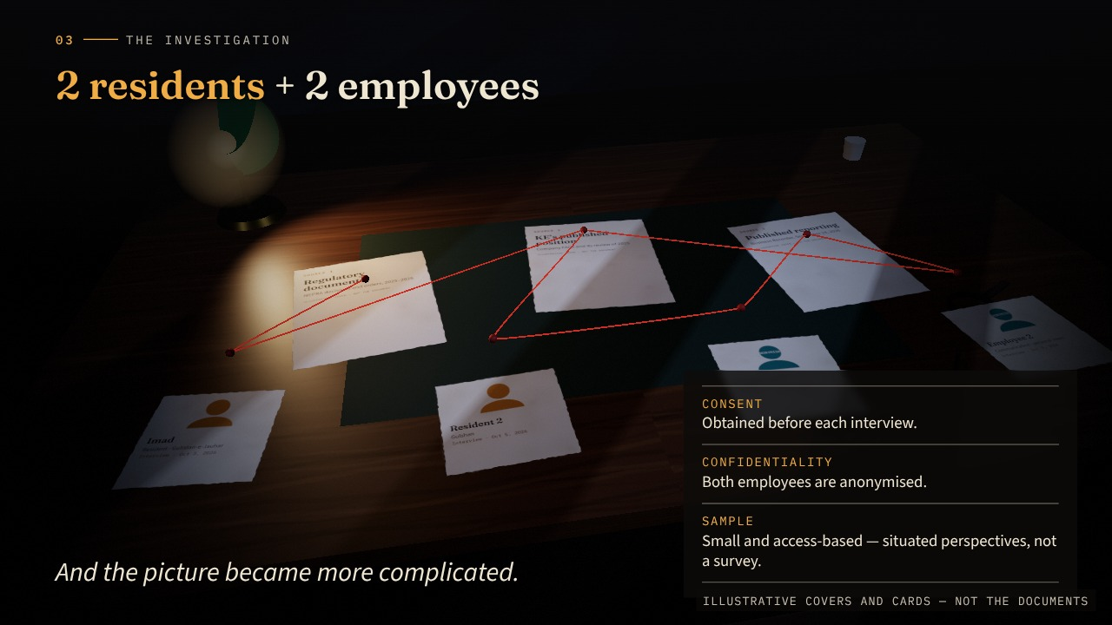
Notes:
The investigation — Beyond the headline · scene 4/22 · reveal 2/2 · advance 8/37
SCRIPT
and four interviews: two residential customers and two employees.
And the picture became more complicated.
[Pause briefly.]
ON SCREEN
ADVANCE → four interview cards slide in below; a red string runs between sources and accounts; the camera leans closer.
QUALIFICATIONS
Semi-structured interviews, October 3–9, 2026, English and Urdu. No interviewer names or speaking roles are shown. Interviewer framing may have shaped some answers (see limitations).
SOURCES
Khan, A. (2026, September 24). NEPRA and K-Electric representatives grilled over power outages. Business Recorder. https://www.brecorder.com/news/40440981
National Electric Power Regulatory Authority. (2026, August 31). Order of the Authority under Section 27C of the NEPRA Act 1997 in the matter of K-Electric Limited on account of unannounced and excessive load shedding in Karachi. https://nepra.org.pk/M%26E/Decisions/2026/08%20Aug/LAD-01%20ORDER%20UNDER%20SECTION%2027C%20OF%20NEPRA%20ACT%201997%20IN%20MATER%20OF%20K-ELECTRIC%2031-08-2026%2018150.PDF
National Electric Power Regulatory Authority. (2025, July 11). Decision in the matter of complaint filed by Mr. Shariq Jamal against K-Electric Limited regarding load shedding [Complaint No. KElectric-KHI-51771-03-25]. https://nepra.org.pk/consumer%20affairs/cad/Authority%20Decisions/K-Electric/2025/07%20July/TCD-04%20K-ELECTRIC%2011-07-2025%202793.pdf
K-Electric. (n.d.). FAQs. Retrieved October 11, 2026, from https://ke.com.pk/faqs/
K-Electric. (2026b, January 2). Year in review: K-Electric shows steady progress during 2025. https://ke.com.pk/year-in-review-k-electric-shows-steady-progress-during-2025/

Slide 10
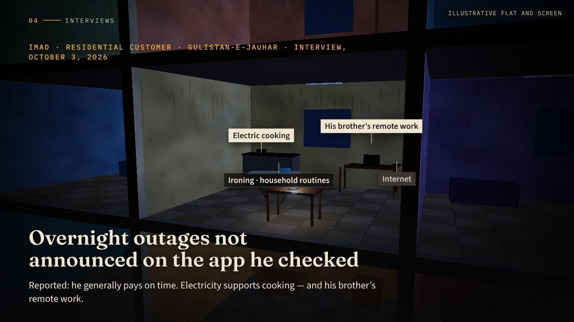
Notes:
Interviews — Imad’s household · scene 5/22 · reveal 1/2 · advance 9/37
SCRIPT
Start with Imad, a customer in Gulistan-e-Jauhar.
He told us he generally pays his bills on time. Yet he described overnight outages that were not announced on the application he checked.
At home, electricity supports cooking. His brother works remotely, so an outage also interrupts internet access and work.
ON SCREEN
Cut-away apartment block at night, Gulistan-e-Jauhar (illustrative). The camera drifts into the centre flat: stove, laptop, router, iron. Partway in, the block loses power; only the phone’s outage page stays lit — and it lists nothing.
QUALIFICATIONS
Imad agreed to be named. No precise outage frequency or measured duration was supplied; no expense or income-loss total. The service responses are his description, not verbatim transcripts. He also mentioned ironing and household schedules.

Slide 11
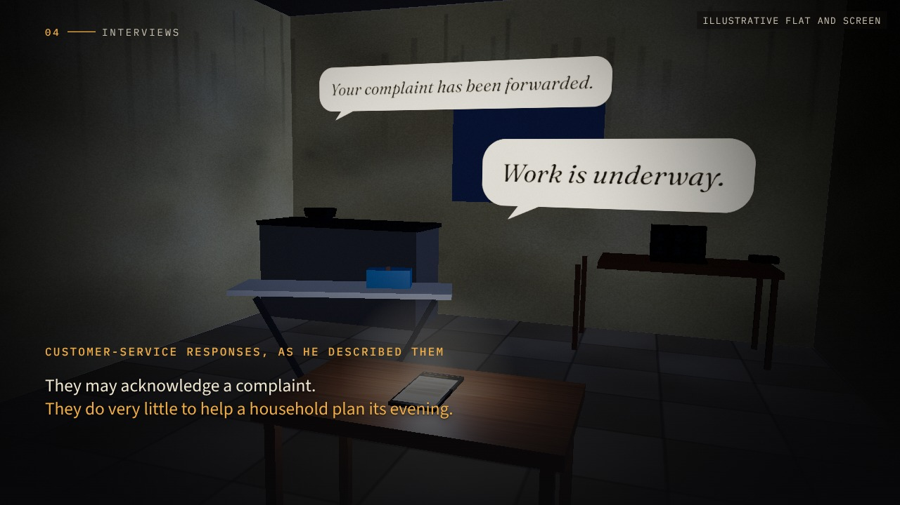
Notes:
Interviews — Imad’s household · scene 5/22 · reveal 2/2 · advance 10/37
SCRIPT
When he contacted customer service, he described familiar responses: work is underway; your complaint has been forwarded.
Those responses may acknowledge a complaint. They do very little to help a household plan its evening.
ON SCREEN
ADVANCE → closer on the phone; the service responses he described rise as speech bubbles and hang there.
QUALIFICATIONS
Imad agreed to be named. No precise outage frequency or measured duration was supplied; no expense or income-loss total. The service responses are his description, not verbatim transcripts. He also mentioned ironing and household schedules.

Slide 12
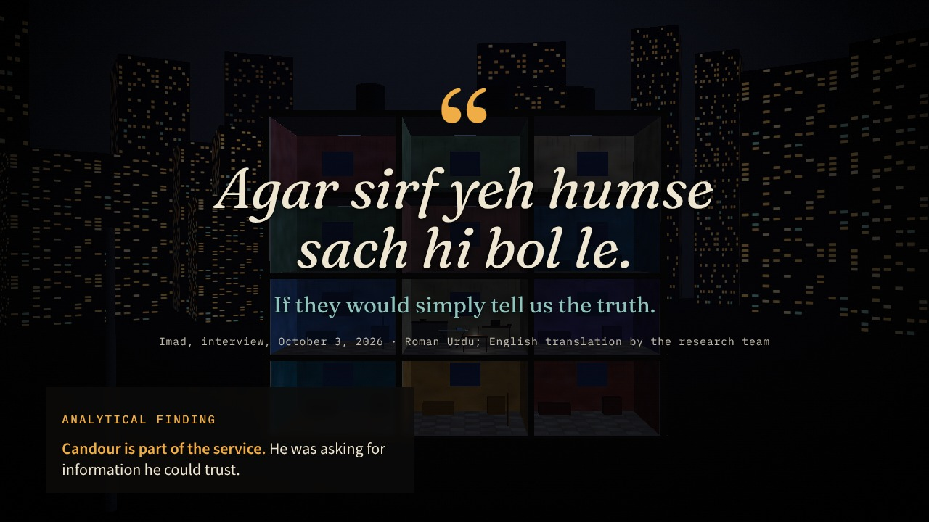
Notes:
Interviews — Imad: “tell us the truth” · scene 6/22 · reveal 1/1 · advance 11/37
SCRIPT
At the end, his request was strikingly simple:
“Agar sirf yeh humse sach hi bol le.”
If they would simply tell us the truth.
Think about how low that expectation has become.
He was asking for information he could trust.
ON SCREEN
The camera floats back out of the dark block until the whole building is one silhouette with a single phone glowing. The quotation arrives word by word; hold.
QUALIFICATIONS
Exact quotation from the report (Appendix A). The finding links directly to Recommendation 2 (outage updates). It is a demand for candour, not for impossible precision.

Slide 13
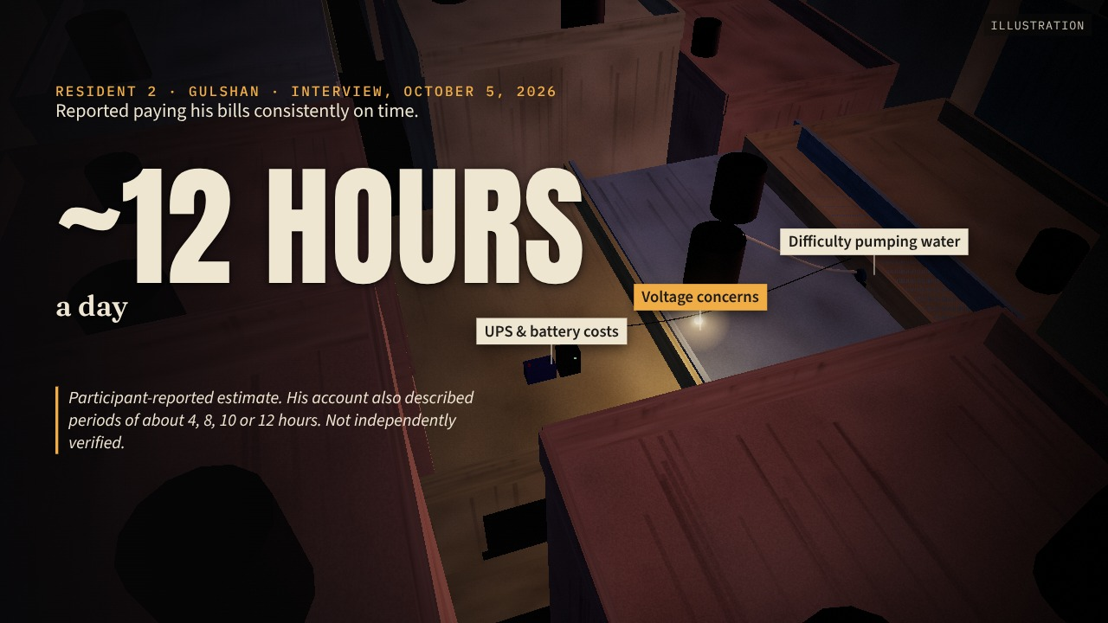
Notes:
Interviews — The Gulshan resident · scene 7/22 · reveal 1/2 · advance 12/37
SCRIPT
Our second resident, from Gulshan, described approximately twelve hours of daily load-shedding, although the durations varied within his account.
We could not independently verify those hours.
But his description of the burden was clear: UPS costs, battery costs, difficulty pumping water, and concerns about voltage.
ON SCREEN
Dusk over Gulshan rooftops (illustrative): the camera glides low across water tanks. Tags find a UPS and battery, a water pump, a flickering bulb. The ~12 hours figure is participant-reported.
QUALIFICATIONS
Durations: he initially said 12 hours daily, then described ~4, 8, 10 or 12 hours (Appendix C). No bills, technical measurements or appliance-damage records were supplied. His view of the CEO's motive was speculation. Consent was confirmed by the group beforehand.

Slide 14
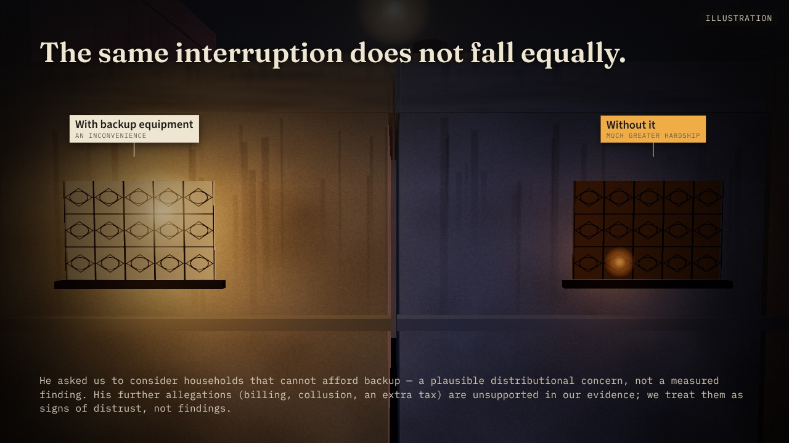
Notes:
Interviews — The Gulshan resident · scene 7/22 · reveal 2/2 · advance 13/37
SCRIPT
He also asked us to consider households that cannot afford backup equipment.
That changes the ethical calculation.
The same interruption can mean inconvenience for one household and much greater hardship for another.
He made several further allegations about billing and collusion. We did not adopt those as facts.
Their value to our analysis was different: they showed how deeply distrust can grow when people feel that explanations are missing.
ON SCREEN
ADVANCE → down to two neighbouring windows as darkness falls: one with a dim backup bulb, one with only a candle.
QUALIFICATIONS
Durations: he initially said 12 hours daily, then described ~4, 8, 10 or 12 hours (Appendix C). No bills, technical measurements or appliance-damage records were supplied. His view of the CEO's motive was speculation. Consent was confirmed by the group beforehand.

Slide 15
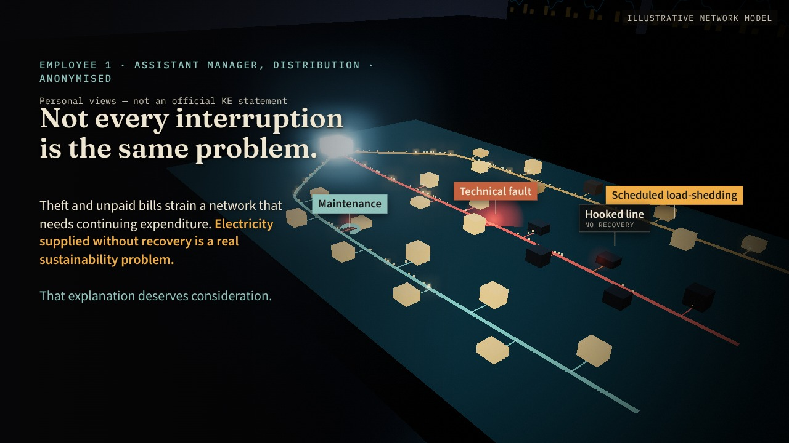
Notes:
Interviews — The operational perspective · scene 8/22 · reveal 1/2 · advance 14/37
SCRIPT
[Shift to a calmer tone.]
Then we listened to the distribution employee.
His account reminded us that customers may experience every interruption as the same problem, while the causes can differ.
Scheduled load-shedding, a technical fault and maintenance require different responses.
He also explained the financial pressure created by theft and unpaid bills.
A distribution network requires continuing expenditure. Electricity supplied without corresponding recovery creates a real sustainability problem.
That explanation deserves consideration.
ON SCREEN
Calmer: a dark room, a glowing network model (illustrative). The feeders separate into three kinds of interruption — scheduled (amber), fault (red), maintenance (teal). Revenue flows back to the substation; two hooked lines send nothing back.
QUALIFICATIONS
He supported progressively targeted measures (better metering, targeted disconnections, network improvements) and a resourced compliance plan. He had not reviewed the detailed August order and gave no legal interpretation. He did not speculate about the CEO's absence and thought the delegates should have been allowed to explain. This is a reasoned personal view, not an adopted corporate plan.

Slide 16
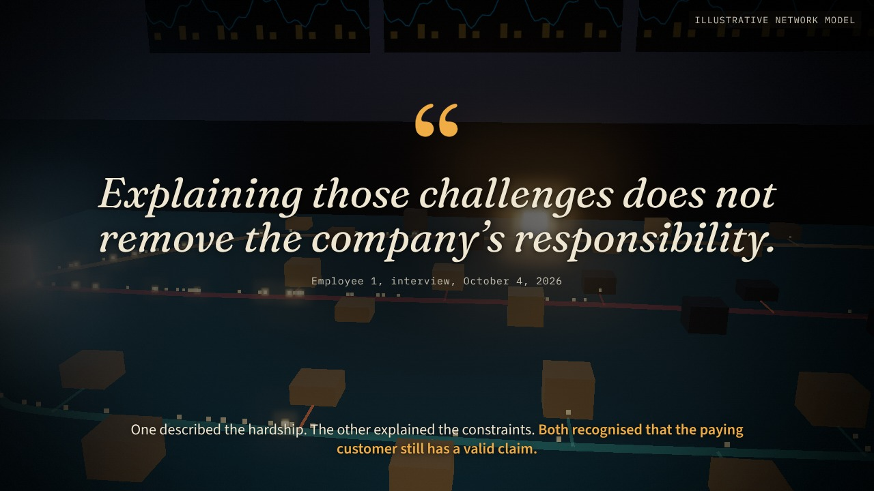
Notes:
Interviews — The operational perspective · scene 8/22 · reveal 2/2 · advance 15/37
SCRIPT
But he added something equally significant:
“Explaining those challenges does not remove the company’s responsibility.”
Here, the customer and the employee moved closer together.
One described the hardship.
The other explained the constraints.
Both recognised that the paying customer still has a valid claim.
ON SCREEN
ADVANCE → the model dims; one paying house stays lit. The quotation holds.
QUALIFICATIONS
He supported progressively targeted measures (better metering, targeted disconnections, network improvements) and a resourced compliance plan. He had not reviewed the detailed August order and gave no legal interpretation. He did not speculate about the CEO's absence and thought the delegates should have been allowed to explain. This is a reasoned personal view, not an adopted corporate plan.

Slide 17
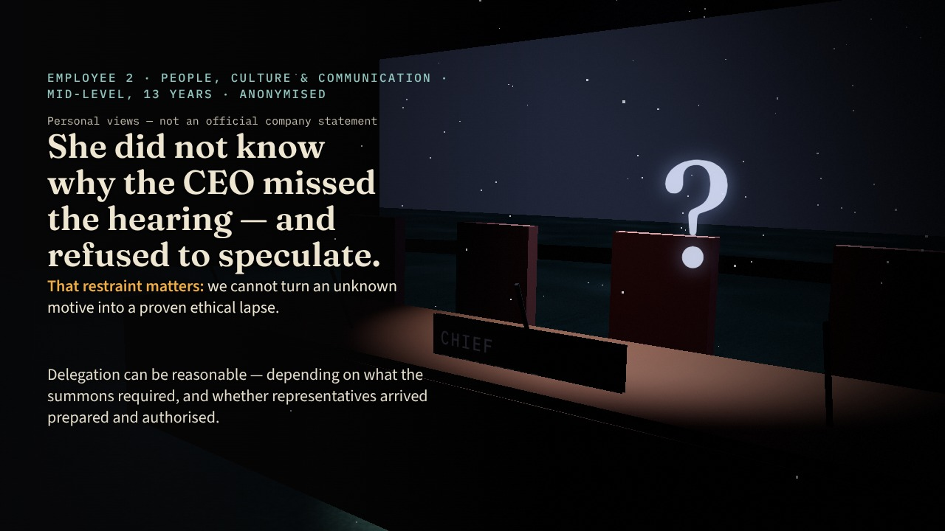
Notes:
Interviews — Communication and accountability · scene 9/22 · reveal 1/2 · advance 16/37
SCRIPT
The communication employee added another layer.
She did not know why the CEO had missed the hearing and refused to speculate.
That restraint matters. We cannot turn an unknown motive into a proven ethical lapse.
She explained that delegation can be reasonable, depending on what the summons required and whether the representatives arrived prepared and authorised.
ON SCREEN
Back to the empty chair, now under a cold light only. She did not know why the CEO missed the hearing and refused to speculate: the question mark is left unresolved.
QUALIFICATIONS
She said improvement work had begun but declined to give details; we cannot infer scope, completion or effectiveness. Some communication passages had uncertain speaker attribution; we rely only on answers clearly attributed to her (Appendix E).

Slide 18
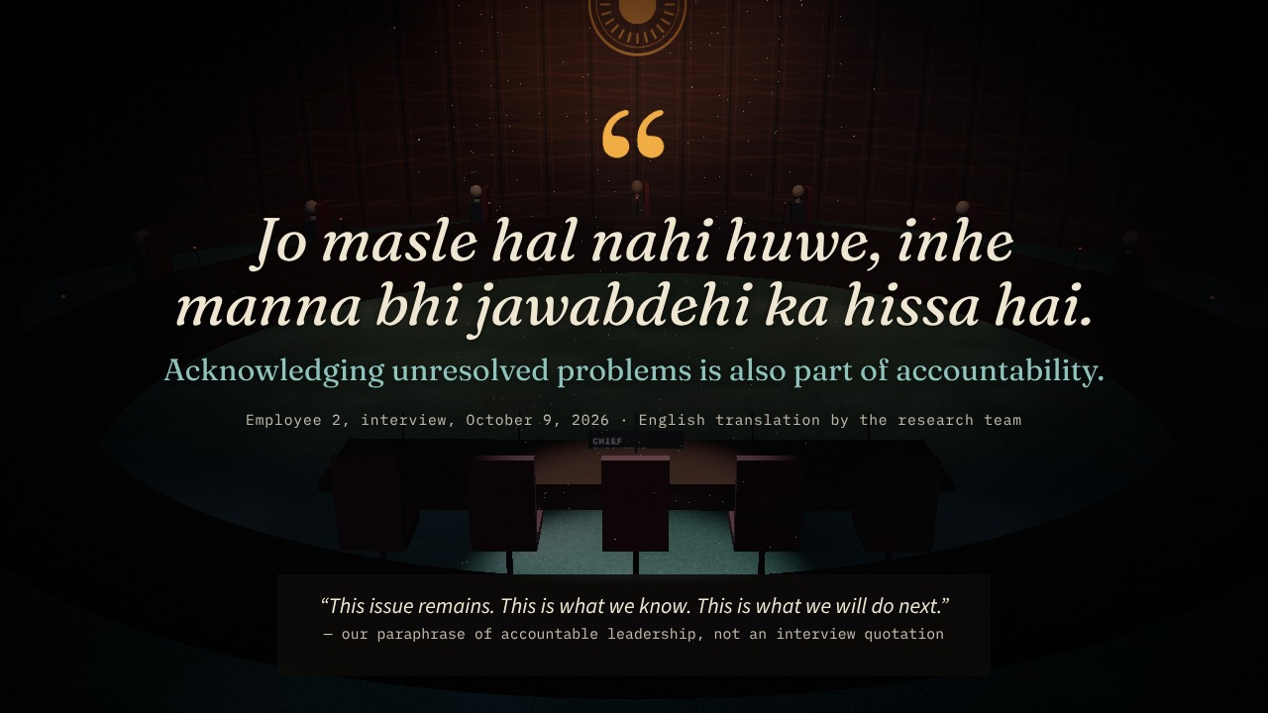
Notes:
Interviews — Communication and accountability · scene 9/22 · reveal 2/2 · advance 17/37
SCRIPT
She also said that acknowledging unresolved problems is part of accountability.
In other words, leadership must be willing to say: this issue remains, this is what we know, and this is what we will do next.
[Pause.]
ON SCREEN
ADVANCE → the camera rises slowly; the quotation lands.
QUALIFICATIONS
She said improvement work had begun but declined to give details; we cannot infer scope, completion or effectiveness. Some communication passages had uncertain speaker attribution; we rely only on answers clearly attributed to her (Appendix E).

Slide 19
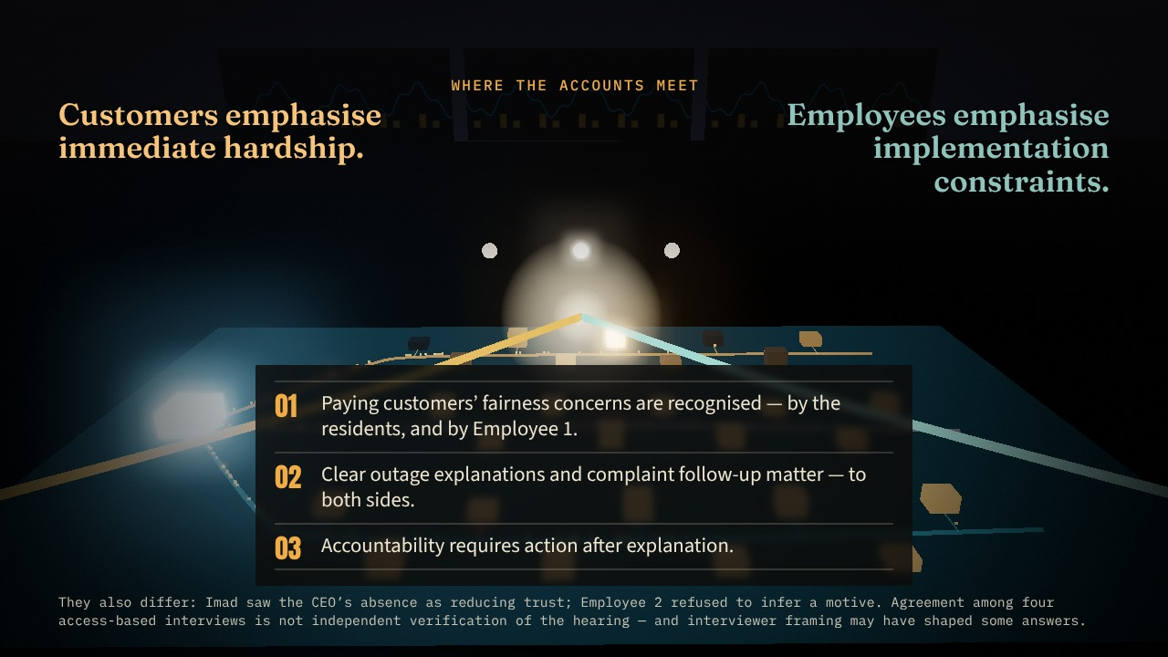
Notes:
Interviews — Where the accounts meet · scene 10/22 · reveal 1/1 · advance 18/37
SCRIPT
Across the interviews, we found a recurring tension.
Customers wanted fair treatment and useful answers.
Employees described financial pressures, technical limitations and the need for practical implementation.
Our task was to evaluate both.
ON SCREEN
The network model again: a warm stream (customers) and a teal stream (employees) run in from opposite edges and meet over the table; three points of agreement light in turn.
QUALIFICATIONS
Three themes from the report: (1) paying customers object to bearing others’ losses, and Employee 1 recognises it; (2) both sides value clearer cause distinctions and follow-up; (3) accountability = explanation followed by action. We do not count agreement as corroboration or infer prevalence.

Slide 20
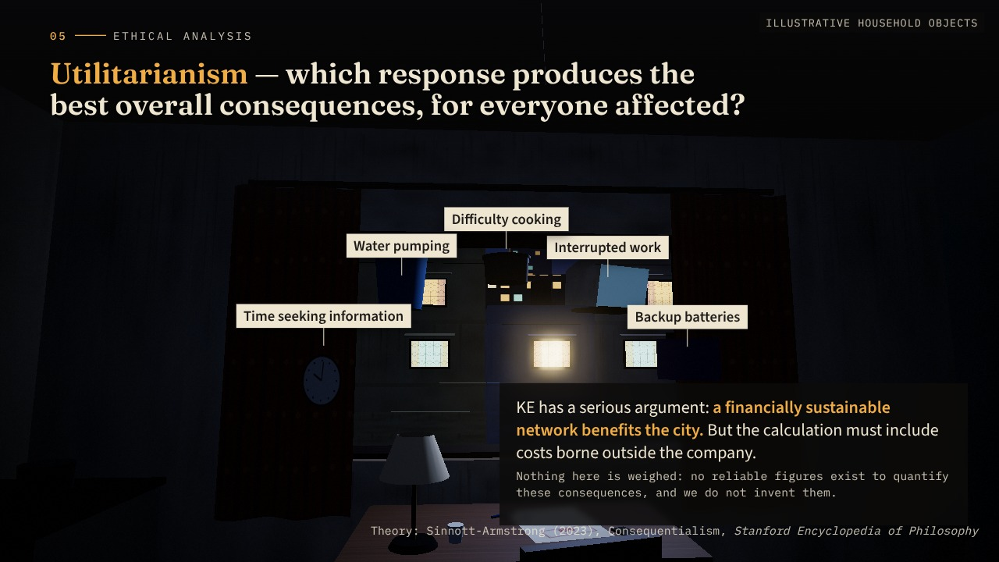
Notes:
Ethical analysis — Utilitarianism · scene 11/22 · reveal 1/2 · advance 19/37
SCRIPT
We tested the case through three ethical theories.
First, utilitarianism.
This asks us to consider the overall consequences.
KE has a serious argument here: a financially sustainable network benefits the city. Ignoring theft and non-payment could undermine maintenance and future supply.
But an ethical calculation must also include costs borne outside the company.
Backup batteries. Interrupted work. Difficulty cooking. Water pumping. Time spent seeking information.
ON SCREEN
Back in the dark room. The household’s burdens rise from where they sit — battery, laptop, pot, bucket, clock — and hang around the bill. Outside, the transformer stands for the network. Nothing is weighed.
QUALIFICATIONS
Report: the available evidence cannot establish that collective outages maximise welfare. A defensible assessment compares targeted enforcement, infrastructure investment and outage management using actual costs and service outcomes. No numbers are invented.
SOURCES
Sinnott-Armstrong, W. (2023). Consequentialism. In E. N. Zalta & U. Nodelman (Eds.), The Stanford encyclopedia of philosophy. https://plato.stanford.edu/entries/consequentialism/

Slide 21
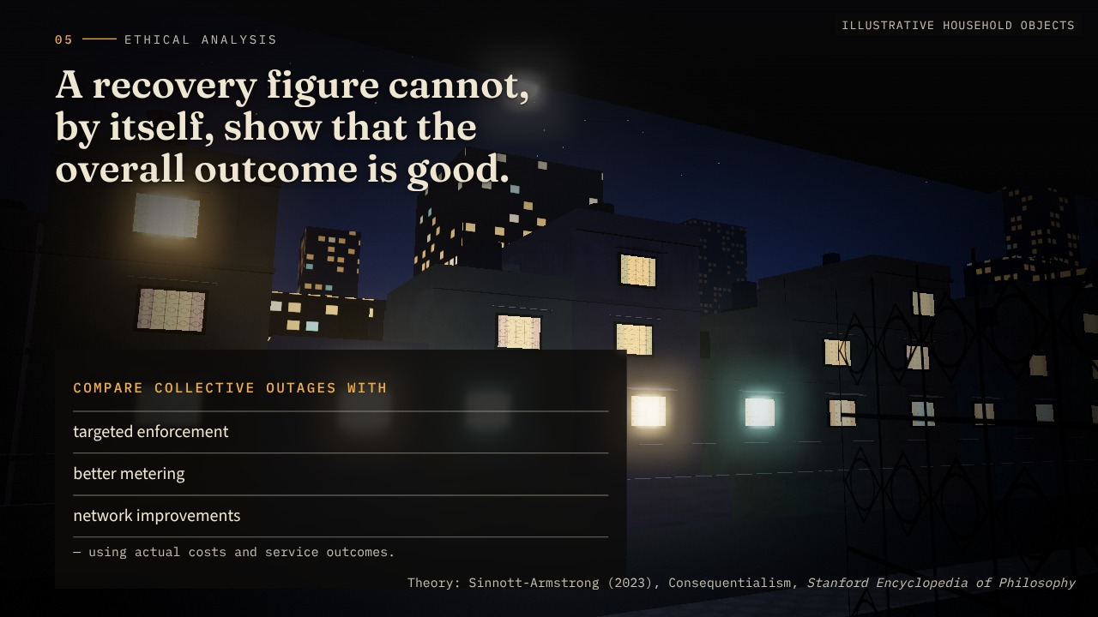
Notes:
Ethical analysis — Utilitarianism · scene 11/22 · reveal 2/2 · advance 20/37
SCRIPT
A recovery figure cannot tell us, by itself, whether the overall outcome is good.
We would need to compare collective outages with alternatives such as targeted enforcement, better metering and network improvements.
ON SCREEN
ADVANCE → the camera moves past the objects toward the window and the network beyond; alternatives listed.
QUALIFICATIONS
Report: the available evidence cannot establish that collective outages maximise welfare. A defensible assessment compares targeted enforcement, infrastructure investment and outage management using actual costs and service outcomes. No numbers are invented.
SOURCES
Sinnott-Armstrong, W. (2023). Consequentialism. In E. N. Zalta & U. Nodelman (Eds.), The Stanford encyclopedia of philosophy. https://plato.stanford.edu/entries/consequentialism/

Slide 22
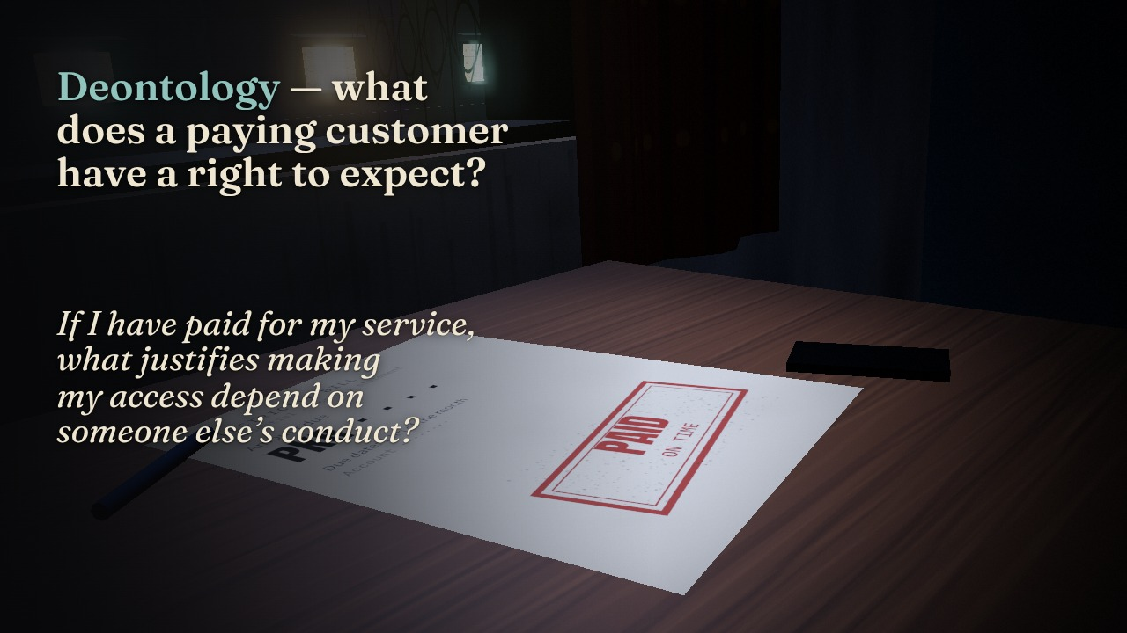
Notes:
Ethical analysis — Deontology · scene 12/22 · reveal 1/2 · advance 21/37
SCRIPT
Second, deontology.
This asks what duties are owed to individuals, even when a policy offers wider benefits.
If I have paid for my service, what justifies making my access depend on someone else’s conduct?
ON SCREEN
The objects settle back. A single cold spotlight finds the paid bill: the camera drops low beside it.
QUALIFICATIONS
This is the case’s strongest objection. The duty to explain also matters: a truthful account of what is known, what is uncertain and when an update will follow — without promising restoration times staff cannot support.
SOURCES
Alexander, L., & Moore, M. (2024). Deontological ethics. In E. N. Zalta & U. Nodelman (Eds.), The Stanford encyclopedia of philosophy. https://plato.stanford.edu/entries/ethics-deontological/
National Electric Power Regulatory Authority. (2026, August 31). Order of the Authority under Section 27C of the NEPRA Act 1997 in the matter of K-Electric Limited on account of unannounced and excessive load shedding in Karachi. https://nepra.org.pk/M%26E/Decisions/2026/08%20Aug/LAD-01%20ORDER%20UNDER%20SECTION%2027C%20OF%20NEPRA%20ACT%201997%20IN%20MATER%20OF%20K-ELECTRIC%2031-08-2026%2018150.PDF

Slide 23
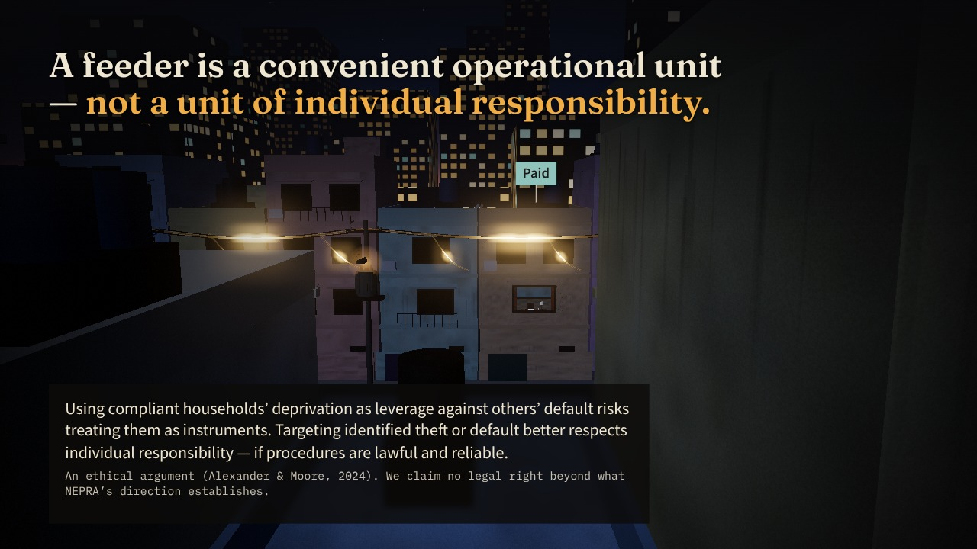
Notes:
Ethical analysis — Deontology · scene 12/22 · reveal 2/2 · advance 22/37
SCRIPT
A feeder may be a convenient operational unit. It does not mean every household on that feeder carries the same responsibility.
That is the strongest ethical objection in our case: the gap between collective loss measurement and individual fair treatment.
ON SCREEN
ADVANCE → the camera pulls out through the window to the whole dark feeder: one wire, many separate households.
QUALIFICATIONS
This is the case’s strongest objection. The duty to explain also matters: a truthful account of what is known, what is uncertain and when an update will follow — without promising restoration times staff cannot support.
SOURCES
Alexander, L., & Moore, M. (2024). Deontological ethics. In E. N. Zalta & U. Nodelman (Eds.), The Stanford encyclopedia of philosophy. https://plato.stanford.edu/entries/ethics-deontological/
National Electric Power Regulatory Authority. (2026, August 31). Order of the Authority under Section 27C of the NEPRA Act 1997 in the matter of K-Electric Limited on account of unannounced and excessive load shedding in Karachi. https://nepra.org.pk/M%26E/Decisions/2026/08%20Aug/LAD-01%20ORDER%20UNDER%20SECTION%2027C%20OF%20NEPRA%20ACT%201997%20IN%20MATER%20OF%20K-ELECTRIC%2031-08-2026%2018150.PDF

Slide 24
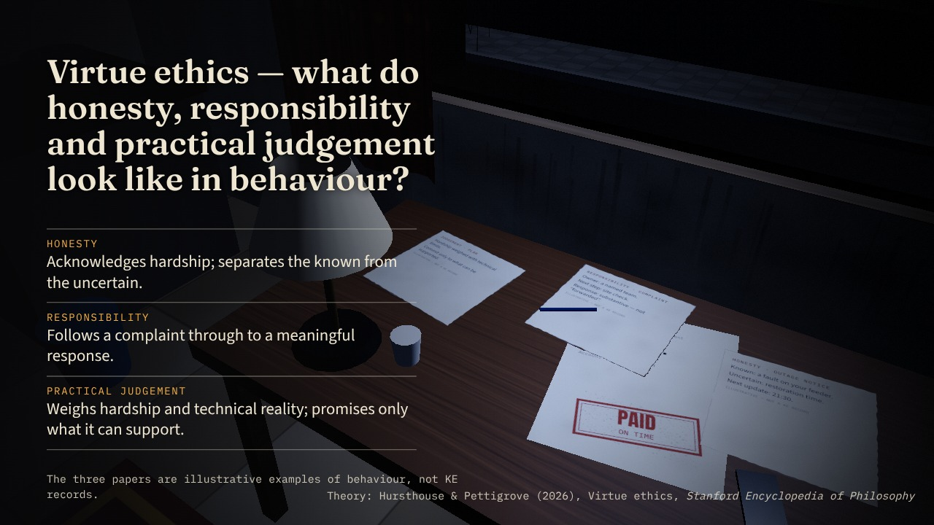
Notes:
Ethical analysis — Virtue ethics · scene 13/22 · reveal 1/2 · advance 23/37
SCRIPT
Third, virtue ethics.
This asks what honesty, responsibility and practical judgement look like in the company’s behaviour.
Does leadership acknowledge hardship?
Does it distinguish what is known from what is uncertain?
Does it follow a complaint through to a meaningful response?
ON SCREEN
The camera flies back in through the window to the table: three illustrative papers settle — an honest outage notice, a complaint with an owner, a plan that promises only what it can support.
QUALIFICATIONS
Script says “several interviewees”; the report specifies Imad and Employee 1 — the slide names them. KE still bears responsibility for adequate representation and follow-through; the committee bears responsibility for scrutiny that produces a usable record.
SOURCES
Hursthouse, R., & Pettigrove, G. (2026). Virtue ethics. In E. N. Zalta & U. Nodelman (Eds.), The Stanford encyclopedia of philosophy. https://plato.stanford.edu/entries/ethics-virtue/

Slide 25
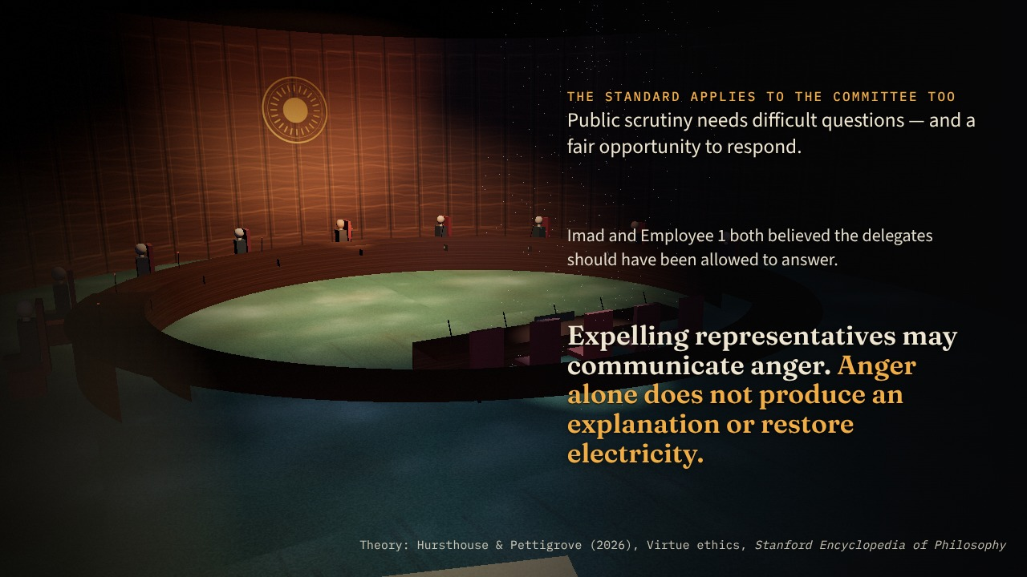
Notes:
Ethical analysis — Virtue ethics · scene 13/22 · reveal 2/2 · advance 24/37
SCRIPT
And this standard also applies to the committee.
Several interviewees believed the delegates should have been allowed to answer.
Public scrutiny needs difficult questions. It also needs a fair opportunity to respond.
Expelling representatives may communicate anger, but anger alone does not produce an explanation or restore electricity.
ON SCREEN
ADVANCE → cut to the committee room: the witness table empty, the door still lit. The standard applies to the committee too.
QUALIFICATIONS
Script says “several interviewees”; the report specifies Imad and Employee 1 — the slide names them. KE still bears responsibility for adequate representation and follow-through; the committee bears responsibility for scrutiny that produces a usable record.
SOURCES
Hursthouse, R., & Pettigrove, G. (2026). Virtue ethics. In E. N. Zalta & U. Nodelman (Eds.), The Stanford encyclopedia of philosophy. https://plato.stanford.edu/entries/ethics-virtue/

Slide 26

Notes:
Ethical analysis — Comparing the theories · scene 14/22 · reveal 1/1 · advance 25/37
SCRIPT
[Bridging line — not in the supplied script; optional, ~20 seconds, drawn from the report:]
The three approaches overlap but are not interchangeable. Duties set the boundary on how compliant customers may be treated. Consequences help us choose workable alternatives. Character and practical judgement guide how the remedy is implemented. Financial sustainability matters — but it cannot automatically override the compliant customer’s claim.
ON SCREEN
A dark studio. Three glass slabs rise from the floor at different depths — deontology, utilitarianism, virtue ethics — then glide into one readable row as the camera arcs to face them. Bridging line (optional).
QUALIFICATIONS
Report: “Our preferred response uses duties as a boundary, consequences to choose workable alternatives and practical judgement to guide implementation.” Limitation: targeted measures need resources and enforcement support — a reason for a credible plan, not an indefinite exemption from fairness. The supplied script moves directly from virtue ethics to evaluation; the bridge is optional.
SOURCES
Sinnott-Armstrong, W. (2023). Consequentialism. In E. N. Zalta & U. Nodelman (Eds.), The Stanford encyclopedia of philosophy. https://plato.stanford.edu/entries/consequentialism/
Alexander, L., & Moore, M. (2024). Deontological ethics. In E. N. Zalta & U. Nodelman (Eds.), The Stanford encyclopedia of philosophy. https://plato.stanford.edu/entries/ethics-deontological/
Hursthouse, R., & Pettigrove, G. (2026). Virtue ethics. In E. N. Zalta & U. Nodelman (Eds.), The Stanford encyclopedia of philosophy. https://plato.stanford.edu/entries/ethics-virtue/

Slide 27
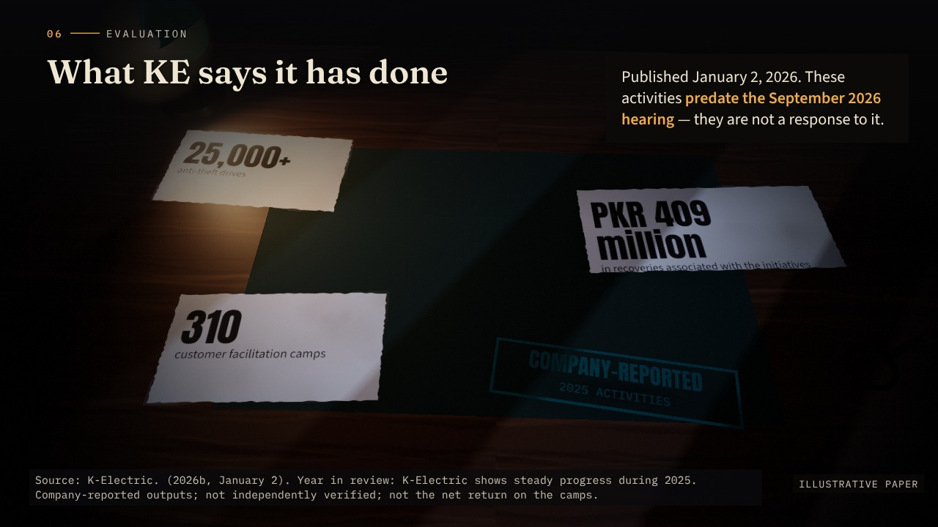
Notes:
Evaluation — What KE reports doing · scene 15/22 · reveal 1/1 · advance 26/37
SCRIPT
[Move into the evaluation.]
We also examined what KE says it has actually done.
Its published review of 2025 reports more than 25,000 anti-theft drives, 310 customer facilitation camps and recoveries of PKR 409 million associated with those initiatives.
Those are company-reported figures. They predate the September hearing.
They give us evidence of activity and a reason to take targeted recovery efforts seriously.
ON SCREEN
Back at the desk: three paper slips land with KE’s 2025 figures; a teal stamp slams down — company-reported, 2025 activities. The dates note they predate the hearing.
QUALIFICATIONS
Report: these challenge an interpretation that KE has taken no practical action. PKR 409m is not the net return on the camps — delivery costs and other initiatives are not isolated. Their ethical adequacy depends on whether they reduce interruptions for compliant households and improve complaint resolution.
SOURCES
K-Electric. (2026b, January 2). Year in review: K-Electric shows steady progress during 2025. https://ke.com.pk/year-in-review-k-electric-shows-steady-progress-during-2025/

Slide 28
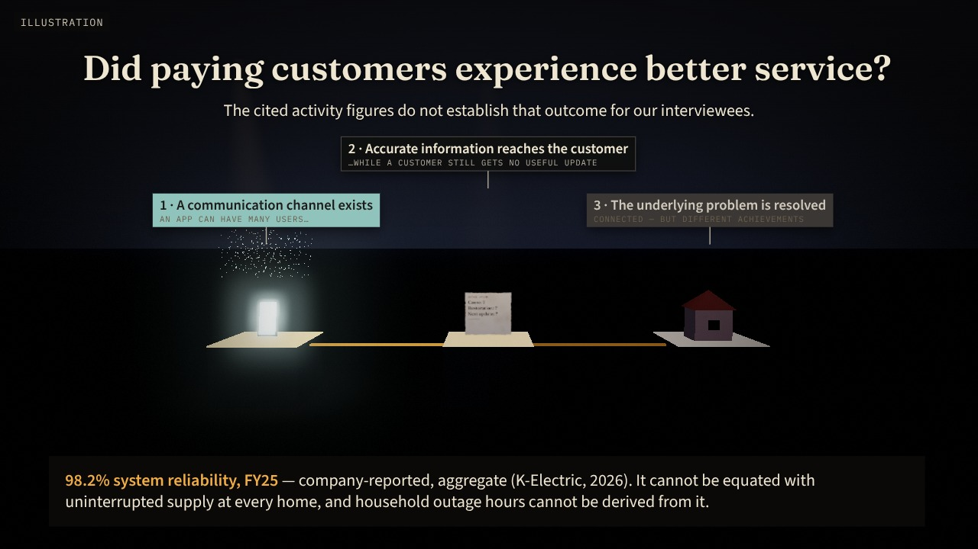
Notes:
Evaluation — Activity versus outcome · scene 16/22 · reveal 1/1 · advance 27/37
SCRIPT
But the next question is essential:
Did that activity produce better service for compliant customers?
The cited figures do not establish that outcome for our interviewees.
Similarly, KE reports aggregate system reliability and growing digital engagement.
Those indicators can coexist with poor experiences in particular neighbourhoods.
An app can have many users while a customer still receives no useful outage update.
So we distinguished three things: having a communication channel, providing accurate information through it, and resolving the underlying problem.
They are connected, but they are different achievements.
ON SCREEN
Three plinths: a phone with a cloud of users lights fully; an outage update half-lights with question marks; the house window stays dark. The gaps between them are the point.
QUALIFICATIONS
Imad’s outage missing from the app raises a specific question about local information accuracy — it does not disprove all reported digital progress. The 98.2% figure’s definitions and coverage are not examined in our sources. Citation discrepancy: the report cites this as “K-Electric, 2026s”, which matches no reference-list entry; most likely 2026a (sustainability report release). Verify before submission.
SOURCES
K-Electric. (2026a, January 7). K-Electric releases sustainability report 2025, showcasing responsible progress towards inclusive and resilient energy future. https://ke.com.pk/k-electric-releases-sustainability-report-2025-showcasing-responsible-progress-towards-inclusive-and-resilient-energy-future/

Slide 29
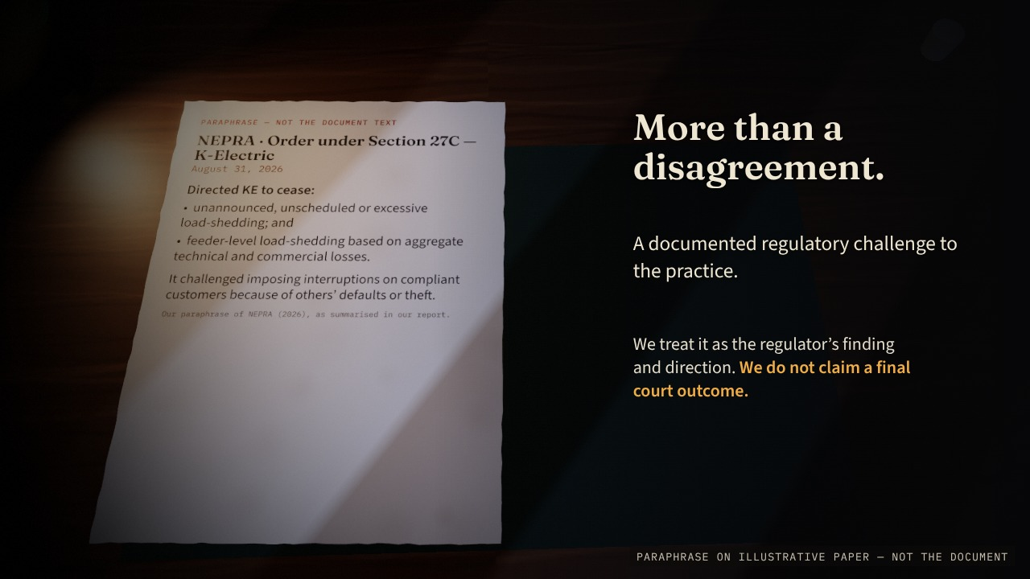
Notes:
Evaluation — The regulatory record · scene 17/22 · reveal 1/2 · advance 28/37
SCRIPT
The regulatory evidence also matters.
NEPRA’s August 2026 order directed KE to stop feeder-level loss-based load-shedding and unannounced, unscheduled or excessive interruptions.
That makes this more than a disagreement between frustrated customers and a commercial organisation.
There is a documented regulatory challenge to the practice.
ON SCREEN
A clearly labelled paraphrase of the August 31, 2026 order slides onto the desk and the camera settles over it.
QUALIFICATIONS
Script says “August 2026 order”; the report dates it August 31, 2026 — shown on screen. We could not retrieve the PDF for this build, so no wording is quoted or highlighted. The July 2025 decision records KE’s explanations; these are not findings about the two neighbourhoods interviewed.
SOURCES
National Electric Power Regulatory Authority. (2026, August 31). Order of the Authority under Section 27C of the NEPRA Act 1997 in the matter of K-Electric Limited on account of unannounced and excessive load shedding in Karachi. https://nepra.org.pk/M%26E/Decisions/2026/08%20Aug/LAD-01%20ORDER%20UNDER%20SECTION%2027C%20OF%20NEPRA%20ACT%201997%20IN%20MATER%20OF%20K-ELECTRIC%2031-08-2026%2018150.PDF
National Electric Power Regulatory Authority. (2025, July 11). Decision in the matter of complaint filed by Mr. Shariq Jamal against K-Electric Limited regarding load shedding [Complaint No. KElectric-KHI-51771-03-25]. https://nepra.org.pk/consumer%20affairs/cad/Authority%20Decisions/K-Electric/2025/07%20July/TCD-04%20K-ELECTRIC%2011-07-2025%202793.pdf

Slide 30
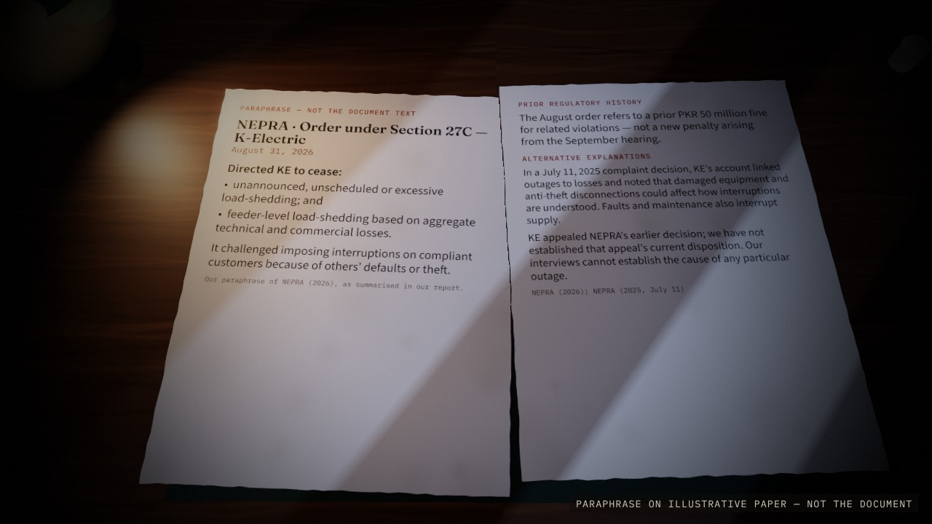
Notes:
Evaluation — The regulatory record · scene 17/22 · reveal 2/2 · advance 29/37
SCRIPT
We have treated it as the regulator’s finding and direction, while avoiding unsupported claims about final court outcomes.
[Optional, from the report:] The order also refers to a prior PKR 50 million fine — earlier history, not a penalty for the hearing. And KE’s own account points to alternative explanations: faults, damaged equipment, maintenance and anti-theft disconnections.
ON SCREEN
ADVANCE → a second sheet slides across: the prior PKR 50 million fine as history, and alternative explanations.
QUALIFICATIONS
Script says “August 2026 order”; the report dates it August 31, 2026 — shown on screen. We could not retrieve the PDF for this build, so no wording is quoted or highlighted. The July 2025 decision records KE’s explanations; these are not findings about the two neighbourhoods interviewed.
SOURCES
National Electric Power Regulatory Authority. (2026, August 31). Order of the Authority under Section 27C of the NEPRA Act 1997 in the matter of K-Electric Limited on account of unannounced and excessive load shedding in Karachi. https://nepra.org.pk/M%26E/Decisions/2026/08%20Aug/LAD-01%20ORDER%20UNDER%20SECTION%2027C%20OF%20NEPRA%20ACT%201997%20IN%20MATER%20OF%20K-ELECTRIC%2031-08-2026%2018150.PDF
National Electric Power Regulatory Authority. (2025, July 11). Decision in the matter of complaint filed by Mr. Shariq Jamal against K-Electric Limited regarding load shedding [Complaint No. KElectric-KHI-51771-03-25]. https://nepra.org.pk/consumer%20affairs/cad/Authority%20Decisions/K-Electric/2025/07%20July/TCD-04%20K-ELECTRIC%2011-07-2025%202793.pdf

Slide 31
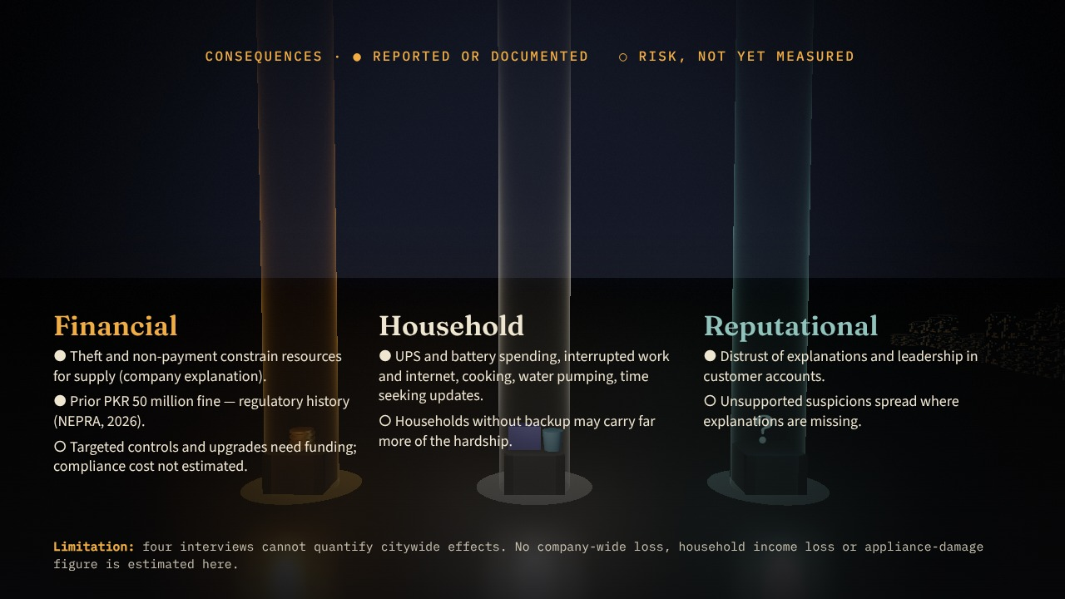
Notes:
Evaluation — Consequences · scene 18/22 · reveal 1/1 · advance 30/37
SCRIPT
[Bridging passage — not in the supplied script; optional, ~25 seconds, drawn from the report:]
The consequences run in several directions. Financially, theft and non-payment constrain the company, and targeted controls cost money. Households absorb their own costs — batteries, interrupted work, water and time — and those without backup may carry more of the hardship. Reputationally, missing explanations feed distrust. These are reported burdens and risks; four interviews cannot quantify them across the city.
ON SCREEN
Three pillars of light rise in turn — financial, household, reputational — each over its objects (coins; a battery and bucket; a question mark). Bridging passage (optional).
QUALIFICATIONS
Report section “Financial, Reputational and Other Consequences”. No estimate of KE’s total loss, compliance cost, financial damage from the hearing, or stock-price effect. The PKR 409m recovery is a reason to consider engagement alongside enforcement — not a net return. Household costs are reported burdens, not quantified estimates.
SOURCES
National Electric Power Regulatory Authority. (2026, August 31). Order of the Authority under Section 27C of the NEPRA Act 1997 in the matter of K-Electric Limited on account of unannounced and excessive load shedding in Karachi. https://nepra.org.pk/M%26E/Decisions/2026/08%20Aug/LAD-01%20ORDER%20UNDER%20SECTION%2027C%20OF%20NEPRA%20ACT%201997%20IN%20MATER%20OF%20K-ELECTRIC%2031-08-2026%2018150.PDF
K-Electric. (2026b, January 2). Year in review: K-Electric shows steady progress during 2025. https://ke.com.pk/year-in-review-k-electric-shows-steady-progress-during-2025/

Slide 32
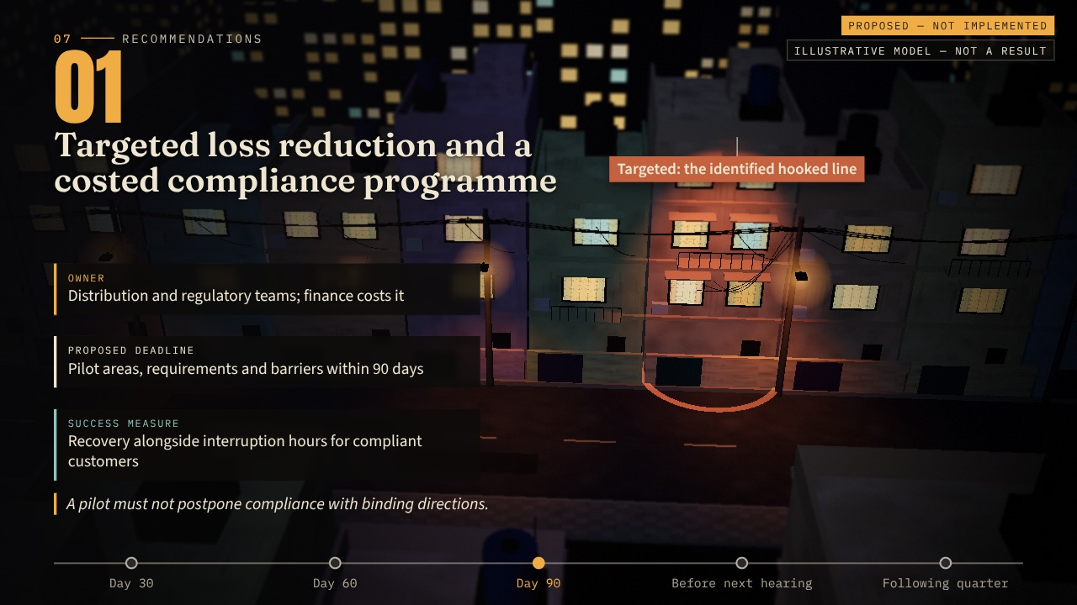
Notes:
Recommendations — Recommendations 1–2 · scene 19/22 · reveal 1/2 · advance 31/37
SCRIPT
[Slow down slightly.]
Our recommendations follow directly from what we found.
First, reduce losses through more targeted measures.
Identify where the losses arise, assess metering and network requirements, and cost the interventions.
Measure whether recovery improves alongside fewer interruptions for paying customers.
A pilot must not become a reason to postpone compliance with binding directions.
ON SCREEN
The street again, seen from above as a lit miniature (tilt-shift). Recommendation 1: a ring targets only the hooked line while paying houses keep their light. Owner, proposed deadline and measure land as chips.
QUALIFICATIONS
Implementation begins with a baseline of interruption hours, repeat complaints and payment status using anonymised records. Regulatory team checks compliance; distribution checks feasibility; finance costs interventions. Timelines are proposed management deadlines — not regulatory permissions or predictions.
SOURCES
National Electric Power Regulatory Authority. (2026, August 31). Order of the Authority under Section 27C of the NEPRA Act 1997 in the matter of K-Electric Limited on account of unannounced and excessive load shedding in Karachi. https://nepra.org.pk/M%26E/Decisions/2026/08%20Aug/LAD-01%20ORDER%20UNDER%20SECTION%2027C%20OF%20NEPRA%20ACT%201997%20IN%20MATER%20OF%20K-ELECTRIC%2031-08-2026%2018150.PDF

Slide 33
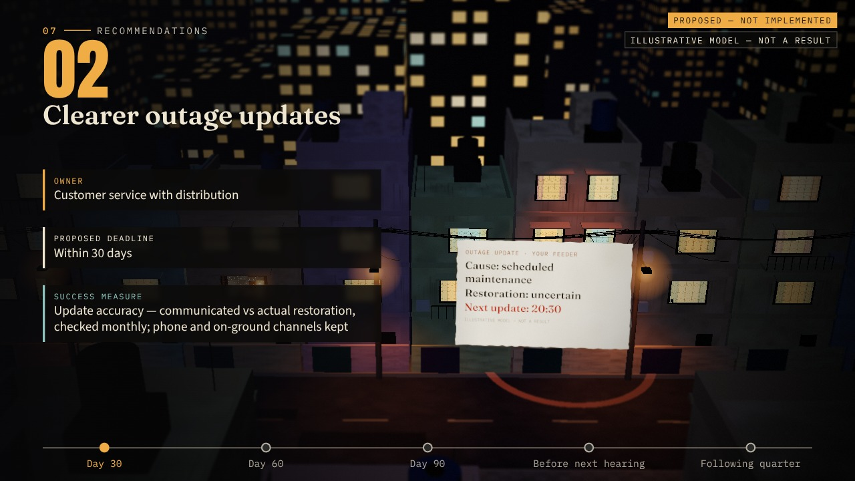
Notes:
Recommendations — Recommendations 1–2 · scene 19/22 · reveal 2/2 · advance 32/37
SCRIPT
Second, improve outage information.
Tell customers whether the issue is scheduled load-shedding, maintenance or a fault.
If the restoration time is uncertain, say so—and give a time for the next update.
That addresses Imad’s request for candour without making promises the company cannot support.
ON SCREEN
ADVANCE → recommendation 2: an honest outage update hangs over the street — cause, uncertainty, and the time of the next update.
QUALIFICATIONS
Implementation begins with a baseline of interruption hours, repeat complaints and payment status using anonymised records. Regulatory team checks compliance; distribution checks feasibility; finance costs interventions. Timelines are proposed management deadlines — not regulatory permissions or predictions.
SOURCES
National Electric Power Regulatory Authority. (2026, August 31). Order of the Authority under Section 27C of the NEPRA Act 1997 in the matter of K-Electric Limited on account of unannounced and excessive load shedding in Karachi. https://nepra.org.pk/M%26E/Decisions/2026/08%20Aug/LAD-01%20ORDER%20UNDER%20SECTION%2027C%20OF%20NEPRA%20ACT%201997%20IN%20MATER%20OF%20K-ELECTRIC%2031-08-2026%2018150.PDF

Slide 34
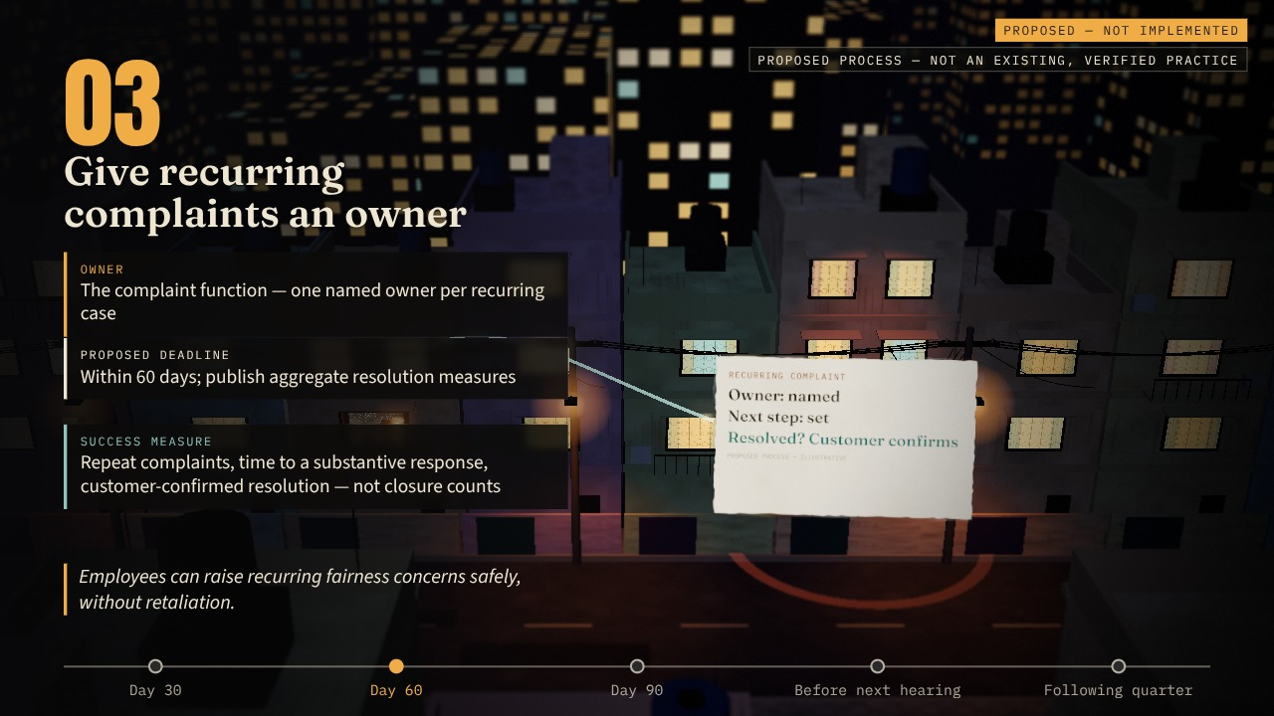
Notes:
Recommendations — Recommendations 3–4 · scene 20/22 · reveal 1/2 · advance 33/37
SCRIPT
Third, give recurring complaints an owner.
A complaint marked “forwarded” should have a next step, a responsible function and a substantive response.
Measure repeat complaints and whether customers confirm resolution, rather than relying only on closure counts.
Employees should also be able to raise recurring fairness concerns safely.
ON SCREEN
Recommendation 3: a recurring complaint leaves our house as a teal thread and arrives at an owner — next step, responsible function, customer-confirmed resolution.
QUALIFICATIONS
A quarterly review should examine whether recovery improves alongside fewer disruptions for compliant customers; improving only one measure leaves the central tension unresolved.

Slide 35
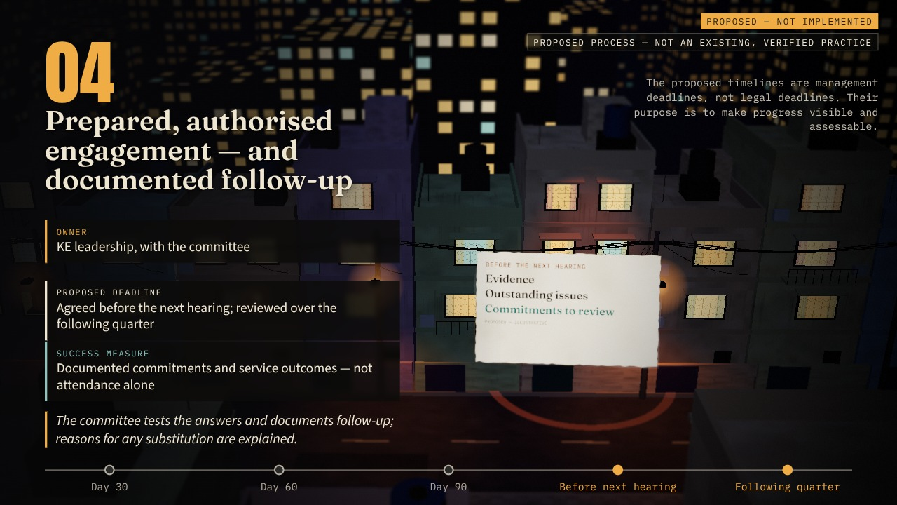
Notes:
Recommendations — Recommendations 3–4 · scene 20/22 · reveal 2/2 · advance 34/37
SCRIPT
Fourth, make public accountability useful.
The CEO or an appropriately authorised representative should arrive with evidence, outstanding issues and commitments that can be reviewed.
The committee should test those answers and document follow-up.
The proposed timelines in our report are management deadlines. Their purpose is to make progress visible and assessable.
ON SCREEN
ADVANCE → recommendation 4: a hearing brief hangs over the street — evidence, outstanding issues, reviewable commitments.
QUALIFICATIONS
A quarterly review should examine whether recovery improves alongside fewer disruptions for compliant customers; improving only one measure leaves the central tension unresolved.

Slide 36
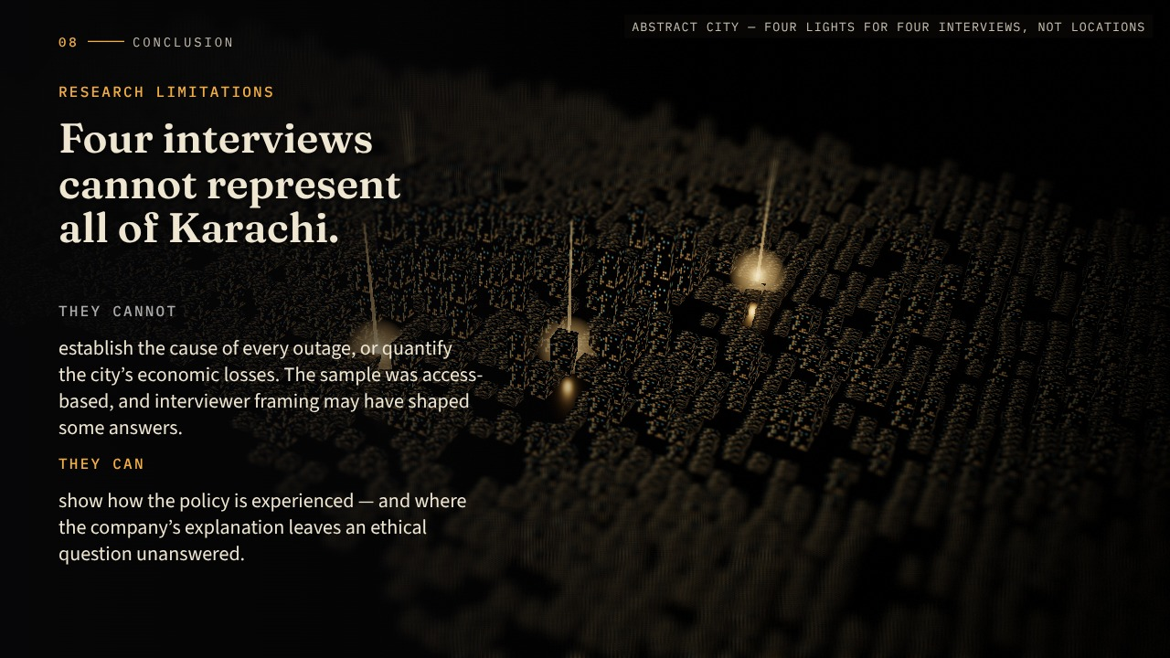
Notes:
Conclusion — Limits and conclusion · scene 21/22 · reveal 1/2 · advance 35/37
SCRIPT
[Pause before the conclusion.]
Four interviews cannot represent all of Karachi.
They cannot establish the cause of every outage or quantify the city’s economic losses.
What they can do is show how the policy is experienced—and where the company’s explanation leaves an ethical question unanswered.
ON SCREEN
A miniature night city — Karachi in the abstract. Four small lights appear, far apart: four interviews. The limits are stated.
QUALIFICATIONS
Operational records, complaint histories and a broader sample would be needed to test generalisability. The CEO’s motive remains unknown; removal of representatives does not prove misconduct.

Slide 37
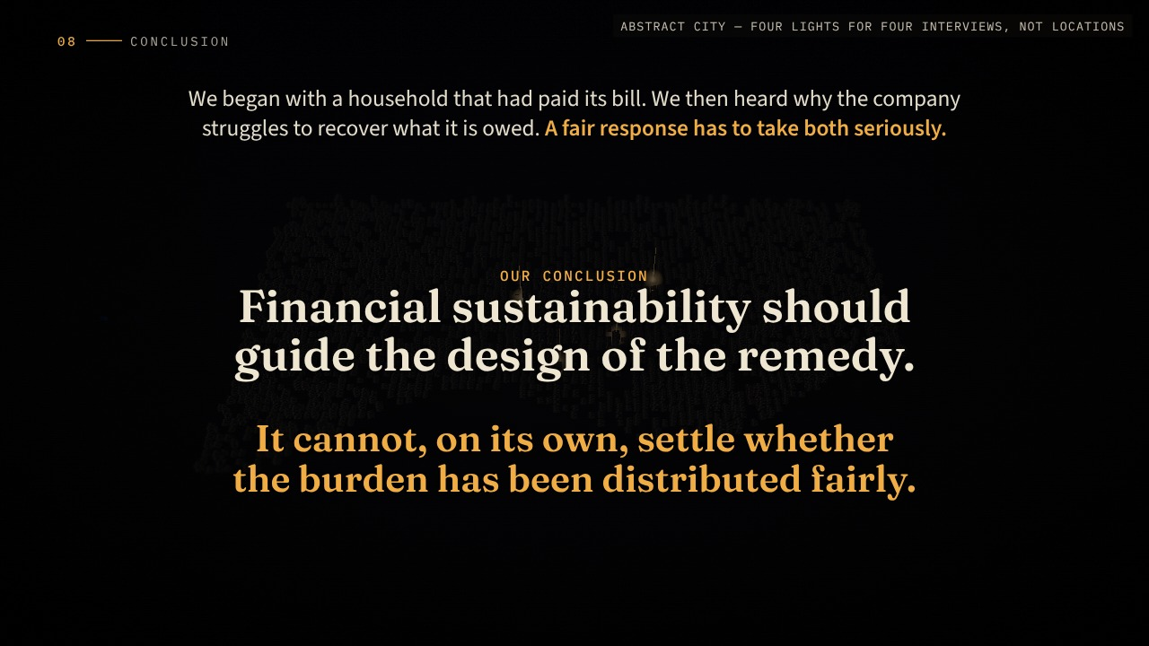
Notes:
Conclusion — Limits and conclusion · scene 21/22 · reveal 2/2 · advance 36/37
SCRIPT
We began with a household that had paid its bill.
We then heard why the company struggles to recover what it is owed.
A fair response has to take both seriously.
Our conclusion is that financial sustainability should guide the design of the remedy. It cannot, on its own, settle whether the burden has been distributed fairly.
The next hearing will matter.
The explanation will matter.
ON SCREEN
ADVANCE → the camera rises; the city dims to a wash; the conclusion settles in the centre.
QUALIFICATIONS
Operational records, complaint histories and a broader sample would be needed to test generalisability. The CEO’s motive remains unknown; removal of representatives does not prove misconduct.

Slide 38
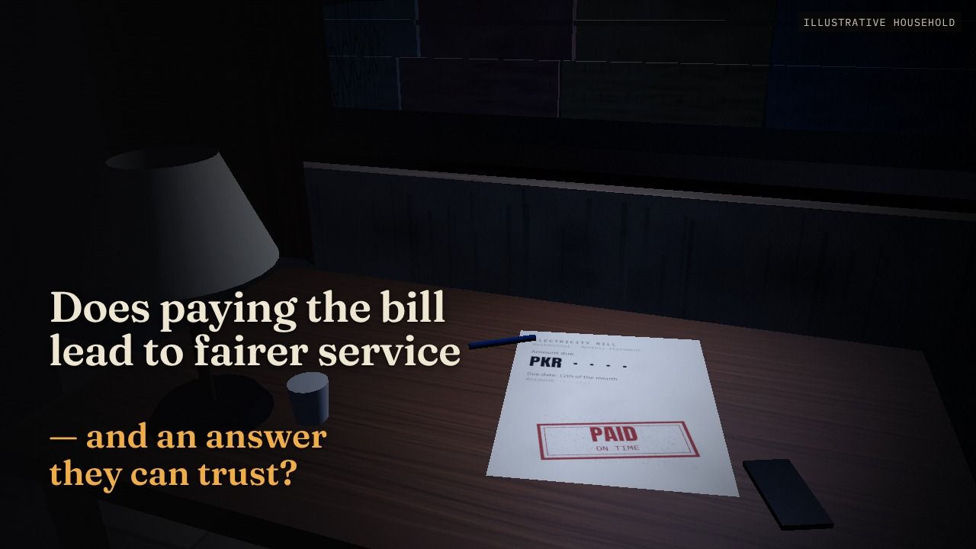
Notes:
Conclusion — Return to the household · scene 22/22 · reveal 1/1 · advance 37/37
SCRIPT
But the clearest test will come afterwards, in the homes of customers who have already fulfilled their side of the bargain:
Does paying the bill lead to fairer service—and an answer they can trust?
[Hold the pause, then finish.]
ON SCREEN
Back on the street, dark. The camera drifts in through the open window, over the table, and turns down to the paid bill in moonlight. The question; hold the pause, then finish.
QUALIFICATIONS
The lights are not shown restored: nothing in our evidence shows the recommendations implemented. End here — no thank-you slide.

Slide 39
References
Alexander, L., & Moore, M. (2024). Deontological ethics. In E. N. Zalta & U. Nodelman (Eds.), The Stanford encyclopedia of philosophy. https://plato.stanford.edu/entries/ethics-deontological/
Hursthouse, R., & Pettigrove, G. (2026). Virtue ethics. In E. N. Zalta & U. Nodelman (Eds.), The Stanford encyclopedia of philosophy. https://plato.stanford.edu/entries/ethics-virtue/
K-Electric. (2026a, January 7). K-Electric releases sustainability report 2025, showcasing responsible progress towards inclusive and resilient energy future. https://ke.com.pk/k-electric-releases-sustainability-report-2025-showcasing-responsible-progress-towards-inclusive-and-resilient-energy-future/
K-Electric. (2026b, January 2). Year in review: K-Electric shows steady progress during 2025. https://ke.com.pk/year-in-review-k-electric-shows-steady-progress-during-2025/
K-Electric. (n.d.). FAQs. Retrieved October 11, 2026, from https://ke.com.pk/faqs/
Notes:
Full reference list from the final report. Links open in a browser (internet required).

Slide 40
References (continued)
Khan, A. (2026, September 24). NEPRA and K-Electric representatives grilled over power outages. Business Recorder. https://www.brecorder.com/news/40440981
National Electric Power Regulatory Authority. (2025, July 11). Decision in the matter of complaint filed by Mr. Shariq Jamal against K-Electric Limited regarding load shedding [Complaint No. KElectric-KHI-51771-03-25]. https://nepra.org.pk/consumer%20affairs/cad/Authority%20Decisions/K-Electric/2025/07%20July/TCD-04%20K-ELECTRIC%2011-07-2025%202793.pdf
National Electric Power Regulatory Authority. (2026, August 31). Order of the Authority under Section 27C of the NEPRA Act 1997 in the matter of K-Electric Limited on account of unannounced and excessive load shedding in Karachi. https://nepra.org.pk/M%26E/Decisions/2026/08%20Aug/LAD-01%20ORDER%20UNDER%20SECTION%2027C%20OF%20NEPRA%20ACT%201997%20IN%20MATER%20OF%20K-ELECTRIC%2031-08-2026%2018150.PDF
Sinnott-Armstrong, W. (2023). Consequentialism. In E. N. Zalta & U. Nodelman (Eds.), The Stanford encyclopedia of philosophy. https://plato.stanford.edu/entries/consequentialism/
Notes:
Full reference list from the final report. Links open in a browser (internet required).

Slide 41
Interviews and labelling
Participant | Date | Report
Imad — residential customer, Gulistan-e-Jauhar (named with consent) | October 3, 2026 | Appendix A
Employee 1 — Assistant Manager, Distribution (anonymised; personal views, not an official KE statement) | October 4, 2026 | Appendix B
Resident 2 — residential customer, Gulshan (name not supplied) | October 5, 2026 | Appendix C
Employee 2 — mid-level, people, culture & communication, 13 years (anonymised; personal opinions) | October 9, 2026 | Appendix D
Interview recordings (instructor access, within participants’ consent): OneDrive / SharePoint audio folder
Company-reported — published by K-Electric, not independently verified (2025 activities predate the September 2026 hearing). Participant-reported — interview estimates, not verified. Paraphrase — our wording; no document or article text is reproduced. Illustrative — the household, street, 8/2 example, committee room, network model and recommendation scenes are teaching illustrations. Proposed — recommendations and milestones are our proposals, not KE practice or legal deadlines.
All scenes are rendered from original procedural 3D illustrations made for this project; no photograph or likeness of any person, meeting or document is used. Live interactive version: munhib-alam-khan.github.io/ke-ethics-midterm
Notes:
Do not open or play the interview recordings during the presentation: they contain identifying details.

