Slide 1


KSBL · ORGANIZATIONAL BEHAVIOUR · FALL 2026
CHECKOUT
REDESIGNING THE CHECKOUT CASHIER ROLE
PRESENTED BY
USING THE JOB CHARACTERISTICS MODEL
CHECKOUT CASHIERS · IMTIAZ STORES · KARACHI
Munhib Alam Khan
Abdullah Khan
a field study
Rabie Sami
Karan Kumar
INSTRUCTOR · Dr. Faryal Razzaq
Photography: AI-generated & illustrative · no real employees or respondents · academic study, not affiliated with Imtiaz
Notes:
[On screen while the class settles. No script. First click starts the opening.]

Slide 2


CHECKOUT
THE LAST
PERSON
YOU MEET.
MONEY
✓
DISCOUNTS
✓
ACCURACY
✓
WAITING TIME
✓
= FINAL IMPRESSION
Notes:
Think about the last time you went grocery shopping.
You probably spent thirty or forty minutes inside the store.
But the final person you interacted with was the cashier.
And in those last few minutes, that person handled your money, your discounts, your billing accuracy, your waiting time, and probably your final impression of the entire visit.

Slide 3

AGAIN.
Notes:
Now imagine doing that same transaction…
again.

Slide 4

FOR AN ENTIRE
SHIFT.
Notes:
And again.
And again.
For an entire shift.

Slide 5
CAN A JOB BE IMPORTANT
AND STILL BE POORLY DESIGNED?
Notes:
That creates an interesting question.
Can a job be important, but still not be designed in a way that brings out the best in the person doing it?

Slide 6

WE ASKED
THE CASHIERS.
Notes:
That is the question behind our study of checkout cashiers at Imtiaz.
And instead of assuming we knew the answer, we asked the cashiers.

Slide 7

























II INVESTIGATE
25
#01
INTERVIEWER-ADMINISTERED
#02
#03
#04
#05
QUESTIONS READ ALOUD & EXPLAINED
#06
#07
#08
#09
#10
VOLUNTARY PARTICIPATION
#11
#12
#13
#15
#14
NO NAMES · NO IDs · NO PHONE NUMBERS
#16
#17
#18
#19
#20
CHECKOUT CASHIERS
SMALL CROSS-SECTIONAL SAMPLE
MULTIPLE IMTIAZ BRANCHES · KARACHI
#24
#25
#21
#22
#23
every one read aloud ✓
Notes:
We collected responses from 25 checkout cashiers across multiple Imtiaz branches in Karachi.
[On screen: interviewer-administered; questions read aloud and explained; voluntary; no names, IDs or phone numbers; small cross-sectional sample.]

Slide 8




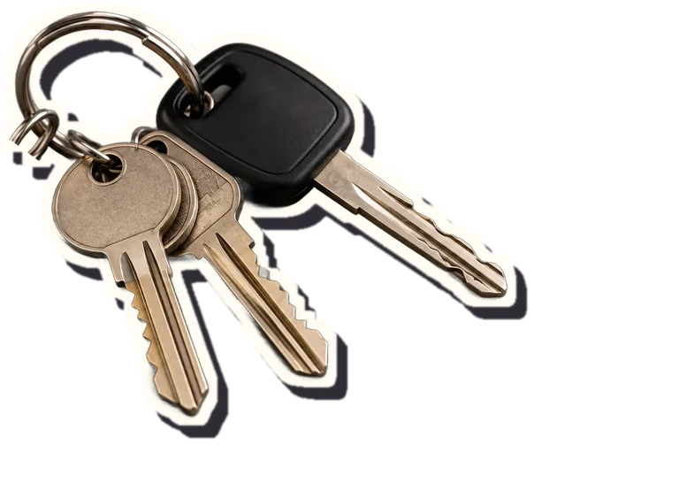
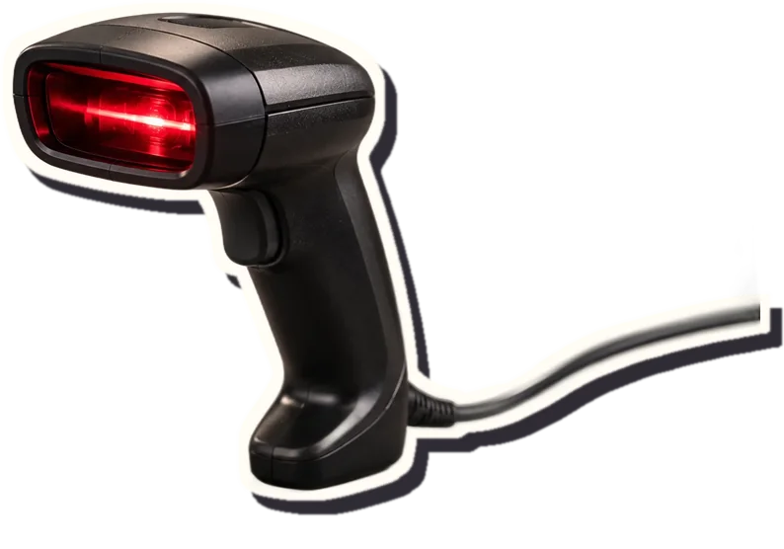
II INVESTIGATE
FIVE JOB CHARACTERISTICS
Job Characteristics Model · Hackman & Oldham (1976)
01
SKILL
VARIETY
02
TASK
IDENTITY
03
TASK
SIGNIFICANCE
04
AUTONOMY
05
FEEDBACK
Notes:
And we looked at their jobs through five dimensions of the Job Characteristics Model:
skill variety,
task identity,
task significance,
autonomy,
and feedback.

Slide 9

II INVESTIGATE
THE EASY ASSUMPTION
repetitive →
job rotation!
THEORY BEFORE PROBLEM
Notes:
But there was something important about our approach.
We did not begin by saying, 'Cashier jobs are repetitive, therefore job rotation is the solution.'
That would be applying theory before understanding the problem.

Slide 10
II INVESTIGATE
DIAGNOSE FIRST.
REDESIGN SECOND.
Notes:
We did the opposite.
Diagnose first. Redesign second.

Slide 11

III REVEAL
MONEY · ACCURACY · THE CUSTOMER
START → FINISH
Task Significance
Task Identity
4.09 / 5
4.04 / 5
CUSTOMER ARRIVES
SCAN
PAYMENT
COMPLETE ✓
→
→
→
TS 4.09
TI 4.04
1
2
3
4
5
1 = strongly disagree
5 = strongly agree
Notes:
And the results challenged what might be the easiest assumption about routine work.
Task Significance was 4.09 out of 5.
Task Identity was 4.04.
In other words, these employees generally understood that what they do matters, and they could see a complete piece of work from beginning to end.
A customer arrives.
Products are scanned.
Payment is processed.
The transaction is completed.

Slide 12
III REVEAL
MONEY · ACCURACY · THE CUSTOMER
START → FINISH
Task Significance
Task Identity
MEANING
ISN'T THE PROBLEM.
4.09 / 5
4.04 / 5
CUSTOMER ARRIVES
SCAN
PAYMENT
COMPLETE ✓
→
→
→
TS 4.09
TI 4.04
1
2
3
4
5
1 = strongly disagree
5 = strongly agree
Notes:
So the cashier job does not appear to suffer primarily from a lack of meaning.
[Pause here.]

Slide 13

III REVEAL
THE PROBLEM IS SOMEWHERE ELSE.
FEEDBACK
3.40
AUTONOMY
2.84
Notes:
The problem appears somewhere else.
Feedback falls to 3.40.
Autonomy falls to 2.84.

Slide 14

SKILL
VARIETY
lowest of
all five
2.55
OUT OF 5
Notes:
And then we reach the lowest score in the entire JCM diagnosis:
Skill Variety: 2.55 out of 5.

Slide 15
III REVEAL
THE FULL DIAGNOSIS
MEAN SCORE PER JOB CHARACTERISTIC · n = 25 · SCALE 1–5
TASK SIGNIFICANCE
4.09
TASK IDENTITY
4.04
FEEDBACK
3.40
AUTONOMY
2.84
SKILL VARIETY
2.55
1
2
3
4
5
strongly disagree
scale midpoint
strongly agree
Notes:
That changes the story completely.
[Full comparison on the 1–5 scale: Task Significance 4.09 · Task Identity 4.04 · Feedback 3.40 · Autonomy 2.84 · Skill Variety 2.55.]

Slide 16

MEANINGFUL.
Notes:
The job is meaningful.

Slide 17
MEANINGFUL.
BUT NARROW.
Notes:
But it is narrow.
The employee can see the importance of the work, while still experiencing the work itself as repetitive and constrained.

Slide 18





IV GO DEEPER
3.28
ROTATION
4.04
FEEDBACK
more regular
4.16
OWNERSHIP
more responsibility
4.32
AUTHORITY
routine issues,
clear guidelines
2.84
JOB
SATISFACTION
WHAT WOULD CASHIERS VALUE?
unlimited freedom
Mean agreement · 1–5 · n = 25
random movement
Notes:
We then asked another question.
If these characteristics are weak, what changes do employees actually value?
The strongest response was not unlimited freedom.
It was not random movement around the store.
Employees rated greater authority to resolve routine customer issues at 4.32 out of 5.
Greater responsibility and ownership scored 4.16.
More regular performance feedback scored 4.04.
And overall job satisfaction in our sample was only 2.84.
[On screen, quietly: rotation into other suitable responsibilities, 3.28. Still positive, but lower.]

Slide 19

IV GO DEEPER
r ≈ .54
n = 25 · exploratory · cross-sectional
Skill Variety ↔ Job Satisfaction
ASSOCIATION
≠ CAUSATION
Each point = one cashier · dashed ring = two cashiers with identical scores
Notes:
There was another signal worth noticing.
Skill variety had the clearest positive association with job satisfaction in our exploratory analysis, at approximately r = .54.
We are deliberately saying association, not causation.
With 25 respondents and a cross-sectional survey, it would be irresponsible to claim that increasing skill variety causes higher satisfaction.

Slide 20
IV GO DEEPER
THREE SIGNALS
most-selected:
learn new skills
& ownership
(14 of 25 each)*
LOWEST JCM SCORE
2.55 SKILL VARIETY
WHAT CASHIERS VALUE
4.32 AUTHORITY 4.16 OWNERSHIP
*exploratory multiple-response item
STRONGEST OBSERVED ASSOCIATION
r ≈ .54
SKILL VARIETY ↔ JOB SATISFACTION
Notes:
But when the lowest JCM score, employee preferences, and the strongest observed association with satisfaction begin pointing in a similar direction…

Slide 21
IV GO DEEPER
THREE SIGNALS
most-selected:
learn new skills
& ownership
(14 of 25 each)*
WHAT CASHIERS VALUE
4.32 AUTHORITY 4.16 OWNERSHIP
*exploratory multiple-response item
LOWEST JCM SCORE
2.55 SKILL VARIETY
STRONGEST OBSERVED ASSOCIATION
r ≈ .54
SKILL VARIETY ↔ JOB SATISFACTION
LOWEST SCORE + EMPLOYEE PREFERENCE + STRONGEST ASSOCIATION
MANAGERIAL SIGNAL
— not proof. A reason to redesign carefully and test.
Notes:
…that becomes a useful managerial signal.
[Not proof. A reason to redesign carefully, and to test.]

Slide 22
V INTERPRET
2.55
4.04
4.09
2.84
3.40
SKILL VARIETY
TASK IDENTITY
TASK SIGNIFICANCE
AUTONOMY
FEEDBACK
EXPERIENCED MEANINGFULNESS
EXPERIENCED
RESPONSIBILITY
KNOWLEDGE
OF RESULTS
OUTCOMES INTERNAL WORK MOTIVATION · JOB SATISFACTION
■ Where our data shows the gaps: variety · autonomy · feedback ■ strengths: significance · identity
Notes:
Why does this matter theoretically?
The Job Characteristics Model links skill variety, task identity and task significance to experienced meaningfulness.
Autonomy links to experienced responsibility.
Feedback links to knowledge of results.
These psychological states are expected to influence outcomes such as internal work motivation and satisfaction.
[Our scores place the gaps in variety, autonomy and feedback; significance and identity are strengths.]

Slide 23

CHANGE THE JOB,
CHANGE THE EXPERIENCE
OF DOING IT.
Notes:
Change specific characteristics of the job so that the psychological experience of doing that job changes.

Slide 24

VI REDESIGN
PROPOSED REDESIGN
ENRICHED CHECKOUT CASHIER
Notes:
Our proposed role is the Enriched Checkout Cashier.
[Same cashier, same checkout. Still the narrow lane, as it is today.]

Slide 25
VI REDESIGN
PROPOSED REDESIGN
ENRICHED CHECKOUT CASHIER
01
STRUCTURED MICRO-ROTATION
→ Skill Variety
02
CONTROLLED DECISION AUTHORITY
→ Autonomy
03
CHECKOUT-ZONE OWNERSHIP
→ Responsibility
04
STRUCTURED FEEDBACK
→ Feedback
Keeps what works: Task Identity ✓ · Task Significance ✓ preserved — he still owns the whole transaction
Notes:
The redesign has four components: structured micro-rotation, controlled decision authority, checkout-zone ownership, and structured feedback.
It keeps what already works: task identity and task significance.

Slide 26

VI REDESIGN
PROPOSED REDESIGN
01 · STRUCTURED MICRO-ROTATION
TARGET → Skill Variety
CHECKOUT-AREA READINESS CHECKS
QUEUE COORDINATION
BASIC PRICE-VERIFICATION COORDINATION
ONBOARDING / SHADOW SUPPORT
CUSTOMER CHECKOUT GUIDANCE
STILL PRIMARILY A CASHIER
NOT RANDOM MOVEMENT AROUND THE STORE
Checkout-adjacent only · subject to training & staffing · checkout coverage protected
Notes:
First, structured micro-rotation, targeting skill variety.
Potential checkout-adjacent activities, subject to training and staffing: queue coordination, basic price-verification coordination, checkout-area availability and merchandising checks, onboarding and shadow support for newer cashiers, and customer checkout guidance where applicable.
The employee remains primarily a cashier.
This is not random movement around the store.

Slide 27


VI REDESIGN
PROPOSED REDESIGN
02 · CONTROLLED DECISION AUTHORITY
TARGET → Autonomy
CURRENT · ROUTINE ISSUES ESCALATE
CUSTOMER
CASHIER
◷ WAIT
SUPERVISOR
DECISION
CASHIER
CUSTOMER
→
→
→
→
→
→
QUEUE
PROPOSED · PREDEFINED LOW-RISK ROUTINE ISSUES
CUSTOMER
TRAINED CASHIER
RESOLVED ✓
→
→
Significant refunds
Discretionary discounts
HIGH-RISK EXCEPTIONS · SUPERVISOR RETAINS
Suspected fraud
TRAINED CASHIER
SUPERVISOR
Security issues
→
Major price disputes
Unusual exceptions
Proposed design principle — exact permissions & any thresholds would be defined by management.
Notes:
Second, controlled decision authority, targeting autonomy.
Today a routine customer problem travels from customer, to cashier, to waiting, to supervisor, to decision, back to the cashier and back to the customer.
Under the proposed design, trained cashiers would resolve predefined low-risk routine issues: customer, trained cashier, resolution.
Supervisors retain high-risk matters: significant refunds, discretionary discounts, suspected fraud, security issues, major price disputes and unusual exceptions.
[This is a proposed design principle. Exact permissions would be defined by management.]

Slide 28
VI REDESIGN
PROPOSED REDESIGN
02 · CONTROLLED DECISION AUTHORITY
TARGET → Autonomy
CONTROLLED AUTONOMY
≠
UNRESTRICTED AUTONOMY
CURRENT · ROUTINE ISSUES ESCALATE
CUSTOMER
CASHIER
◷ WAIT
SUPERVISOR
DECISION
CASHIER
CUSTOMER
→
→
→
→
→
→
QUEUE
PROPOSED · PREDEFINED LOW-RISK ROUTINE ISSUES
CUSTOMER
TRAINED CASHIER
RESOLVED ✓
→
→
Significant refunds
Discretionary discounts
HIGH-RISK EXCEPTIONS · SUPERVISOR RETAINS
Suspected fraud
TRAINED CASHIER
SUPERVISOR
Security issues
→
Major price disputes
Unusual exceptions
Proposed design principle — exact permissions & any thresholds would be defined by management.
Notes:
Controlled autonomy is not unrestricted autonomy.

Slide 29
VI REDESIGN
CUSTOMER PROBLEM
TRAINED CASHIER
SUPERVISOR
MOVE APPROPRIATE DECISIONS CLOSER TO WHERE THE CUSTOMER PROBLEM OCCURS.
Notes:
We are moving appropriate decisions closer to the point where the customer problem actually occurs.

Slide 30

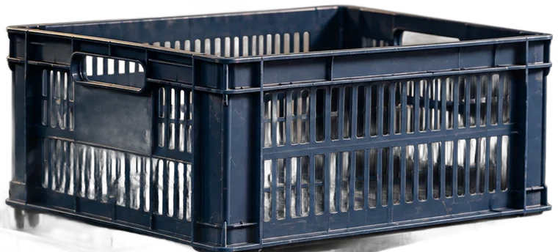
VI REDESIGN
PROPOSED REDESIGN
03 · CHECKOUT-ZONE OWNERSHIP
TARGET → Responsibility & ownership
JOB ENRICHMENT
JOB ENLARGEMENT
= MORE RESPONSIBILITY & OWNERSHIP
= SIMPLY MORE TASKS
HANDOVER COMMUNICATION
CUSTOMER CONCERNS
CHECKOUT-AREA READINESS
+task
+task
+task
RECURRING POS / PRICING ISSUES
+task
+task
+task
QUEUE BUILDUP
WE AIM FOR ENRICHMENT.
Notes:
Third, checkout-zone ownership.
The cashier can take greater responsibility for queue buildup, recurring POS and pricing issues, checkout-area readiness, customer concerns, and handover communication.
Job enlargement simply adds more tasks.
Job enrichment increases meaningful responsibility and ownership.
The redesign aims for enrichment.

Slide 31


VI REDESIGN
PROPOSED REDESIGN
04 · STRUCTURED FEEDBACK
TARGET → Feedback
OPERATIONAL FEEDBACK
DEVELOPMENTAL FEEDBACK
did it work? ✓
am I growing? ↑
Notes:
Fourth, structured feedback: short, regular supervisor conversations.
The terminal already tells the cashier whether the transaction worked.

Slide 32
VI REDESIGN
PROPOSED REDESIGN
04 · STRUCTURED FEEDBACK
TARGET → Feedback
OPERATIONAL FEEDBACK TELLS YOU
WHETHER THE TRANSACTION WORKED.
DEVELOPMENTAL FEEDBACK TELLS YOU
WHETHER YOU ARE GROWING.
ACCURACY
CUSTOMER SERVICE
RELIABILITY
IMPROVEMENT
RECOGNITION
Short · regular · supervisor-led conversations
Notes:
Operational feedback tells you whether the transaction worked. Developmental feedback tells you whether you are growing.
The conversations would cover accuracy, customer service, reliability, improvement, and recognition.

Slide 33
EVERYTHING WE HAVE PROPOSED SO FAR IS
A HYPOTHESIS.
TEST IT.
Notes:
Everything we have proposed so far is a hypothesis.
We have not proven that our redesign works.
So the next step is not to roll it out everywhere.
The next step is to test it.

Slide 34

VII TEST
PROPOSED · NOT YET CONDUCTED
~10–12
CASHIERS
PROPOSED PILOT · PLAN
a plan,
not a result
1
KARACHI BRANCH
6
WEEKS
BASELINE
Same JCM, motivation & satisfaction survey + operational indicators
W0
INTERVENTION
The four proposed changes
W1–6
MIDPOINT CHECK
Catch operational problems early
W3
POST-MEASUREMENT
Same measures again
W6
Notes:
We propose a six-week pilot at one Karachi branch with approximately 10 to 12 cashiers.
Week 0: baseline.
Weeks 1 to 6: the intervention, with a midpoint check in Week 3.
Week 6: post-measurement.
[This pilot has not been conducted. There are no pilot results.]

Slide 35

VII TEST
EMPLOYEE EXPERIENCE
OPERATIONAL SAFETY
Skill Variety
Autonomy
Feedback
Internal Work Motivation
Job Satisfaction
expected ↑
expected ↑
expected ↑
expected ↑
expected ↑
Transaction / error rate
Cash discrepancies
Routine escalations
Checkout complaints
no worse
no worse
no worse
no worse
Notes:
We would measure employee outcomes: skill variety, autonomy, feedback, internal work motivation and job satisfaction.
And we would monitor operational safeguards: transaction and error rate, cash discrepancies, routine escalations, and checkout complaints.
Both must survive.

Slide 36
VII TEST
EMPLOYEE EXPERIENCE
Skill Variety
Autonomy
Feedback
Internal Work Motivation
Job Satisfaction
expected ↑
expected ↑
expected ↑
expected ↑
expected ↑
NOT A SUCCESS
OPERATIONAL SAFETY
Transaction / error rate
Cash discrepancies
Routine escalations
Checkout complaints
no worse
no worse
no worse
no worse
HYPOTHETICAL: satisfaction ↑ while cash discrepancies ↑
Notes:
A redesign is not successful merely because employees like it.
If satisfaction improves while cash discrepancies or errors materially worsen, that is not a successful redesign.

Slide 37
VII TEST
SCALE
MODIFY
STOP
EMPLOYEE EXPERIENCE
OPERATIONAL SAFETY
Skill Variety
Autonomy
Feedback
Internal Work Motivation
Job Satisfaction
expected ↑
expected ↑
expected ↑
expected ↑
expected ↑
Transaction / error rate
Cash discrepancies
Routine escalations
Checkout complaints
no worse
no worse
no worse
no worse
Notes:
The final decision would then be: scale, modify, or stop.

Slide 38

VIII CONCLUDE
ROUTINE
≠ MEANINGLESS
ALREADY THERE
WHAT APPEARS TO BE MISSING
✓ TASK SIGNIFICANCE 4.09
VARIETY
✓ TASK IDENTITY 4.04
APPROPRIATE DISCRETION
DEVELOPMENTAL FEEDBACK
Notes:
If there is one thing we learned from this project, it is that routine work should not automatically be confused with meaningless work.
Our respondents already understand the significance of what they do.
They already see the transaction through from beginning to end.
What they appear to lack is enough variety, appropriate discretion, and developmental feedback.

Slide 39
VIII CONCLUDE
REDESIGN THE ENVIRONMENT AROUND THE CASHIER — NOT THE CASHIER.
ALREADY THERE
WHAT APPEARS TO BE MISSING
✓ TASK SIGNIFICANCE 4.09
VARIETY
✓ TASK IDENTITY 4.04
APPROPRIATE DISCRETION
DEVELOPMENTAL FEEDBACK
Notes:
So our recommendation is not to completely reinvent the cashier.
It is to redesign the environment around the cashier so that the employee can use more capability without sacrificing the controls the business needs.

Slide 40
A JOB SOMEONE PERFORMS…
Notes:
Because sometimes the difference between a job that someone simply performs…

Slide 41
A JOB SOMEONE OWNS.
01
STRUCTURED MICRO-ROTATION
02
CONTROLLED DECISION AUTHORITY
03
CHECKOUT-ZONE OWNERSHIP
04
STRUCTURED FEEDBACK
Notes:
…and a job that someone actually takes ownership of…

Slide 42
NOT A DIFFERENT JOB.
A BETTER-DESIGNED ONE.
Thank you.
— — — — — — — —
Munhib Alam Khan
Abdullah Khan
Rabie Sami
Karan Kumar
Karachi School of Business & Leadership
Organizational Behaviour · Fall 2026 · Dr. Faryal Razzaq
Reference: Hackman & Oldham (1976), Organizational Behavior and Human Performance, 16(2), 250–279.
Photography: AI-generated & illustrative.
No real employees or respondents · not affiliated with Imtiaz.
Notes:
…is not the importance of the work.
It is how the work has been designed.
Not a different job. A better-designed one.
Thank you.

Slide 43
APPENDIX · BACKUP FOR Q&A
EXPLORATORY CORRELATIONS
n = 25 · Pearson r · no significance testing
JOB CHARACTERISTIC | INTERNAL WORK MOTIVATION | JOB SATISFACTION
SKILL VARIETY | +0.312 | +0.539
TASK IDENTITY | +0.439 | -0.048
TASK SIGNIFICANCE | +0.330 | +0.203
AUTONOMY | +0.161 | -0.006
FEEDBACK | +0.354 | +0.364
READ AS ASSOCIATIONS ONLY
Cross-sectional, self-reported, small sample. No p-values were computed, so no coefficient is described as statistically significant. None of these values shows causation.
Highlighted: Skill Variety ↔ Job Satisfaction, r = +0.539, presented in the deck as r ≈ .54.
Notes:
[APPENDIX: backup for viva and Q&A only. Not part of the 7–8 minute presentation.]
If asked about the other relationships: these are exploratory Pearson correlations, n = 25, with no significance testing. They describe associations only, not causation. The one we discuss in the talk is Skill Variety and Job Satisfaction, r = +0.539, presented as r ≈ .54.

