Slide 1
Mental Health News Analysis Using NLP and Machine Learning
Muniprathap Murari

Slide 2
Introduction
Mental health is one of the most widely discussed and reported topics in the media today.
News articles play a major role in shaping public perception and awareness around conditions like depression, anxiety, PTSD, and more.
Understanding how these topics are represented, how sentiment shifts over time, and what patterns emerge in coverage can offer valuable insights.
Objective: Analyze a large set of mental health–related news articles using NLP and machine learning to classify, explore sentiment, and uncover key themes.** Use Natural Language Processing (NLP) and machine learning to classify, cluster, and uncover themes in mental health news articles.

Slide 3
Dataset & Data Collection
News articles were collected using keyword-based filtering from a large news API.
Keywords included: depression, anxiety, suicide, PTSD, bipolar, addiction, stress, and suicidal.
For each keyword, up to 1,000 articles were gathered, resulting in several thousand total articles.
The dataset included: title, description, full article content, source name, URL, publication timestamp, and associated keyword label.
Sources included reputable outlets such as CNN, New York Post, Newsweek, and others.
Articles were stored in a structured format for further analysis after filtering and preprocessing. 6,000+ articles collected using APIs and filtered for duplicates

Slide 4
Data Preprocessing
Cleaned and prepared articles for analysis by applying multiple preprocessing steps.
1. Keyword Filtering:
Started with 8 mental health keywords: depression, anxiety, suicide, PTSD, bipolar, addiction, stress, and suicidal.
Removed less frequent categories like psychosis and psychological support for better model consistency.
2. Duplicate Removal:
Applied a custom priority order to retain more relevant articles.
Dropped duplicates based on URL, title, description, or content fields.
3. Text Cleaning:
Merged title, description, and content into one column.
Removed HTML tags, URLs, punctuation, and normalized spacing.
Final cleaned text was used for vectorization and modeling.

Slide 5
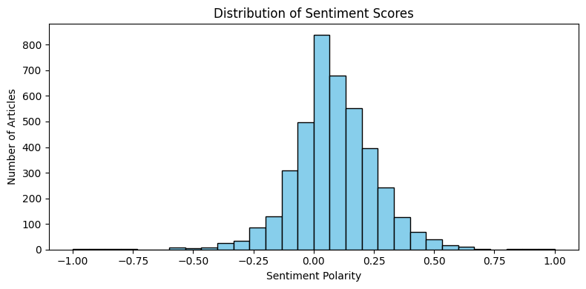
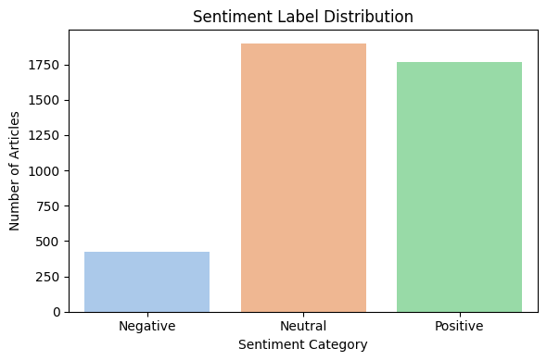
Sentiment Analysis
Used TextBlob to assess the emotional tone of each article.
1. Sentiment Scoring:
Calculated polarity score for each article: range from -1.0 (negative) to 1.0 (positive).
Articles with a score of 0 were labeled as neutral.
2. Sentiment Labels:
Positive if polarity > 0
Negative if polarity < 0
Neutral if polarity = 0
Sentiment labels were added as a new column in the dataset.
This lexicon-based approach helped categorize emotional tone efficiently. Helped validate emotional tone in keyword-specific articles

Slide 6
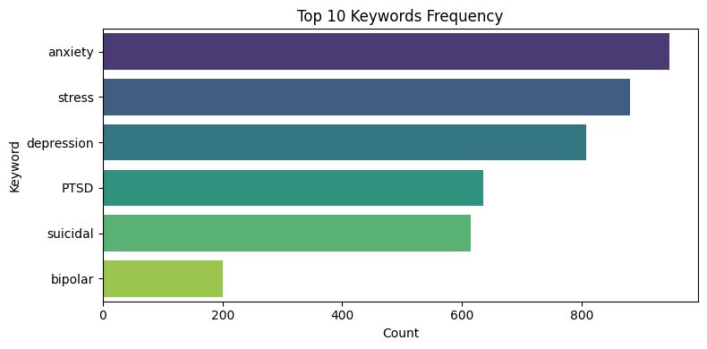
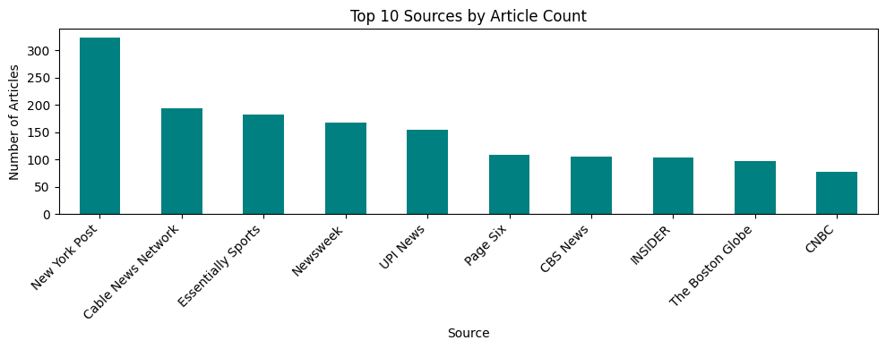
EDA – Keyword & Source Trends
1 Keyword Frequency
Bar chart shows 'anxiety', 'stress', and 'depression' were the most common.
Indicates strong media focus on these mental health concerns.
2 Top News Sources
Most articles were published by: New York Post, CNN, Essentially Sports, and Newsweek.
Highlights key outlets contributing to mental health discourse.

Slide 7
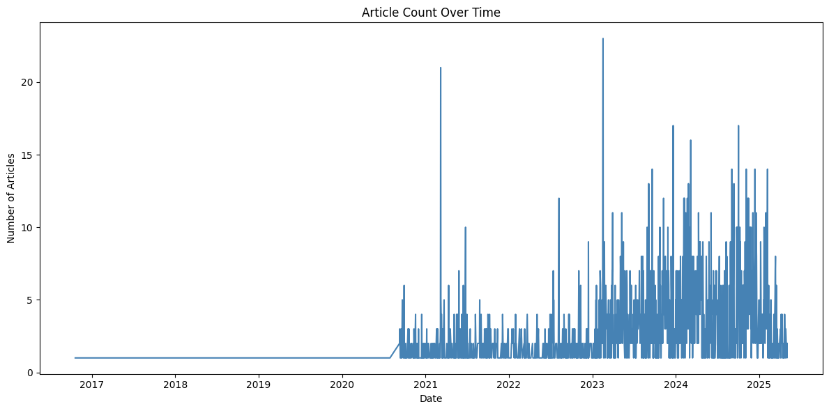
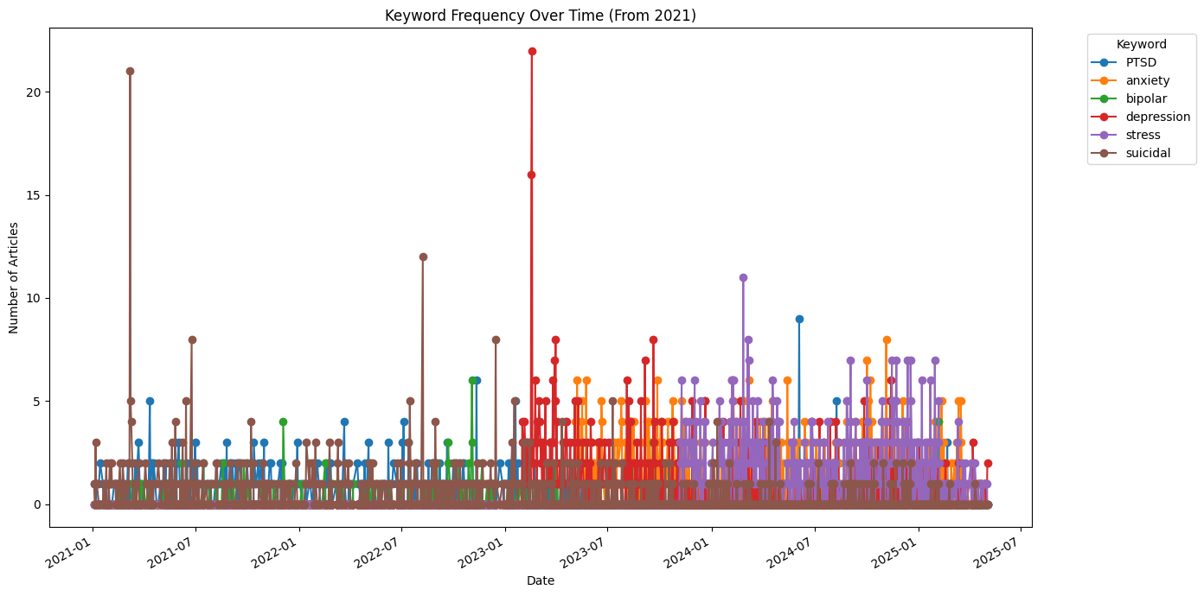
EDA – Temporal Trends
3 Article Count Over Time
Surge in article count observed from 2023 onwards.
Possibly related to post-pandemic stress and increased mental health awareness.
4 Keyword Trends Over Time
Keywords like 'stress' and 'anxiety' saw rising mentions in 2024–2025.
Shows evolving focus of media on mental health challenges.

Slide 8
Model Building – Supervised & Unsupervised
We built models to classify and explore patterns in mental health news articles.
Each keyword category was balanced with the same number of samples (947 each).
Supervised Models:
Used BERT embeddings to convert text into numeric vectors.
Applied three models:
Logistic Regression: Simple and interpretable.
Random Forest: Captures non-linear patterns.
Neural Network: Learns complex relationships through multiple layers.
Unsupervised Models:
Explored natural structure in the data:
KMeans Clustering (K=6): Grouped articles without labels.
DBSCAN: Found dense areas and outliers.
LDA Topic Modeling: Discovered common themes across articles.

Slide 9
Results
Supervised Model Results
Logistic Regression:
Accuracy: 88%, ROC-AUC: 0.9828
Random Forest:
Accuracy: 86%, ROC-AUC: 0.9736
Neural Network:
Accuracy: 82%, ROC-AUC: 0.8920
Logistic Regression chosen as final model
Unsupervised Learning – Clustering
KMeans:
Chosen k = 6 (based on keywords)
Silhouette Score: 0.030 (low, overlapping clusters)
DBSCAN:
Silhouette Score: -0.027
High noise, failed to find distinct clusters
Weak cluster separability due to overlapping language

Slide 10
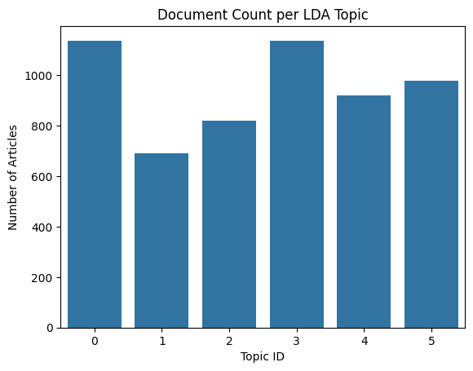
Topic Modeling (LDA)
Chosen number of topics: 6 (to align with keyword categories)
Each topic matched core mental health themes:
Topic 1: anxiety, stress, health
Topic 2: bipolar, diagnosis
Topic 3: depression, suicidal
Topic 4: politics, stress, anxiety
Topic 5: suicidal, PTSD, police
Topic 6: depression, PTSD, study

Slide 11
Conclusion
Supervised models performed well, with Logistic Regression achieving the best metrics.
Clustering was less effective due to low silhouette scores and content overlap.
LDA topic modeling revealed meaningful groupings aligned with keywords.
Analysis reflects emotional and social focus of media.
Can inform health communication, research, and policy.

Slide 12
Thank You

