Slide 1




Evaluation of Machine Learning (ML) Based Systems
Presented by
Munib Hassan
3rd February 2024

Slide 2
Outline
1
Background
2
ML Models
ML Problems
3
Use Cases
4
5
Practical Example
6
Evaluation
Partie 2
Notes:
The agenda of today talk is :
I will briefly explain the context and motivation of this research
Then I will explain contributions followed discussion and conclusion and ending my talk by future perspectives

Slide 3


Slide 4





Context
What is Machine Learning ?
“Computers the ability to learn
field of study that gives
without being Explicitly Programmed”
Arthur Samuel (1959)
“Learning is any process by which a system improves performance from Experience”
Herbert Simon
Notes:
- Diseases, whether affecting humans, animals, or plants, pose significant threats to public health, animal health, and environmental health. Holistically, The One Heath approach emphasizes the interconnectedness of human, animal, and plant health.
- The impact of diseases includes direct costs such as healthcare expenses and veterinary services and agricultural.
Therefore, Collaborative efforts are crucial for effective disease management and prevention.

Slide 5
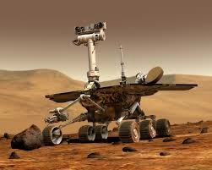
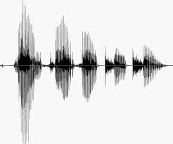
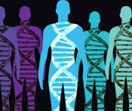
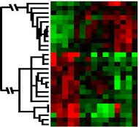
Motivation
When Do We Use Machine Learning?
ML is used when:
Human expertise does not exist (navigating on Mars)
Humans can’t explain their expertise (speech recognition)
Models must be customized (personalized medicine)
Models are based on huge amounts of data (genomics)
Learning isn’t always useful:
There is no need to “learn” to calculate payroll
Based on slide by E. Alpaydin
Notes:
- Diseases, whether affecting humans, animals, or plants, pose significant threats to public health, animal health, and environmental health. Holistically, The One Heath approach emphasizes the interconnectedness of human, animal, and plant health.
- The impact of diseases includes direct costs such as healthcare expenses and veterinary services and agricultural.
Therefore, Collaborative efforts are crucial for effective disease management and prevention.

Slide 6
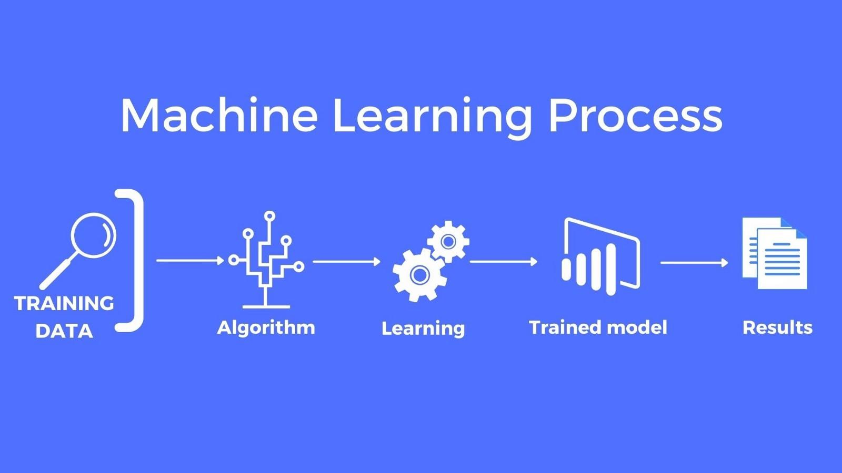
Machine Learning Model
Notes:
- Diseases, whether affecting humans, animals, or plants, pose significant threats to public health, animal health, and environmental health. Holistically, The One Heath approach emphasizes the interconnectedness of human, animal, and plant health.
- The impact of diseases includes direct costs such as healthcare expenses and veterinary services and agricultural.
Therefore, Collaborative efforts are crucial for effective disease management and prevention.

Slide 7
Outline
1
Background
2
ML Techniques
ML Problems
3
Use Cases
4
5
Practical Example
6
Evaluation
Partie 2
Notes:
The agenda of today talk is :
I will briefly explain the context and motivation of this research
Then I will explain contributions followed discussion and conclusion and ending my talk by future perspectives

Slide 8
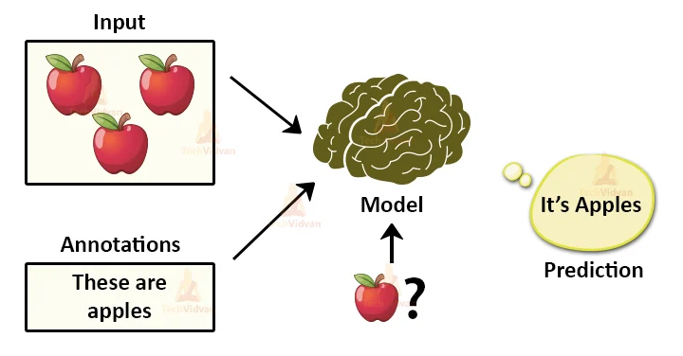
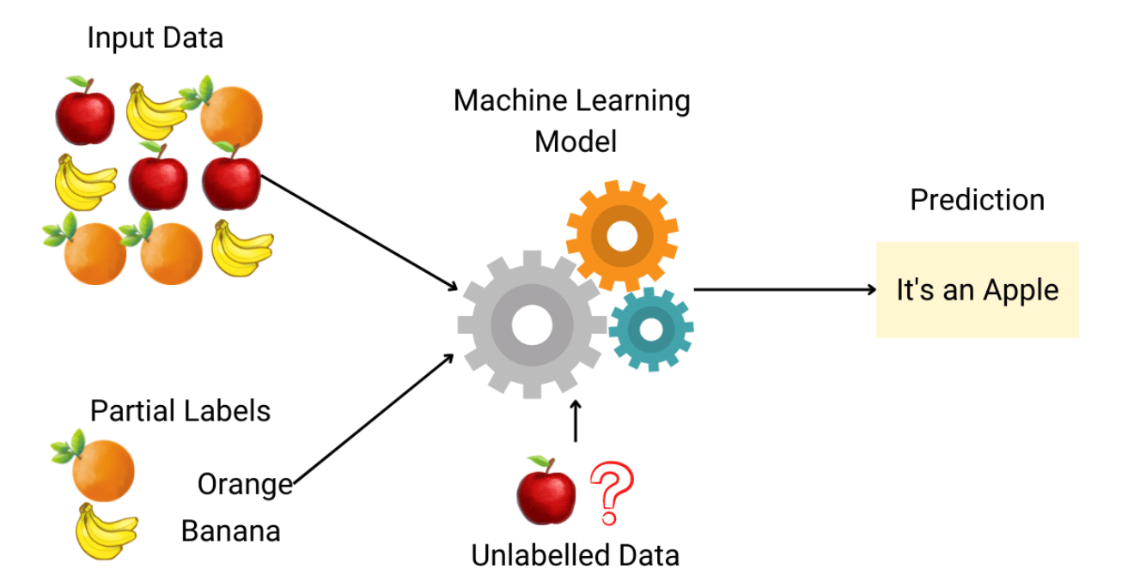
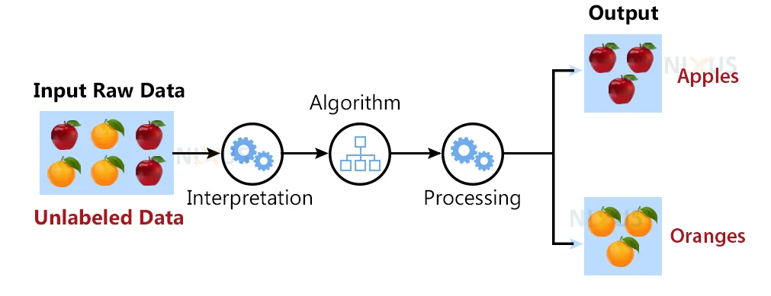
Machine Learning Techniques
Supervised (Inductive) Learning
Given: training data + desired outputs (labels)
Semi- Supervised Learning
Given: labeled training data + unlabeled training data(without explicit desired outputs)
Unsupervised Learning
Given: training data (without desired outputs)
Notes:
- Diseases, whether affecting humans, animals, or plants, pose significant threats to public health, animal health, and environmental health. Holistically, The One Heath approach emphasizes the interconnectedness of human, animal, and plant health.
- The impact of diseases includes direct costs such as healthcare expenses and veterinary services and agricultural.
Therefore, Collaborative efforts are crucial for effective disease management and prevention.

Slide 9
Outline
1
Background
2
ML Techniques
ML Problems
3
Use Cases
4
5
Practical Example
6
Evaluation
Partie 2
Notes:
The agenda of today talk is :
I will briefly explain the context and motivation of this research
Then I will explain contributions followed discussion and conclusion and ending my talk by future perspectives

Slide 10
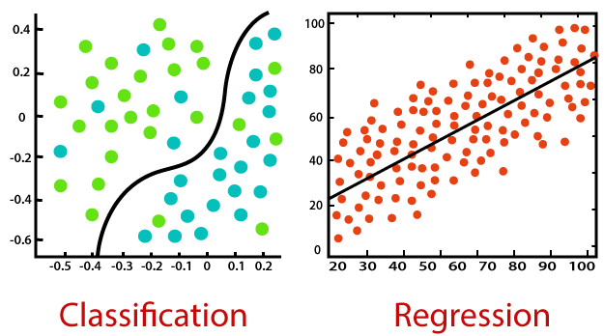
ML Problems
Classification:
Classification is a process of finding a function which helps in dividing the dataset into classes based on different parameters. In Classification, a computer program is trained on the training dataset and based on that training, it categorizes the data into different classes.
Regression:
Regression is a process of finding the correlations between dependent and independent variables. It helps in predicting the continuous variables such as prediction of Market Trends, prediction of House prices, etc.
Notes:
- Diseases, whether affecting humans, animals, or plants, pose significant threats to public health, animal health, and environmental health. Holistically, The One Heath approach emphasizes the interconnectedness of human, animal, and plant health.
- The impact of diseases includes direct costs such as healthcare expenses and veterinary services and agricultural.
Therefore, Collaborative efforts are crucial for effective disease management and prevention.

Slide 11
Outline
1
Background
2
ML Techniques
ML Problems
3
Use Cases
4
5
Practical Example
6
Evaluation
Partie 2
Notes:
The agenda of today talk is :
I will briefly explain the context and motivation of this research
Then I will explain contributions followed discussion and conclusion and ending my talk by future perspectives

Slide 12
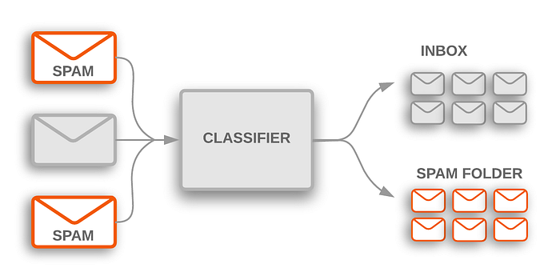
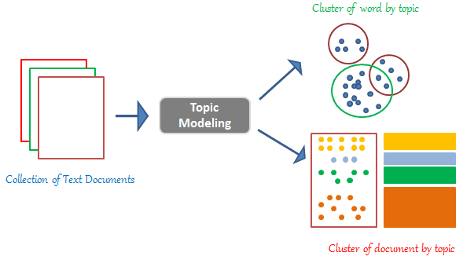
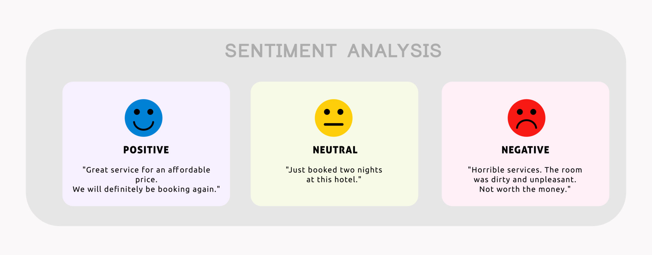
Use Cases
Spam Filtering:
Program used to detect unsolicited, unwanted and virus-infected emails and prevent those messages from getting to a user's inbox.
Topic Modelling:
A natural language processing technique that uncovers latent topics within a collection of text documents. It helps identify common themes or subjects in large text datasets
Sentiment Analysis:
Process of analyzing digital text to determine if the emotional tone of the message is Positive, Negative or Neutral
Notes:
- Diseases, whether affecting humans, animals, or plants, pose significant threats to public health, animal health, and environmental health. Holistically, The One Heath approach emphasizes the interconnectedness of human, animal, and plant health.
- The impact of diseases includes direct costs such as healthcare expenses and veterinary services and agricultural.
Therefore, Collaborative efforts are crucial for effective disease management and prevention.

Slide 13
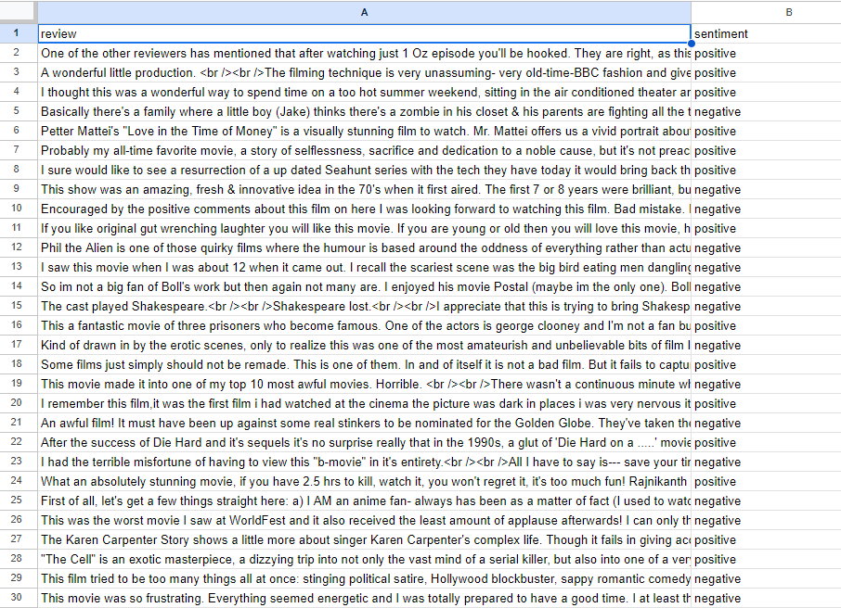
Dataset
Sentiment Analysis Dataset:
Each record corresponds to a piece of text (like a review or comment), and the sentiment is labeled as either Positive or Negative.
Dataset Overview:
Total records: 50,000
Positive sentiments: 50%
Negative sentiments: 50%
Reference:
You can get this dataset from Kaggle
You can download this dataset from here.
Notes:
- Diseases, whether affecting humans, animals, or plants, pose significant threats to public health, animal health, and environmental health. Holistically, The One Heath approach emphasizes the interconnectedness of human, animal, and plant health.
- The impact of diseases includes direct costs such as healthcare expenses and veterinary services and agricultural.
Therefore, Collaborative efforts are crucial for effective disease management and prevention.

Slide 14
Outline
1
Background
2
ML Techniques
ML Problems
3
Use Cases
4
5
Practical Example
6
Evaluation
Partie 2
Notes:
The agenda of today talk is :
I will briefly explain the context and motivation of this research
Then I will explain contributions followed discussion and conclusion and ending my talk by future perspectives

Slide 15
Practical Example
Goal:
Our goal is to build a model that can automatically classify the sentiment (Positive or Negative).
Steps:
Dataset Exploration
Filtration Of Data.
Model Selection.
Data Preprocessing
Model Training
Model Evaluation
To Achieve:
We need to understand basic working of Sentiment Analysis through ML Model and different evaluation metrics. Let’s move on our Practical Example
Notes:
- Diseases, whether affecting humans, animals, or plants, pose significant threats to public health, animal health, and environmental health. Holistically, The One Heath approach emphasizes the interconnectedness of human, animal, and plant health.
- The impact of diseases includes direct costs such as healthcare expenses and veterinary services and agricultural.
Therefore, Collaborative efforts are crucial for effective disease management and prevention.

Slide 16
Outline
1
Background
2
ML Techniques
ML Problems
3
Use Cases
4
5
Practical Example
6
Evaluation
Partie 2
Notes:
The agenda of today talk is :
I will briefly explain the context and motivation of this research
Then I will explain contributions followed discussion and conclusion and ending my talk by future perspectives

Slide 17
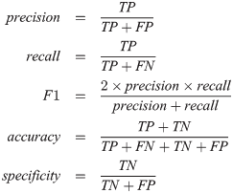
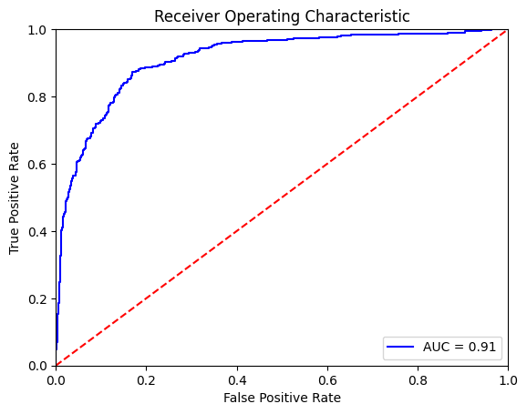
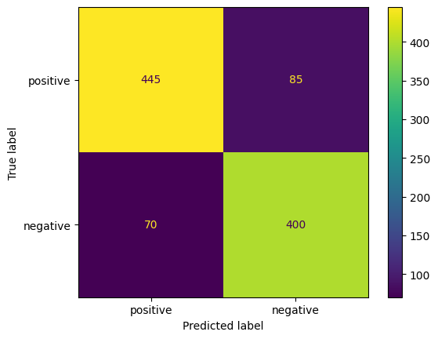
Evaluation
Notes:
- Diseases, whether affecting humans, animals, or plants, pose significant threats to public health, animal health, and environmental health. Holistically, The One Heath approach emphasizes the interconnectedness of human, animal, and plant health.
- The impact of diseases includes direct costs such as healthcare expenses and veterinary services and agricultural.
Therefore, Collaborative efforts are crucial for effective disease management and prevention.

Slide 18
Recap
What we have Learned?
Filtration of Data:
Cleaned and Prepared Dataset: Gained hands-on experience in cleaning and preparing the dataset, ensuring that it is free from irrelevant or duplicate entries.
Addressed Missing Values: Successfully handled missing values, ensuring a clean and complete dataset for subsequent analysis.
Model Selection:
Researched Sentiment Analysis Models: Explored various sentiment analysis models, understanding their strengths and weaknesses.
Informed Model Selection: Made informed decisions about model selection based on the alignment of model characteristics with project goals and dataset features.
Model Evaluation:
Performance Metrics: Learned to evaluate model performance using metrics such as accuracy, precision, recall, and F1 score.
Generalization: Gained insights into the model's ability to generalize to new, unseen data, providing a measure of its real-world applicability.
Notes:
- Diseases, whether affecting humans, animals, or plants, pose significant threats to public health, animal health, and environmental health. Holistically, The One Heath approach emphasizes the interconnectedness of human, animal, and plant health.
- The impact of diseases includes direct costs such as healthcare expenses and veterinary services and agricultural.
Therefore, Collaborative efforts are crucial for effective disease management and prevention.

Slide 19

Acknowledgments
Creator:
Munib Hassan
Lead SQA Lycus Inc
Special Thanks To:
Lycus Inc For organizing such wonderful Event.
PSTB for providing me opportunity as Speaker in meetup.
Syed Mehtab Alam
Doctoral Researcher at CIRAD
GitHub Repo Of Presentation
Notes:
- Diseases, whether affecting humans, animals, or plants, pose significant threats to public health, animal health, and environmental health. Holistically, The One Heath approach emphasizes the interconnectedness of human, animal, and plant health.
- The impact of diseases includes direct costs such as healthcare expenses and veterinary services and agricultural.
Therefore, Collaborative efforts are crucial for effective disease management and prevention.

