Slide 1
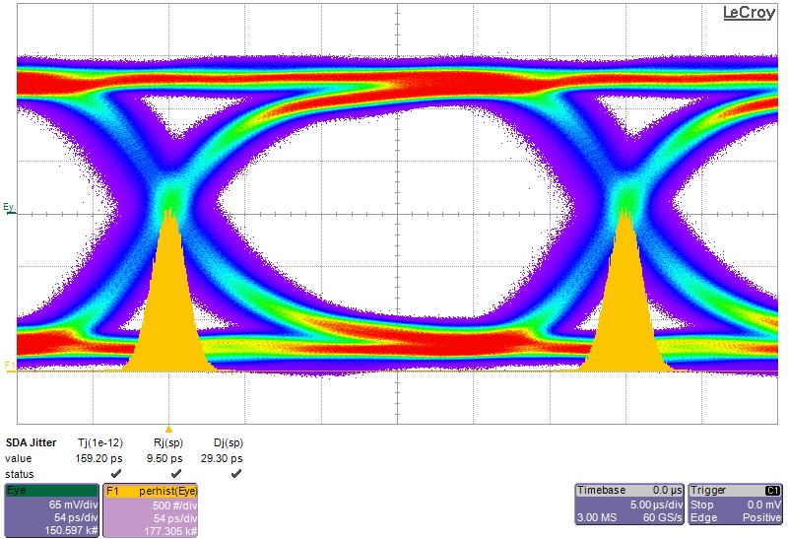
Jitter
one unit interval (UI)

Slide 2
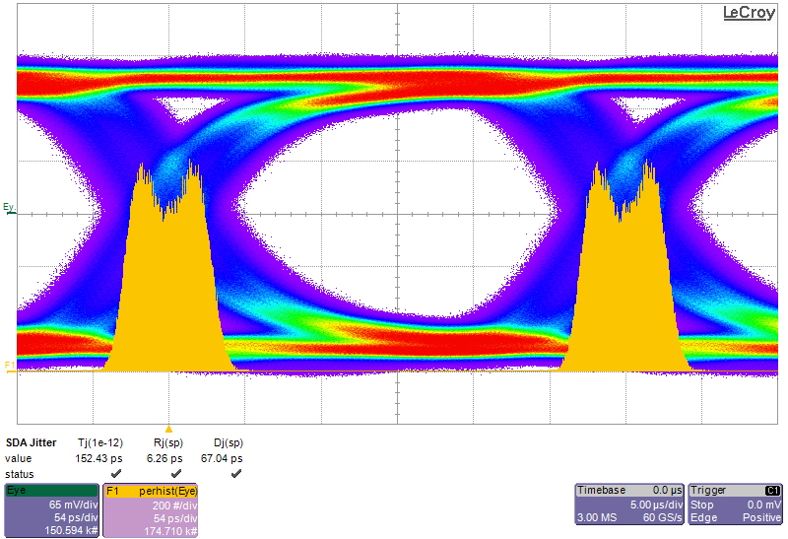
Jitter
one unit interval (UI)

Slide 4
Transmitter
Channel
Receiver
tx_data
rx_data
tx_clk
rx_clk

Slide 5
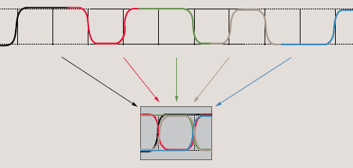
Source: Tektronix Primer „Understanding and Characterizing Timing Jitter“

Slide 6
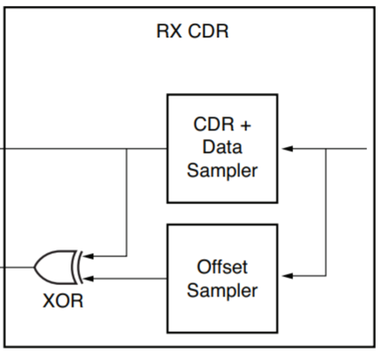
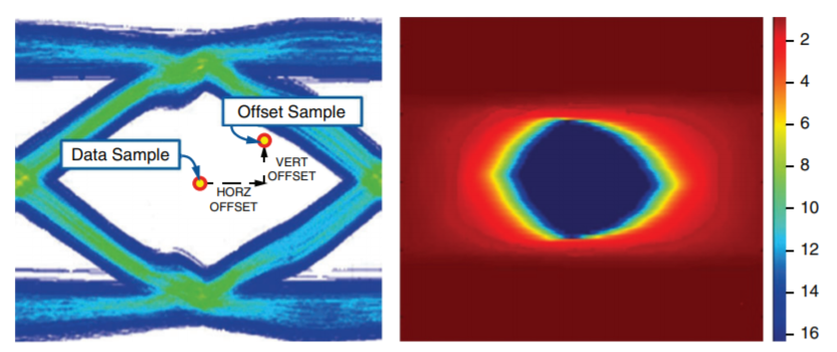
GTP receive CDR with additional Offset Sampler
the Offset Sampler can move independently
statistically reconstructed eye diagramm
Source: XILINX white paper WP428

