Slide 1
Machine Learning with Python

Slide 2
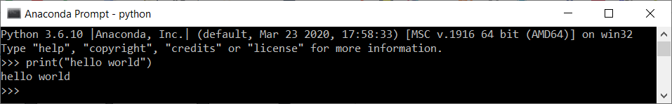




Intro
Why Python?
Running Python locally
scripts.py vs. notebooks.ipynb
Running Jupyter notebooks in the cloud, e.g. collaboratory
GitHub

Slide 3
Schedule

Slide 4
Tools and Notebooks
Jupyter notebooks and datasets are available on GitHub: https://github.com/munich-ml/MLPy2021
Colab notebook environment
https://colab.research.google.com/
Open notebook templates from GitHub:
File >> open notebook >> GitHub >> munich-ml/MLPy2021
Save your own work on your Google Drive:
File >> Save a copy to Drive

Slide 5
Machine learning
Machine learning
Supervised learning
Regression
Classification
Unsupervised learning
Clustering
Reinforcement learning
Example applications
Market forecasting
Robot navigation
Explore & Learn
Dimensionality reduction
Image classification
Recommender systems
Big data visualization

Slide 6

Choosing the right estimator
Source: https://scikit-learn.org/stable/tutorial/machine_learning_map/index.html

Slide 7
Neural networks Computer vision with TensorFlow

Slide 8
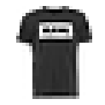
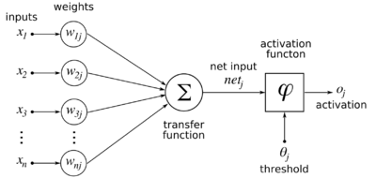
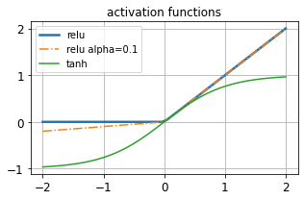
Classification with neural networks
Input
Images
28 * 28 pixel
8 bit/pixel
Input layer
786 neurons
one per pixel
hidden layers
2 in this
example
Output layer
10 neurons
one per class
Output
10 classes
Pullover
T-shirt
…
…
…
…
…
Sneaker
https://en.wikipedia.org/wiki/Backpropagation
Notes:
Dies ist ein Klassifizierungsploblem. Regression ist auch möglich mit Neural Networks
In den Wichtungsfaktoren (weights) steckt das „Wissen“
Es braucht eine Aktivierungsfunktion weil sonst keine komplexen (nichtlinearen) Funktionen möglich sind
Beispiel Klassifizierung im 2D Raum: Ohne nichtlineare Aktivierungsfunktion ist nur eine Gerade möglich
Leaky ReLu, damit die Ableitung nicht 0 ist. (Alpha als Hyperparameter)

Slide 9
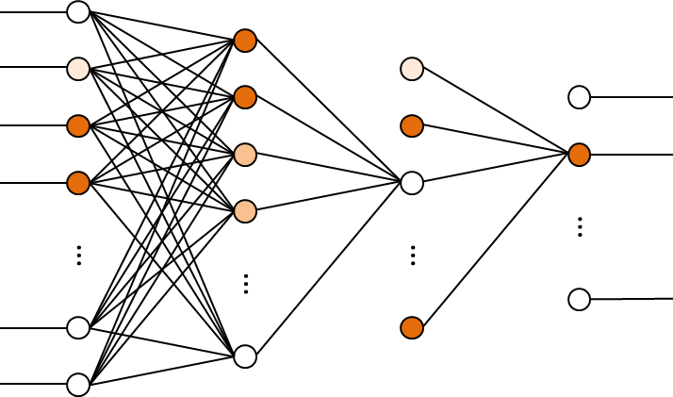
Training a neural network
Training: Learning a function/model that best maps the training dataset
Neural net training: Finding weights & biases that minmize the cost function
Training algorithm: Back propagation in 3 steps:
Feed forward a batch of example images through the model
Compute error from labels and predictions
cost function E=(y_{PRED}-y_{TRUE})²
Effects of weights on the error dE/dWeight
Propagate error through the model
modify weights by their effect on the error -lr * dE/dWeight
Learning rate lr
(1) Prediction
(3) Error back propagation
Epoch is the training over the full dataset, executed in batches

Slide 10
Backpropagation animation
Source: https://towardsdatascience.com/lets-code-convolutional-neural-network-in-plain-numpy-ce48e732f5d5

Slide 11
Convolutional Neural Networks

Slide 12
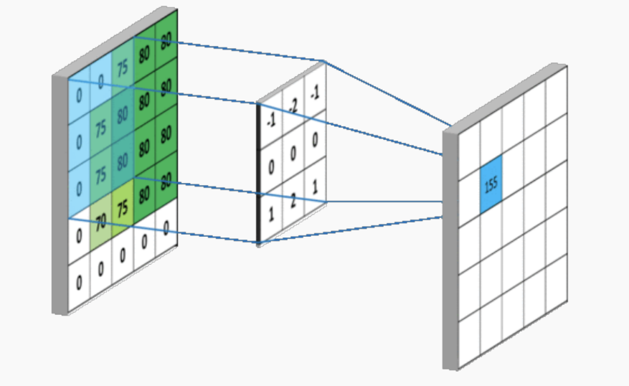
Convolutional neural networks (CNN)
Disadvantages of (fully connected) neural nets (NN) for image processing
Don‘t scale well (many features; prone to overfitting)
Disregard pixel distance (neighborhood have semantic meaning)
Objects of interest are detected at certain positions, only
Convolutional neural networks (CNN) consist of 3 basic layer types:
Convolutional layers
Trainable filters measure the presence certain patterns / objects
The object may occur anywhere
Pooling layers
Downsize resolution
focus (on the maximum)
Fully connected layers
Aggregate information as higher represention
Source: https://towardsdatascience.com/simple-introduction-to-convolutional-neural-networks-cdf8d3077bac
Notes:
For CNNs: „Elements of interest can appear anywhere in the image” → irrelevant for fashion_MNIST

Slide 13
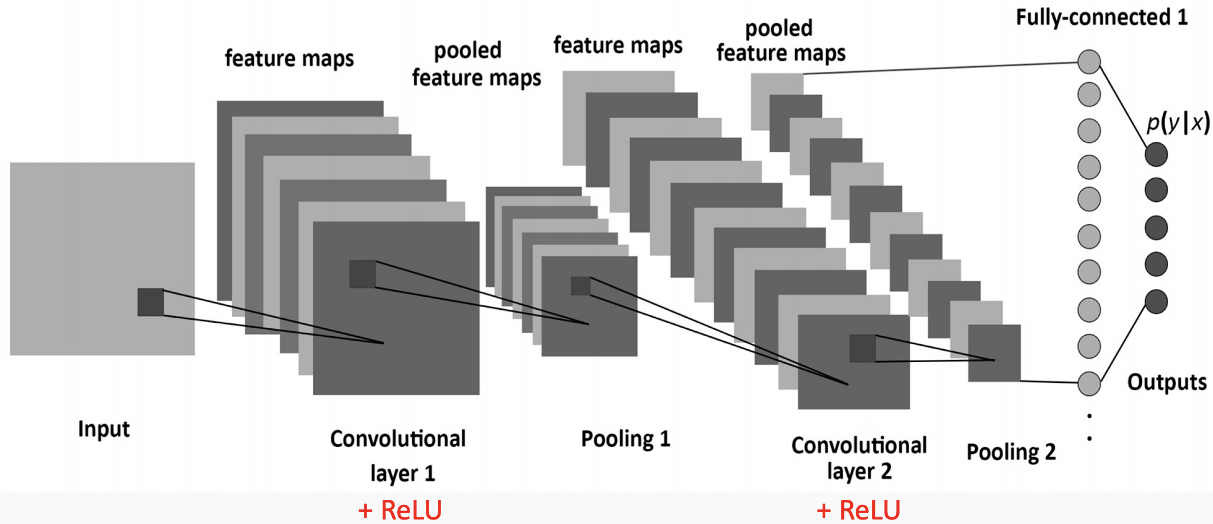
Convolutional neural networks (CNN)
low conv layers
learn basic shapes like edges, corners, circles, textures,…
middle conv layers
learn parts of object like eyes, fingers, wheels, leafs,…
higher dense layers
learn to recognize full objects, in different shapes and positions
Interactive 3D CNN on MNIST: https://www.cs.ryerson.ca/~aharley/vis/conv/
Source: https://towardsdatascience.com/simple-introduction-to-convolutional-neural-networks-cdf8d3077bac

Slide 14
Appendix

Slide 15
all data
training set
test set
→ model training
→ final test
all data
training set
validation set
test set
→ model training
→ model selection
→ final test
hyperparameter tuning
all data
training set
test set
run 0
fold 0
fold 1
fold 2
…
fold k
run 1
fold 0
fold 1
fold 2
…
fold k
run 2
fold 0
fold 1
fold 2
…
fold k
…
run k
fold 0
fold 1
fold 2
…
fold k

