Slide 1
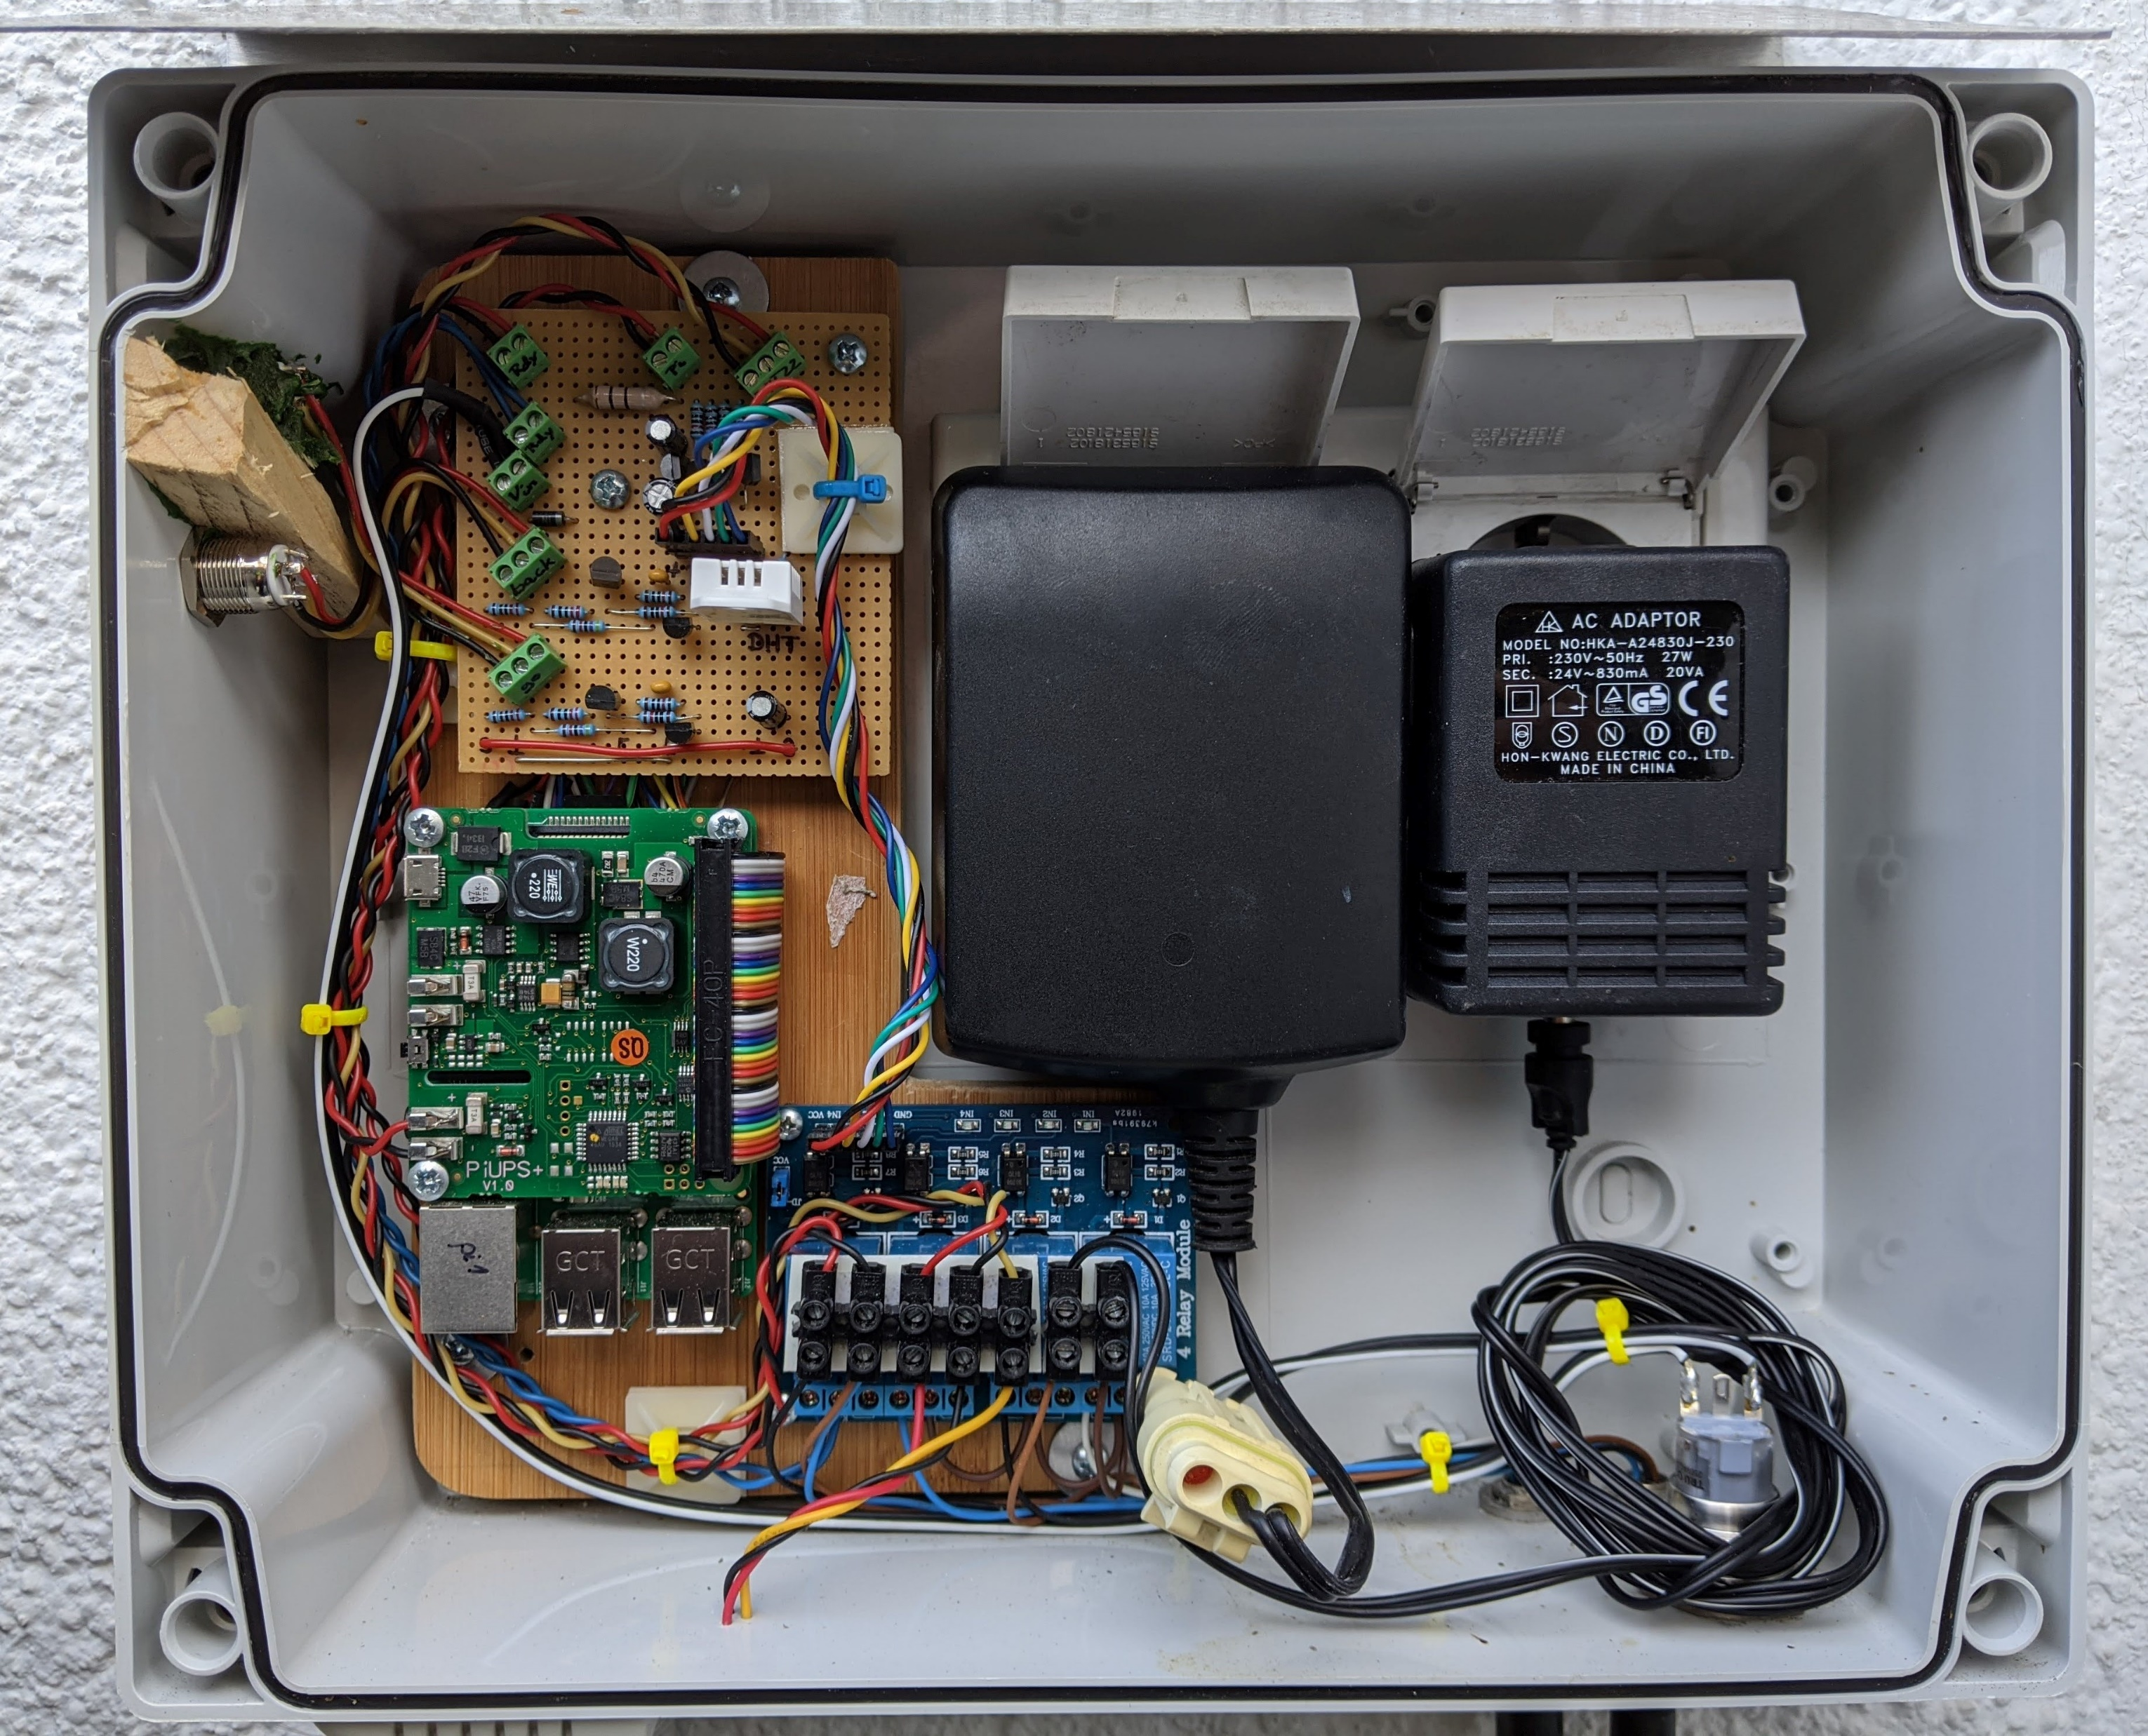
RaspiGarden Hardware
go button & green LED
DHT int
28VDC supply for Randy (mow robot) also used for Raspi via piUSV
back button & red LED
Relay card
3 relays für sprinkler valves
1 relay to switch Randy supply
24VAC supply for sprinkler
Raspi with piUSV
Power switch
DHT ext
M8 connectors to Randy and sprinkler valves

Slide 2
RaspiGarden Button User Interface
Asleep
PwrDn
Start by timer
xl
long
AboutTo-PwrDn
1010 1010
AboutTo-WakeUp
11110000
Raining
Awake
Random
0111 1111
1000 0000
0101 1111
long
AboutTo-Rain
1x short
2x short
long
3x short
AboutTo-Random
1000 0000
AboutTo-Load
1010 0000
Loading
control.txt
1010 1000
0101 0111
long
GoButton short: < 0.7s
long: > 0.7s
BackButton xl: > 8s
After time / done (dashed)

Slide 3
RaspiGarden GoButton StateMashine
state 0 1 2 3 4 0
Return 0 0 2 0
tLong
tShort

Slide 4
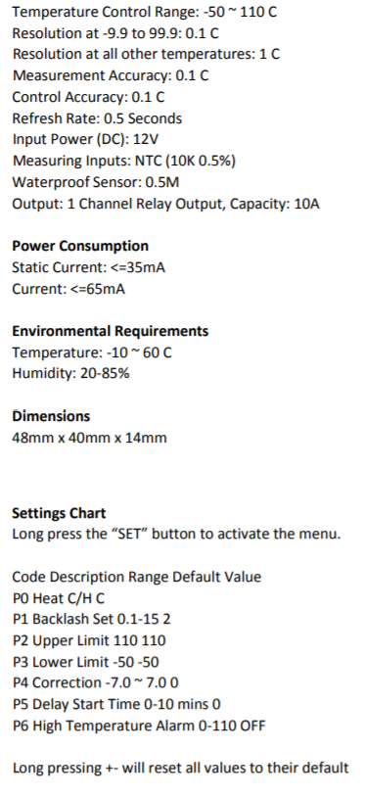
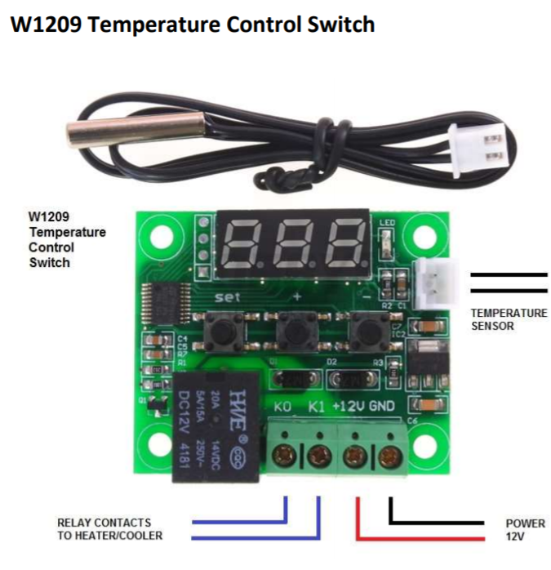
RaspiGarden Heizung
http://www.kelco.rs/katalog/images/17670.pdf

