Slide 1
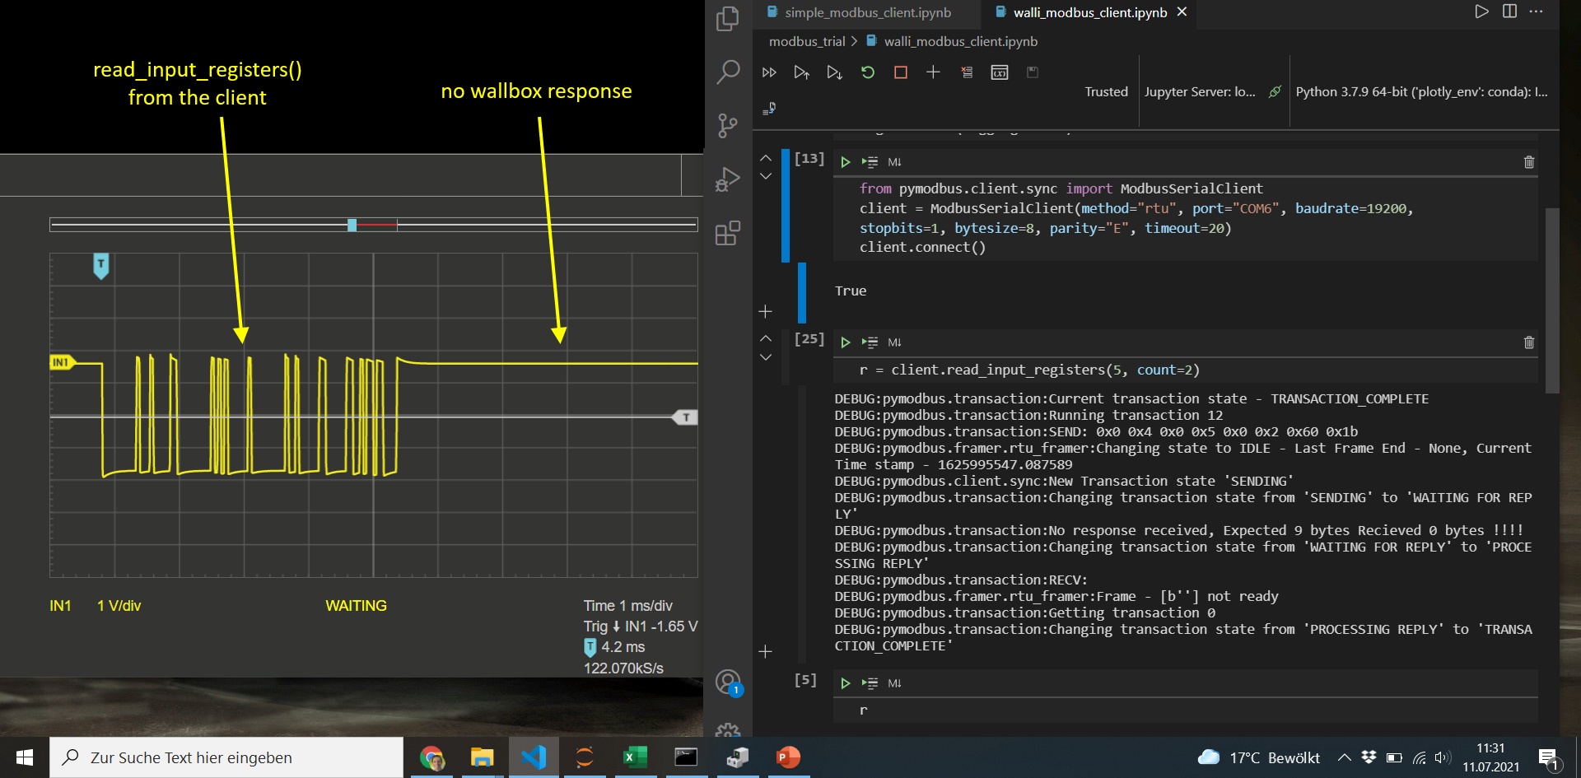

Slide 2
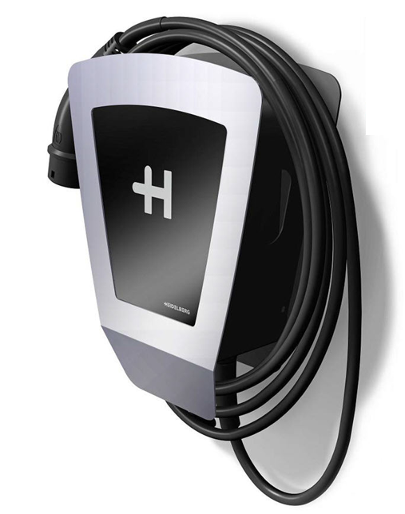

Slide 3
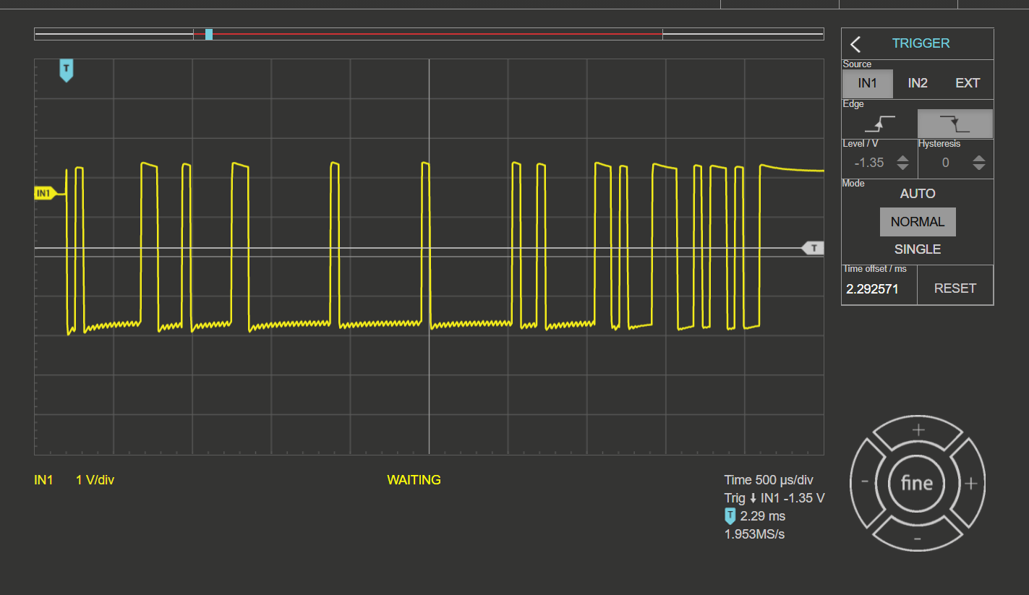
Walli pollt im Leader mode, Bus-ID 1, Term on
Linerate estimate
~17,3 kb/s !!
address
function
CRC
CRC
High jitter

Slide 4
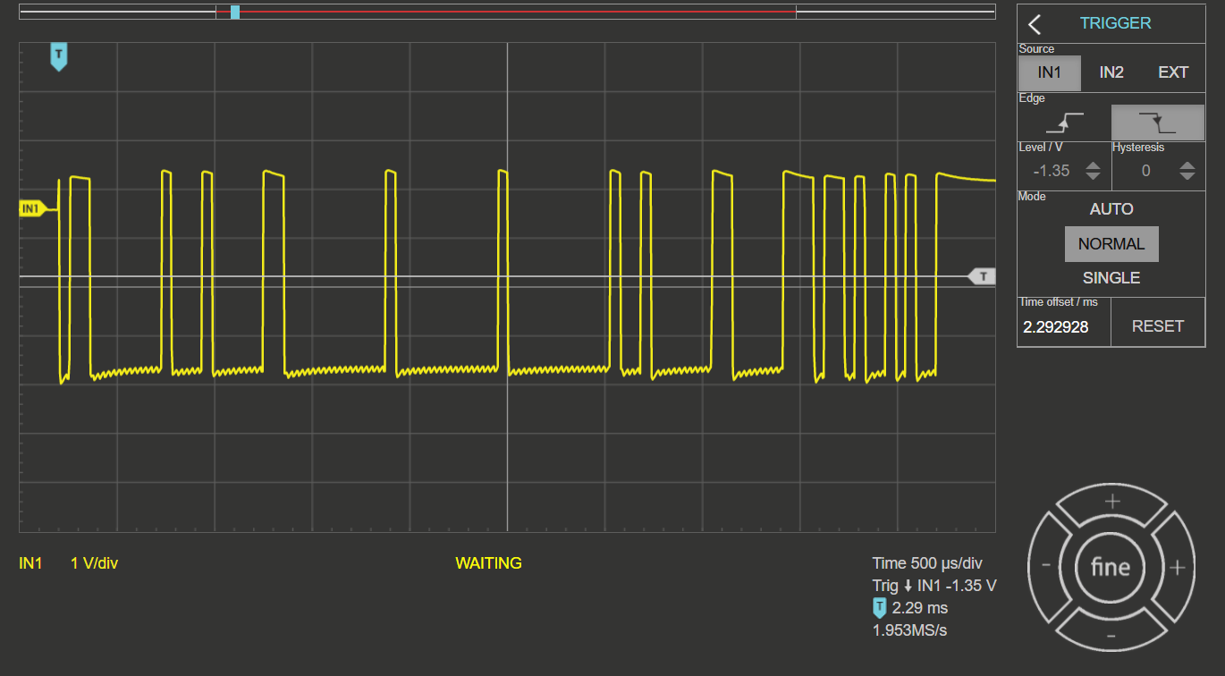
Walli pollt im Leader mode, Bus-ID 3, Term on
Linerate estimate
~17,3 kb/s !!
address
function
CRC
CRC

Slide 5
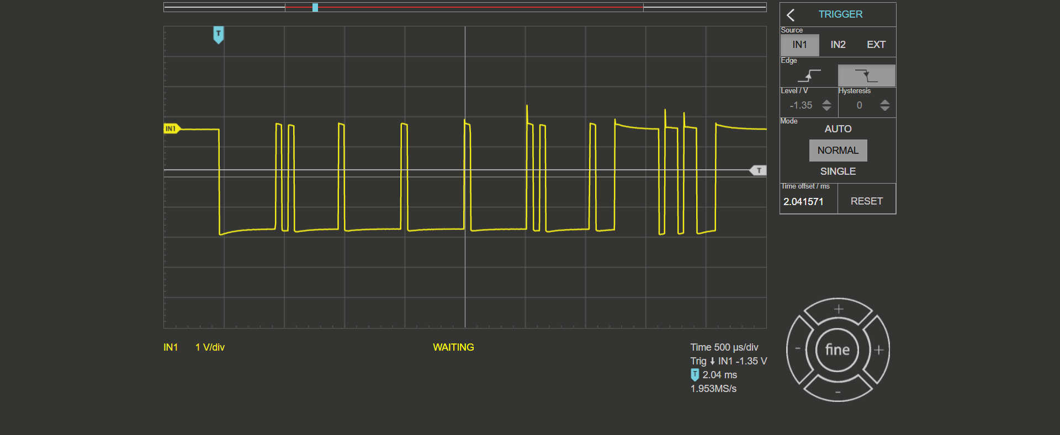
CAS polling Device 0; function 1
Linerate estimate
~19,1 kb/s
address
function
CRC
CRC

Slide 6
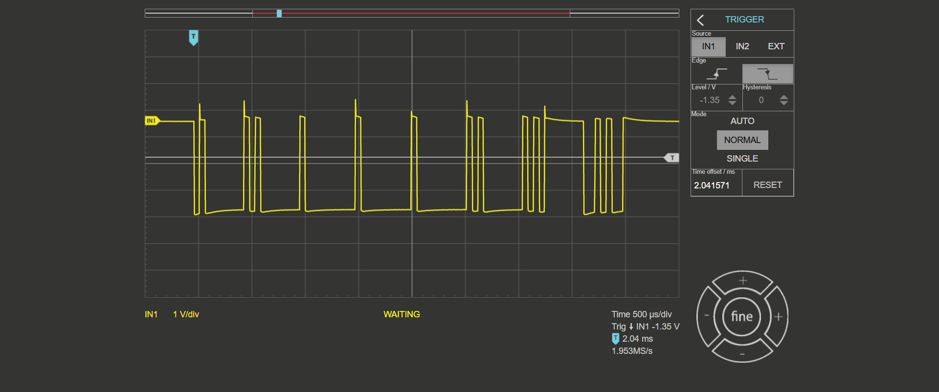
CAS polling Device 1; function 1
Linerate estimate
~19,1 kb/s
address
function
CRC
CRC

Slide 7

CAS polling Device 1; function 2
Linerate estimate
~19,1 kb/s
address
function
CRC
CRC

Slide 8

CAS polling Device 0; function 2
Linerate estimate
~19,1 kb/s
address
function
CRC
CRC

Slide 9
address
function
CRC
CRC

Slide 10
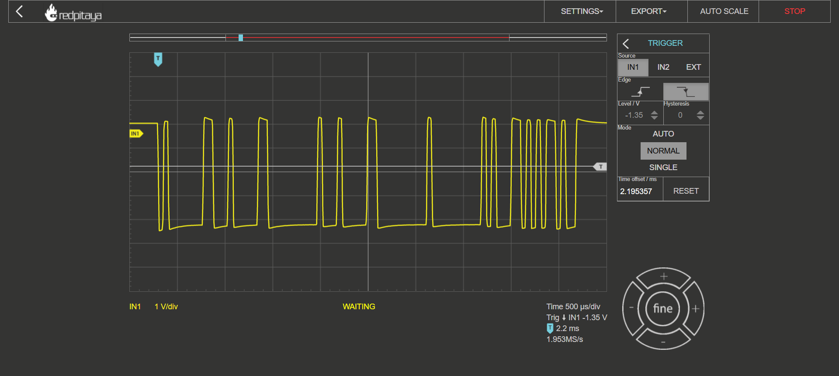
ReadInputReg(reg=4, unit=1)

Slide 11
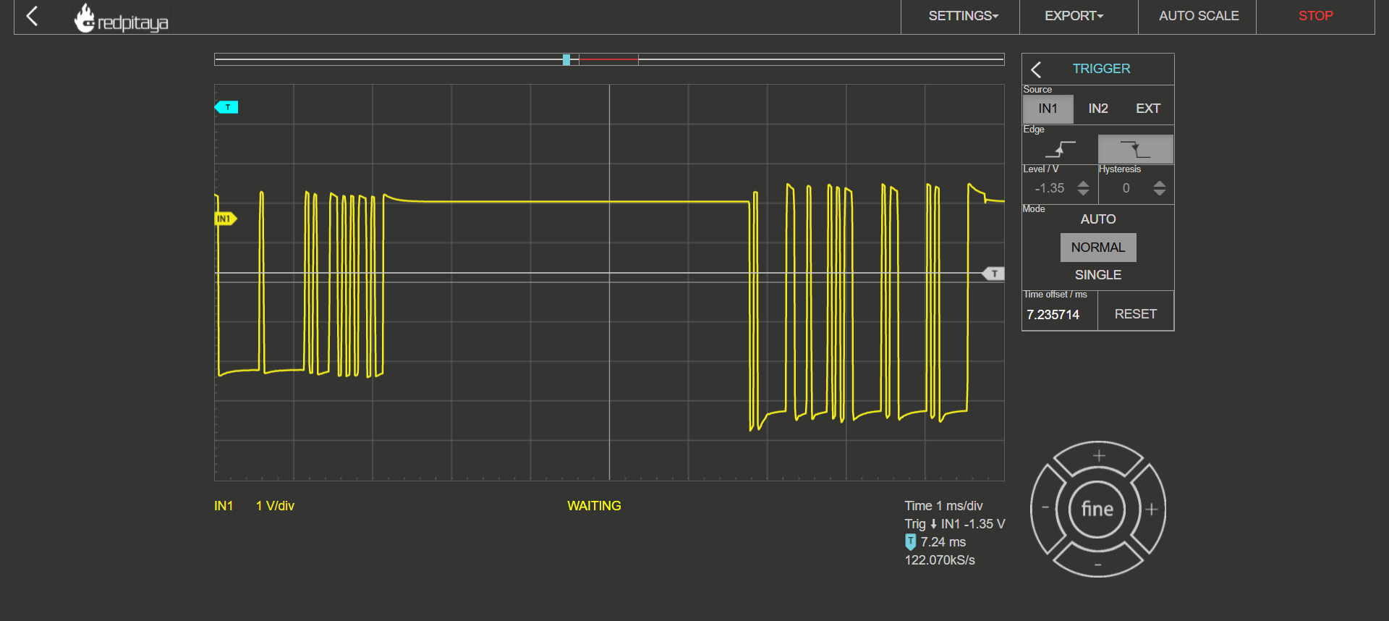
Answer w/ isError()=True

Slide 13
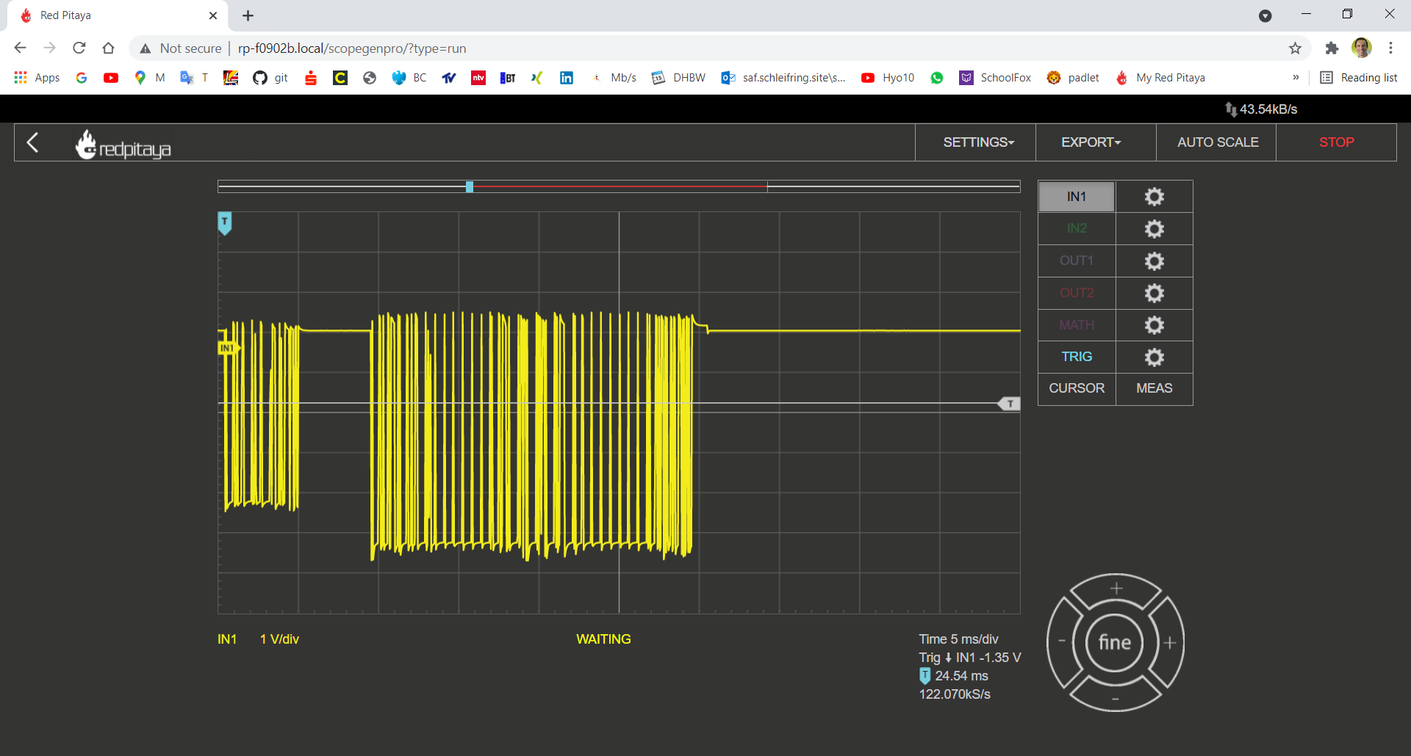

Slide 14
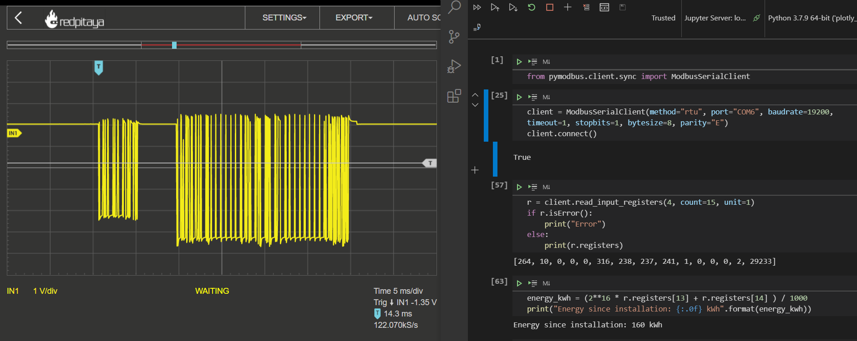
its talking to me
Wallbox response
[264, 2, 0, 0, 0, 292, 238, 239, 241, 1, 0, 0, 0, 2, 29233]
client.read_input_registers
(4, count=15, unit=1)

Slide 15
