Slide 1

Medical Post-Surgery RAG System: An AI-Powered Medical Information Assistant
Transforming medical information accessibility with cutting-edge AI technology.
-Muni Eshwar Evakattu

Slide 2
The Problem: Bridging the Gap in Post-Surgical Care
Lack of Accessible Information
Need for Immediate & Reliable Information
Limited resources for patients seeking clear guidance on post-surgery care.
Patients require accurate and up-to-date medical information right when they need it.

Slide 3


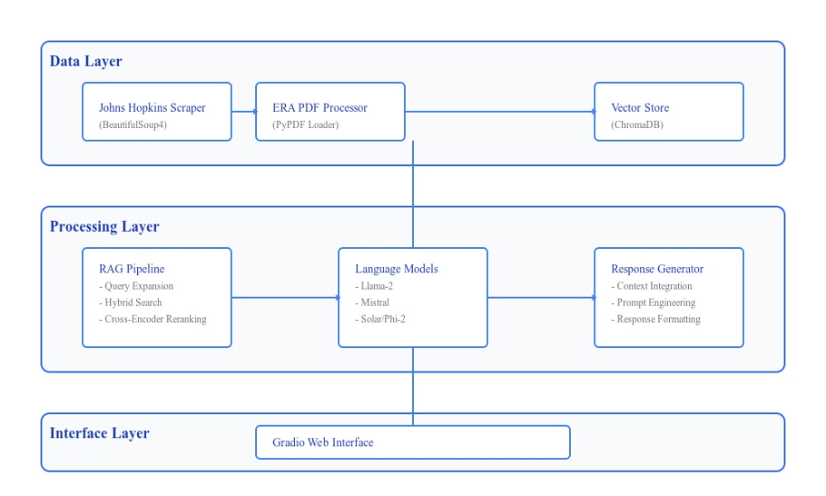
System Architecture: A
Comprehensive Approach
1
Interface Layer
2
Processing Layer
3
Data Layer

Slide 4

Data Collection & Processing: Robust Foundation
1
Expert Sources
2
Processing Pipeline
Johns Hopkins Medicine Website, ERA Society Guidelines
Custom web scraper, PDF processing, chunking strategy
3
Data Quality & Validation
Rigorous data cleaning and verification processes

Slide 5
RAG Implementation Evolution: From Basic to Sophisticated
Initial Approach
1
Basic similarity search, limited context understanding
Enhanced System
2
Hybrid retrieval, medical query expansion, cross-encoder reranking

Slide 6
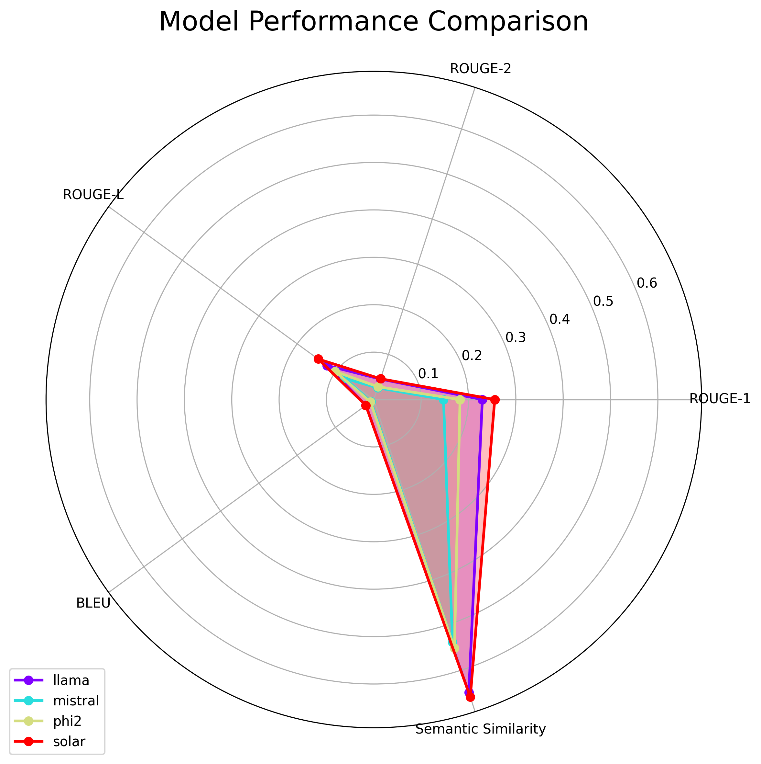
Model Comparison: Performance Evaluation
Quality Metrics
ROUGE-1 Scores (Text Overlap): Solar: 0.255 (highest) Llama: 0.229 Phi2: 0.182 Mistral: 0.147
Semantic Similarity (Relevance): Solar: 0.660 (highest) Llama: 0.650 Phi2: 0.551 Mistral: 0.538
Key Takeaways
Inference Time
Processing Speed:
Mistral: 8.761s Solar: 9.752s Llama: 12.305s Phi2: 17.425s
- Solar performs best on quality metrics - Mistral has significant speed advantages - Llama provides balanced performance - Trade-off between speed and quality
across models

Slide 7
Performance Improvements
35%
90%
10ms
Retrieval Increase
Accuracy
Inference Time
Improved document retrieval accuracy
Enhanced respnse accuracy and precision
Fast and efficient response generation
Model Strengths
Solar
Llama
Best for accuracy-critical applications
Good for balanced requirements
Mistral
PHI 2
Ideal for time-sensitive queries
Consistent but slower

Slide 8
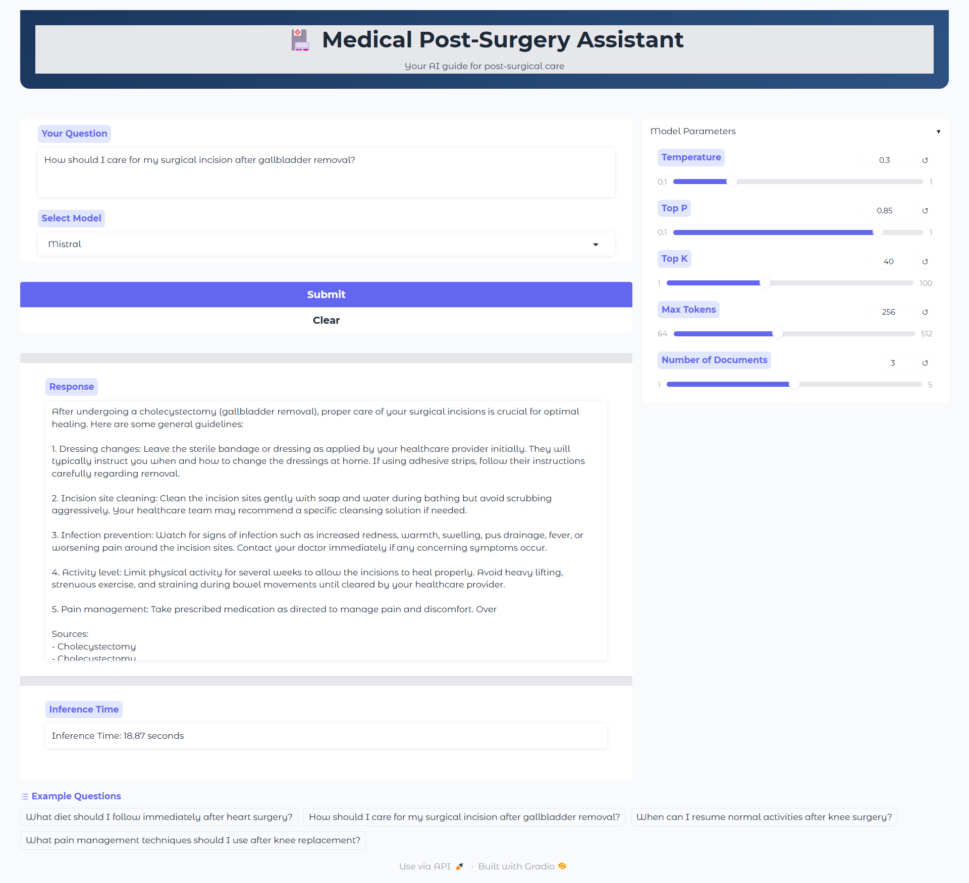



Interface Design: User-Centric Experience
Intuitive Search
Easy-to-use query input for patients and clinicians
Parameter Controls
Customize search options for specific needs
Visual Response
Clear and concise display of relevant medical information

Slide 9
Conclusion & Future Work
Conclusion
Future Scope
🎯 Key Achievements
🔮 Planned Enhancements
Successfully implemented hybrid retrieval system
Advanced query expansion for medical terminology
Demonstrated Solar's superiority for accurate responses
Real-time response validation
Multi-language support
Developed efficient medical query processing
Enhanced source attribution
Created accessible medical information interface
Thank You…

