Slide 1
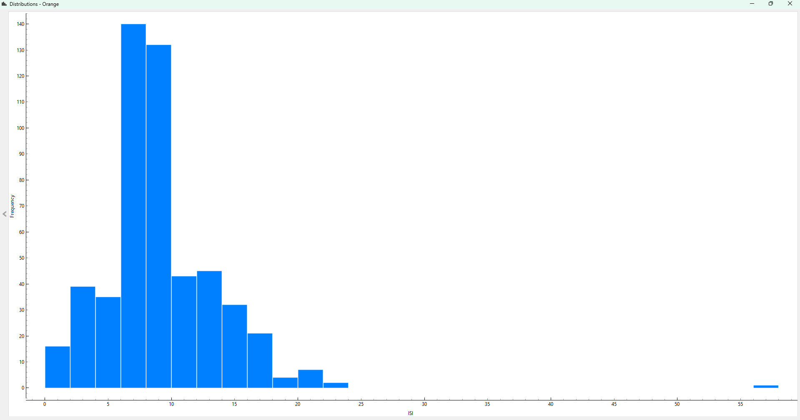
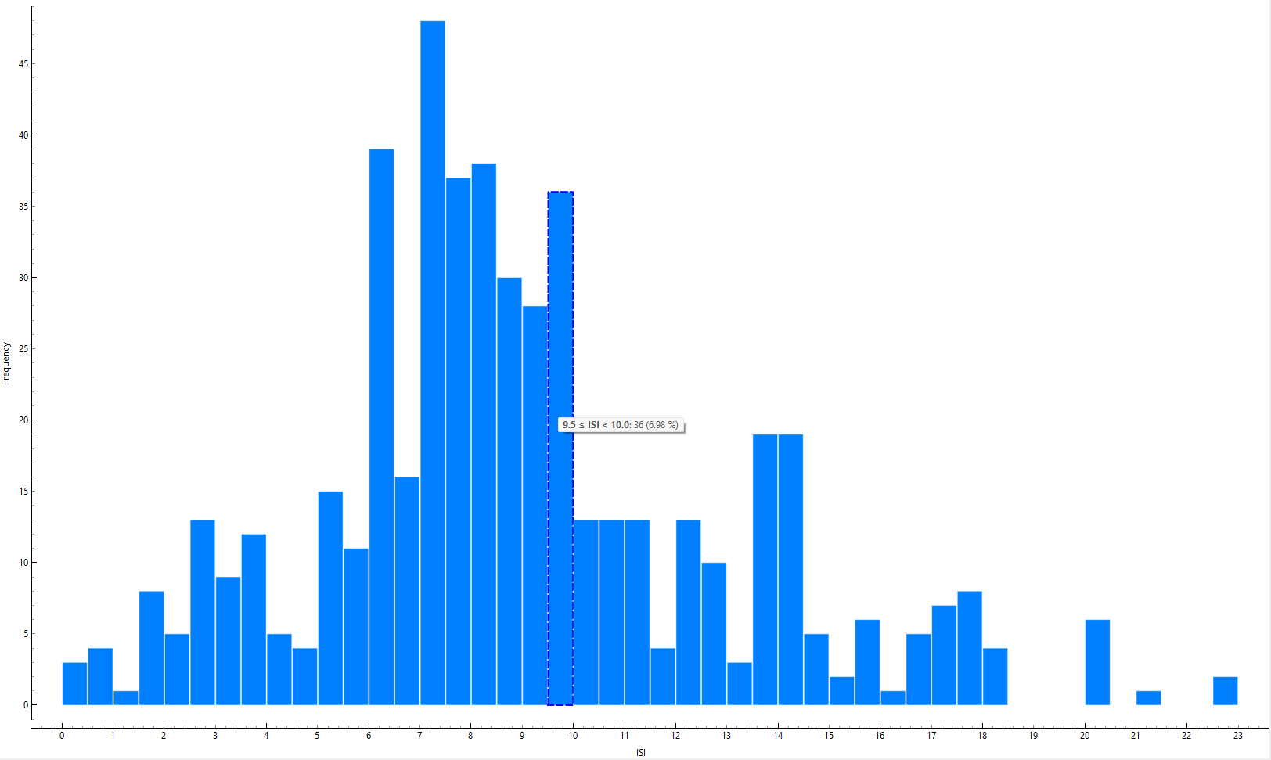
CSCU9M5 Assignment 1. Student Number 3344671
2. Project Methodology List the steps you took to carry out the project Include train/validate/test split and model selection This list should cover ALL the steps in the process … … 4. Data Preparation In the ISI variable histogram showed there is one extreme outlier far outside the normal range. The outlier was trimmed using the select rows widget in Orange. Histograms below show the ISI distribution before and after cleaning. | 3 Variables/ Data Understanding
5. Model Training and Hyper Parameters A table showing the different models and hyper parameters you trained, along with the correct metric for each; Add a sentence on how you chose the hyper parameter values. Make sure you name the metric correctly. | Model Hyper Parameters
6. Final Model and Results Say how you chose the final model to test, and how you trained that model. Put the confusion matrix here Explain what the confusion matrix tells us. | 7. Insight about data or models gained For example, did you learn anything about specific features that drive the model? Is the model biased towards particular groups in the data? Is the model you've chosen good for helping us to understand why particular predictions are made?
Variable | Type | Used | Impact
X | Categorical | yes | Used as categorical to avoid false numerical order and helps model identify location-based fire
Y | Categorical | yes | Used as categorical to avoid false numerical order and helps model identify location-based fire.
Month | Categorical | yes | Helps models detect seasonal fire risk. It is categorical to avoid false numerical order
Day | Categorical | No | Day of the week has no physical influence on fire behaviour so removed as it just adds noise without value.
FFMC | Numeric | yes | Strong predictor for fire. Few instances of near outliers but still kept as they are in a scientifically possible range
DMC | Numeric | yes | Important predictor for fire. Numeric so linear/tree models can learn trends.
DC | Numeric | yes | Important predictor for fire. Numeric so linear/tree models can learn trends.
ISI | Numeric | yes | Important predictor for fire. One extreme outlier removed for model stability.
TEMP | Numeric | yes | Important predictor for fire. Numeric so linear/tree models can learn trends.
RH | Numeric | yes | Important predictor for fire. Numeric so linear/tree models can learn trends.
Wind | Numeric | yes | Important predictor for fire. Numeric so linear/tree models can learn trends.
Rain | Numeric | yes | 509 of 517 entries are zero. May weaken linear models but tree-models handle Zero dominated data well.
Area | Categorical | Target | Defines the classification task. Binary as it is just true or false
Model | Hyper Parameters | Validation Metric
Random Forest | 150 trees, attributes at each split 5, Do not split subsets smaller than 5 | CA: 0.922, F1: 0.922
Gradient Boosting | 150 trees, 0.1 learning rate, depth limit 3, subsampling 1.00, Do not split subsets smaller than 2 | CA: 0.922, F1: 0.922
Tree | Do not split subsets smaller than 5, Maximum tree depth 10, Stop when class majority reaches 95%, Min leaves 2 | CA: 0.883, F1: 0.883
Neural Networks | Hidden layers: 5, 10. Activation: ReLU Solver Adam, Regularisation: 0.01 Iterations: 200 | CA: 0.649, F1: 0.645
Logistic Regression | Regularisation: L2 (Ridge)strength C = 10 | CA: 0.701, F1: 0.699
KNN | 5 neighbours, metric: Euclidean, Weight: Uniform | CA: 0.831, F1: 0.832
Explain here how you chose the hyper parameter settings to explore and how you ran your experiments.
Actual / Predicted | Good | Bad
Good | 220 | 25
Bad | 32 | 195
8. References
[1] If you reference any papers or websites, list them here

Slide 2
CSCU9M5 Assignment 1. Student Number 3344671
2. Project Methodology
List the steps you took to carry out the project
Include train/validate/test split and model selection
This list should cover ALL the steps in the process
…
…
3 Variables/ Data Understanding
Say which variables you used in your model, and whether you treated then as numeric3 Variables
Say which variables you used in your model, and whether you treated then as numeric or categorical. Explain the impact your choices will have on the models you build. You can use a table:
or categorical. Explain the impact your choices will have on the models you build. You can use a table:
Variable | Type
Variable 1 | Numeric
Variable 2 | Categorical
4. Data Preparation
Show two histograms here. One should show the distribution of one
variable before it has been cleaned. The other should show the
distribution of the same variable after cleaning. Choose a variable
that needs to be cleaned!!
Before Cleaning
After Cleaning
5. Model Training and Hyper Parameters
A table showing the different models and hyper parameters you trained, along with the correct metric for each; Add a sentence on how you chose the hyper parameter values. Make sure you name the metric correctly.
Model | Hyper Parameters | Validation Metric
Model 1 | Hyper parameter list | A%
Model 2 | Hyper parameter list | B%
Model 3 | Hyper parameter list | C%
Model 4 …. | Hyper parameter list | D%
Explain here how you chose the hyper parameter settings to explore and how you ran your experiments.
6. Final Model and Results
Say how you chose the final model to test, and how you trained that model.
Put the confusion matrix here
Actual / Predicted | Good | Bad
Good | X | X
Bad | X | X
Explain what the confusion matrix tells us.
7. Insight about data or models gained
For example, did you learn anything about specific features that drive the model? Is the model biased towards particular groups in the data? Is the model you've chosen good for helping us to understand why particular predictions are made?
8. References
[1] If you reference any papers or websites, list them here

