Slide 1
DBMS Project Review-2
Recycling Management System
TEAM NUMBER:15
Presented by:
25B11AI646 - M Muni Kiran - AIML
25B11AIA16 - R Lilly - AIML
25B11AI053 - A Jahnavi - AIML
25B11AI035 - A Mokshita - AIML
Under esteemed guidance of:
Mr. D .Priyanth
M.Tech, Assistant Professor (AIML)

Slide 2
Outline
Introduction
Problem Statement and Objectives
Scope of the project
Concepts and advantages of E-R model
Tables and Attributes
Relationships
E-R Diagram
Advantages of the E-R Model
The Relational Model
Primary Keys and Foreign Keys
Relational Schema
Main Queries and CRUD Operations
Conclusion

Slide 3



Introduction
Efficient Collection & Tracking
The system schedules and monitors recyclable material pickups from households, offices, and industries, ensuring timely and organized collection.
Automated Sorting & Processing
Materials like plastic, paper, glass, metal, and e‑waste are categorized and processed automatically, reducing manual effort and improving accuracy.
Data Management & Reporting
MySQL/PostgreSQL backend stores structured records of contributors, recycling centers, and processed quantities, while dashboards generate reports on recycling rates and environmental impact.

Slide 4
Problem Statement
Manual screening is time-consuming
Sorting and tracking recyclable materials by hand is slow, error‑prone, and cannot scale as
waste volumes increase.
1
Data redundancy and inconsistency
Recordsof collected materials are scattered across spreadsheets or paper logs, leading to
mismatched, outdated, or missing information.
2
Difficult to generate reports
Generating reports on recycling rates, environmental benefits, and processed quantities is time‑consuming without a structured database system.
3

Slide 5

Objectives
Streamline collection and scheduling of recyclable materials.
Automate sorting and processing of plastic, paper, glass, metal, and e‑waste.
Maintain structured records of contributors and recycling centers.
Generate accurate reports on recycling rates and environmental impact.
Encourage citizen participation through notifications and incentives.

Slide 6





Scope of the Project
User Registration
Register households, offices, and industries into the system.
Data Storage
Store records of collected recyclable materials (plastic, paper, glass, metal, e‑waste).
Search Records
Query recycling data by material type, contributor, or collection date.
Update Records
Edit details of contributors, collection schedules, and processed quantities.
Delete Records
Remove outdated, duplicate, or incorrect recycling entries.
Generate Reports
Produce statistics on recycling rates, processed materials, and environmental impact.

Slide 7





E-R Model Concepts
Entity
Represents real‑world objects such as Contributor, Collection Vehicle, Recycling Center, and Material.
Attribute
Describes properties of entities, e.g. Contributor_Name, Material_Type, Collection_Date, Processed_Quantity.
Relationship
Collection Record Delivered_To Recycling Center
Recycling Center Processes Material
Primary Key
Uniquely identifies each record in the database, e.g. Contributor_ID, Vehicle_ID, Center_ID, Material_ID, Record_ID.
Foreign Key
Links related tables, e.g. Contributor_ID in Collection Record refers to Contributor table, Center_ID refers to Recycling Center table.
Cardinality
Contributor ↔ Collection Record → 1:M
Collection Record ↔ Material → M:M
Collection Record ↔ Recycling Center → M:1

Slide 8
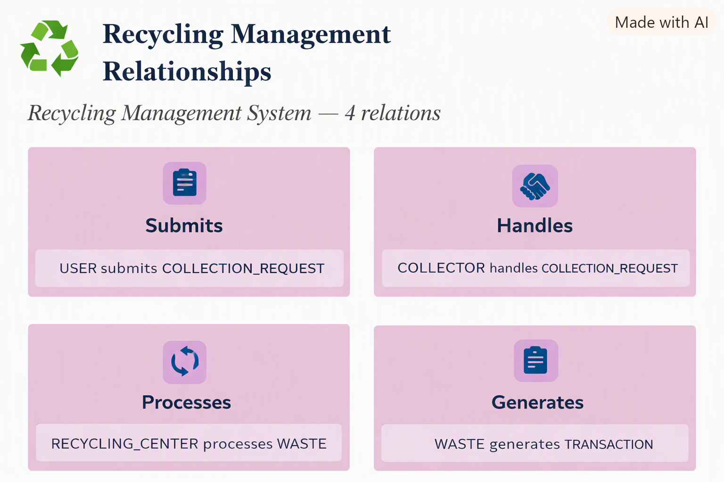
Tables (Relations)

Slide 9
Table Attributes
USER
user_id (PK), name, contact_info, address
COLLECTION_REQUEST
request_id (PK), user_id (FK), waste_type, requested_date, status
COLLECTOR
collector_id (PK), name, assigned_area, contact_info
WASTE
waste_id (PK), waste_type, quantity, category, request_id (FK)
RECYCLING_CENTER
center_id (PK), location, capacity, contact_info
TRANSACTION
transaction_id (PK), collector_id (FK), center_id (FK), date, quantity_processed,

Slide 10
Relationships
USER → COLLECTION_REQUEST (1:N) via user_id
COLLECTION_REQUEST → WASTE (1:N) via request_id
COLLECTION_REQUEST → COLLECTOR (M:1) via collector_id
COLLECTOR → RECYCLING_CENTER (1:N) via center_id
WASTE → TRANSACTION (1:N) via waste_id
RECYCLING_CENTER → TRANSACTION (1:N) via center_id
Cardinality shown in the badge (1:M = one-to-many, M:1 = many-to-one, 1:1 = one-to-one).

Slide 11
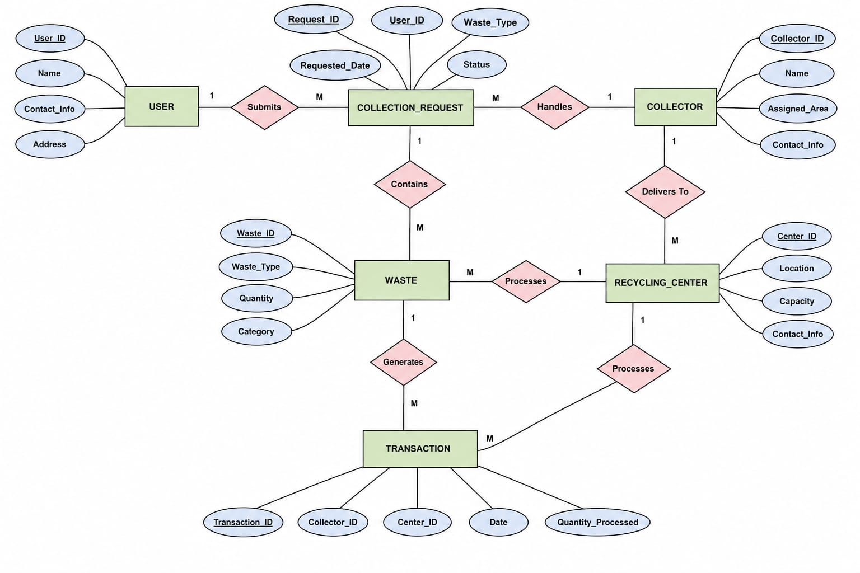
E-R Diagram

Slide 12

Advantages of the E-R Model
Easy Visualization
The diagram makes it simple to see how candidates, skills, and jobs connect at a glance
Better Database Design
Thinking through entities and relationships upfront leads to a cleaner, more logical schema
Reduces Redundancy
Normalizing entities like SKILLS into their own table avoids repeated, inconsistent data
Simplifies Implementation
A clear E-R model translates directly into CREATE TABLE statements with minimal rework

Slide 13
Primary Keys
Table
Primary Key
Type
USER
User_id
Simple,Auto increment
COLLECTION_REQUEST
Request_id
Simple, auto-increment
COLLECTOR
Collector_id
Simple, auto-increment
WASTE
Waste_id
Simple, auto-increment
RECYCLING_CENTRE
Center_id
Simple, auto-increment
TRANSACTION
Transaction_id
Simple, auto-increment
Note: No composite keys are needed here, since each entity has a unique identifier.

Slide 14
Foreign Keys
Table
Foreign Key Column
References
COLLECTION_REQUEST
user_id
USER (user_id)
WASTE
request_id
COLLECTION_REQUEST (request_id)
TRANSACTION
collector_id
COLLECTOR (collector_id)
TRANSACTION
center_id
RECYCLLING CENTER(center_id)
This ensures no orphan records — for example, you can’t log waste without a valid request, or a transaction without a valid collector/center.

Slide 15
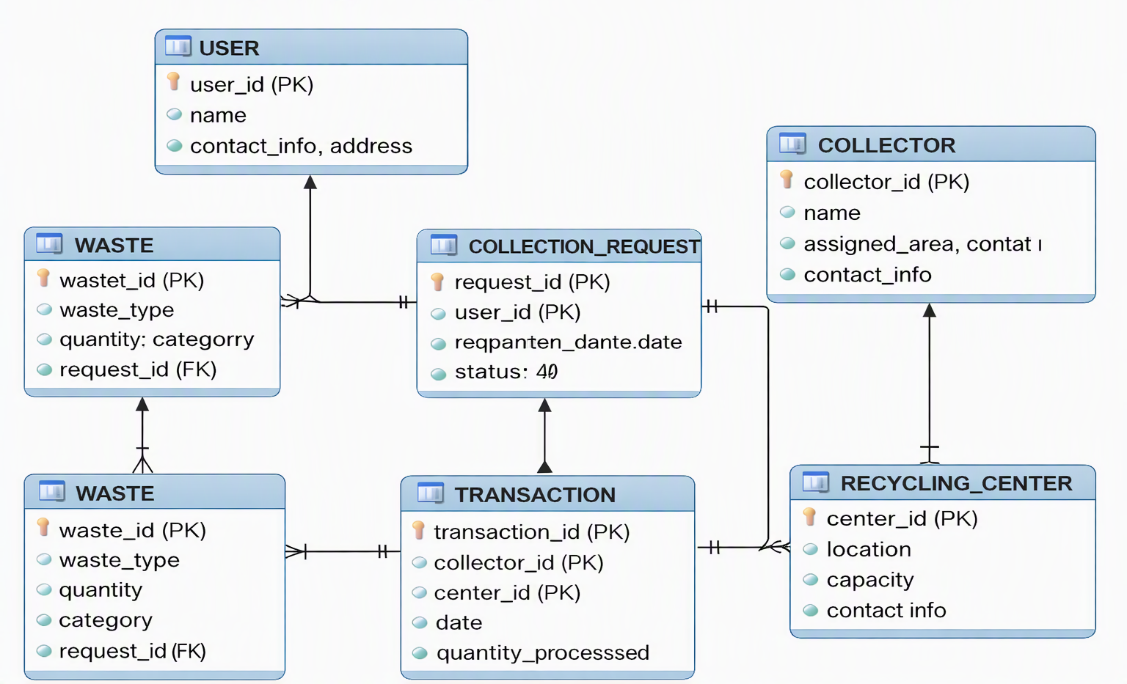


Relational Schema
Reverse-engineered directly from the live MySQL schema

Slide 16

Main Queries — Overview
Users & Materials
Collection Tracking
Joins tables: User, Material, CollectionRecord.
Lists every contributor alongside the materials they recycle (plastic, paper, e‑waste, etc.).
  Calculates total quantity recycled per user.
  Tracks timestamps, center location, and transport details.
  Useful for monitoring recycling frequency.
Center Capacity Ranking
CRUD Operations
Ranks recycling centers by current load vs. capacity.
Lists centers needing urgent transport or processing first.
Supports efficient logistics planning.
  Add, update, delete records of recycled materials.
  Live updates on user profiles, material logs, and center data.
  Ensures real‑time accuracy of the system.

Slide 17
Query 1: Recycling Items and Categories
SELECT r.item_name, c.category_name, r.quantity, r.status
FROM RECYCLING_ITEMS r
JOIN CATEGORIES c ON r.category_id = c.category_id
ORDER BY c.category_name, r.item_name;
RESULT:
proficiency
item_name | category_name | quantity | status
Plastic Bag | Plastic | 120 | Collected
Bottle | Plastic | 80 | Processed
Newspaper | Paper | 200 | Collected
Cardboard | Paper | 50 | Processed
Tin Can | Metal | 40 | Collected

Slide 18
Query 2: Recycling Efficiency Percentage
SELECT r.center_name, c.category_name, COUNT(*) AS processed_items,
(COUNT(*) + SUM(CASE WHEN r.status = 'Collected' THEN 1 ELSE 0 END)) AS total_items,
ROUND(COUNT(*) / (COUNT(*) + SUM(CASE WHEN r.status = 'Collected' THEN 1 ELSE 0 END)) * 100, 2) AS efficiency_percentage
FROM RECYCLING_ITEMS r
JOIN CATEGORIES c ON r.category_id = c.category_id
GROUP BY r.center_name, c.category_name;
RESULT:
center_name | category_name | processed_items | total_items | efficiency_%
GreenCycle | Plastic | 80 | 120 | 66.67
GreenCycle | Paper | 150 | 200 | 75.00
EcoHub | Metal | 30 | 40 | 75.00
EcoHub | Plastic | 60 | 80 | 75.00
matched
required

Slide 19
Query 3: Final Ranking — Result
SELECT rc.center_name, c.category_name,
r.efficiency_score, r.rank_label,
GROUP_CONCAT(r.item_name SEPARATOR ', ') AS recycled_items
FROM RANKINGS r
JOIN RECYCLING_ITEMS ri ON r.item_id = ri.item_id
JOIN CATEGORIES c ON ri.category_id = c.category_id
JOIN RECYCLING_CENTERS rc ON ri.center_id = rc.center_id
GROUP BY rc.center_name, c.category_name, r.efficiency_score, r.rank_label
ORDER BY rc.center_name, r.efficiency_score DESC;
RESULT:
center_name | category_name | efficiency_score | rank_label | recycled_items
GreenCycle | Plastic | 95.00 | Excellent | Bottle, Plastic Bag
GreenCycle | Paper | 85.00 | Good | Newspaper, Cardboard
EcoHub | Metal | 75.00 | Moderate | Tin Can, Aluminum Foil
EcoHub | Plastic | 60.00 | Needs Improvement | Bottle, Container

Slide 20
CRUD — Candidate Management
UPDATE
UPDATE RECYCLING_ITEMS
SET status = 'Processed', quantity = 90
WHERE item_id = 101;
Result: Plastic Bottles record updated — status changed to Processed and quantity adjusted.
DELETE
DELETE FROM RECYCLING_ITEMS
WHERE item_name = 'Test Item';
Result: Test record removed — verified with a follow‑up SELECT returning 0 rows.
Note: If foreign key constraints exist (e.g., linked to CATEGORIES or RECYCLING_CENTERS), deletion will be blocked to prevent orphaned data.

Slide 21
Conclusion
The Recycling Management System provides a structured way to manage waste collection, transportation, and processing using a database‑driven approach.
It ensures efficient tracking of contributors, materials, and recycling centers, reducing manual errors and improving transparency.
By integrating modules such as material tracking, reward systems, and reporting, the system motivates citizens and organizations to participate actively in recycling.
The use of primary keys, foreign keys, and cardinality relationships guarantees data integrity and smooth connectivity between entities.
Overall, the system promotes sustainability, accountability, and better decision‑making, contributing to environmental protection and resource conservation.

Slide 22


