Slide 1
Recycling Management System
TEAM NUMBER:15
Presented by:
25B11AI646 - M Muni Kiran - AIML
25B11AIA16 - R Lilly - AIML
25B11AI053 - A Jahnavi - AIML
25B11AI035 - A Mokshita - AIML
Under esteemed guidance of:
Mr. D .Priyanth
M.Tech, Assistant Professor (AIML)

Slide 2
Outline
F
Problem Formulation
Problem Definition
Objectives
Methodology
System Architecture
ER Model
Dataset Description
Database Configuration
Performance Metrics
Results
Conclusion
Future Enhancements

Slide 3
Problem Formulation
Recycling management generates large amounts of structured information about users, waste materials, collection requests and recycling centers.
Efficient management is difficult due to:
Manual record maintenance
Data redundancy
Data inconsistency
Difficulty tracking collection status
Difficulty generating reports

Slide 4
Problem Definition
Design and implement a database-based Recycling Management System that:
Stores user and waste information
Records collection requests
Manages collectors and recycling centers
Tracks recycling transactions
Ensuring:
Accurate data storage
Reduced redundancy
Fast retrieval of information
Consistent relationships between entities

Slide 5
Objectives
Store recycling data efficiently
Preprocess and validate database records
Design an ER model for the recycling system
Implement relational tables using primary and foreign keys
Reduce data redundancy through normalization
Enable fast search, update and delete operations
Maintain data integrity and consistency
Generate useful recycling-management reports

Slide 6
Dataset Description:
Dataset: Recycling Management Dataset
Total Records: 1500
Features:
User_ID
Name
Waste_Type
Quantity
Collection_Date
Collector_ID
Transaction_ID
Target Variable: Collection / Recycling
Data Type: Structured Relational Data
User Records: 500
Collection Records: 600
Transaction Records: 400

Slide 7
Data Preprocessing
Steps Performed:
Validated required fields
Removed duplicate records
Handled missing values
Validated dates and quantities
Checked primary-key uniqueness
Validated foreign-key references
Separated data into related entities
Applied normalization to reduce redundancy
Prepared records for efficient SQL queries

Slide 8
System Architecture
Architecture:
User / Admin
→ Application
→ DBMS (MySQL)
→ Relational Database
→ Reports
Database Design Flow:
→ Requirements
→ ER Model
→ Relational Schema
→ Primary & Foreign Keys
→ Normalized Tables
→ SQL Queries
→ Reports

Slide 9
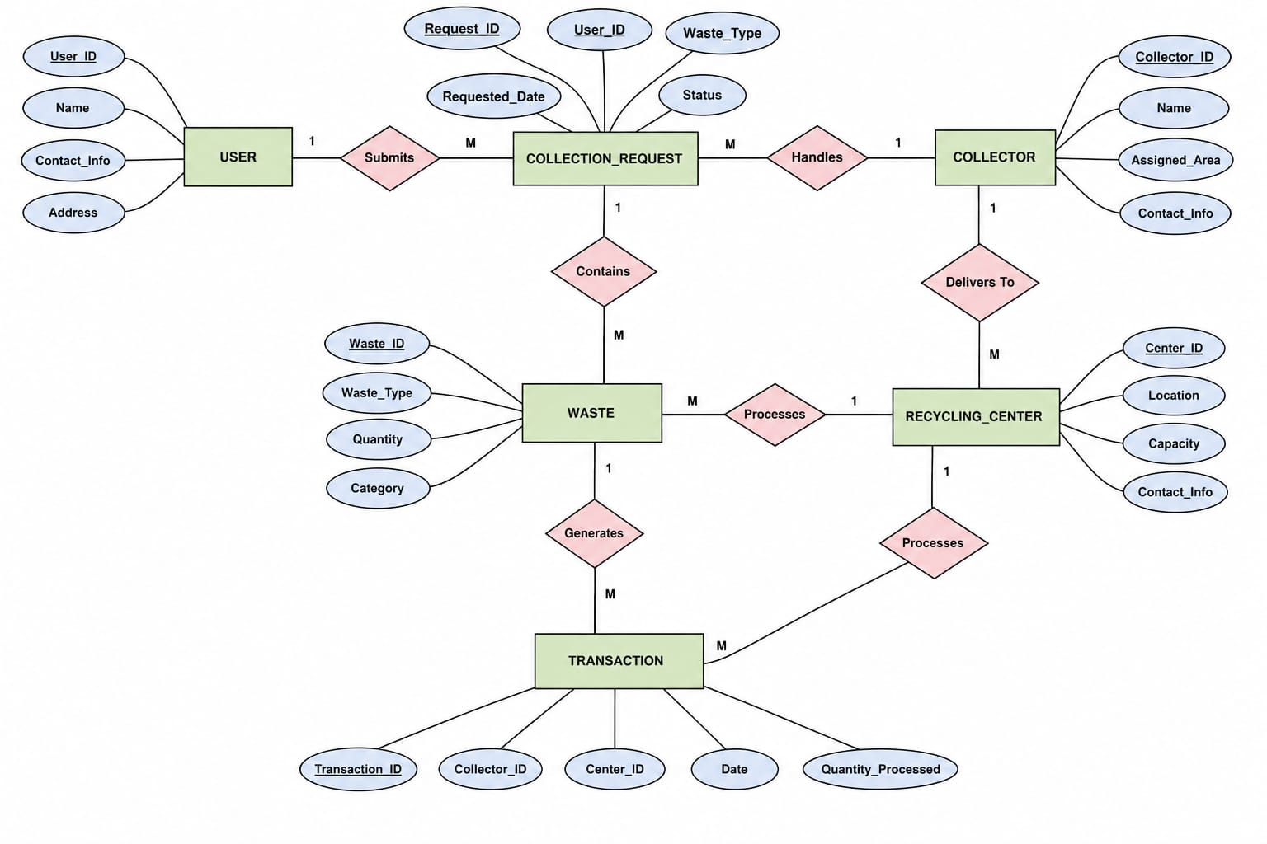
ER Model
Entities: User, Collector, Collection, Recycling_Center, Waste, Transaction
Relationships: Makes,Handles, Has, Contains, Processes — with 1:M cardinalities

Slide 10
Relationships
Relationship List:
Submits – User → Collection_Request (1:M)
Handles – Collector → Collection_Request (1:M)
Delivers To – Collector → Recycling_Center (1:M)
Contains – Collection_Request → Waste (1:M)
Generates – Collection_Request → Transaction (1:M)
Processes – Recycling_Center → Transaction (1:M)

Slide 11
Attributes
Entity | Attributes (Primary Key underlined)
User | User_ID, Name, Contact_Info, Address
Collector | Collector_ID, Name, Assigned_Area, Contact_Info
Collection_Request | Request_ID, User_ID, Waste_Type, Requested_Date, Status
Waste | Waste_ID, Waste_Type, Quantity, Category
Recycling_Center | Center_ID, Location, Capacity, Contact_Info
Transaction | Transaction_ID, Collector_ID, Center_ID, Date, Quantity_Processed

Slide 12
Database Configuration
Database: MySQL
Number of Main Tables: 6
Primary Keys: 6
Foreign-Key Relationships: Multiple
Normalization: Up to 3NF
Observation:
Proper table relationships reduce redundancy, maintain referential integrity and support efficient data retrieval.

Slide 13
Performance Metrics
Record Retrieval: Fast
Data Redundancy: Reduced
Data Integrity: Maintained
Referential Integrity: Maintained
Query Efficiency: Improved
Data Consistency: High
Interpretation:
Well-structured relational tables improve record retrieval
Primary keys uniquely identify records
Foreign keys maintain relationships between tables
Normalization reduces repeated information
The database supports reliable reporting and management

Slide 14
Results
Observation:
User and waste records can be
stored systematically
Collection requests can be
tracked efficiently
Collectors can be associated with collection activities
Recycling centers can be linked with processed waste
Transactions can be recorded with proper relationships
Duplicate and inconsistent records are reduced Structured data supports report generation

Slide 15
Conclusion
The Recycling Management System provides a structured approach to managing
recycling data
Demonstrates the suitability of DBMS for centralized recycling operations
ER-based design clearly identifies entities, attributes and relationships
Primary and foreign keys help maintain data integrity
Normalization reduces redundancy and improves consistency
The proposed database forms a strong foundation for implementation using MySQL

Slide 16
Future Enhancements
Integrate real-time waste collection tracking
Develop a mobile application for users and collectors
Add automated waste-category classification
Implement dashboards for recycling statistics
Use QR codes for collection and transaction tracking
Add notifications for collection schedules
Deploy the database on cloud infrastructure
Integrate IoT-based smart waste-bin data

Slide 17
THANK YOU

