Slide 1

Data Analysis Essentials
Cornerstone Project
Traffic Accident Data Analysis System
Presented by
Department
Department of Artificial Intelligence & Machine Learning,
Aditya University
M. MUNI KIRAN | – | 25B11AI646
S. KIRAN PRABHU | – | 25B11AIB29
V. GANESH | – | 25B11AIC58
T. SAI MANISH | – | 25B11AIB78

Slide 2

PROPOSAL SYSTEM
Input
Raw traffic accident records: 3,024 rows × 12 columns, loaded from a CSV file in Google Colab.
Processing
Inspection and cleaning (24 duplicates removed, 50 missing values filled), then scaling and encoding.
Output
A cleaned dataset of 3,000 records, three charts and hotspot / high-risk month insights.
Proposed Workflow
Raw Dataset
Data Inspection
Cleaning
Preprocessing
Analysis
Visualization
Hotspot Analysis
Insights / Report
›
›
›
›
›
›
›
Tools: Python, Pandas, NumPy, Matplotlib, Scikit-learn and Google Colab.
Each stage is supported by corresponding code, outputs, visualizations and analysis.

Slide 3
ABSTRACT
Road accident records hold useful patterns, but reviewing them manually is slow, error-prone and hard to scale. This project presents a Traffic Accident Data Analysis System built with Python (Pandas, NumPy, Matplotlib) in Google Colab. The raw dataset of 3,024 records and 12 columns was inspected and cleaned: 24 duplicate rows were removed and 50 missing values were filled using the mode for categorical and the median for numeric columns, leaving 3,000 analysis-ready records across 110 locations. Statistics, bar, line and pie charts show that Chandigarh is the top hotspot with 82 accidents and Jan-20 is the peak month with 53 accidents, while severity is almost evenly split between Minor, Fatal and Serious. Predictive modelling is proposed as future work.
3,024 → 3,000
Records before → after cleaning
110
Unique locations
3
Visualizations with interpretations

Slide 4
PROBLEM STATEMENT
Problem
Manual review of accident records is slow, error-prone and hard to scale, so patterns in location, severity and time stay hidden.
Objective
Clean the raw accident data, analyze locations, severity and monthly trends, visualize the patterns and identify hotspots and high-risk periods.
Expected Outcome
A cleaned, analysis-ready dataset, three charts and hotspot / high-risk month insights.
Domain
Road safety / Transport analytics
Target Variable
Accident_Severity → Minor / Serious / Fatal
Tools
Python, Pandas, NumPy, Matplotlib, Scikit-learn, Google Colab

Slide 5
DATASET — BEFORE & AFTER CLEANING
Check | Before | After
Rows | 3,024 | 3,000
Columns | 12 | 12
Missing values | 50 | 0
Duplicate rows | 24 | 0
Dataset Details
Source: traffic_accidents_raw.csv, loaded in Google Colab.
Domain: road safety / transport analytics.
3,000 records after cleaning, covering 110 unique locations.
Target variable: Accident_Severity (Minor / Serious / Fatal).
Features: Location, Month_Year, Vehicle_Type, Weather_Condition, Road_Type, Light_Condition, Speed_Limit (km/h).
Also recorded: Accident_ID, Time, Number_of_Casualties, Number_of_Fatalities.
Result
A clean dataset of 3,000 records and 12 columns, ready for analysis.

Slide 6
MISSING VALUES & DUPLICATE RECORDS
Duplicate Records
24 duplicate rows were detected and removed with drop_duplicates(); rows went from 3,024 to 3,000.
Missing Values
50 missing values across four columns. Categorical columns (weather, light) were filled with the mode; numeric columns (casualties, fatalities) with the median.
Verified: 0 missing values and 0 duplicate rows remain.

Slide 7
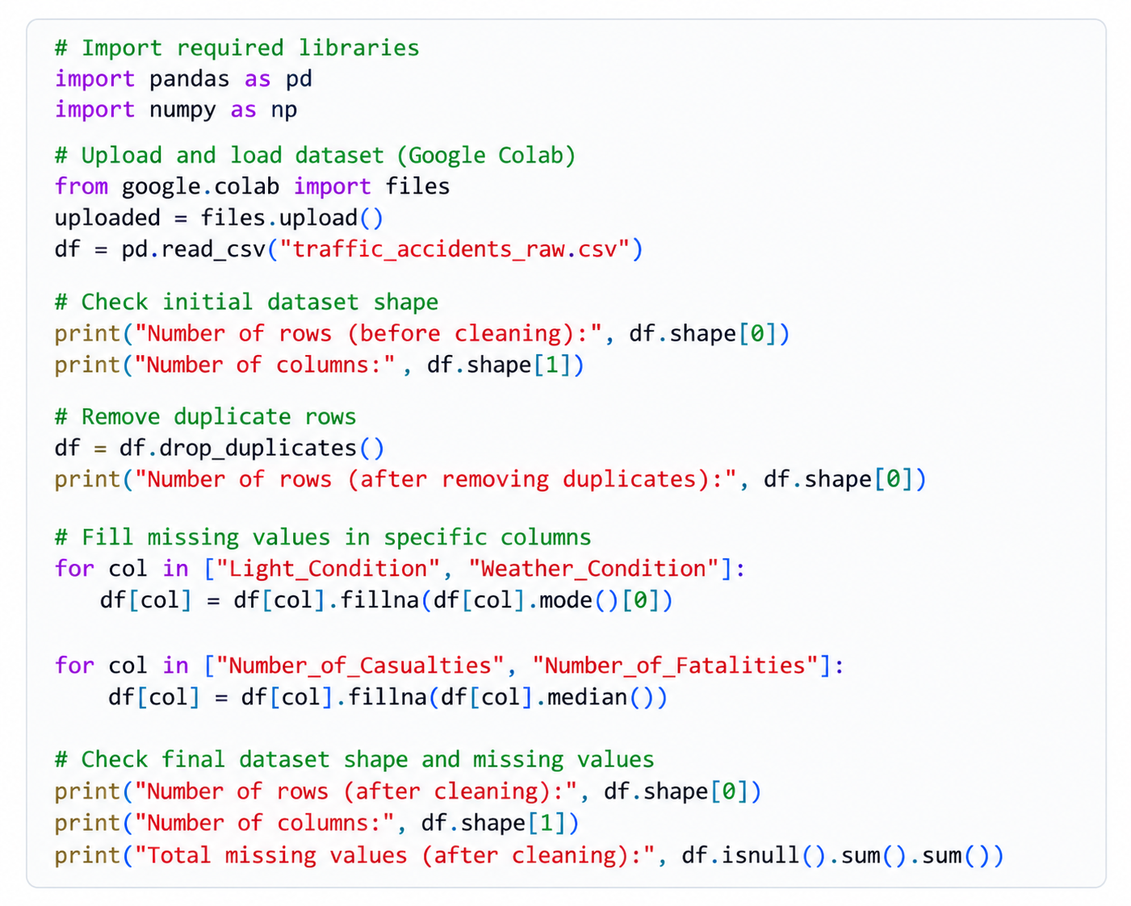
CODING IMPLEMENTATION — CLEANING
Step-by-step explanation
1. Import and load. Pandas and NumPy are imported; the CSV is uploaded in Colab and read with read_csv().
2. Inspect. The shape is printed: 3,024 rows and 12 columns before cleaning.
3. Remove duplicates. drop_duplicates() removes the 24 repeated rows.
4. Fill missing values. fillna() with the mode for Light_Condition and Weather_Condition, and the median for Number_of_Casualties and Number_of_Fatalities.
5. Verify. The final shape and total missing values are printed: 3,000 rows, 12 columns, 0 missing.

Slide 8
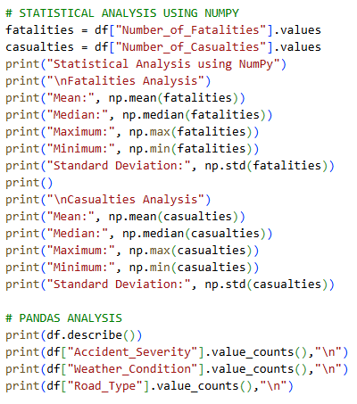
CODING IMPLEMENTATION — ANALYSIS
Step-by-step explanation
1. NumPy statistics. Fatalities and casualties are taken as arrays; np.mean, np.median, np.max, np.min and np.std are printed for each.
2. Pandas summary. describe() summarizes the numeric columns.
3. Category counts. value_counts() on Accident_Severity, Weather_Condition and Road_Type.
Statistic | Fatalities | Casualties
Mean | 2.45 | 5.07
Median | 2 | 5
Min–Max | 0–5 | 0–10
Std. deviation | 1.71 | 3.20

Slide 9
EXPECTED VS ACTUAL OUTPUTS
Stage | Expected output | Actual output | Status
Data loading | Raw dataset loaded in Colab | 3,024 rows × 12 columns loaded | Matched
Duplicate records | Duplicates detected and removed | 24 found and removed (3,000 rows left) | Matched
Missing values | All missing values filled | 50 found and filled; 0 remaining | Matched
Summary statistics | Mean, median, min, max, std. dev. | Mean fatalities 2.45, casualties 5.07 | Matched
Category counts | Counts by severity, weather, road type | Top: Minor 1,034; Rainy 642; State Highway 771 | Matched
Accident hotspots | Locations with the most accidents | Chandigarh (82); Puducherry and Karaikal (49 each) | Matched
High-risk month | Month with the highest accident count | Jan-20 with 53 accidents | Matched
Visualizations | Bar, line and pie charts with interpretation | Three charts generated, each interpreted | Matched
Expected outputs follow the project objective; actual outputs come from the executed Colab notebook.

Slide 10
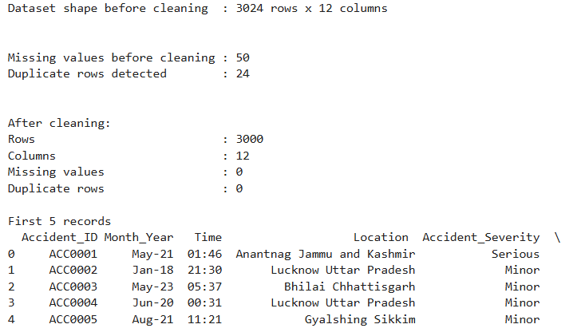
ACTUAL OUTPUT — GOOGLE COLAB
What the output confirms
Before cleaning: 3,024 rows × 12 columns.
50 missing values and 24 duplicate rows were detected.
After cleaning: 3,000 rows, 12 columns, 0 missing values, 0 duplicate rows.
The first five records preview Accident_ID, Month_Year, Time, Location and Accident_Severity.
Result
Clean dataset of 3,000 records ready for analysis.

Slide 11
ACCURACY DETAILS
99.2%
Records retained (3,000 of 3,024)
100%
Completeness after cleaning (0 missing of 36,000 values)
0
Duplicate rows remaining
3,000
Severity, weather and road-type counts each add up to 3,000
Model accuracy
Not applicable in this review: no classification model has been trained, so accuracy, precision and recall are not reported. All results are descriptive statistics and charts; findings represent dataset patterns, not proven causes.
Baseline for future models
Minor is the most frequent severity class: 1,034 of 3,000 records (34.5%). A prediction model should score clearly above this.

Slide 12
PREDICTION MODELS
Prediction Task (proposed future work)
Predict Accident_Severity (Minor / Serious / Fatal) from Location, Month_Year, Vehicle_Type, Weather_Condition, Road_Type, Light_Condition and Speed_Limit. The current system is descriptive; a machine learning model is planned as the next step.
Logistic Regression
A simple baseline classifier that is easy to interpret.
Decision Tree
Rule-based splits that show which factors drive severity.
Random Forest
An ensemble of trees that handles mixed categorical and numeric features.
Encode and scale features
Train / test split
Train models with Scikit-learn
Evaluate: accuracy, precision, recall
›
›
›

Slide 13
DATA VISUALIZATION — OVERVIEW
Visualization | Type | How it is implemented | What it shows
Accidents by Location | Bar graph | Pandas counts accidents per Location; the top 10 locations are drawn as bars with Matplotlib | Hotspot: Chandigarh (82)
Monthly Accident Trend | Line chart | Accidents are counted per Month_Year and plotted over time with Matplotlib, with a marker on each month | Peak month: Jan-20 (53)
Severity Distribution | Pie chart | Severity counts are converted to percentages and drawn as a labelled pie with Matplotlib | Minor 34.5%, Fatal 32.8%, Serious 32.7%
Common approach
Pandas prepares the counts, Matplotlib draws the charts in Google Colab, and every chart is labelled with a title and axes and followed by an interpretation.

Slide 14
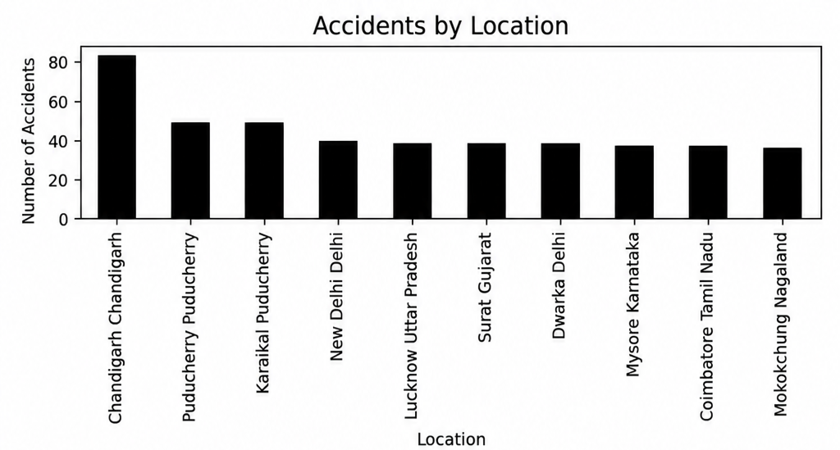
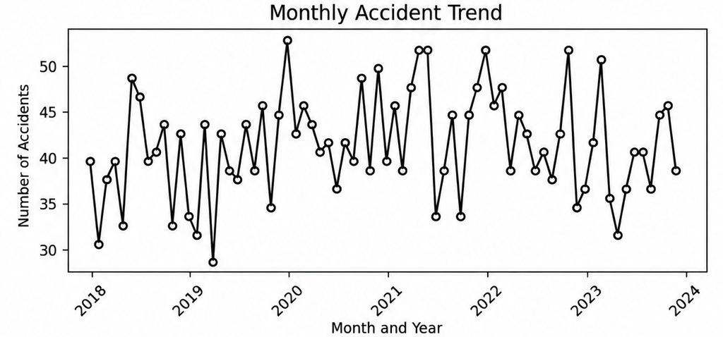
VISUALIZATION — LOCATION & TREND
Bar graph — Accident hotspots
Chandigarh is the top hotspot with 82 accidents, followed by Puducherry and Karaikal with 49 each.
Line chart — Monthly accident trend
Monthly counts fluctuate across 2018–2023; Jan-20 is the peak of the dataset with 53 accidents.

Slide 15
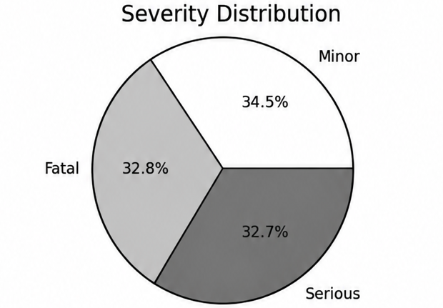
VISUALIZATION — SEVERITY & FINDINGS
Pie chart — Severity distribution
Minor 1,034 (34.5%), Fatal 985 (32.8%) and Serious 981 (32.7%): severity is almost evenly distributed, so no single category dominates.
Key findings
Top hotspot: Chandigarh (82 accidents).
High-risk month: Jan-20 (53 accidents).
Weather: Rainy highest (642); Foggy and Clear lowest (572 each).
Road type: State Highway highest (771); Urban Road lowest (712).

Slide 16
THANK YOU

