Slide 1
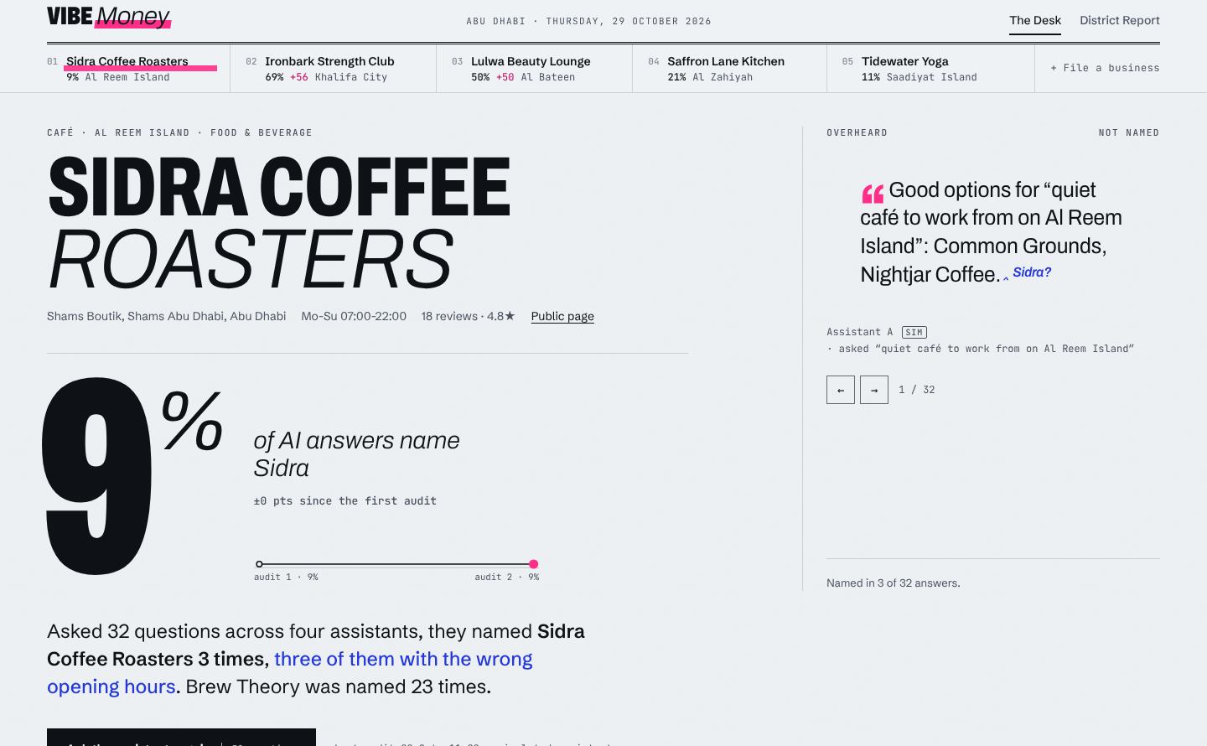
The Answer Desk
User guide: see what AI assistants say about a business, correct it, and publish facts AI agents can read
Vibe Money · Abu Dhabi SME pilot
Notes:
Welcome. This guide walks through the Answer Desk: audit how AI assistants describe a business, correct what holds it back, publish facts for agents, and report outcomes. The screenshots are from the live demo.

Slide 2




What the Answer Desk does
1 Audit
2 Correct
3 Publish
Ask assistants the questions customers ask. See how often the business is named, and whether the facts they give are right.
Follow a ranked fix plan: more reviews, consistent listings, and structured facts assistants can trust.
Put verified facts online where assistants and AI agents read them, with a signed agent card agents can check.
Then ask the assistants again. Same questions, same assistants, so the change is measured, not guessed.
Notes:
Three steps and a loop. The audit tells you where you stand, the fix plan tells you what to do, publishing makes the facts readable by agents, and the re-audit proves whether it worked.

Slide 3


Two ways to open the Desk
Static edition
Server edition
munikumargv.github.io/VibeMoney
Runs entirely in your browser; nothing is sent anywhere
Your changes are saved in this browser only
Simulated assistants only
Reset the demo, in the page footer, restores the starting state
npm start, then open localhost:3000
Adds real Claude answers when ANTHROPIC_API_KEY is set
Saves to a data file and serves published files at real URLs
Outside agents can call the MCP endpoint
Both editions use the same engine and look identical.
Notes:
The static edition is what is on GitHub Pages. It is the easiest way to try the product. The server edition adds real Claude answers and real endpoints that other agents can call.

Slide 4
What is real and what is simulated
Step | Real | Simulated
Audit | Claude's answers, in the server edition with an API key | Four labelled assistants (A to D), driven by review count, listing consistency and structured data
Fix listings, ask for reviews | Nothing yet: no platform connection | The whole step. Marked SIM
Publish | schema.json, llms.txt, a signed agent card and an MCP endpoint | Nothing
Program outcomes | Compares only assistants present in both audits | Flagged SIM whenever it rests on simulated assistants
Simulated results show how the method works. They are not evidence. The pilot's evidence must come from real assistants.
Notes:
Be clear about this with any audience. The simulated assistants are deterministic and respond to the same signals research links to being recommended, so the fix-to-score loop is demonstrable. But it is a model, not evidence.

Slide 5
A tour of the Desk
1
Index of businesses
Every pilot business with its score and change. Select one to open its desk.
1
3
2
The score
The share of AI answers that name this business.
2
3
Overheard
Real answers, one at a time. Use the arrows or the keyboard arrow keys.
4
The summary
A sentence written from the data: how often named, and how often wrong.
5
4
5
Score history
One point per audit, so you can see the line move.
Notes:
Orient the audience: index across the top, the headline score, the carousel of real answers, the generated summary, and the score history. Everything below this front page is numbered with section marks, 01 to 05.

Slide 6
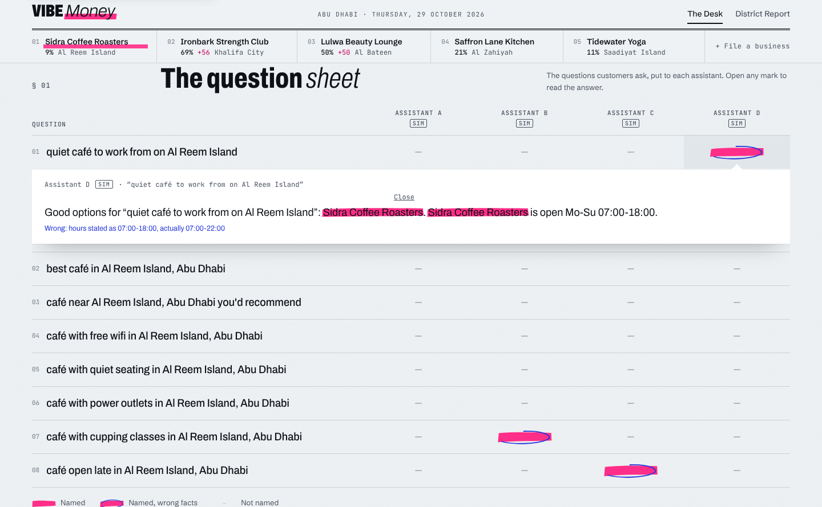
Step 1: Run the audit
Run it
Press Run the free audit. Once a business has been audited, the button reads Ask the assistants again.
Read the question sheet
Each row is a question a customer might ask. Each column is an assistant.
Open a mark
Select any mark to read the answer and see exactly what was wrong.
Named
Named, wrong facts
Not named
Notes:
The question sheet is section 01. Open a mark with a blue ring to read an answer that named the business but gave the wrong hours. Marks labelled SIM come from simulated assistants.

Slide 7
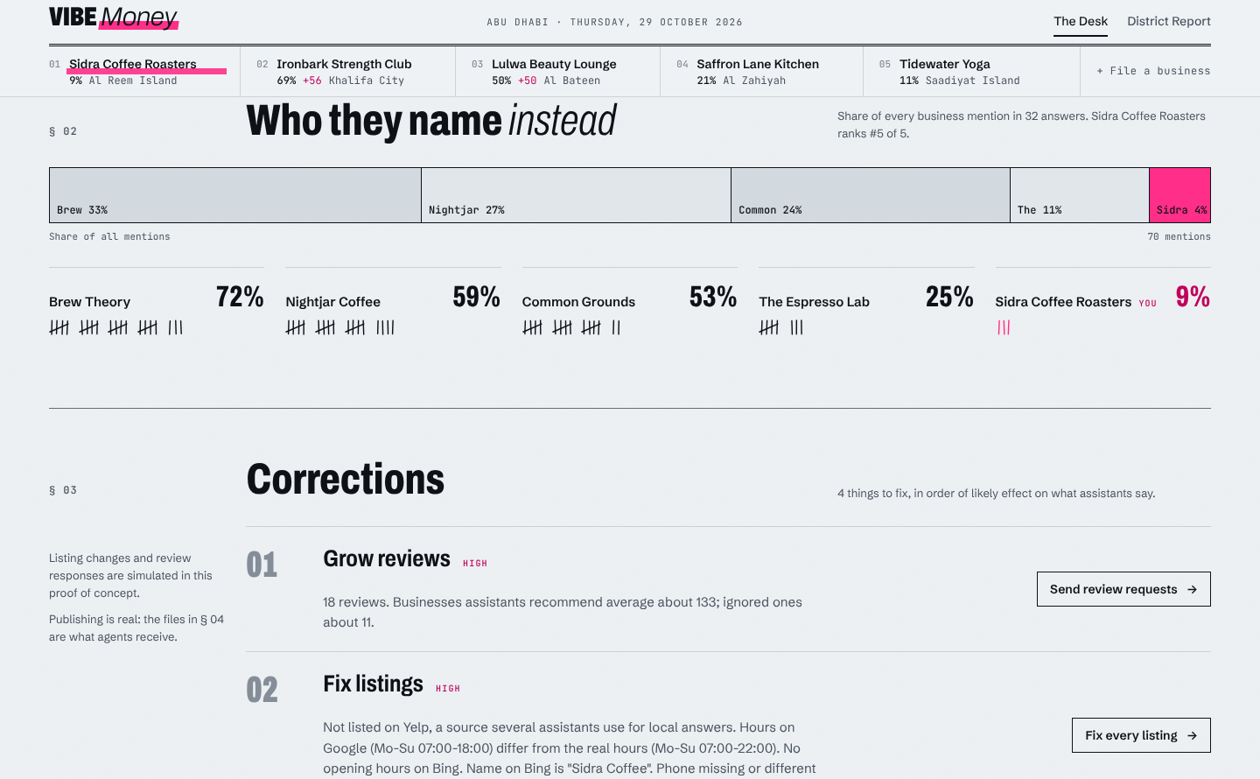
Read who they name instead
Share of mentions
The bar shows every business mention across all answers. Your slice is pink.
Tally marks
One stroke each time a business was named, so you can compare yours with each rival.
Rank
Your rank among nearby businesses shows how far there is to climb.
Notes:
Section 02. This is the competitive view: who the assistants name when they do not name you.

Slide 8
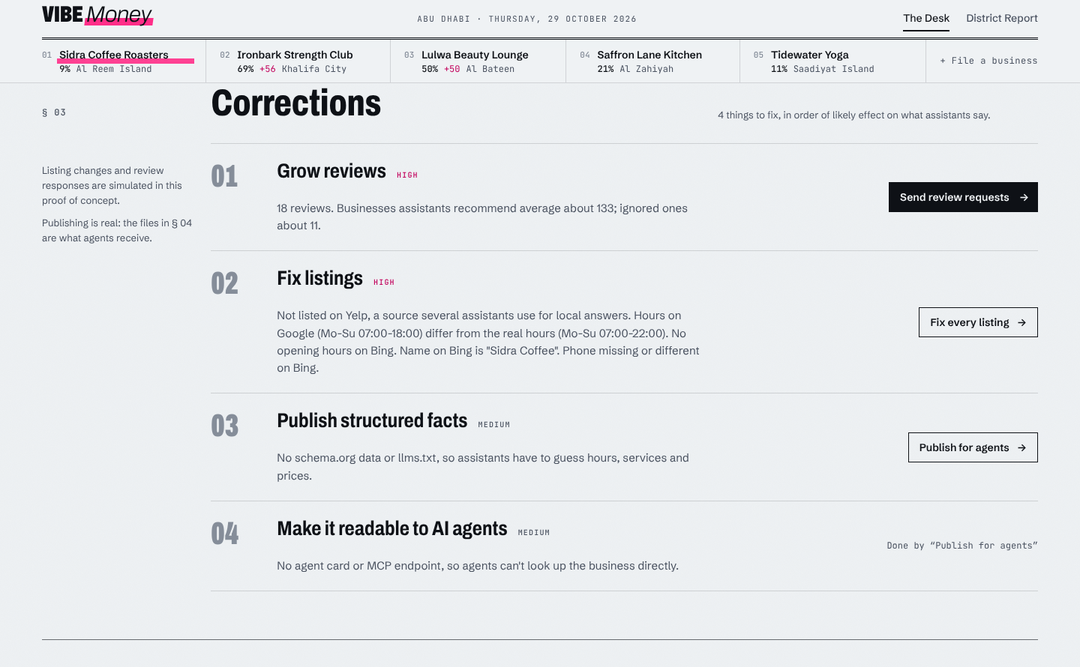
Step 2: Correct what holds it back
Send review requests
Asks recent customers for reviews. Simulated: it assumes a 30% response.
Fix every listing
Sets one name, address, phone and hours on Google, Yelp and Bing. Simulated.
Publish for agents
Puts the facts online for assistants and agents. This one is real.
Fixed items are struck through and stamped Corrected.
Notes:
Section 03. Items are ranked by likely effect. Fixed items are struck through in blue and stamped Corrected. Fixes show up only after a new audit.

Slide 9
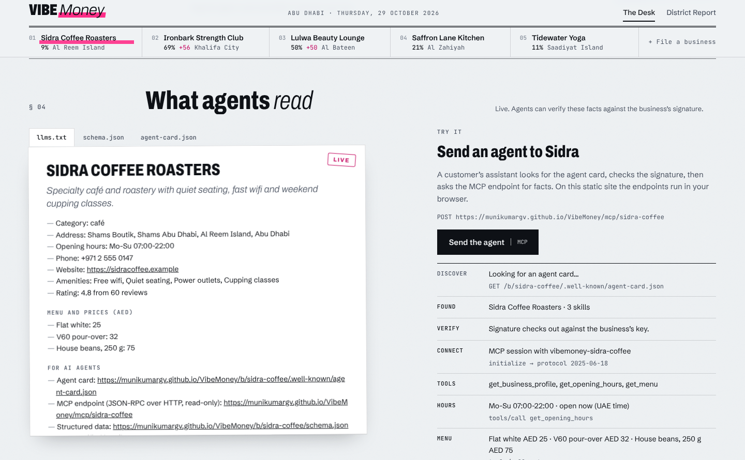
Step 3: Publish for agents
Four things go live
llms.txt and schema.json hold the facts. A signed agent card proves they are unaltered. An MCP endpoint answers questions.
Send the agent
It finds the card, checks the signature, then asks for hours, menu and profile.
Before publishing
The same test fails: the agent falls back to old listings and may quote the wrong closing time.
Notes:
Section 04. The console really calls the endpoints. In the static edition they run in the browser; in the server edition they are real HTTP endpoints other agents can call.

Slide 10
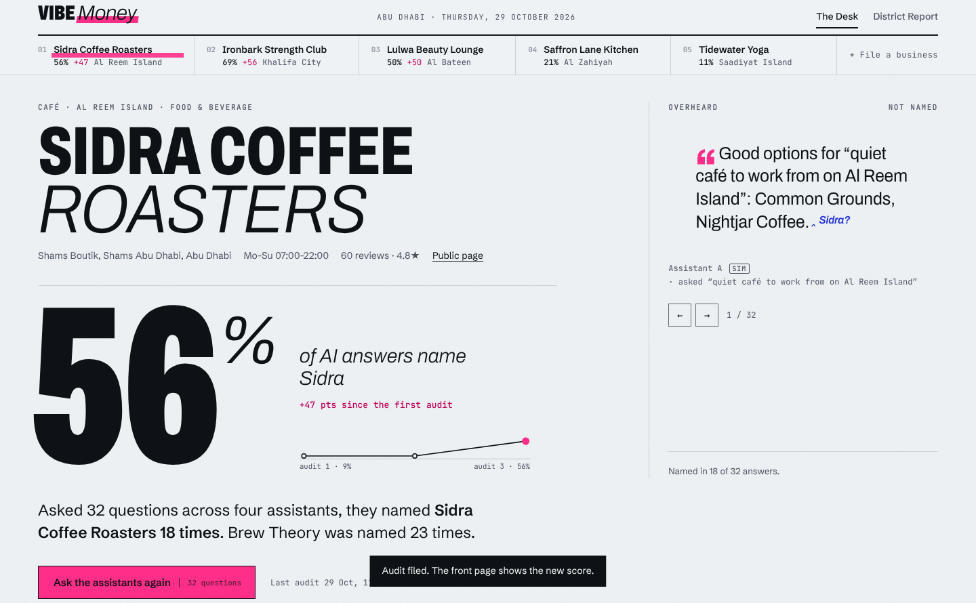
Re-audit and see the change
Ask again
Same questions, same assistants, so the two audits are comparable.
Read the change
The front page shows the new score and the change since the first audit. The line under the number shows every audit.
Keep going
Re-audit monthly, or on the server set REAUDIT_INTERVAL_HOURS to repeat on a schedule.
Notes:
In the demo, Sidra moves from 9% to 56% after the three fixes. That uplift is from simulated assistants and shows the method, not a measured result.

Slide 11
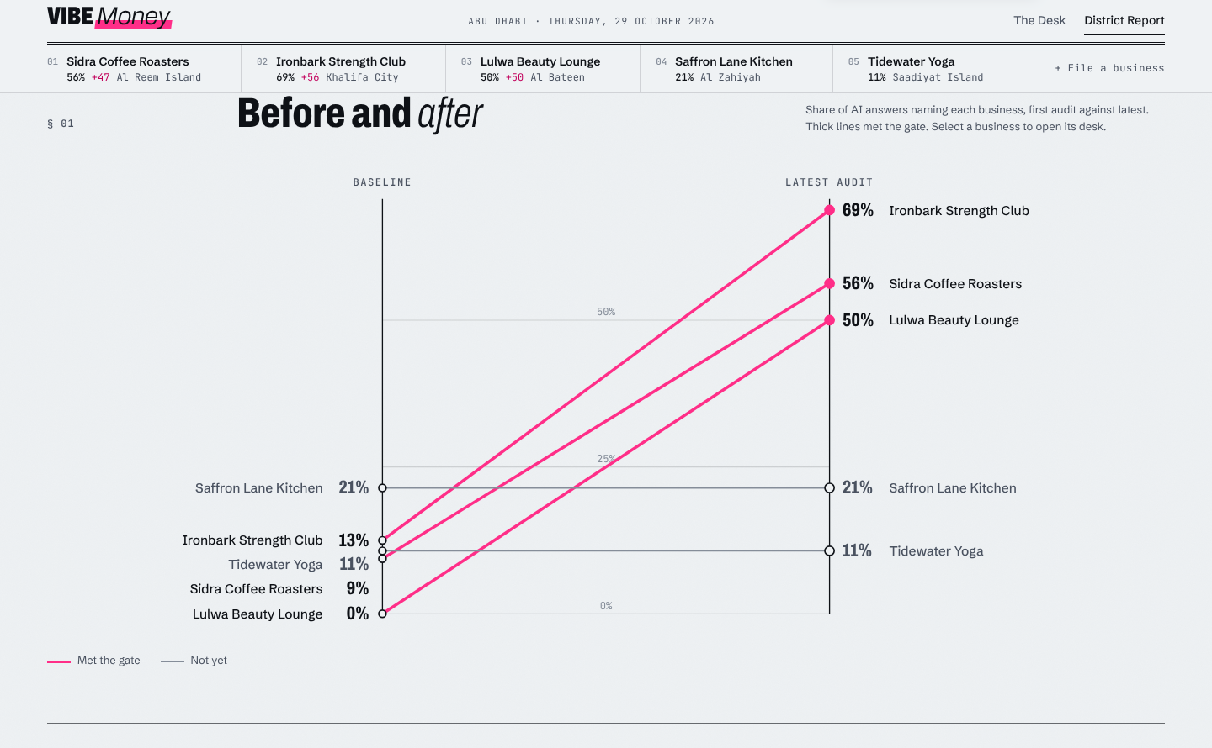
The District Report
The gate
Visibility up 30% or more for at least half of the businesses.
Before and after
Each line runs from baseline to the latest audit. Pink lines met the gate; grey ones have not yet.
Roll-ups
Tables below break results down by sector and district.
Re-audit every business
One button on the report repeats every audit.
Notes:
The District Report is for the program sponsor. It compares only assistants present in both audits, and flags results that rest on simulated assistants.

Slide 12
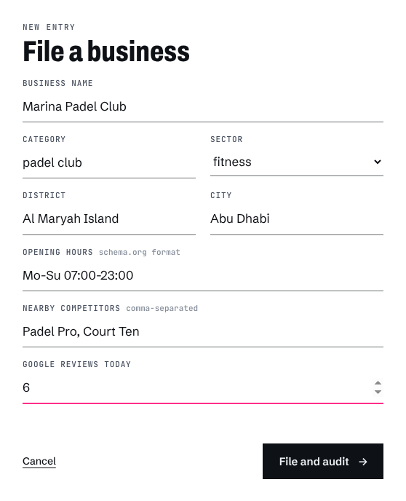
File a new business
Required
Business name, category and city. Choose a sector so it appears in the sector roll-up.
Opening hours
Use schema.org format, for example Mo-Su 07:00-23:00, or Mo-Th 09:00-21:00; Fr 14:00-22:00. The audit checks hours stated by assistants against these.
Competitors
Name nearby rivals, separated by commas. They are tracked in every answer.
File and audit
Creates the business and runs its first audit.
Notes:
Use the plus File a business control at the right end of the index. Accurate hours matter: the audit flags any answer that states different hours.

Slide 13
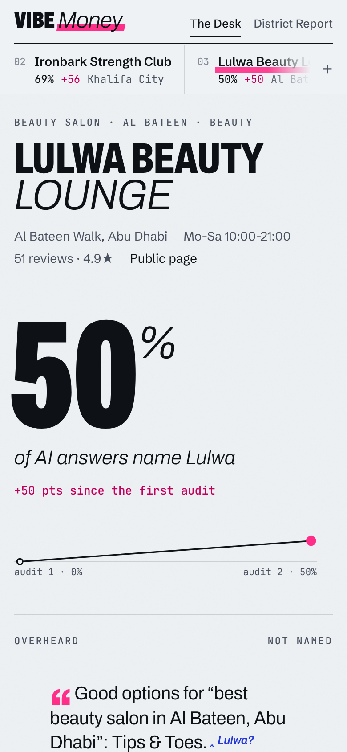
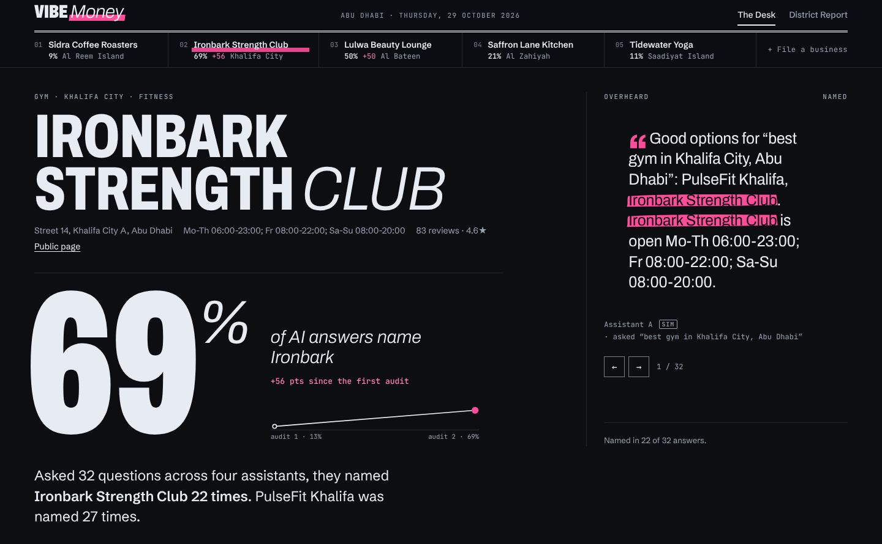
Phone, tablet and dark mode
Phone
The index becomes a swipeable strip and the question sheet becomes a list.
Tablet
Two-column sections stack into one.
Dark mode
Follows your device setting. Marks and ink keep their meaning.
Dark mode, Ironbark Strength Club at 69%
Notes:
The layout is designed separately for each screen size rather than just shrunk.

Slide 14
Run the server edition
Variable | What it does
PORT | HTTP port (3000)
BASE_URL | Public URL written into published files
DATA_FILE | Where state is saved
ANTHROPIC_API_KEY | Turns on real Claude answers
VIBEMONEY_MODEL | Model for audit answers
REAUDIT_INTERVAL_HOURS | Re-audit on a schedule (0 is off)
# install and load the demo data
npm install
npm run seed
# optional: real Claude answers
ANTHROPIC_API_KEY=sk-ant-... npm start
# then open http://localhost:3000
# send an agent at a business
npm run demo:agent -- ironbark-strength
npm test
Needs Node 20 or newer.
Notes:
This is the only part that needs a terminal. Everything else in the guide works in the browser.

Slide 15
A five-minute walkthrough
1
Open Sidra
2
Open a mark
3
Fix it
Select Sidra Coffee Roasters. Note the score: 9%, with wrong hours in some answers.
In section 01, open a pink mark with a blue ring to read an answer with the wrong hours.
In section 03, press the three buttons in order. Items are struck through.
4
Send an agent
5
Ask again
6
Check the gate
In section 04, press Send the agent. Watch it check the signature and read the hours.
Scroll up and press Ask the assistants again. The score rises to about 56%.
Open District Report. The gate flips from not met to met.
Notes:
A good demo script for a board or a pilot business. The story: a business invisible to AI, one visible wrong fact, three fixes, an agent that now answers correctly, and a gate that flips.

Slide 16


Troubleshooting and limits
If something looks off
Known limits
The score did not change
Press Ask the assistants again. Fixes only show in a new audit.
The agent finds no card
Press Publish for agents in section 03 first.
My changes disappeared
In the static edition, state lives in one browser. Clearing site data starts fresh.
I want the starting numbers back
Use Reset the demo in the page footer.
Assistants are simulated
Unless you run the server with an API key.
Listing fixes and new reviews
Simulated. No platform connection yet.
Business facts
Entered by hand. The pilot will pull them from websites and Google.
Fonts
Load from Google Fonts. Offline, system fonts take over.
Notes:
Close with the limits so expectations are right. The headline limit: simulated assistants show the method, not measured results.

