Slide 1
EEE 318 Project Title: Automated Face Mask Detector and Mask Distributor System Submitted To: Dr. Shaikh Anowarul Fattah Tasnima Afsana
Prepared by:
1706008,1706010,1706017,1706020,1706033

Slide 2
Objectives
To develop a system to detect whether people are wearing masks or not using DL Algorithm.
If they are wearing masks properly, the system will let them go.
But if anyone is found without mask, the system will automatically impose a barrier.
Modelling another system to provide a mask and then let the person go if the first system provides green signal.

Slide 3

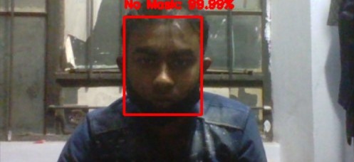
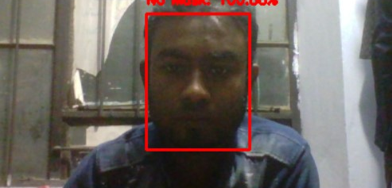
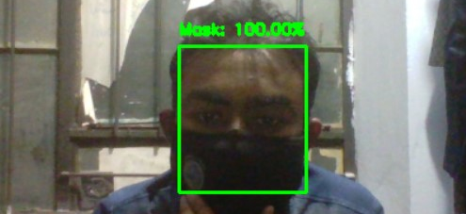
Implementation: Software
A DL-based code is run with high accuracy(around 90% in both training and validation).
The model is saved and then a live video detection using PC webcam is done using faceNet model. We got high accuracy detection, both with and without mask. Some examples are given side by side.
Then we used the 'with mask' or 'without mask' state to turn on or off the barrier controlled by Arduino board.
An Arduino code to implement the barrier is run at first, which is called in another Python code that also connects to the main code and implements the barrier when needed.

Slide 4
Software :
Data Collection : A Kaggle dataset of 11792 data has been taken with labels of "WithMask" and "Without Mask".
Data Preprocessing : Data were roughly split into 80:10:10 for train, validation and test data.
Models Used:
Data Augmentation : ImageDataGenerator from Keras used to augment the data which increases total data and helps to secure more accuracy.
Base Model : Pre-trained model “ImageNet" was used to start the base model "MobileNetV2"
Deep Learning Models: AveragePooling2D, Conv2D, MaxPooling2D, Flattening layer, Dense and Dropout layers were used for further training .
Activation Function : ’Relu’ for all the layers except the last one. For the last layer, "softmax" was used for binary classification.

Slide 5
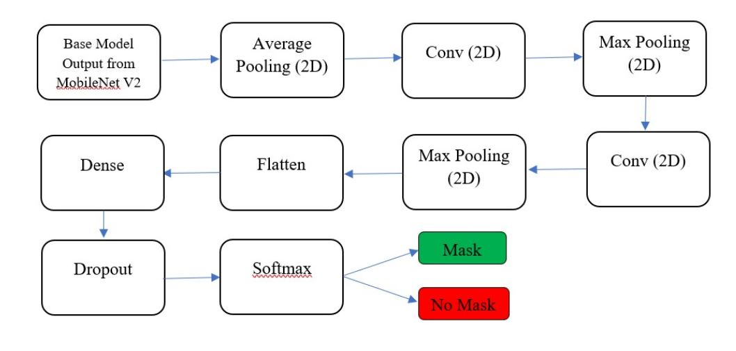
Software : Optimizer : Adam Optimizer was used. Loss Function : Binary Loss Entropy was used.
Architecture of Proposed Network

Slide 6
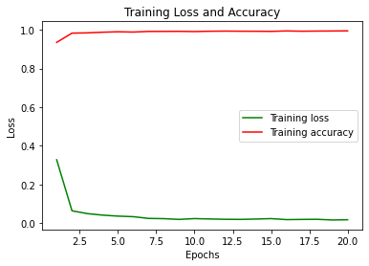
Training The Model
Using the proposed architecture on the previous slide, we trained the model.
Training parameters are:
Number of Epochs = 20
Batch Size = 32
Learning Rate = Adaptive

Slide 7
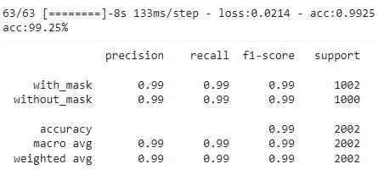
Evaluating the model
After the model was trained, lowest training loss was recorded as 0.0163 and highest training efficiency was 99.51%
We evaluated the model on our test data, and it gave 99.25% accuracy which is high enough.
Then we calculated precision, recall and F1 score. These give us a satisfactory result.

Slide 8
Linking Model With Hardware Components
To connect software and hardware part, arduino is used.
For this, a special function called "doorAutomate" is created.
Our main model gives two outputs. If a person is wearing mask output is 0 and if a person is not wearing a mask output is 1. Then this main model calls the "doorAutomate" function.
Then "doorAutomate" also call two functions - "rotateSUrvo1" & "rotateSurvo2".
These two controls the two servos -
Servo1 – For Mask Distribution
Servo2 – As Barrier

Slide 9
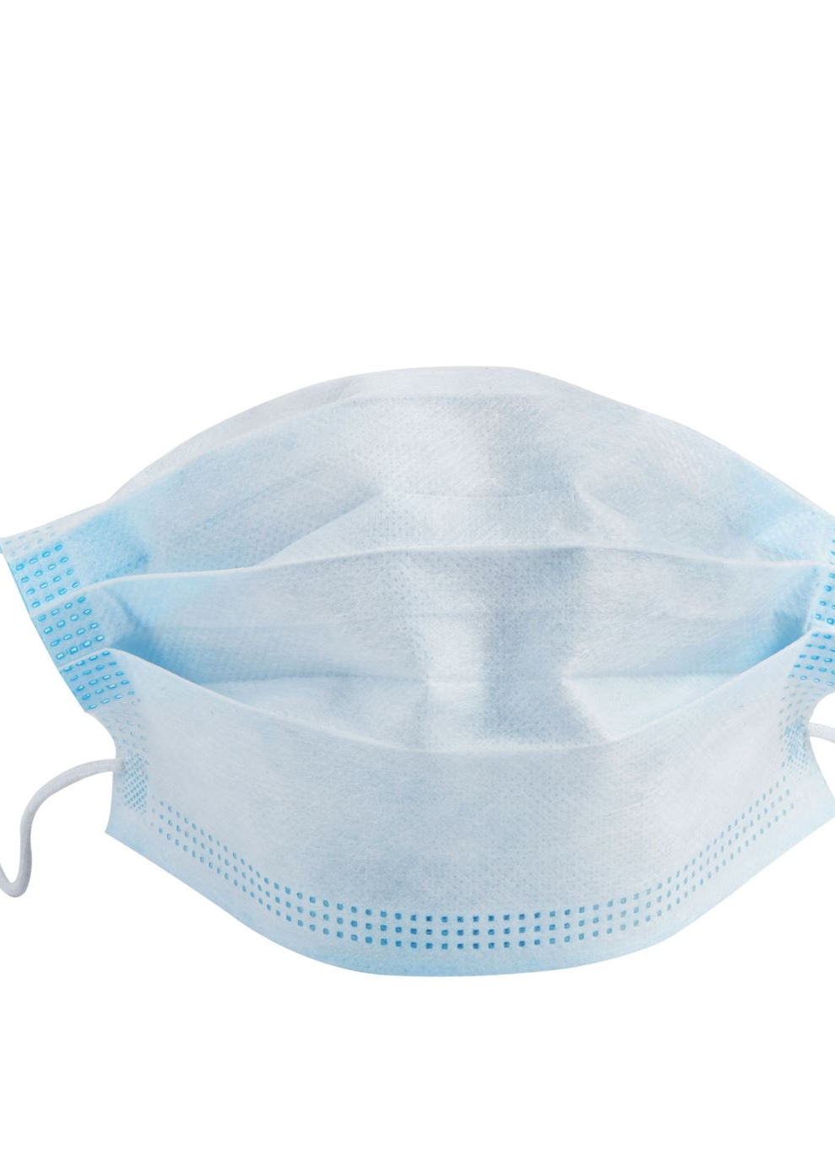
Working of the Servos
When Output = 0 (Person wearing mask)
Servo1 = 0⁰ (Mask Distributor in its place)
Sevo2 = 120⁰ (Barrier Up)
When Output = 1 (Person not Wearing Mask)
Servo1 = 75⁰ (Mask Distributor pushing the mask)
Sevo2 = 0⁰ (Barrier Down)
Then when the person puts on the given mask, the whole system again resets itself to the default values.

Slide 10
Hardware Implementation
A barrier has been constructed, which is dependent on the condition whether the person is wearing a mask or not.
If the person wears a mask, the barrier will remain open.
If the person does not wear a mask, the barrier will activate. If the person wears the mask that is given to him, the barrier will be lifted.

Slide 11
Hardware Implementation
Distribution of masks automatically without any human contact.
A synchronous continuation of total system: monitoring presence of face mask, barrier control, distribution, warning or confirmation.

Slide 12
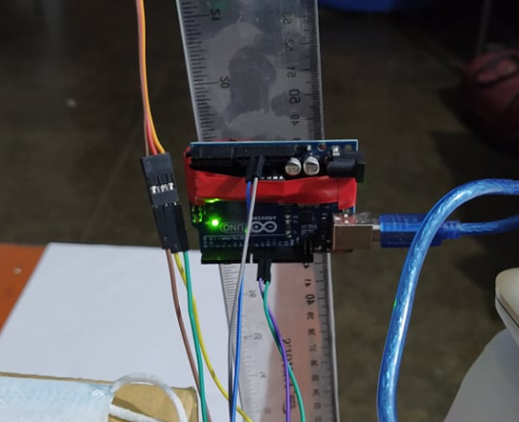
Implementation: Hardware
A mask-providing system has been constructed, which is dependent on the condition whether the person is wearing a mask or not.
As the system is synchronized with the deep learning model, whenever the model completes the detection, the arduino gets a signal and a barrier is controlled.

Slide 13
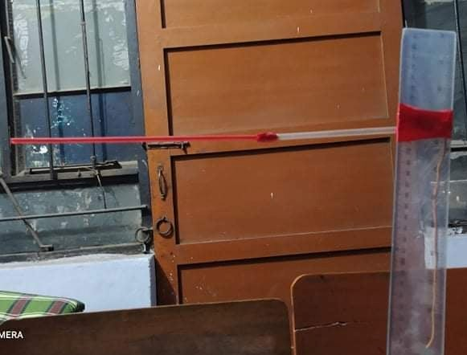
Implementation: Hardware
The barrier(made of a straw and T-scale) is controlled by a servo motor(sg90) whose rotation is controlled by arduino.
If the person wears a mask, servo motor doesn't rotate, and the barrier remains still in its position.
When a person appears without a mask or with a mask in appropriate position, servo motor rotates and makes the barrier to block the person entrance.

Slide 14

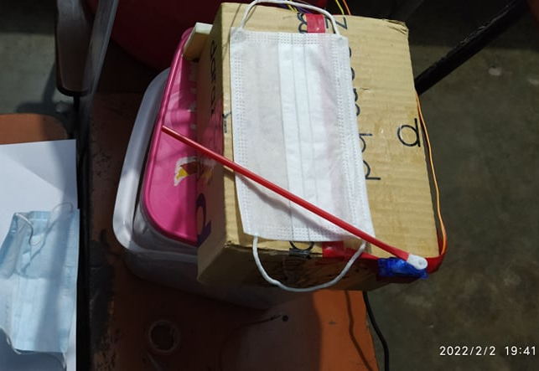


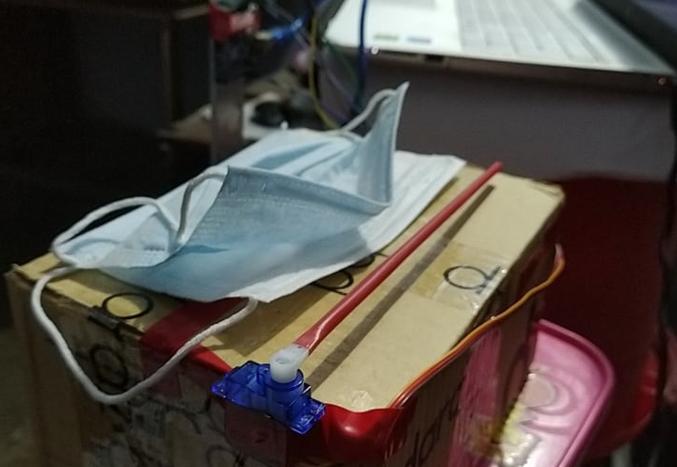

Implementation: Hardware
To distribute the mask, another servo motor is placed over a platform and based on given signal, it can move a pushing system (here, it's a straw).
If the person already wears a mask, there will be no action by the servo motor.
But when a person without any mask appears, the servo rotates, pushes a mask in front of the person.
When the person wears the mask, DL model again checks his face and provides signal to the barrier and distributor to go back to its previous position.

Slide 15
Cost Analysis
As we just try to implement a simple hardware model, cost was tried to be minimized as much as possible. The total model contains:
One Arduino UNO 600 Tk
Two SG90 Servo Motor 400 Tk
Rest of the materials were collected from daily used things like straw,
T-scale, tape etc.

Slide 16
Possible Improvement in future
Creating a database of the institution where it can be used.
Training a model that can detect a person's identity so that his awareness can be recorded.
Including a warning system.
Implementing a rorbotic arm system which will distribute the mask.

Slide 17
Reference Paper
Face Mask Detection Using MobileNetV2 in The Era of COVID-19 Pandemic. Link: https://ieeexplore.ieee.org/document/9325631
FaceNet: A Unified Embedding for Face Recognition and Clustering. Link: https://ieeexplore.ieee.org/document/7298682

Slide 18
Thank You

