Slide 1
Stuff
Munir

Slide 2
Encryption and Decryption
Protects data
Converts plain text to cipher text
Decryption converts cipher text to plain text
Ultimate goal of encryption is to make it as difficult as possible to decrypt cipher text without a key

Slide 3
Hashing
One way
Some common algorithms
SHA-1 (Secure Hash Algorithm)
SHA-512
MD5 (Message Digest)
Goal simply is to make it as difficult as possible to convert to plain text
Ideally used for passwords

Slide 4
Salt and Peppers
User wont know salt and pepper are being used
Salts are random (to the user) strings that are stored with a password
Salt, stored with the plain text password and converted to hash
Pepper, short string or character
A site will cycle through all combination of the user password and peppers to check the output

Slide 5
MD5
Widely used
Performs binary Operation on the “Message” to produce a 128-bit hash value

Slide 6
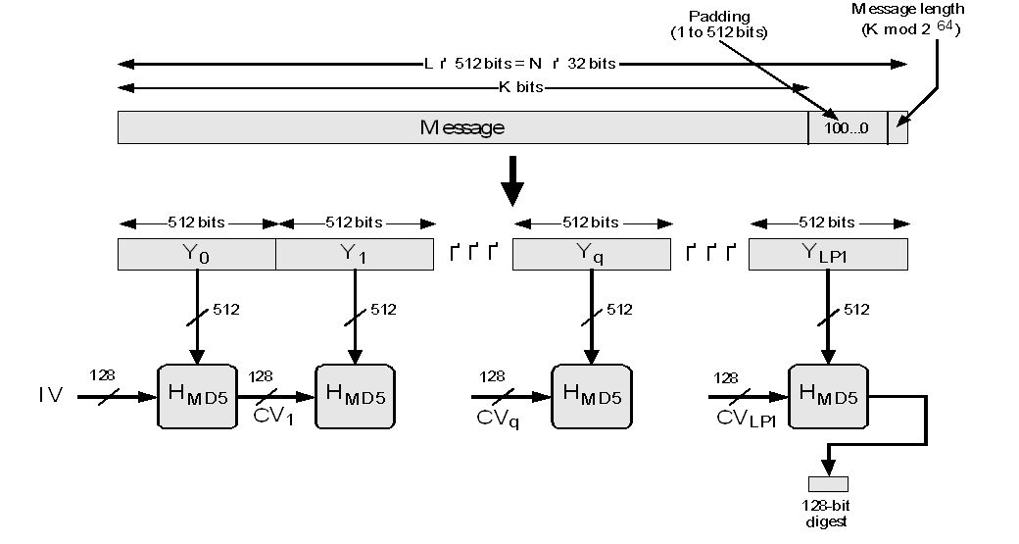

Slide 7
MD5 Vulnerabilities
Recently some vulnerabilities have been discovered
Rainbow tables have been published
For those without good salts
Rainbow table (A Precomputed table for reserving cryptographic hash functions to crack hashes)

Slide 8
Attacks
Two major ones
Dictionary Attack
Hashing common password in an attempt to find the password
Brute force Attack
Trying every possible password

