Slide 1

Exploratory Data Analysis
EDA
31-July-2021

Slide 2

Agenda
Executive Summary
Problem Statement
Approach
EDA
EDA Summary
Recommendations

Slide 3
projective : provide the brief of two cabs , analysis their customer
Analysis:
Data understanding
Finding the most profitable for the cab
know how to investment
Recommendation

Slide 4
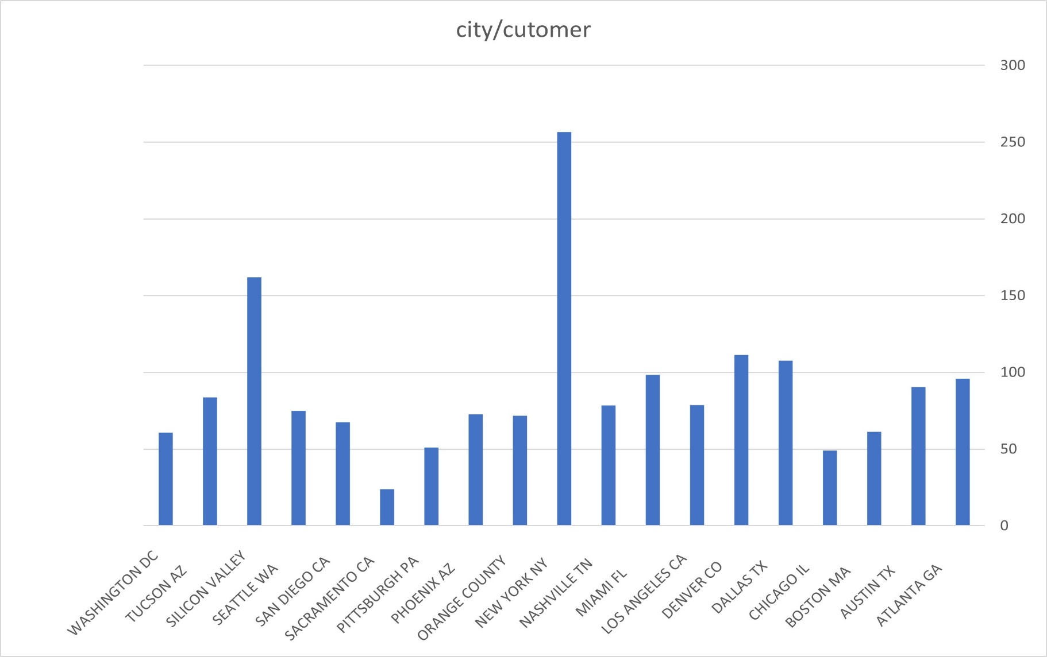
Number of city analysis
For Both Cabs car for potential customer

Slide 5
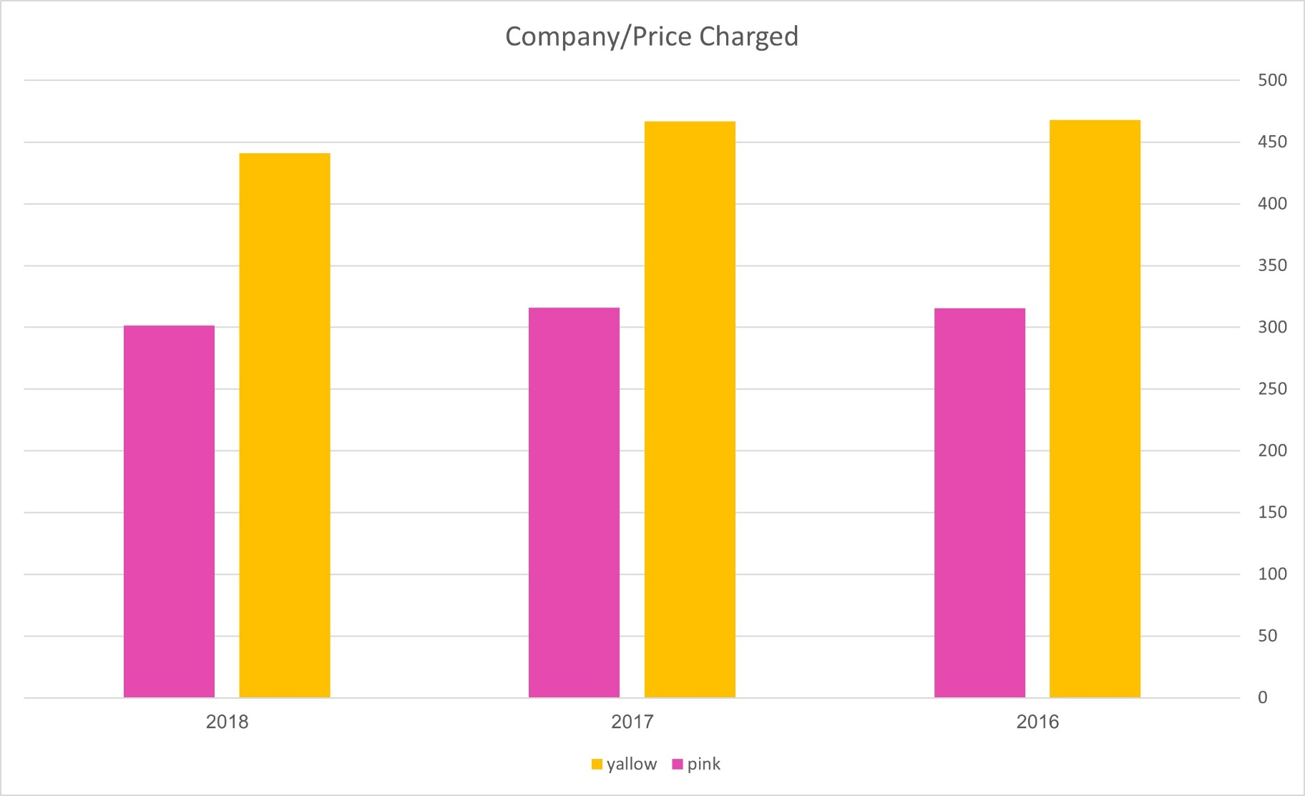
Price chaged analysis
There is almost
equal distribution
Of price

Slide 6
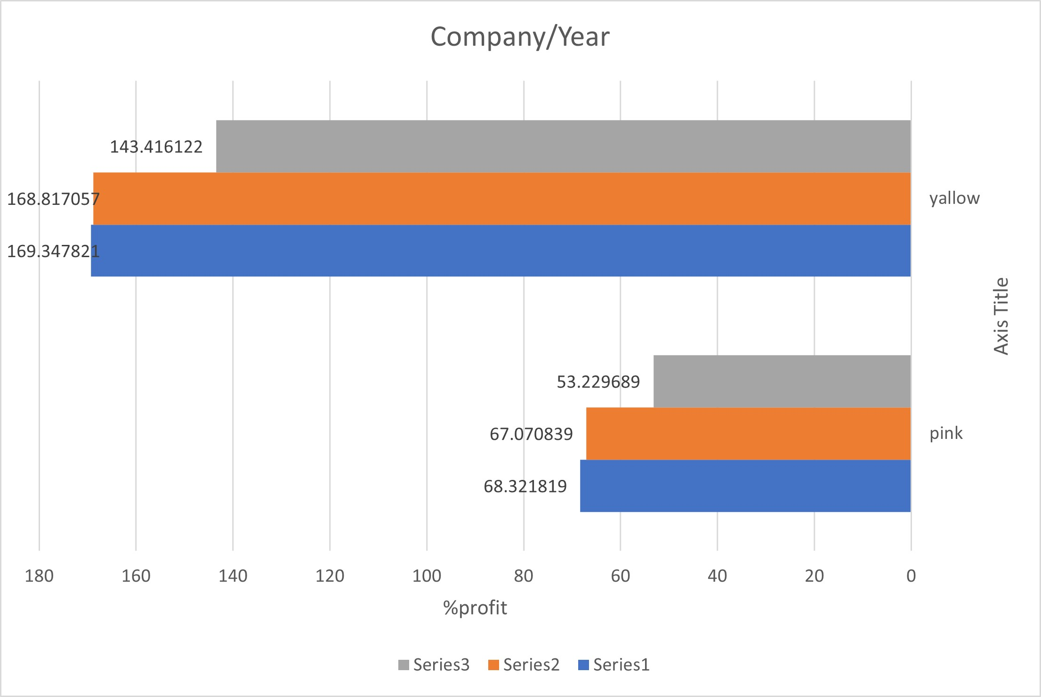
profit years

Slide 7
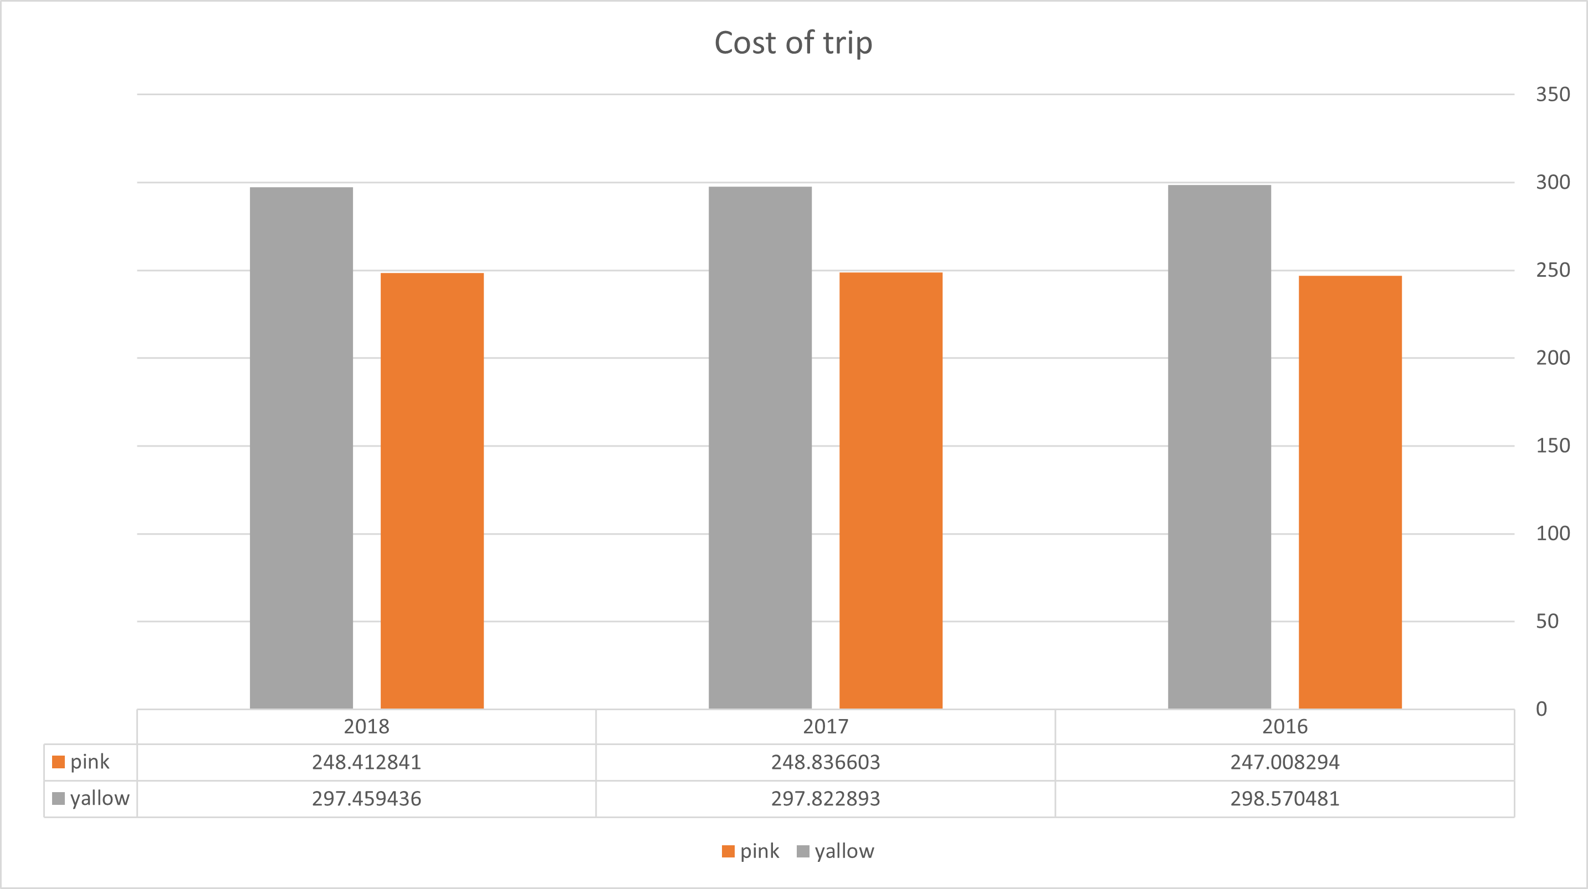
profit years

Slide 8
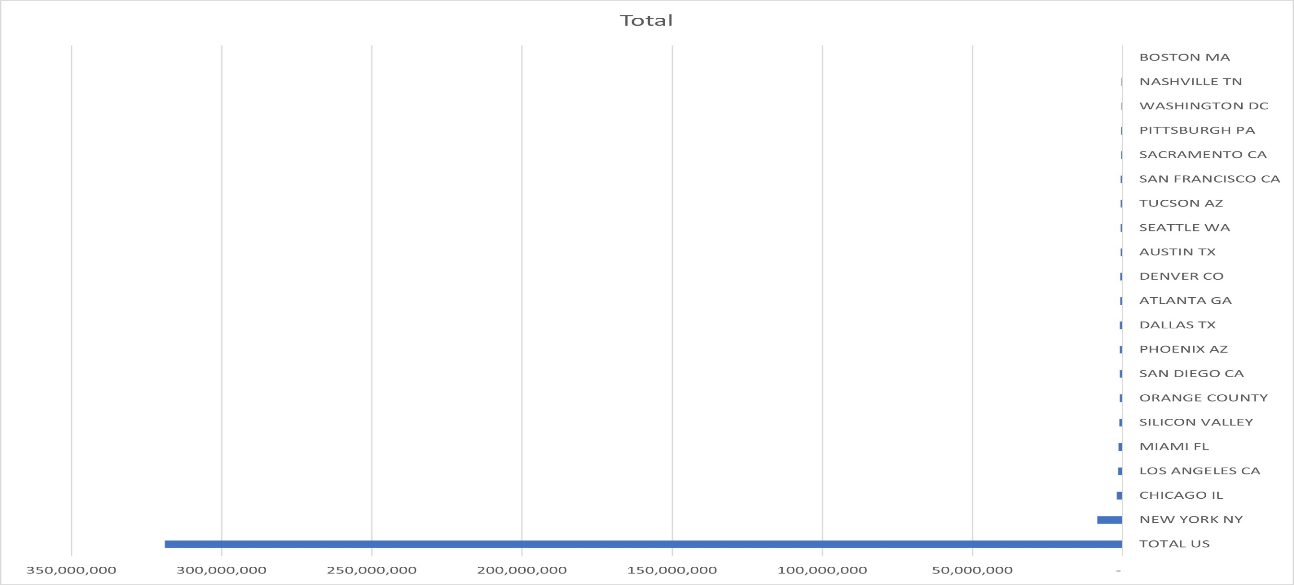
profit based on city

Slide 9
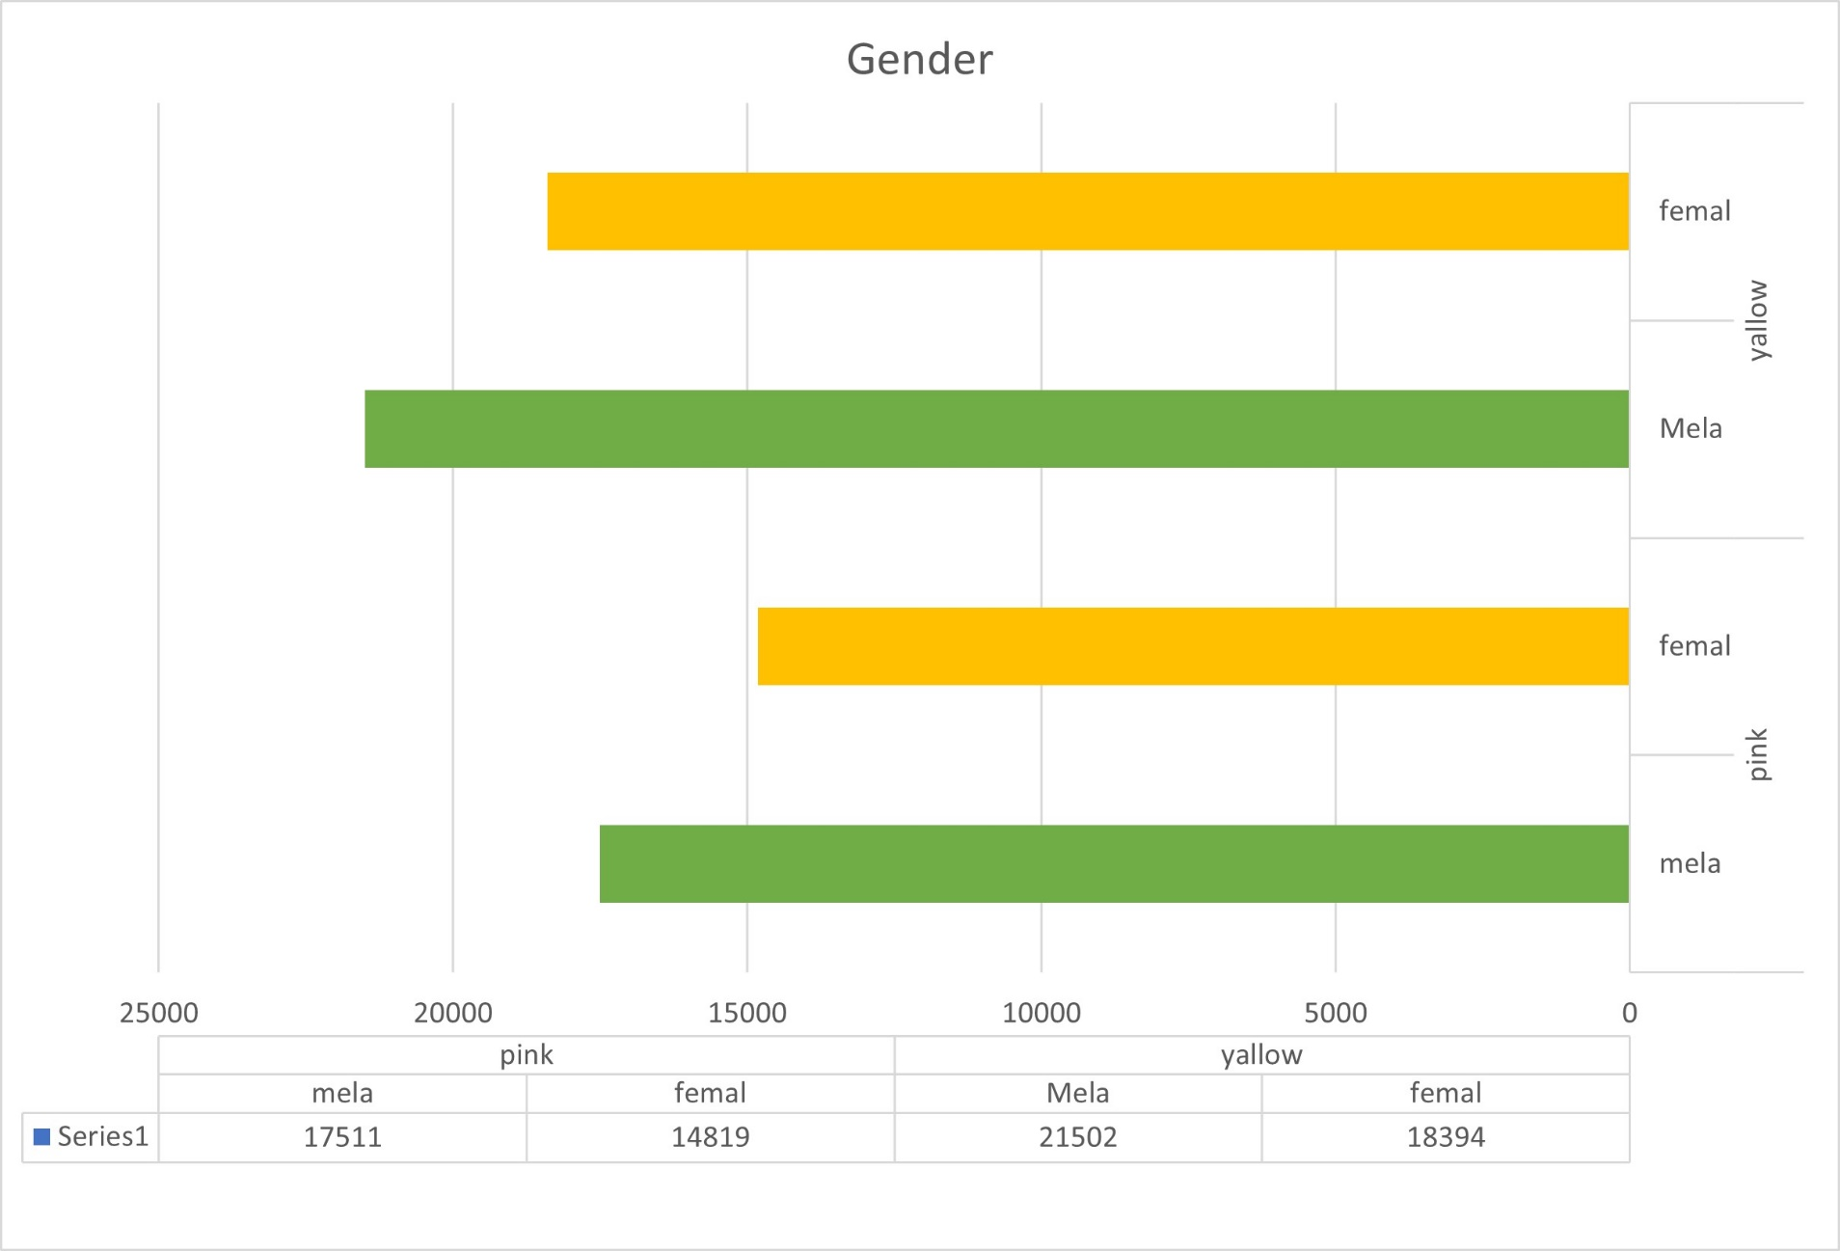
Profit and customer base Analysis Gender
Here is equal distribution of gender in the Profit and customer base of
both the cabs.

Slide 10
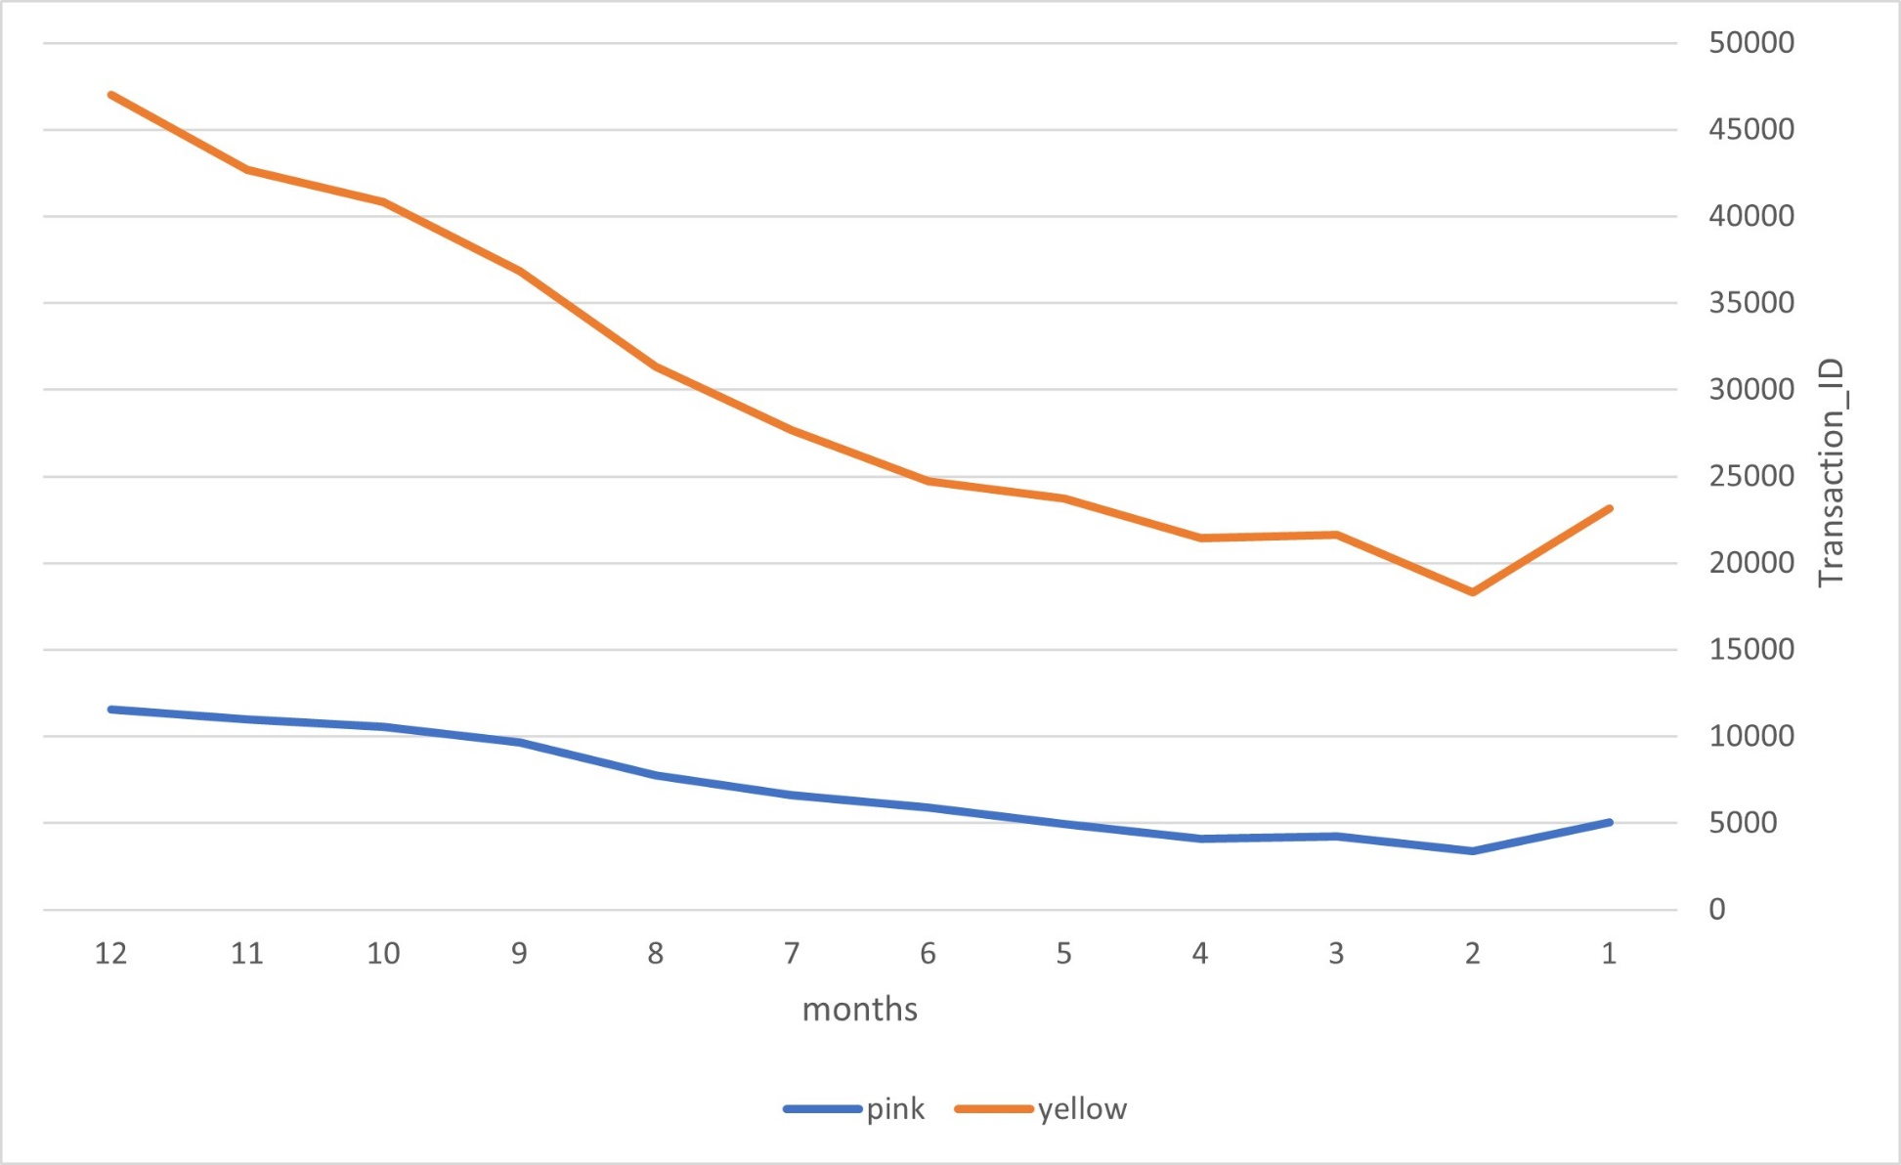
Profit and customer base Analysis Gender

Slide 11
RECOMNDTION
We have evaluated both the cab companies on following points and found Yellow cab better than Pink cab:
Customer Reach : Both Cabs reach in new York than the other cites .
Customer Retention: We have analyzed the gender and the man are potential more than women .
Average Profit : Yellow cab’s average profit almost three times the average profit of the Pink cab.
Cost trip :Both the cabs are very popular in high , the yellow cab in three years in same cost price also for the pink cab.
No. transition id : the noumber of transition in yellow cab higher from the pink cab.
On the basis of above point , we will recommend pink cab for investment.

Slide 12
Thank You

