Slide 1
Resume Extraction
Name: Munira saud bin munif Email: muniaralmunif1@gmail.com City: Saudi Arabia College: Princess Norah university Specialization: NLP

Slide 2
Introduction
Corporate companies and recruitment agencies process numerous resumes daily. This is no task for humans. An automated intelligent system is required which can take out all the vital information from the unstructured resumes and transform all of them to a common structured format which can then be ranked for a specific job position. Parsed information include name, email address, social profiles, personal websites, years of work experience, work experiences, years of education, education experiences, publications, certifications, volunteer experiences, keywords and finally the cluster of the resume (ex: computer science, human resource, etc.). The parsed information is then stored in a database (NoSQL in this case) for later use. Unlike other unstructured data (ex: email body, web page contents, etc.), resumes are a bit structured. Information is stored in discrete sets. Each set contains data about the person's contact, work experience or education details. In spite of this resumes are difficult to parse. This is because they vary in types of information, their order, writing style, etc. Moreover, they can be written in various formats. Some of the common ones include '.txt', '.pdf', '.doc', '.docx', '.odt', '.rtf' etc. To parse the data from different kinds of resumes effectively and efficiently, the model must not rely on the order or type of data.
PREPROCESSING
Data preprocessing is the first and foremost step of natural language processing. Data preprocessing is a technique of data mining which transforms raw data into a comprehensible format. Data from the real world is mostly inadequate, conflicting and contains innumerable errors. The method of Data preprocessing has proven to resolve such issues. Data preprocessing thus further processes the raw data. Data is made to pass through a series of steps in the time of preprocessing:
Data Cleaning: Processes, like filling in missing values, smoothing noisy data or resolving inconsistencies, cleanses the data.

Slide 3
Data Integration: Data consisting of various representations are clustered together and the clashes between the data are taken care of. Data Transformation: Data is distributed, assembled, and theorized. Data Reduction: The objective of this step is to present a contracted model in a data warehouse. Data Discretization: In this step, the number of values of an uninterrupted characteristic is reduced by division of the range of intervals of characteristics.
Natural Language Processing:
Natural language processing is a branch of artificial intelligence and computational linguistics. It can be defined as the process which is involved in the interaction between a computer and natural language i.e the language, spoken by humans. It is directly related to the field of human-computer interaction. Now that natural language processing is properly defined, we will be using the following constraints of NLP to parse the information from the resumes: I. Lexical Analysis II. Syntactic Analysis III. Semantic Analysis
I. LEXICAL ANALYS
IS The pilot stage of the compiler is lexical analysis. The altered source code is taken from the language preprocessor which writes in the form of sentences. The analyzer removes any comments or whitespace from the source code, breaking these syntaxes into a chain of tokens.
Considering our case, the resume is discriminated onto various segments including contact information, educational experiences, work experiences and more. We use a database or a data dictionary to hold the keywords or headings we find common in most of the resumes. Now

Slide 4
when a new resume is taken, the parser searches for the keywords and extracts all the
data between the starting and the ending of them, which we call as segments. Out of the many exceptions which might occur, one which is common is that the first segment generally contains the name as well as the contact information of the person. Now we program chunkers or Named Entity Recognizer to extract data from each segment specifically. This method makes the system efficient and reduces its complexity. Now if due to some reason the recognizer runs on a wrong piece of data, the system will produce unexpected results.
II. SYNTACTIC ANALYSIS
The syntactic analysis determines the structure of data. The architecture comprises of a hierarchy of expressions, the smallest being a basic symbol and the largest being sentences. We can visualise the architecture as a tree whose nodes represents the expressions. Values stored in the nodes represent the basic symbols. The root represents the sentence
Parse Tree: The parse tree is generated by the parser with syntactic analysis. A parse tree or a parsing tree is an organised, entrenched structure which we use to represent the syntactic analysis of a string. They categorically reflect the syntax of the input data, making them noticeable from the abstract syntax trees used in programming.

Slide 5
II. S EMANTIC ANALYS IS
Semantic analysis can be defined as the study of semantics i.e the structure and meaning of speech. This process relates syntactic structure to the level of the writing as a whole from the levels of clauses, phrases, paragraph and sentences. It relates to their language-independent meanings. Let's take an example. Person A has a resume which states he has graduated from the "University of Calcutta" and person B has a resume which says he has graduated from "Calcutta University". Essentially they both graduated from the same place. So what semantic analyzer does is convert "University of Calcutta" to "Calcutta University". In Information Retrieval research, text classification system is given the utmost focus which bounds the decisions to either relevant or nonrelevant depending upon the information need of the user. It is not a hard task to get the user information need.
Project lifecycle
The planning phase:
Objective is allowing for the automated storage and analysis of resume data.
The execution phase:
Package PyPDF2.
Language:Python
Data Visualization: Matplotlib
The closing phase:
Get the resume extraction works.

Slide 6
To Get data
Named Entity Recognition: Places
Next, we want to enrich our data. Ultimately, the goal of structuring data is typically to perform some kind of analysis or visualization — in the case of this international conflict information, it would be valuable to plot the information geographically. To do this, we need coordinates corresponding to the documents.
First, we will use natural language processing (NLP) and named entity recognition (NER) to extract place-names from the text.
Named Entity Recognition: People
Next, we will extract the names of people mentioned in the document.
To do this, we will again use the NER algorithms from the NER-D python library.
Get the Full Names
In the final structured data, I only want full names. Wouldn't it be confusing to find a data entry with a 'mentioned person' of "Jack" or "John"? To accomplish this, we will once again employ some rudimentary statistics. The function will track full names when they are mentioned, usually in the beginning of the text.

Slide 7
When a partial name is mentioned later, it will reference the list of full names to identify who the partial name is referencing. For example, if a news article read as follows: 'Joe Biden is running for President. Joe is best known as the Vice President for former President Barrack Obama.' We know that Joe is referencing Joe Biden, because his full name was given earlier in the text. This function will operate in that same way.
De-Conflict Similar Names
In the case of duplicates, the function will use the same statistics used earlier for the country function. It will measure a count of how many times a name was mentioned, and use that as the most likely identifier. Example: 'Joe Biden and his son, Hunter Biden, are popular US politicians. Joe Biden is the former VP. Biden is now making a run for president against incumbent Donald Trump' We know that 'Biden' is referencing 'Joe Biden' from context. The passage is clearly about Joe Biden, not Hunter Biden, based on the statistical focus of the text.
Code:
https://github.com/munira4x/code

Slide 8
Human microbiome studies have shown a major link between microbial composition and health and disease and dysbiosis (Fremont et al. 2013; Lourenco et al.
2014; Urbaniak et al. 2014). High-throughput DNA sequencing methodologies have made this possible, along with breakthroughs in culturing techniques. The former has used approaches such as 16S rRNA gene sequencing, metagenomics, transcriptomics, and meta-transcriptomics, leading to vast data sets that must be simplified and analyzed (Di Bella et al. 2013). Indeed, each sample may have tens of thousands to millions of sequence reads associated with it, and the entire data set across all samples can easily exceed many hundreds of millions of reads. Such has been the rapidity of these developments that some studies appear to have been published using methods that are potentially flawed. The result can be papers with serious deficiencies that are publicized as major advances or breakthroughs (Reardon 2013), when in some cases the data are far from sufficient for such claims. We will examine the evidence for one of these papers below (Hsiao et al. 2013).
Data for microbiome analysis are collected by the following general workflow. The sample (swab, stool, saliva, urine, or other type) is collected; the DNA is isolated and used in a polymerase chain reaction with primers specific to one or more variable regions of the 16S rRNA gene. It is also possible to target other conserved genes such as the cpn60 gene (Schellenberg et al. 2009). However, analysis problems are the same regardless of the amplification target chosen, and Walker et al. (2015) present a good summary of how choices taken upstream of data analysis affect the results. Following amplification, a random sample of the product is used to make a sequencing library, and it is common to multiplex many samples in the library. A small aliquot of the library is processed on the high-throughput DNA sequencing instrument. As outlined below, this workflow imposes constraints on the resulting data.
It should be recognized that the investigator is sequencing a random sample of the DNA in the library, which is itself a random sample of the DNA in the environment. Th us, it is important to ensure that any analysis takes this random component into account (Fernandes et al. 2013).
Perhaps less obvious is that the number of sequencing reads obtained for a sample bears no relationship to the number of molecules of DNA in the environment, because the number of reads obtained for a sample is determined by the capacity of the instrument. For example, the same library sequenced on an Illumina MiSeq or HiSeq would return approximately 20 million or 200 million reads. That there is no information in the actual read numbers per sample is implicitly acknowledged by the common use of "relative abundance" values for analysis of microbiome data sets.

Slide 9
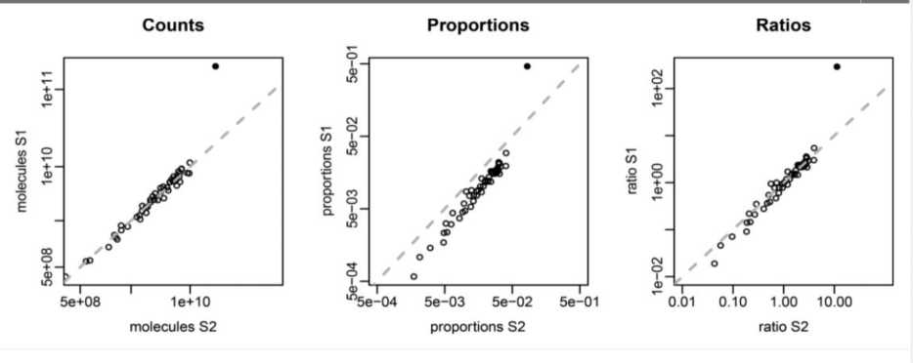
Such data sets are referred to as compositional, and there is a long history of the development of proper analysis techniques for such data in other fields (Pawlowsky-Glahn et al. 2015).
Compositional data are a term used to describe a data set in which the parts in each
sample have an arbitrary or noninformative sum (Aitchison 1986), such as data
obtained from high-throughput DNA sequencing (Friedman and Alm
2012; Fernandes et al. 2013, 2014). These data have long been known to be
problematic (Pearson 1896), and we now understand that multivariate data analysis approaches such as ordination and clustering and univariate methods that measure differential abundance are invalid (Aitchison 1986; Warton et al. 2012; Friedman and Alm 2012; Fernandes et al. 2013; Pawlowsky-Glahn et al. 2015).
The essential problem is illustrated in Fig. 1, in which we set up an artificial example and count the number of molecules in the environment. We allow one part (shown as solid black circle) to increase 10-fold between samples 1 and 2, while the abundance of the other 49 parts (in open circles) remains unchanged. The proportion panel shows how the data are distorted when we convert it to relative abundances or proportions, or as happens when the sequencing instrument imposes a constant sum. The black part still appears to become more abundant, although it is less than a 10-fold change. However, the 49 other parts appear to become less abundant. This property leads to the negative correlation bias observed in compositional data, and renders invalid any type of correlation- or covariance-based analysis such as correlation networks, principal component analysis, and others (Pearson 1896; Aitchison 1986). Note that this distortion will also lead to false univariate inferences as well (Fernandes et al. 2013, 2014).

