Slide 1
NAVIXAR
VLA-Powered
India’s Fastest Path to
Deployed Autonomy
Simulation-First
Purpose-built for India's unstructured roads.
India-Native
₹XX Cr
SAFE
April 2026
Global AV giants spent $80B+. None of it is optimised for India.
Navixar changes that.
Pre-Seed Round
Instrument
Current Raise
Munish Raj · Founder & CEO · munish02@gmail.com · STRICTLY CONFIDENTIAL

Slide 2
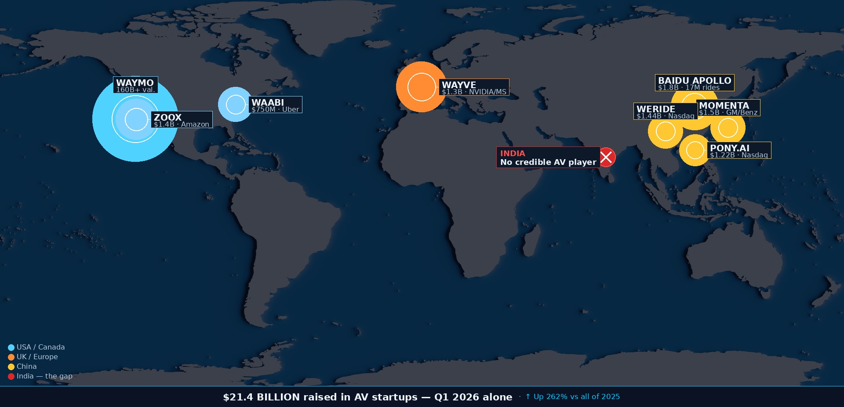
$21.4B
raised Q1 2026 • Up 262%
The World Is Betting Billions on Robotaxis. Right Now.
Sources: Crunchbase Q1 2026 AV Sector Report • TechCrunch • Waymo Blog Feb 2026 • Waabi raise Jan 2026 • Wayve Series D 2026

Slide 3
Global AV Giants Spent $80B+. None of It Is Optimised for India.
India’s roads and traffic are the unique - and no existing stack is engineered to navigate them.
The Data Gap
Simulation Environments
The Market Gap
99%
Broken Roads, Potholes and …
₹0
of AV training data is Western. A model trained on San Francisco cannot handle Saidapet — 40+ vehicle types, cattle, lane-less chaos.
Simulation is key for Advanced Automated Driving.
Existing simulators rely on structured roads and traffic
India has 3M+ Ola/Uber rides per day, the world's ideal robotaxi culture — and zero commercial autonomous vehicle deployments.
Source: Crunchbase 2025
Source: MoRTHS Gazette Notification 2024
Source: Ola/Uber India ride data 2025
“Waymo has spent $3.5B (Alphabet 10-K, FY2024) and has no India operations. Mobileye and Baidu have global reach — but neither has India-native training data, local regulatory access, or a deployment roadmap for unstructured Indian traffic.”

Slide 4
Advanced Automated Driving models rely on accurate data
The Data Gap
Simulation Environments
The Market Gap
99%
Broken Roads, Potholes and …
₹0
of AV training data is Western. A model trained on San Francisco cannot handle Saidapet — 40+ vehicle types, cattle, lane-less chaos.
Simulation Environments used by existing global organizations rely on structured roads and traffic
India has 3M+ Ola/Uber rides per day, the world's ideal robotaxi culture — and zero commercial autonomous vehicle deployments.
Source: Crunchbase 2025
Source: MoRTHS Gazette Notification 2024
Source: Ola/Uber India ride data 2025
“Waymo has spent $3.5B (Alphabet 10-K, FY2024) and has no India operations. Mobileye and Baidu have global reach — but neither has India-native training data, local regulatory access, or a deployment roadmap for unstructured Indian traffic.”

Slide 5
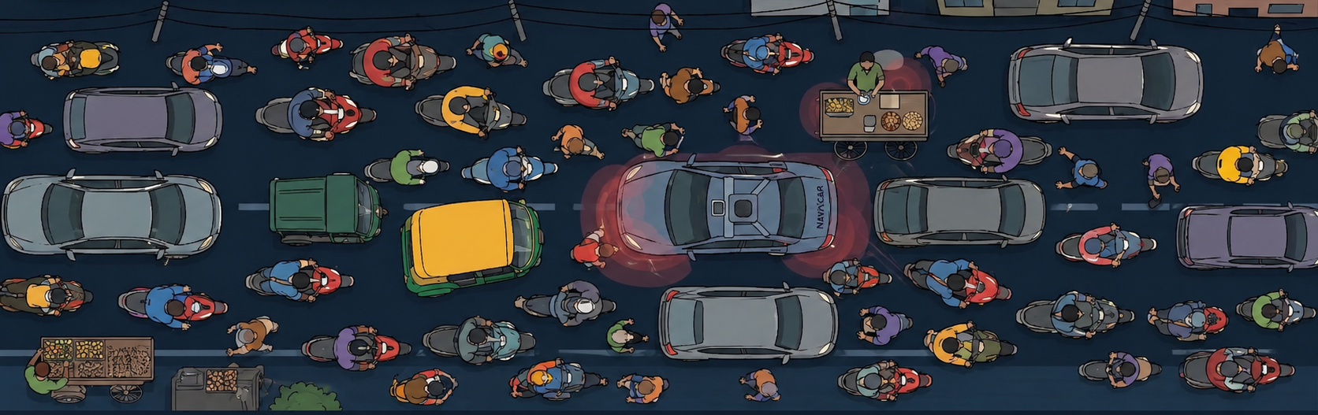
Data Collection strategies need to be tailored for India
Current data collection strategies do not account for blind spots where two-wheelers and pedestrians move close to the vehicle. Navixar fixes this with India-specific Data collection pipelines
Owning the Data Collection pipeline enables Navixar to focus on the key aspects that enable Navixar’s vehicles to run autonomously
Notes:
Collect Data with a game – Re-create Indian Traffic with Gaussian splats and get people to drive them around – That’s the training process for Autoamted Driving

Slide 6
Simulation is key. Simulation lets you experiment and test endlessly
The Data Gap
Simulation Environments
The Market Gap
99%
Broken Roads, Potholes and …
₹0
of AV training data is Western. A model trained on San Francisco cannot handle Saidapet — 40+ vehicle types, cattle, lane-less chaos.
Simulation Environments used by existing global organizations rely on structured roads and traffic
India has 3M+ Ola/Uber rides per day, the world's ideal robotaxi culture — and zero commercial autonomous vehicle deployments.
Source: Crunchbase 2025
Source: MoRTHS Gazette Notification 2024
Source: Ola/Uber India ride data 2025
“Waymo has spent $3.5B (Alphabet 10-K, FY2024) and has no India operations. Mobileye and Baidu have global reach — but neither has India-native training data, local regulatory access, or a deployment roadmap for unstructured Indian traffic.”

Slide 7
The Simulation environment needs to be tailored for India
Current simulators focus on lanes, and predominantly structured traffic. India brings challenges in roads, textures, traffic and unknown objects
Notes:
Make this interactive – show a normal simulation environment – then a simulation environment with Gaussian splats, and possibly to move around in a gaussian splat based environment – add traffic, get traffic to move?

Slide 8
India is moving. Fast.
The Data Gap
Simulation Environments
The Market Gap
99%
Broken Roads, Potholes and …
₹0
of AV training data is Western. A model trained on San Francisco cannot handle Saidapet — 40+ vehicle types, cattle, lane-less chaos.
Simulation Environments used by existing global organizations rely on structured roads and traffic
India has 3M+ Ola/Uber rides per day, the world's ideal robotaxi culture — and zero commercial autonomous vehicle deployments.
Source: Crunchbase 2025
Source: MoRTHS Gazette Notification 2024
Source: Ola/Uber India ride data 2025
“Waymo has spent $3.5B (Alphabet 10-K, FY2024) and has no India operations. Mobileye and Baidu have global reach — but neither has India-native training data, local regulatory access, or a deployment roadmap for unstructured Indian traffic.”

Slide 9
In a country where Chaos is structural, Robotaxis will prove there’s order in Chaos
Robotaxis open multiple revenue streams, Partnerships, can be marketed as safe, act as “the protectors with eyes always open”, a symbol of engineering excellence developed in India, for India, by India ect..
Notes:
Show projected car sales in India going forward – need for nice car brands in india

Slide 10
Here’s what else that’s going for us
Existing ADAS ecosystem that’s underserved without enough OEMs, Engineers graduating without enough opportunities , access to talent , Existing EV ecosystem and enough investments in the EV supply chain.

