Slide 1
studify

Slide 2
agenda
Introduction
AI-based face recognition for attendance
Confidence
Built with Python, OpenCV & face_recognition
Engagement
Live demo with names & bounding boxes
Visual Aids
Architecture diagram & workflow
Takeaways
Scalable & future-ready (apps, dashboards)

Slide 3
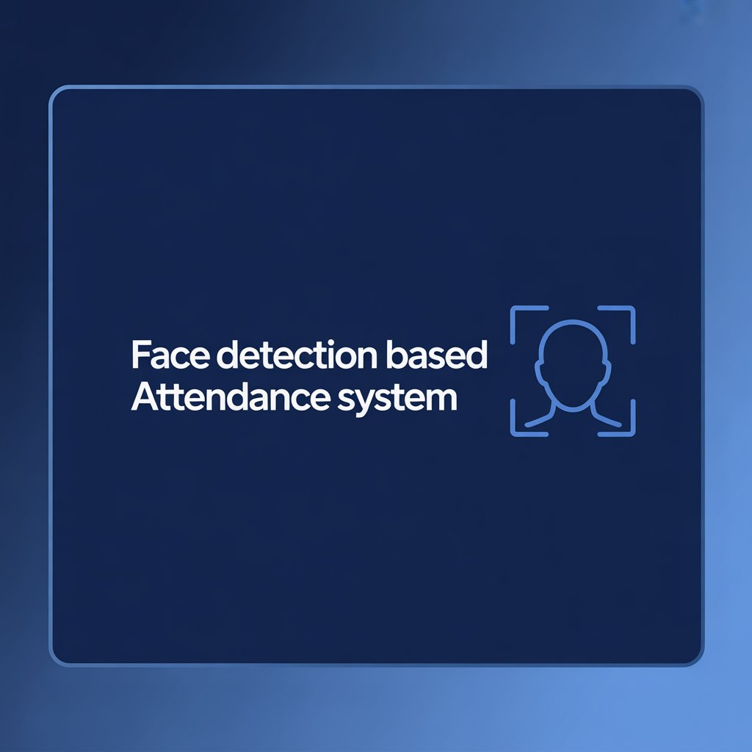
Introduction

Slide 4

Manual attendance is slow and error-prone
Face recognition makes the process automatic
Ensures accuracy, security, and time saving
Stores records in a digital format for easy tracking
Daily/weekly quiz conduction

Slide 5
Engaging the audience
Show live demo of face detection
Showcase student dashboard
Add weekly Quiz for students
Leaderboard with gift coupons like amazon,flipkart etc.

Slide 6
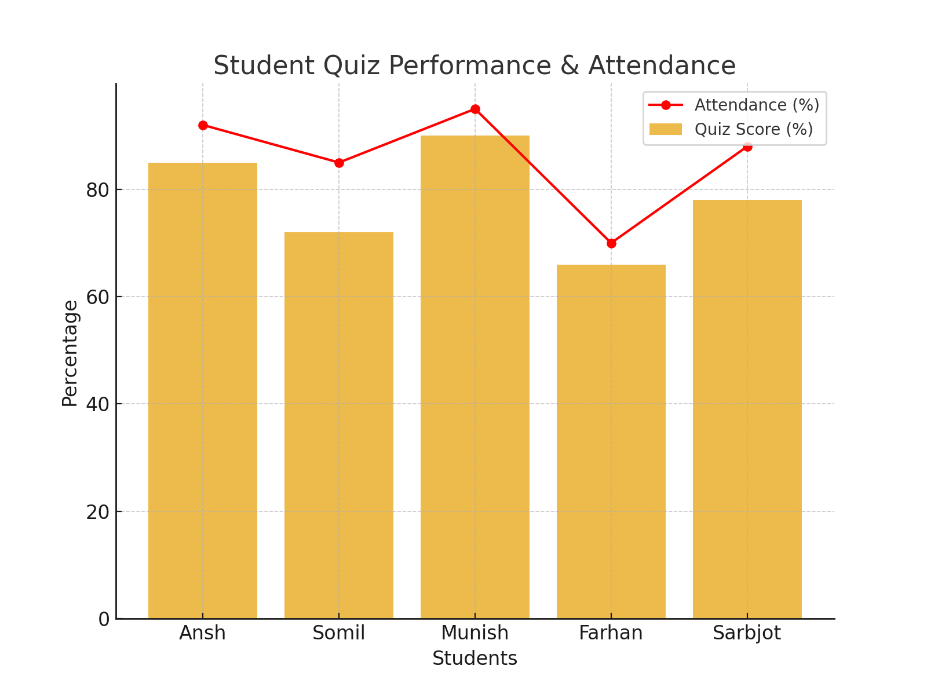
Visual Representation of the System
Reports & Analytics: Generate performance and attendance reports.

Slide 7
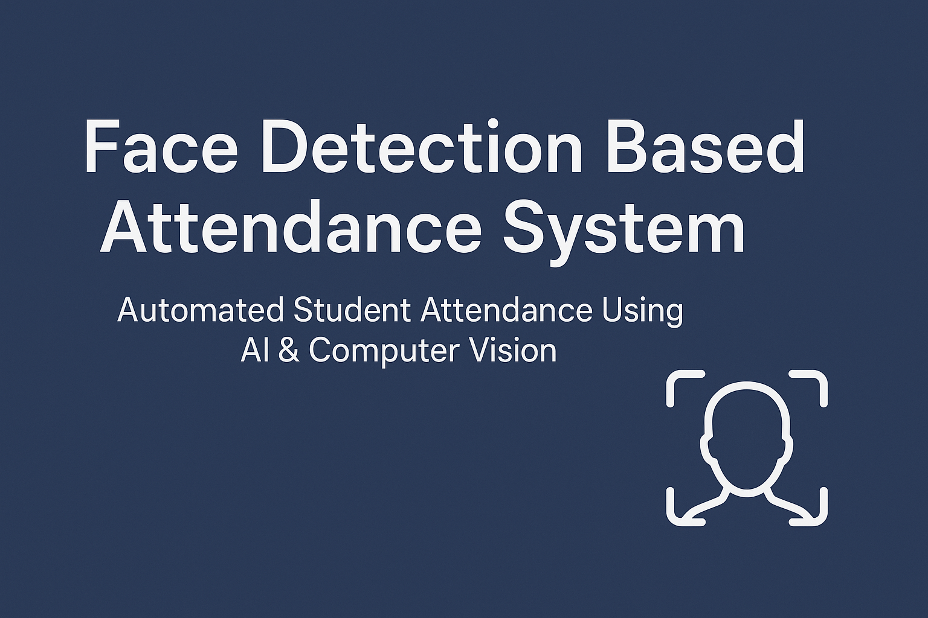
Presenting Smart Attendance

Slide 8
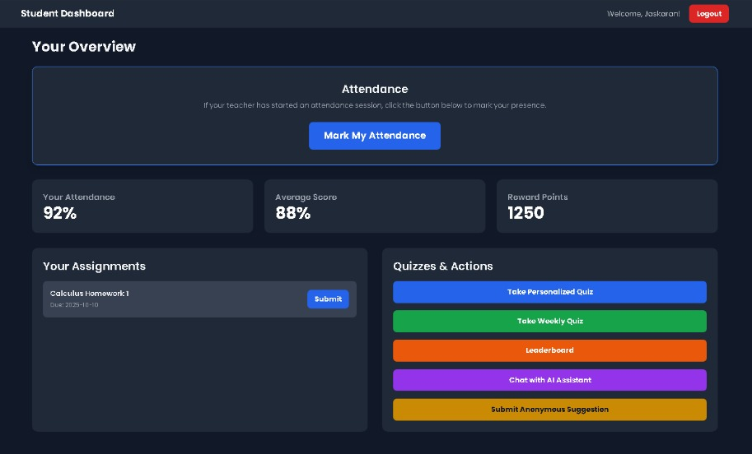
dashboard

Slide 9

Chat bot
Smart Assistant: Integrated chatbot helps students interact with the system easily.
Quick Doubt Solving: Students can ask questions about quizzes, schedules, or attendance.
24/7 Availability: Provides instant support without waiting for teachers/admin.
Personalized Help: Guides students based on their profile and performance.
Easy Navigation: Helps students find features like quiz results, attendance reports, etc.

Slide 10
Thank you
Team: Blue Screener

